Slide 1


Lending Club Case Study
Case study group:
Pankaj Kumar Agrawal
Priyanka Gulati

Slide 2
Objective
The Objective of this case study is to implement EDA technique on a real world problem and understand the insights and present in a business first manner via presentation.
By analyzing Lending Club's loan data, the objective is to identify the key factors that influence loan defaults and to develop a predictive model that assists investors in making more informed decisions.
Benefits of the case study:
Gives a idea about how EDA is used in real life business problems.
It also develops a basic understanding of risk analytics in banking and financial services.
How the data is used to minimize loss of money while lending it to clients.
It improves our understating of visualization and what charts to use for real life data.

Slide 3
Technology Used - Python Libraries used - numpy - pandas - seaborn - matplotlib

Slide 4
Data Overview:
The dataset includes various features, such as:
Loan details: loan amount, interest rate, purpose, installment.
Borrower details: income, employment length, home ownership score, Annual income, grade , purpose etc.
Loan status: whether the loan was paid off, ongoing or defaulted.
.

Slide 5
Data Processing Approach
1. Data Import
2. Data Cleaning : Removing null value and duplicate data
3. Data Preprocessing: Removing irrelevant columns. Encode categorical variables, and normalize numeric data for analysis.
Importing the Data
Removing irrelevant columns
Removing/Fixing null values
Removing outliers
Removing large null value columns
Removing Duplicate Data
Correcting data types and deriving new columns
Filter Data for requirement

Slide 6
Data Analysis Approach
Univariate Analysis
- Analyzing each column, plotting the distributions of each column.
2. Segmented Univariate Analysis
- Analyzing continuous data columns to the categorical column.
3. Bivariate Analysis
- Analyzing the two variable behavior like term and loan status
with respect to loan amount.

Slide 7
Bivariate Analysis of Ordered Categorical Variables.
1. Loan Disbursal Quarter Vs Loan Status
2. Term of Loan Vs Loan Status
3. Employment Tenure Vs Loan Status
Bivariate Analysis of Unordered Categorical Variables.
1. Purpose of Loan v/s Loan Status
2. Home Ownership Status v/s Loan Status
Bivariate Analysis of Quantitative Variables
Annual Income range v/s Loan Status
Loan Interest Rate v/s Loan Status

Slide 8
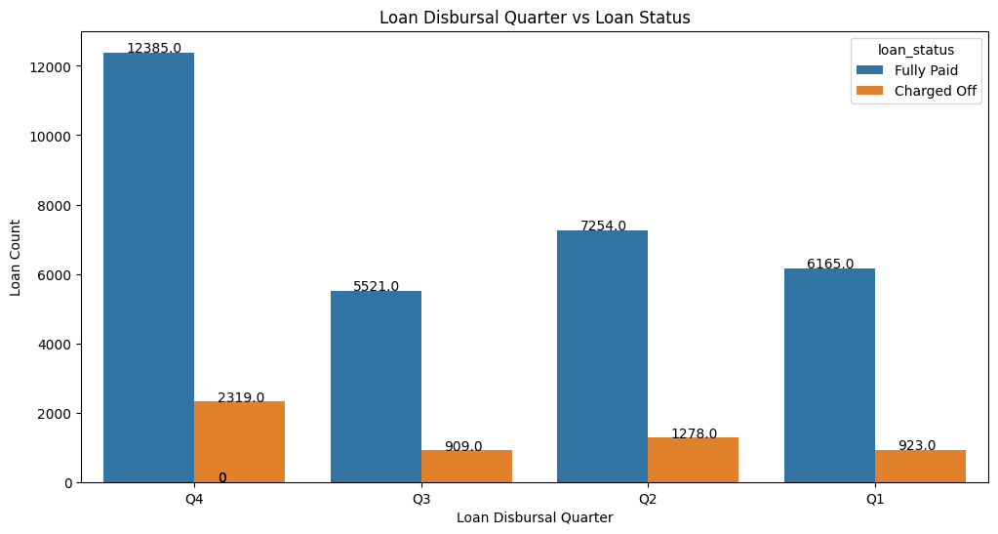
Bivariate Analysis of Ordered Categorical Variables.
1. Loan Disbursal Quarter Vs Loan Status
Q4 is the most preferred quarter for taking loans

Slide 9
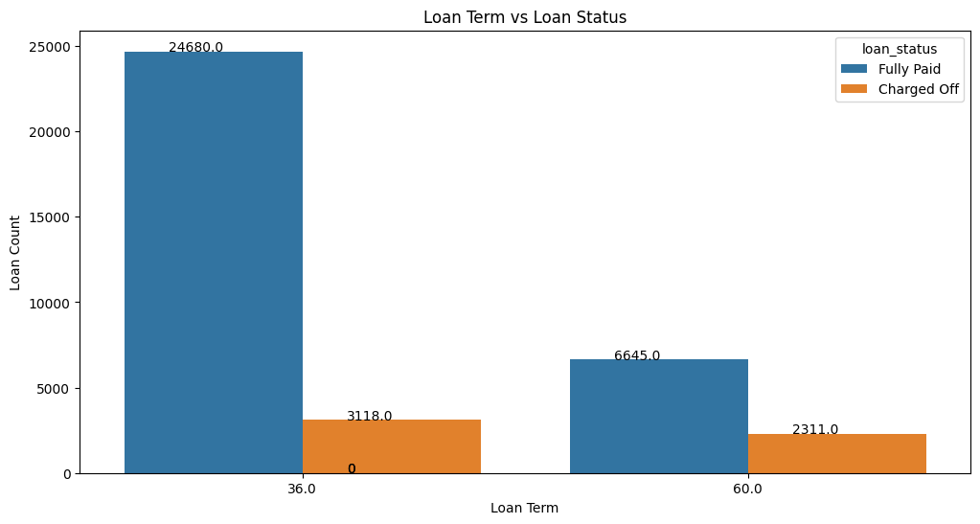
Bivariate Analysis of Ordered Categorical Variables.
2. Term of Loan Vs Loan Status
Loan applicants those applying it for 60 months are likely to default more than the those for 36 months.

Slide 10
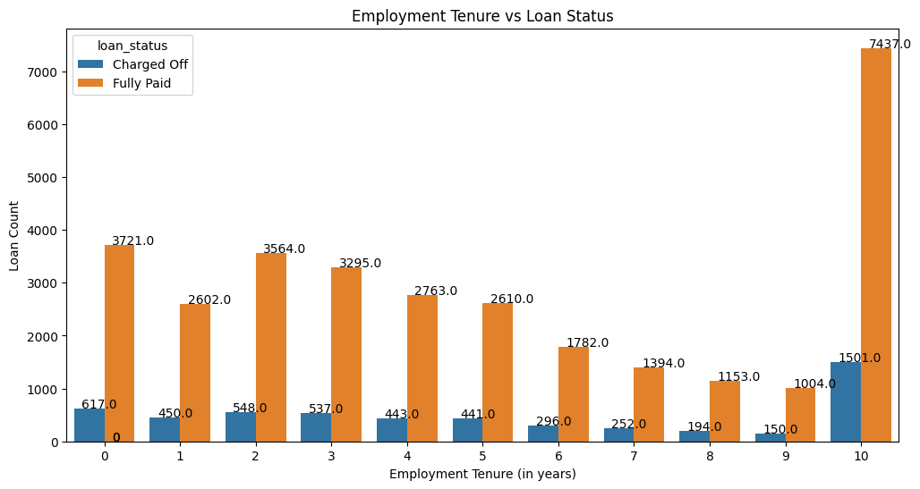
Bivariate Analysis of Ordered Categorical Variables.
3. Employment Tenure Vs Loan Status
Most number of loan applicants have 10+yrs of Work experience, they are most likely to default as well.

Slide 11
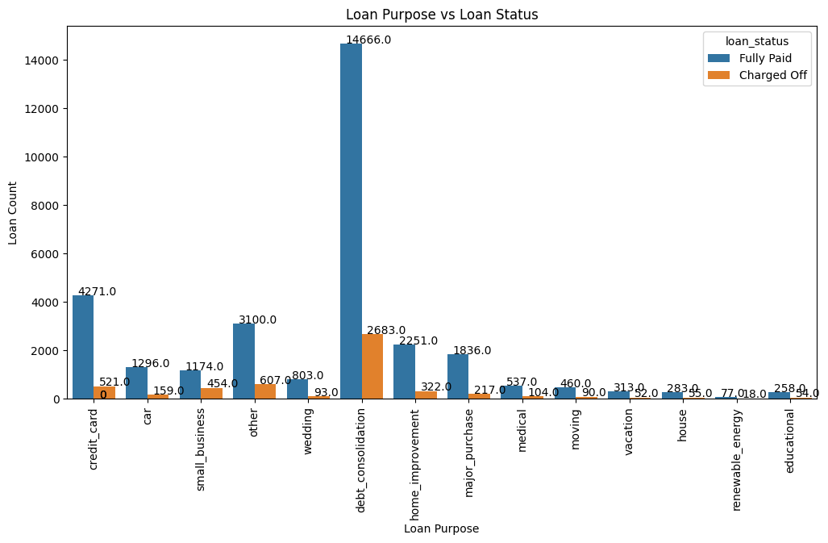
Bivariate Analysis of Unordered Categorical Variables.
Purpose of Loan v/s Loan Status
maximum loans are issued against Debt consolidation category and at the same time most people have defaulted in this category.st
Maximum loans are issued against Debt consolidation category and at the same time most people have defaulted in this category.

Slide 12
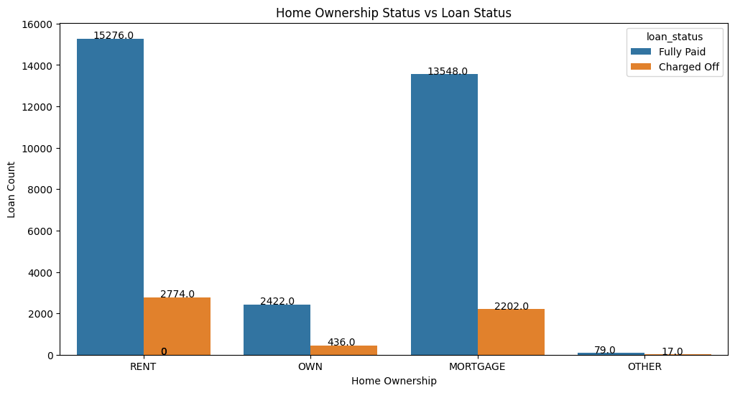
Bivariate Analysis of Unordered Categorical Variables.
2. Home Ownership Status v/s Loan Status
The applicants who stay in a rented or mortgaged house are more likely to default.

Slide 13
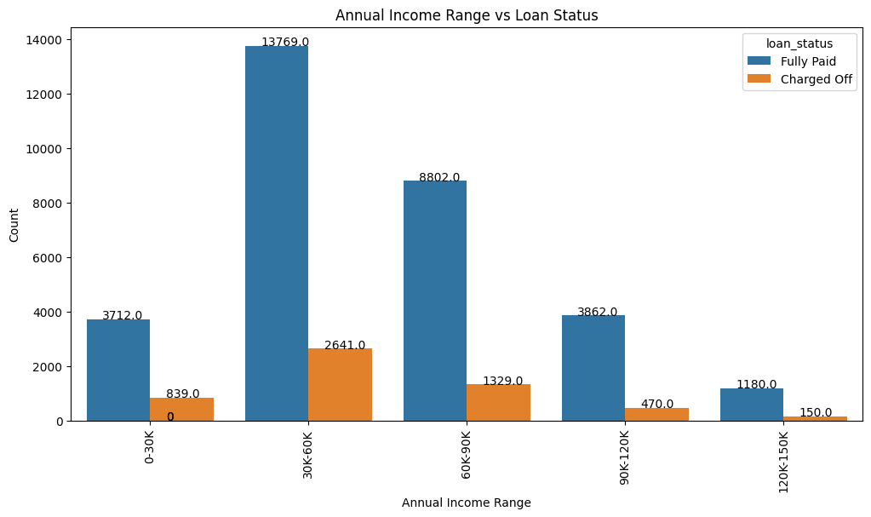
Bivariate Analysis of Quantitative Variables
Annual Income range v/s Loan Status
Those who have annual income in the range between 30K-60K have mostly paid the loan.

Slide 14
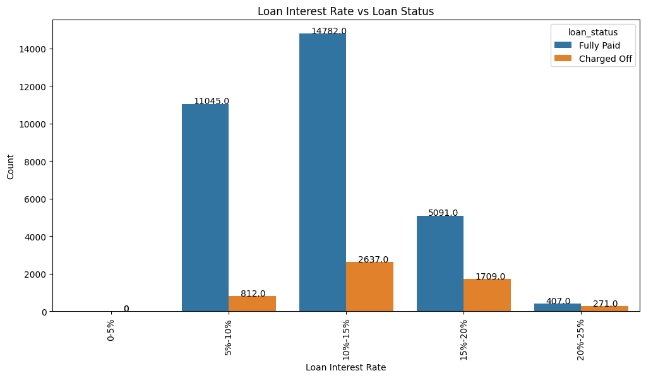
Bivariate Analysis of Quantitative Variables
Loan Interest Rate v/s Loan Status
Most of the borrowers belong to category where Loan Interest Rate is in range of 10%-15%.

Slide 15
Summary of Bivariate Analysis
1. Q4 is the most preferred quarter for taking loans.
2. Loan applicants those applying it for 60 months are likely to default more than the those for 36 months.
3. Most number of loan applicants have 10+yrs of Work experience, they are most likely to default as well.
4. Maximum loans are issued against Debt consolidation category and at the same time most people have defaulted in this category.
5. The applicants who stay in a rented or mortgaged house are more likely to default
6. Those who have annual icome in the range between 30K-60K have mostly paid the loan.
7. Most of the borrowers belong to category where Loan Interest Rate is in range of 10%-15%.

Slide 16
Conclusion of Bivariate Analysis
1. Seasonal Trends: December and Q4 are peak periods for loan applications, likely due to the holiday season. The company should anticipate increased demand during these periods and ensure efficient processing to meet customer needs.
2. Term Length: Given that applicants opting for 60-month loans are more likely to default, the company should consider evaluating the risk associated with longer-term loans and potentially limiting the maximum term or adjusting interest rates accordingly.
3. Experience and Default Probability: Loan applicants with ten or more years of experience are more likely to default. This suggests that experience alone may not be a reliable indicator of creditworthiness. The company should use a more comprehensive credit scoring system that factors in other risk-related attributes.
4. Debt Consolidation Risk: Since debt consolidation is the category with the maximum number of loans and high default rates, the company should carefully evaluate applicants seeking debt consolidation loans and potentially adjust interest rates or offer financial counseling services.
5. Housing Status and Default Risk: Applicants living in rented or mortgaged houses are more likely to default. This information can be considered in the underwriting process to assess housing stability and its impact on repayment ability.
6. Low Annual Income: Applicants with annual incomes less than $40,000 have a higher likelihood of defaulting. The company should consider offering financial education resources or setting maximum loan amounts based on income levels to ensure affordability for borrowers.

Slide 17
Multivariate Analysis
Multivariate analysis for below listed columns against loan status and the charged off percentage.
1. Employment Tenure
2. Loan Purpose
3. Home Ownership Status
4. Annual Income Range

Slide 18
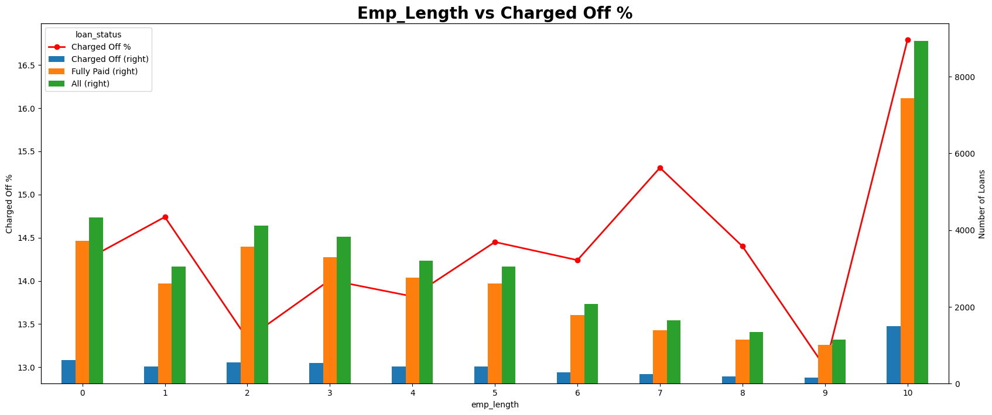
Multivariate Analysis
Multivariate analysis of Employment Tenure against loan status and the charged off percentage.

Slide 19
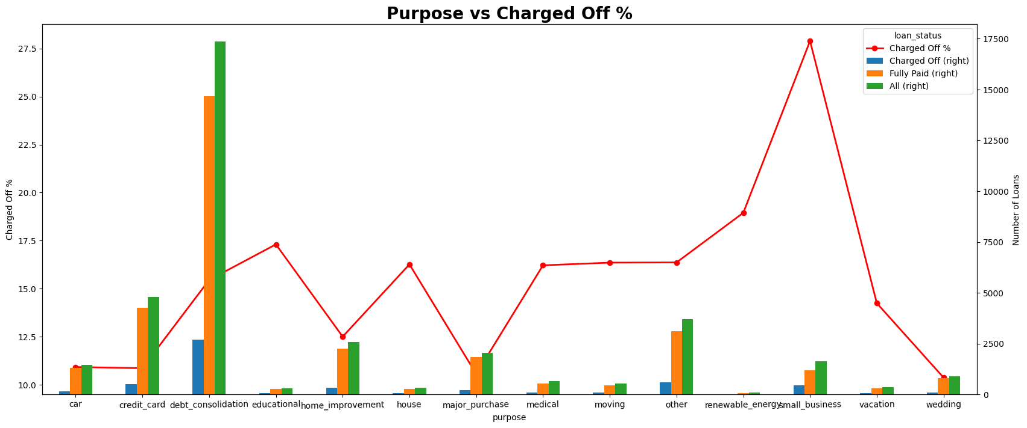
Multivariate Analysis
Multivariate analysis of Loan Purpose against loan status and the charged off percentage.

Slide 20
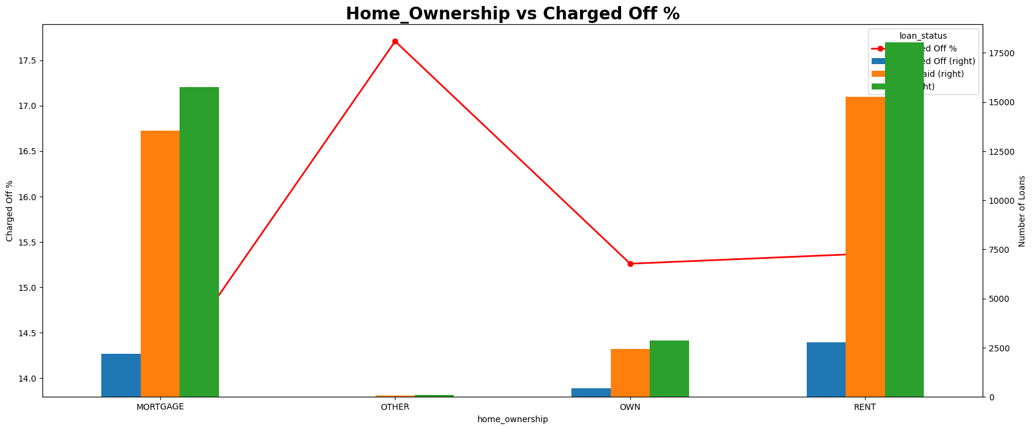
Multivariate Analysis
Multivariate analysis of Home Ownership Status against loan status and the charged off percentage.

Slide 21
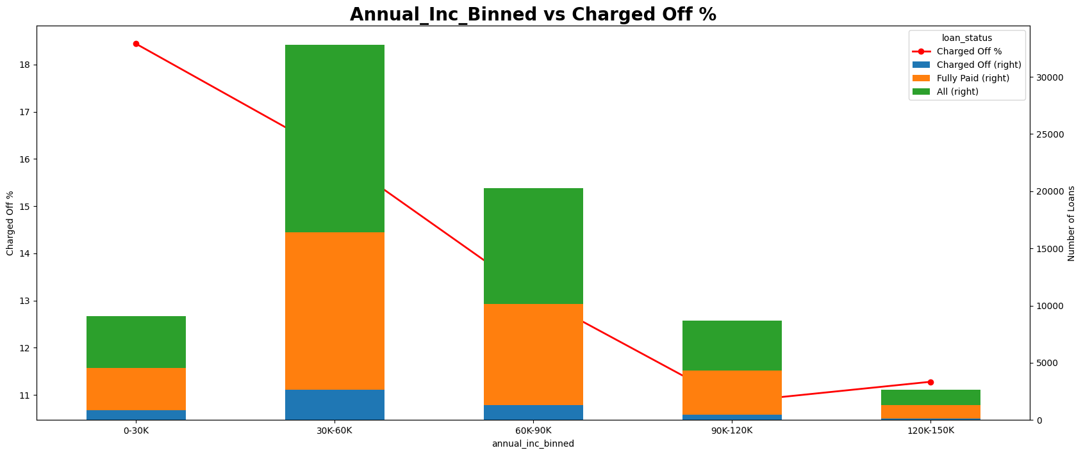
Multivariate Analysis
Multivariate analysis of Annual Income Range against loan status and the charged off percentage.

