Slide 1
SECURE DATA HIDING IN IMAGES USING
STEGANOGRAPHY
Presented By: Pankaj Sanjay Zurange
Student Name : Pankaj Sanjay Zurange
College Name & Department : Indira Gandhi National Open University. BCA

Slide 2
OUTLINE
Problem Statement
Technology used
Wow factor
End users
Result
Conclusion
Git-hub Link
Future scope

Slide 3
Problem Statement
Steganography is the practice of concealing messages or information within other non-secret text or data. Here are a few potential problem statements related to steganography:
Developing Steganographic Techniques:
Problem Statement:
"Design a steganographic algorithm that can embed a secret message within a digital image in a way that the alteration is imperceptible to the human eye while maintaining the integrity and quality of the image."

Slide 4
Technology used
JavaScript :- JavaScript is a scripting or programming language that allows you to implement complex features on web pages. Its also cross platform so its doesn't need any IDE or specific code editor. Normal text editor can be used to make programs.
HTML :- HyperText Markup Language (HTML) is a language used to create web pages. It's the basic building block of the web, and is used to define the structure and meaning of web content.
Web browser :- Chrome, Edge, Firefox.

Slide 5
Wow factors
JavaScript steganography is quite fascinating! Here are some "wow" factors that make it stand out:-
Ease of Use: Libraries like steganography.js make it incredibly simple to hide messages within images using JavaScript. All you need is a browser that supports the HTML5 canvas element.
Cross-Browser Compatibility: JavaScript steganography tools work across various browsers, including Chrome, Firefox, Safari, and more.
Versatility: You can hide messages not just in images but also in other media types like audio and video files. This opens up a wide range of possibilities for secure communication.
Least Significant Bit (LSB) Technique: Many JavaScript steganography tools use the LSB technique, which alters the least significant bits of the image pixels to embed the secret message. This method is effective and minimally impacts the image quality.

Slide 6
End users
JavaScript steganography can be used by a variety of end users for different purposes. Here are some examples:
Developers and Programmers:- They can use JavaScript steganography libraries like steganography.js to embed hidden messages within images for secure communication or digital watermarking.
Cybersecurity Professionals:- They can utilize steganography techniques to protect sensitive information and detect hidden messages in digital media to prevent data breaches.
Privacy Enthusiasts:- Individuals who value privacy can use steganography to communicate securely by embedding messages in images or other media files, making it difficult for unauthorized parties to intercept or decipher the information.
Open Source Community:- Contributors to open-source projects can explore and enhance existing JavaScript steganography tools, like those available on GitHub, to improve their functionality and security.

Slide 7
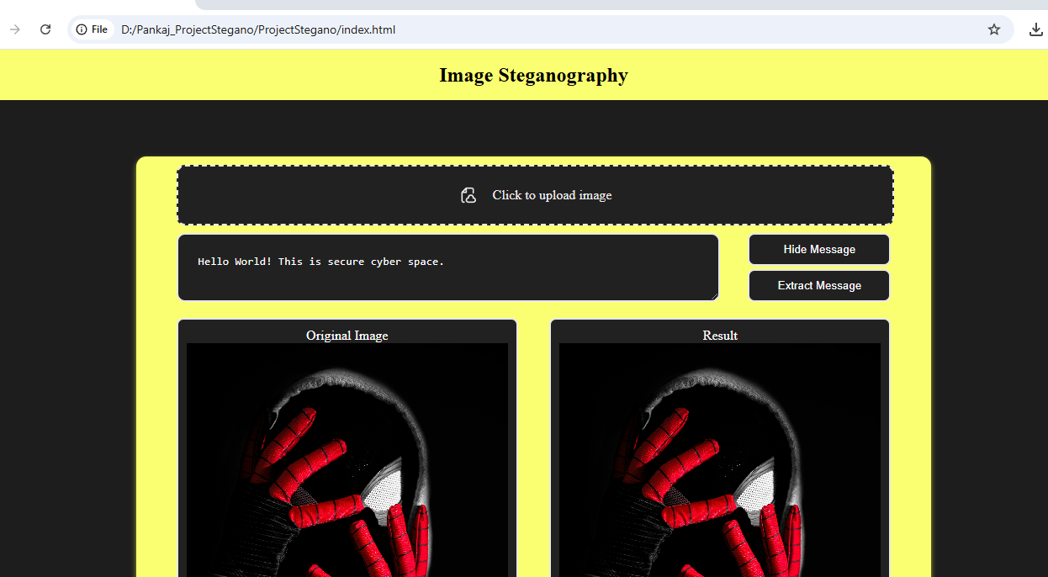
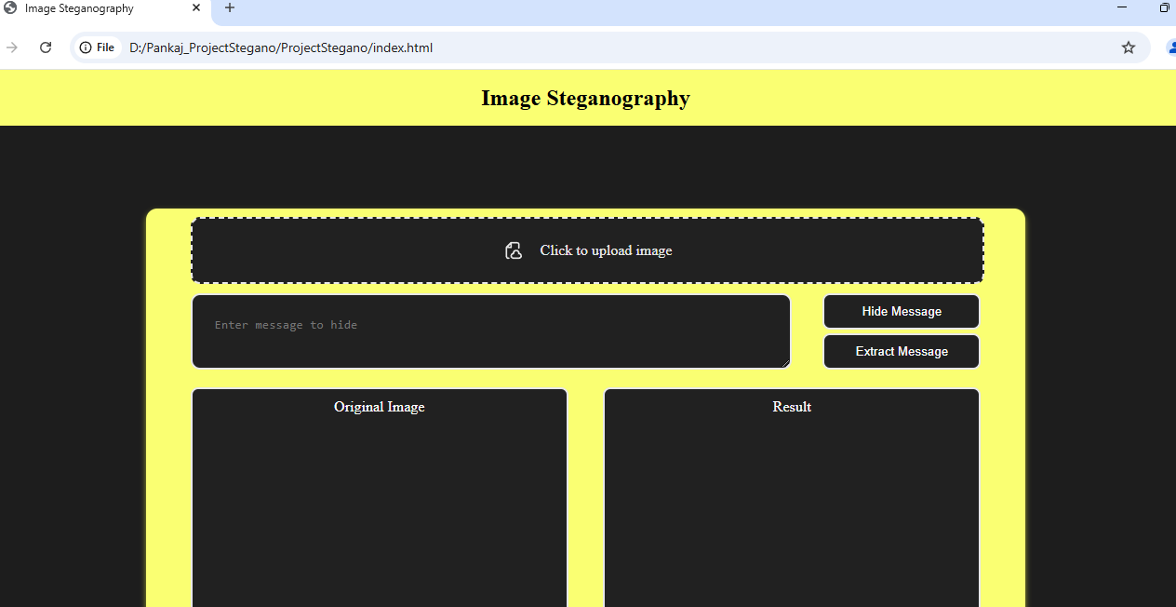
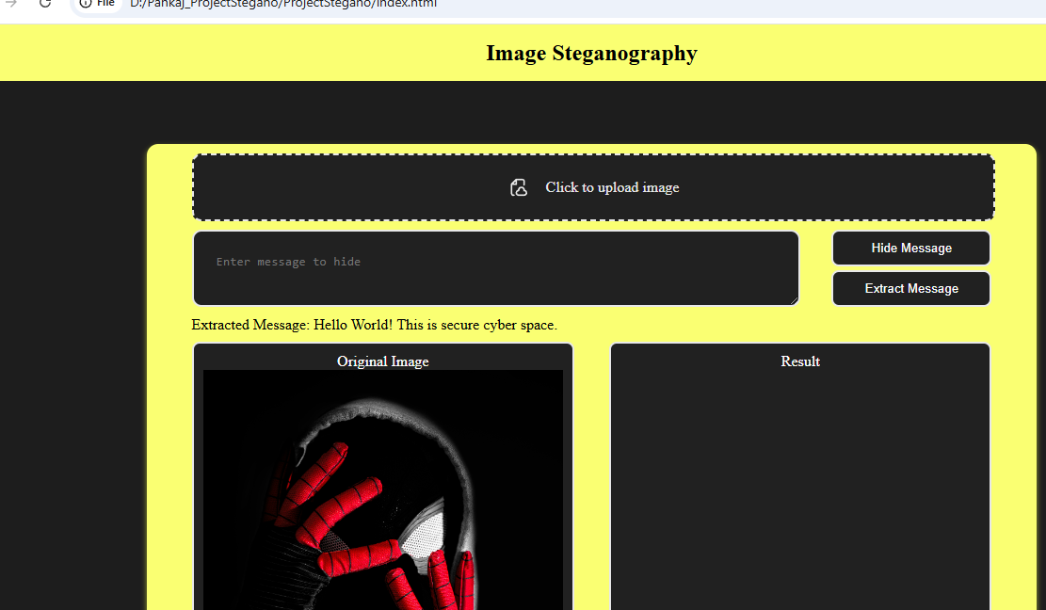
Results

Slide 8
Conclusion
JavaScript steganography: offers a fascinating blend of creativity and security. By leveraging libraries and techniques such as the Least Significant Bit (LSB) method, developers can effectively embed hidden messages within digital media. This practice has various applications, from secure communication and digital watermarking to enhancing artistic expression and educational research.
Ease of Use: JavaScript libraries make steganography accessible and straightforward.
Versatility: It can be applied to images, audio, video, and other multimedia files.
Cross-Browser Compatibility: Ensures functionality across different platforms.
Real-World Applications: Includes cybersecurity, digital art, and secure communication.

Slide 9
GitHub Link
https://github.com/pankajZ2510/ProjectStegano.git

Slide 10
Future scope(optional)
Enhanced Algorithms: Future research will likely focus on developing more robust and efficient steganographic algorithms that can withstand various attacks, such as image manipulation, compression, and noise addition.
Integration with Emerging Technologies: Steganography can be integrated with emerging technologies like blockchain and artificial intelligence to enhance security and create more sophisticated data-hiding techniques.
Increased Data Capacity: Researchers will work on increasing the data capacity of steganographic methods, allowing more information to be hidden within digital media without compromising quality.

Slide 11
THANK YOU

