Slide 1

ChainProof
Snowflake-native
CoCo CLI-assisted
Metric Trust and Reconciliation for Supply-Chain AI
One KPI name. Three valid calculations. One governed enterprise answer.
Planning
Procurement
Logistics
Material Availability
Accepted Supplier Fill
On-Time Arrival
95%
85%
90%
Enterprise Supplier Fill Rate v1.0 = 85%
Notes:
Opening: Three teams report the same KPI name. Planning says 95%, Procurement says 85%, and Logistics says 90%. All three can be correct. ChainProof governs the enterprise definition before AI answers.

Slide 2
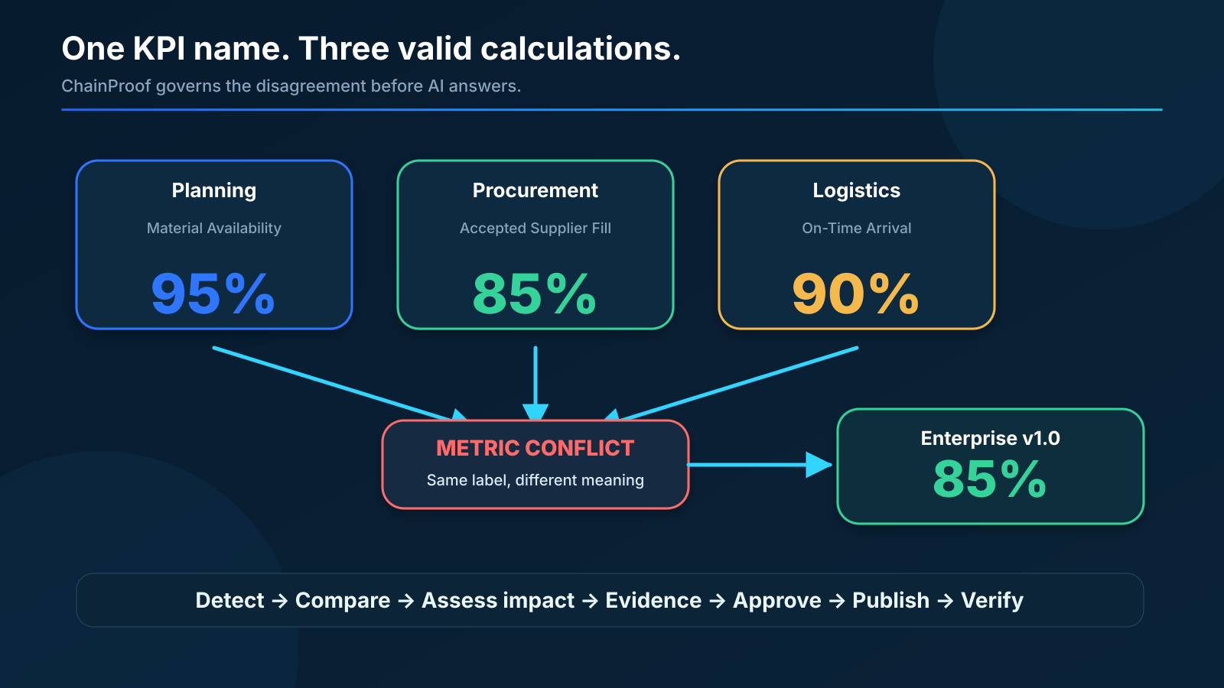
The business problem
Correct data and valid SQL can still produce the wrong business answer.
Executive inconsistency
Different teams publish incompatible KPIs under one label.
Supplier disputes
Date and quality rules change accountability.
AI risk
A copilot can confidently select the wrong definition.
Manual reconciliation
Analysts repeatedly rebuild the same explanation.
Correct SQL + wrong metric meaning = confidently wrong AI
Notes:
Explain that the conflict is semantic, not merely malformed data. ChainProof treats the metric contract itself as governed data.

Slide 3
The ChainProof trust lifecycle
AI analytics begins only after the metric is governed.
1
Detect
2
Compare
3
Assess impact
4
Evidence
5
Approve
6
Publish
7
Verify
Find one label with competing calculations
Grain, numerator, denominator, dates
Translate rates into supplier, logistics, and production action
Attach agreement, SLA, and policy
Human Data Steward decision
Only approved version reaches Semantic
Cortex answer + visible evidence
Metric trust firewall
A normal copilot answers the question. ChainProof first proves which definition it is allowed to use.
USP: Semantic layers govern agreed metrics. ChainProof governs the disagreement that exists before agreement.
Notes:
Use this slide to position ChainProof as a metric trust control plane, not a dashboard or generic chatbot.

Slide 4
Human governance changes the answer
The AI consumes the Data Steward decision; it does not make it.
BEFORE APPROVAL
AFTER DATA STEWARD APPROVAL
Planning
95%
Enterprise Supplier Fill Rate
Procurement
85%
85%
Logistics
90%
Version 1.0 | Enterprise - Approved
85 accepted on time / 100 ordered
Enterprise answer: NOT APPROVED
Approved → Active → Published
“View as” demonstrates persona presentation under one learner role. It never changes permissions or formulas.
Notes:
Explain View as in plain language: the account has one learner role, so the UI demonstrates what each persona would see. It is not impersonation or RBAC. The approval preview is session-only; the stored v1.0 approval exists in governance.

Slide 5
Judge-first product journey
The deployed app tells the business story before showing architecture.
Start Here - historical conflict
Trusted Enterprise Answer
View as
One KPI name. Three answers.
View as
Trusted Enterprise Answer
Data Steward
Data Steward
PO-5001
Planning
Procurement
Logistics
PO-5001
Enterprise Supplier Fill Rate
Demo stage
95%
85%
90%
Demo stage
85%
Version 1.0 | Enterprise - Approved
Metric conflict detected - no enterprise answer selected
85 accepted on time / 100 ordered
Start with the bad state
End with the governed answer
Notes:
Replace these stylized mockups with final screenshots if desired: 01_conflict_scanner.png and 04_trusted_enterprise_v1.png. The deck remains understandable without them.

Slide 6
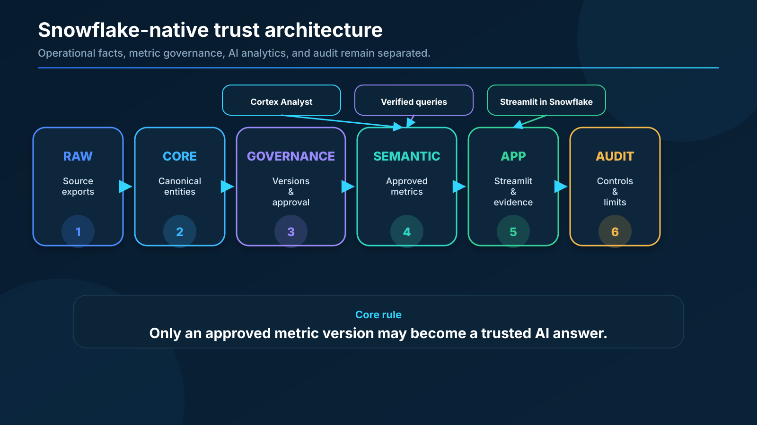
Snowflake-native architecture
Each layer has one responsibility and a deterministic validation gate.
Semantic View
Only approved metrics are public
Cortex Analyst
Natural-language governed SQL
Streamlit in Snowflake
No external app credential required
Evidence workflow
Citations + trusted boundary
AUDIT
Release controls + limitations
RAW → CORE → GOVERNANCE → SEMANTIC → APP → AUDIT
Notes:
Walk left to right. Emphasize that Streamlit presents governed results and does not reimplement formulas in Python. [Sources] - Hackathon workshop transcript supplied by participant: synthetic supply-chain data → Semantic Views → verified queries → agent/orchestration → analyst app.

Slide 7
Trust controls around every AI answer
ChainProof does not trust generated SQL merely because it compiles.
1
Question scope
2
Read-only SQL
3
Semantic boundary
PO-specific vs enterprise aggregate
One SELECT/WITH statement only
No RAW, CORE, or GOVERNANCE access
4
Version passport
5
Evidence trust
6
Human authority
Name, scope, owner, version, formula
Citations; injection fixture excluded
Advisor cannot approve or write
Fail visibly. Preserve the approved formula. Never fabricate a capability or answer.
Notes:
Highlight the scope defect that Part 8R fixed: PO-5001 must return 85%, while enterprise aggregate intentionally returns 288/555 = 51.9%.

Slide 8
Evidence and operational impact
The governed number is explainable and connected to a concrete business action.
Evidence-backed review
PO-5001 business impact
View as
Evidence-backed review
Enterprise Supplier Fill Rate
Data Steward
Supplier agreement [cited]
85%
15 units
PO-5001
Demo stage
Carrier SLA [cited]
supplier shortfall
against 90% threshold
Quality policy [cited]
Governance policy [cited]
Procurement
15 acceptable units short by original PO date
Advisor cannot approve or write governance data
Logistics
10 units arrived after carrier commitment
Planning
5 usable batteries short; up to 5 laptops at risk
Action: supplier escalation + carrier follow-up + production mitigation
One governed metric, three clearly separated operational consequences.
Notes:
Show that the evidence is cited and the operational consequences are separated by responsibility. Do not describe a hypothetical candidate metric in the main demo.

Slide 9
Technical execution and validation
A twelve-part build with deterministic gates, real account evidence, and truthful limitations.
12
6
4
6
1
controlled build parts
Snowflake schemas
approved public metrics
verified questions
deployed Streamlit app
RAW
files, rows, edge cases
CORE
types, lineage, quality
GOVERNANCE
versions, approval, activation
SEMANTIC
metrics, relationships, verified SQL
APP
scope, persona, evidence, SQL safety
AUDIT
release controls and limitations
Known limitation: official Analyst batch evaluation needs account-level task privileges. Live Cortex Analyst and deterministic tests passed.
Notes:
Do not claim an official evaluation score. Explain that only the account-level batch automation was blocked; live Cortex Analyst questions and direct semantic tests work. [Sources] - https://coco-cli.yourstory.com/hackathon - evaluation rubric: real-world relevance 30%, technical execution 40%, solution completeness 30%.

Slide 10
Why ChainProof is different
It governs metric disagreement - the gap before a normal semantic layer can help.
Category
Typical capability
ChainProof addition
BI dashboard
Displays configured KPIs
Detects conflicting KPI meaning
Data catalog
Documents names and owners
Executes formulas and compares impact
Semantic layer
Publishes agreed definitions
Governs disagreement before agreement
Generic AI copilot
Answers with available metadata
Refuses ambiguity until governed
Metric store
Centralizes formulas
Preserves conflict, approval, activation, rollback
Business value: fewer conflicting reports, faster reconciliation, stronger supplier accountability, and auditable AI answers.
Notes:
Use the comparison to prevent judges from categorizing ChainProof as a dashboard, catalog, or generic chat interface.

Slide 11
ChainProof
Prevents AI from confidently answering the wrong KPI.
One KPI name. Three valid calculations. One governed enterprise answer.
GitHub
https://github.com/pankajadam-tech/chainproof-snowflake
Live app
https://app.snowflake.com/SFEDU05/nxb07453/#/streamlit-apps/CHAINPROOF.APP.CHAINPROOF_APP
Walkthrough
https://drive.google.com/file/d/1sbCqeRjcNWpvU3oHDjV-CBssD_QQyQaK/view?usp=sharin
Snowflake-native • CoCo CLI-assisted • Human governed • Evidence backed
Notes:
Closing line: Semantic layers govern agreed metrics. ChainProof governs the disagreement that exists before agreement. The official submission expects a public repository, deployed prototype, and presentation. [Sources] - Hackathon workshop transcript supplied by participant: public GitHub, deployed link, working prototype, and presentation are requested. - https://coco-cli.yourstory.com/hackathon - end-to-end deployable system and evaluation rubric.

