Slide 2
Power BI Custom Visual
Notes:
Talk briefly about the client; describe the product suite and its modules. What business/technical problems are being solved and for whom (ie. end users).

Slide 3
Visual / Custom Visual Approaches
Standard Panel
Users Market Place
Using JavaScript
R Script
Python Script
Charticulator
Notes:
Talk briefly about the client; describe the product suite and its modules. What business/technical problems are being solved and for whom (ie. end users).

Slide 4
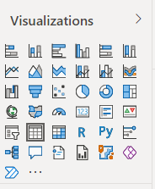
Standard Panel
Easy to use and available all the time
All tested and reliable
A limited number of visual
Notes:
Talk briefly about the client; describe the product suite and its modules. What business/technical problems are being solved and for whom (ie. end users).

Slide 5
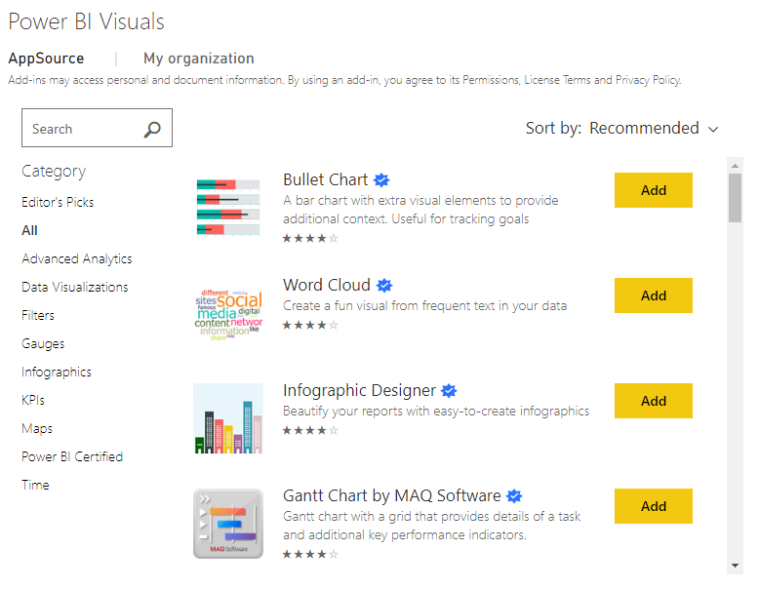
User Market Place
Easy to use and need to login in Power BI account
Most of the Visuals has been certified but there are some that are not fully certified and not tested.
There are some visuals that you need to pay for them.
Notes:
Talk briefly about the client; describe the product suite and its modules. What business/technical problems are being solved and for whom (ie. end users).

Slide 6
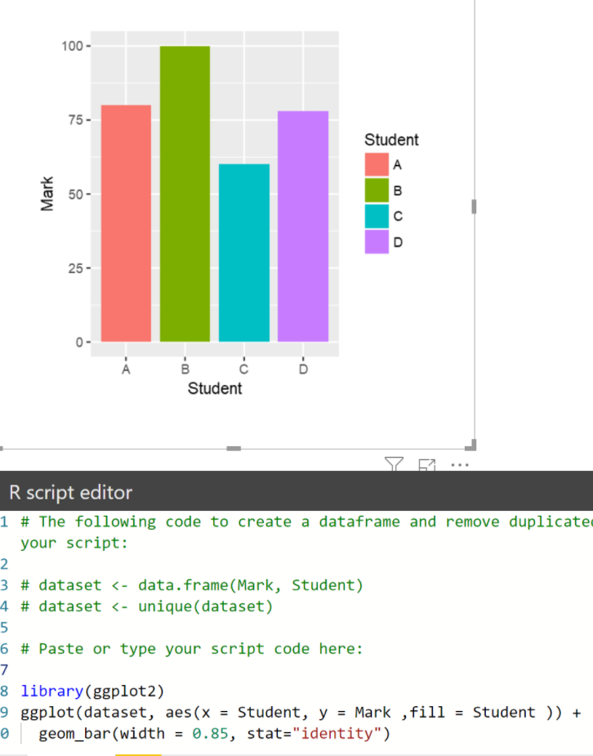
R Script
Need to know the R language.
Create visual inside the Power BI
The library of different visuals need to be installed beforehand
No need to get the certify the visual
Notes:
Talk briefly about the client; describe the product suite and its modules. What business/technical problems are being solved and for whom (ie. end users).

Slide 7
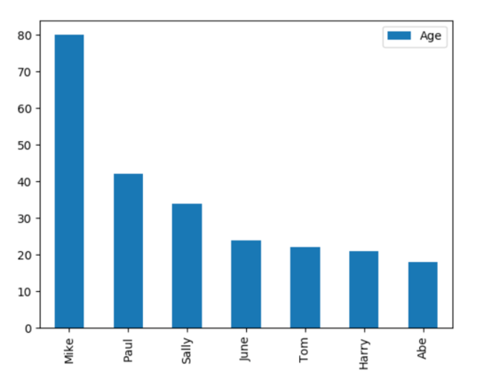
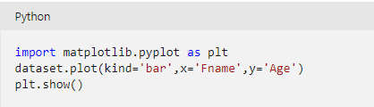
Python Script
Need to know the Python language.
Create visual inside the Power BI
The library of different visuals need to be installed beforehand
No need to get the certify the visual
Notes:
Talk briefly about the client; describe the product suite and its modules. What business/technical problems are being solved and for whom (ie. end users).

Slide 8
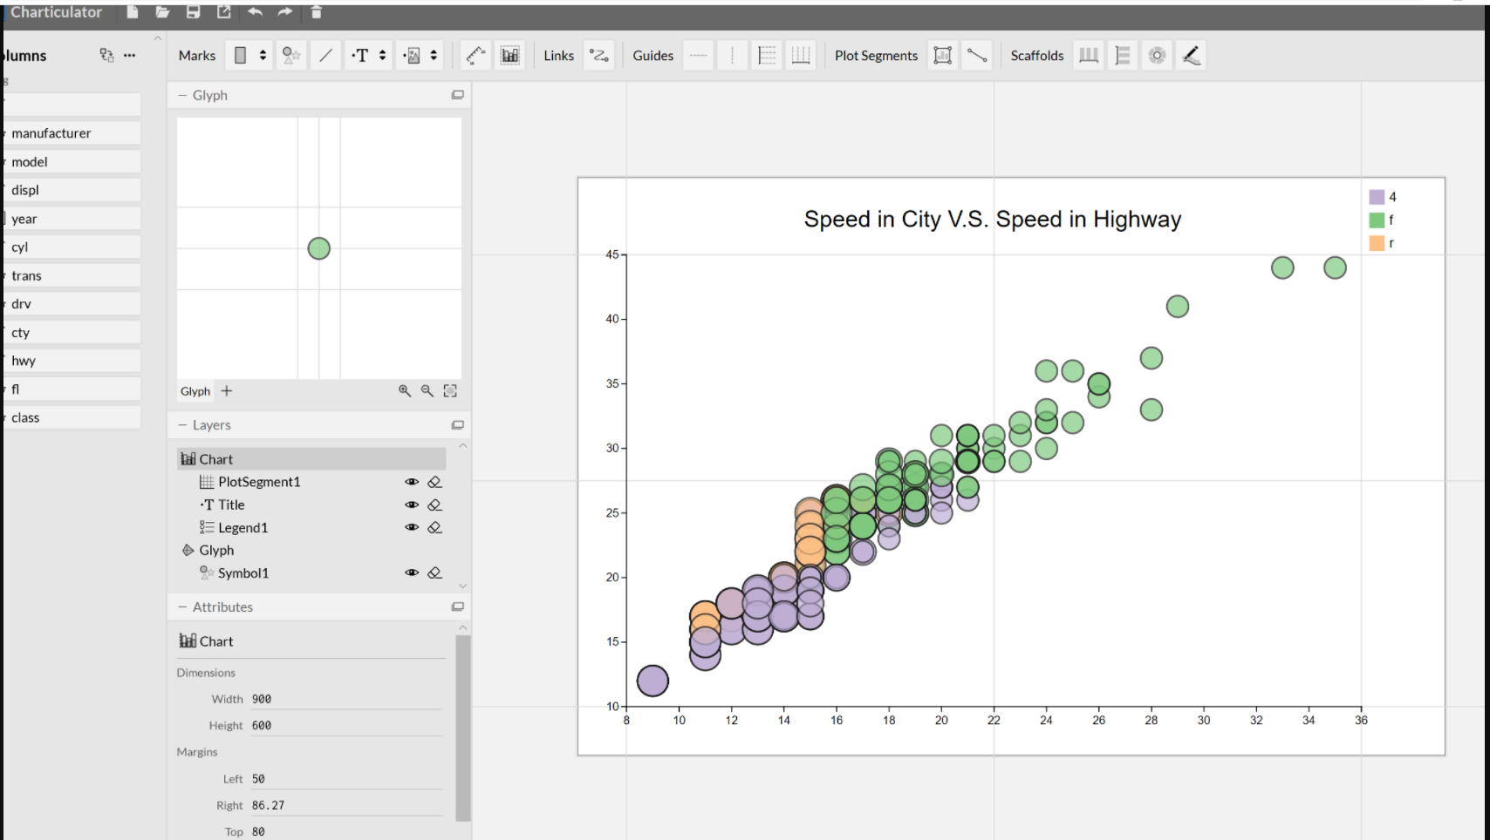
Charticulator
Using a studio to create a custom visual (NO CODE)
No package installation needed
Able to import via Power BI visualization Pannel.
Able to create most of the visuals in just an hour
Notes:
Talk briefly about the client; describe the product suite and its modules. What business/technical problems are being solved and for whom (ie. end users).

Slide 9
JavaScript Custom Visual
Software Installation:
Node JS
Visual Studio Code
Notes:
Talk briefly about the client; describe the product suite and its modules. What business/technical problems are being solved and for whom (ie. end users).

Slide 10
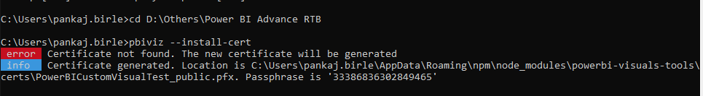
Setup Environment
Install Power BI Visual Tool Package
-> npm install –g powerbi-visuals-tools
2. Install Certificate
-> pbiviz –install-cert
Notes:
Talk briefly about the client; describe the product suite and its modules. What business/technical problems are being solved and for whom (ie. end users).

Slide 11
Setup Environment
3. Create Project
-> pbiviz new <project name>
4. Start Project (After move in project directory)
-> pbiviz start
5. For the trouble shoot issue, please use the URL: https://localhost:8080/assets/status
6. Publish a dataset and enable Developer mode
7. Create a Visual Package
-> pbiviz package
Notes:
Talk briefly about the client; describe the product suite and its modules. What business/technical problems are being solved and for whom (ie. end users).

Slide 12
Using JavaScipt
It is easy to change it as every aspect is created by a developer.
You can create all the visuals you want.
Hard to create visual as you need to know to code in JAVA scripts and JSON.
Need to get the certify the visual over the Power BI Web Service.
Notes:
Talk briefly about the client; describe the product suite and its modules. What business/technical problems are being solved and for whom (ie. end users).

Slide 13
Thanks

