Slide 1
Ziyo Forum & SAP
Intro Call
Stefanie, Anja, Pankaj
Sept 28th, 2026

Slide 2
Agenda
01
Introductions / Getting to know each other
02
Review and discussion of the Scope of Work
03
Logistics and planning
04
Next steps
Notes:
Introductions / Getting to know each other
Review and discussion of the Scope of Work
Logistics and planning
Next steps

Slide 3
Introductions / Getting to know each other

Slide 4
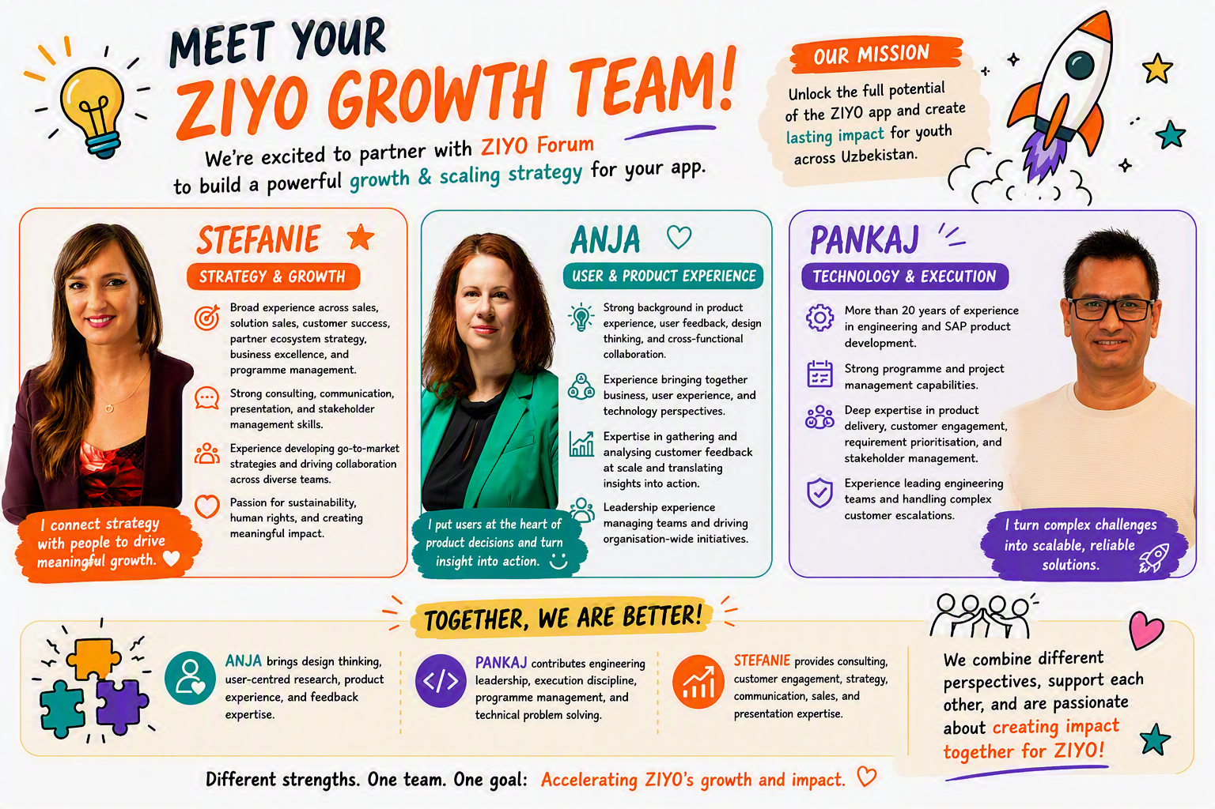

Slide 5
Review and discussion of the Scope of Work

Slide 6
Initial Questions
What is working particularly well today, and what are you most proud of?
What is the biggest bottleneck currently holding the platform back?
What is your unique value proposition? What differentiates your offering from others in the market?
What is the main target audience? Are you also considering expanding to otheruser groups (e.g like artisans)?
What does success look like in 3 years?
• Бугун айниқса нималар яхши ишлаяпти ва сиз энг кўп нимадан фахрланасиз?
• Ҳозирда платформанинг ривожланишига тўсқинлик қилаётган энг катта муаммо (бўғин, bottleneck) нима?
• Сизнинг ноёб қиймат таклифингиз (Unique Value Proposition) нимадан иборат? Таклифингизни бозордаги бошқа ечимлардан нима ажратиб туради?
• Асосий мақсадли аудиториянгиз ким? Бошқа фойдаланувчи гуруҳларига (масалан, ҳунармандлар каби) кенгайишни ҳам кўзда тутяпсизми?
• 3 йил ичида муваффақият сизнинг назарингизда қандай кўринишга эга бўлади?

Slide 7
Logistics and Planning

Slide 8
Additional Questions
Workspace
Availability of people
  Co-workers
  Leaders
  Users
(Regular) meetings or events we should attend
  E.g. International Conference on E-Education, E-Business, E-Management and E-Learning (IC4E): Scheduled for October 8, 2026, in Tashkent.
Additional information (as described in SoW)
  User data, product data, growth data,…
Access to Ziyo app
  Local phone number only?
Anything else we should bring or think of?

Slide 9
Next Steps

Slide 10
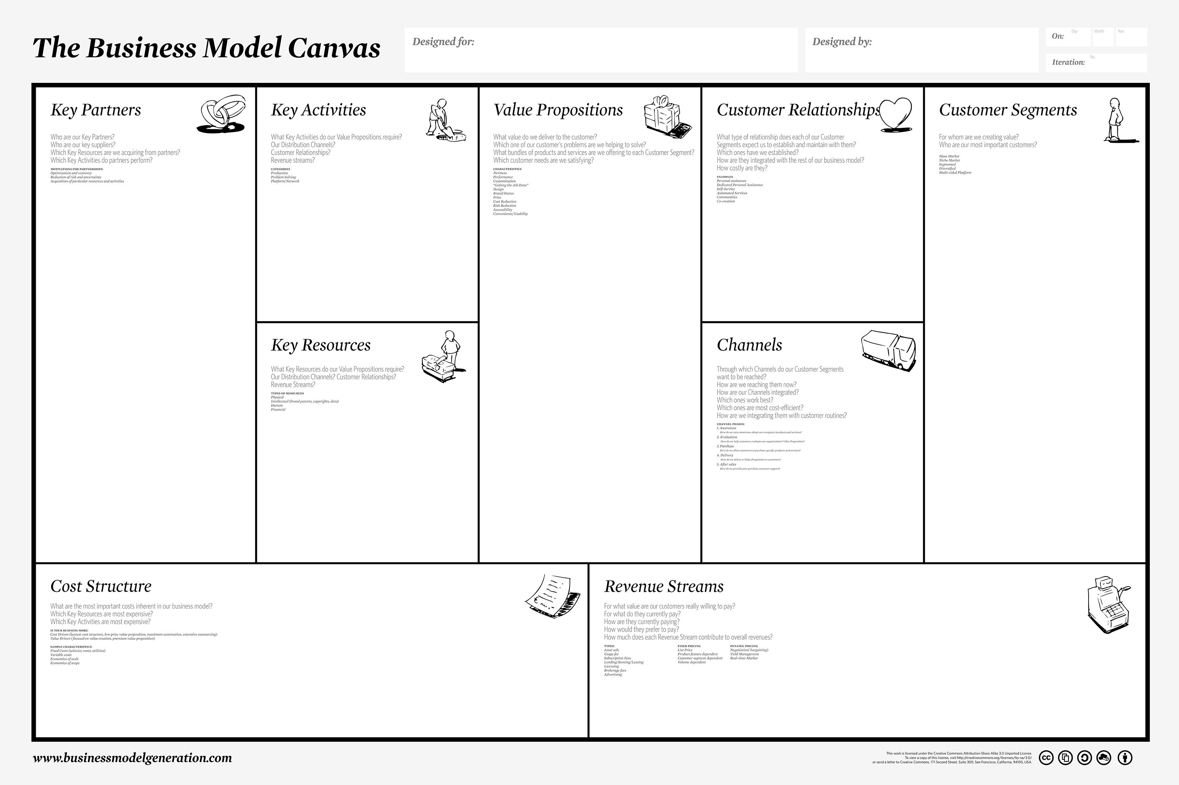
Universities and educational institutions
Employers and private-sector companies
Government institutions
Nonprofit and youth-development organizations
ZIYO Forum leadership and management
Content/opportunity providers (scholarships, grants, volunteer programs, events)
Aggregating opportunities
Managing and validating content
Platform development and maintenance
User acquisition
User onboarding
User engagement and retention
Partnership acquisition and management
Product and UX improvement
Monitoring impact and KPIs
Aggregating opportunities
Managing and validating content
Platform development and maintenance
User acquisition
User onboarding
User engagement and retention
Partnership acquisition and management
Product and UX improvement
Monitoring impact and KPIs
Aggregating opportunities
Managing and validating content
Platform development and maintenance
User acquisition
User onboarding
User engagement and retention
Partnership acquisition and management
Product and UX improvement
Monitoring impact and KPIs
Aggregating opportunities
Managing and validating content
Platform development and maintenance
User acquisition
User onboarding
User engagement and retention
Partnership acquisition and management
Product and UX improvement
Monitoring impact and KPIs
Aggregating opportunities
Managing and validating content
Platform development and maintenance
User acquisition
User onboarding
User engagement and retention
Partnership acquisition and management
Product and UX improvement
Monitoring impact and KPIs
Aggregating opportunities
Managing and validating content
Platform development and maintenance
User acquisition
User onboarding
User engagement and retention
Partnership acquisition and management
Product and UX improvement
Monitoring impact and KPIs
Aggregating opportunities
Managing and validating content
Platform development and maintenance
User acquisition
User onboarding
User engagement and retention
Partnership acquisition and management
Product and UX improvement
Monitoring impact and KPIs
Aggregating opportunities
Managing and validating content
Platform development and maintenance
User acquisition
User onboarding
User engagement and retention
Partnership acquisition and management
Product and UX improvement
Monitoring impact and KPIs

Slide 11

Thank you & see you soon!

Slide 12
Parking Lot

Slide 13

Thank you!
Name, SAP
Month Date, Year

Slide 14
Name, SAP
Month Date, Year

Slide 15

Name, SAP
Month Date, Year

Slide 16
Name, SAP
Month Date, Year

Slide 17
Name, SAP
Month Date, Year

Slide 18
Name, SAP
Month Date, Year

Slide 19


Slide 20


Slide 21


Slide 22
Headline

Slide 23
Headline
Sub-Headline

