Slide 1
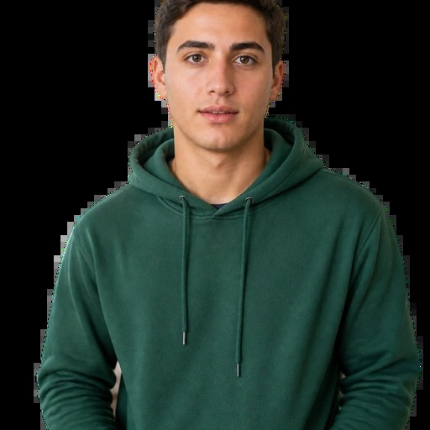
END USER PERSONA
Ziyo Forum · Discovery Research · October 2026
“
I want to study abroad - everyone says it's possible - but I have no idea where to even start or which scholarships I am actually eligible for.
— Asilbek Normatov, 17 · Final-Year School Student, Tashkent
Asilbek Normatov
Goals
What He Needs from Ziyo
Final-Year Secondary School Student
School No. 110, Tashkent
• Get accepted to a reputable foreign university on a full scholarship
• Pass IELTS/ SAT at a competitive score before applications close
• Build a strong profile: grades, extracurriculars, and a standout essay
• Understand exactly what each scholarship requires before he commits
• Scholarships and programs filtered for school leavers and freshmen
• Step-by-step guidance: what to prepare, in what order, by when
• Real stories from students who went abroad straight from school
• Deadline alerts so he never misses a window while finishing exams
AGE
17 years old
LOCATION
Tashkent, Uzbekistan
EDUCATION
11th Grade · Secondary School
GOAL
Bachelor's degree at a foreign university
Pain Points Today
Challenges
• Overwhelming volume of information — no clear starting point
• Most resources are aimed at university students, not school leavers
• Relies on teachers and older cousins for guidance; advice is inconsistent
• Deadlines sneak up while he is focused on final school exams
• Balancing final-year schoolwork with scholarship research and test prep
• Limited experience writing personal statements or navigating portals
• No budget for test fees, prep courses, or application costs
• Parents supportive but unable to guide him through foreign admissions
FUNDING
Needs full scholarship - family cannot self-fund
INTERESTS
Study Abroad
IELTS / SAT
Tech & IT
Gaming
YouTube
Football
WHERE HE LOOKS
KEY DESIGN INSIGHT
Telegram
Instagram
YouTube
Asilbek is at the most critical — and most underserved — decision point of his life. He is motivated but paralysed by complexity and a total lack of a structured starting point. Ziyo's opportunity is to meet him where he is: curate scholarships open to school leavers, sequence the steps for him, and make the path to a foreign university feel achievable, not overwhelming.
School Teachers
Google

