Slide 1
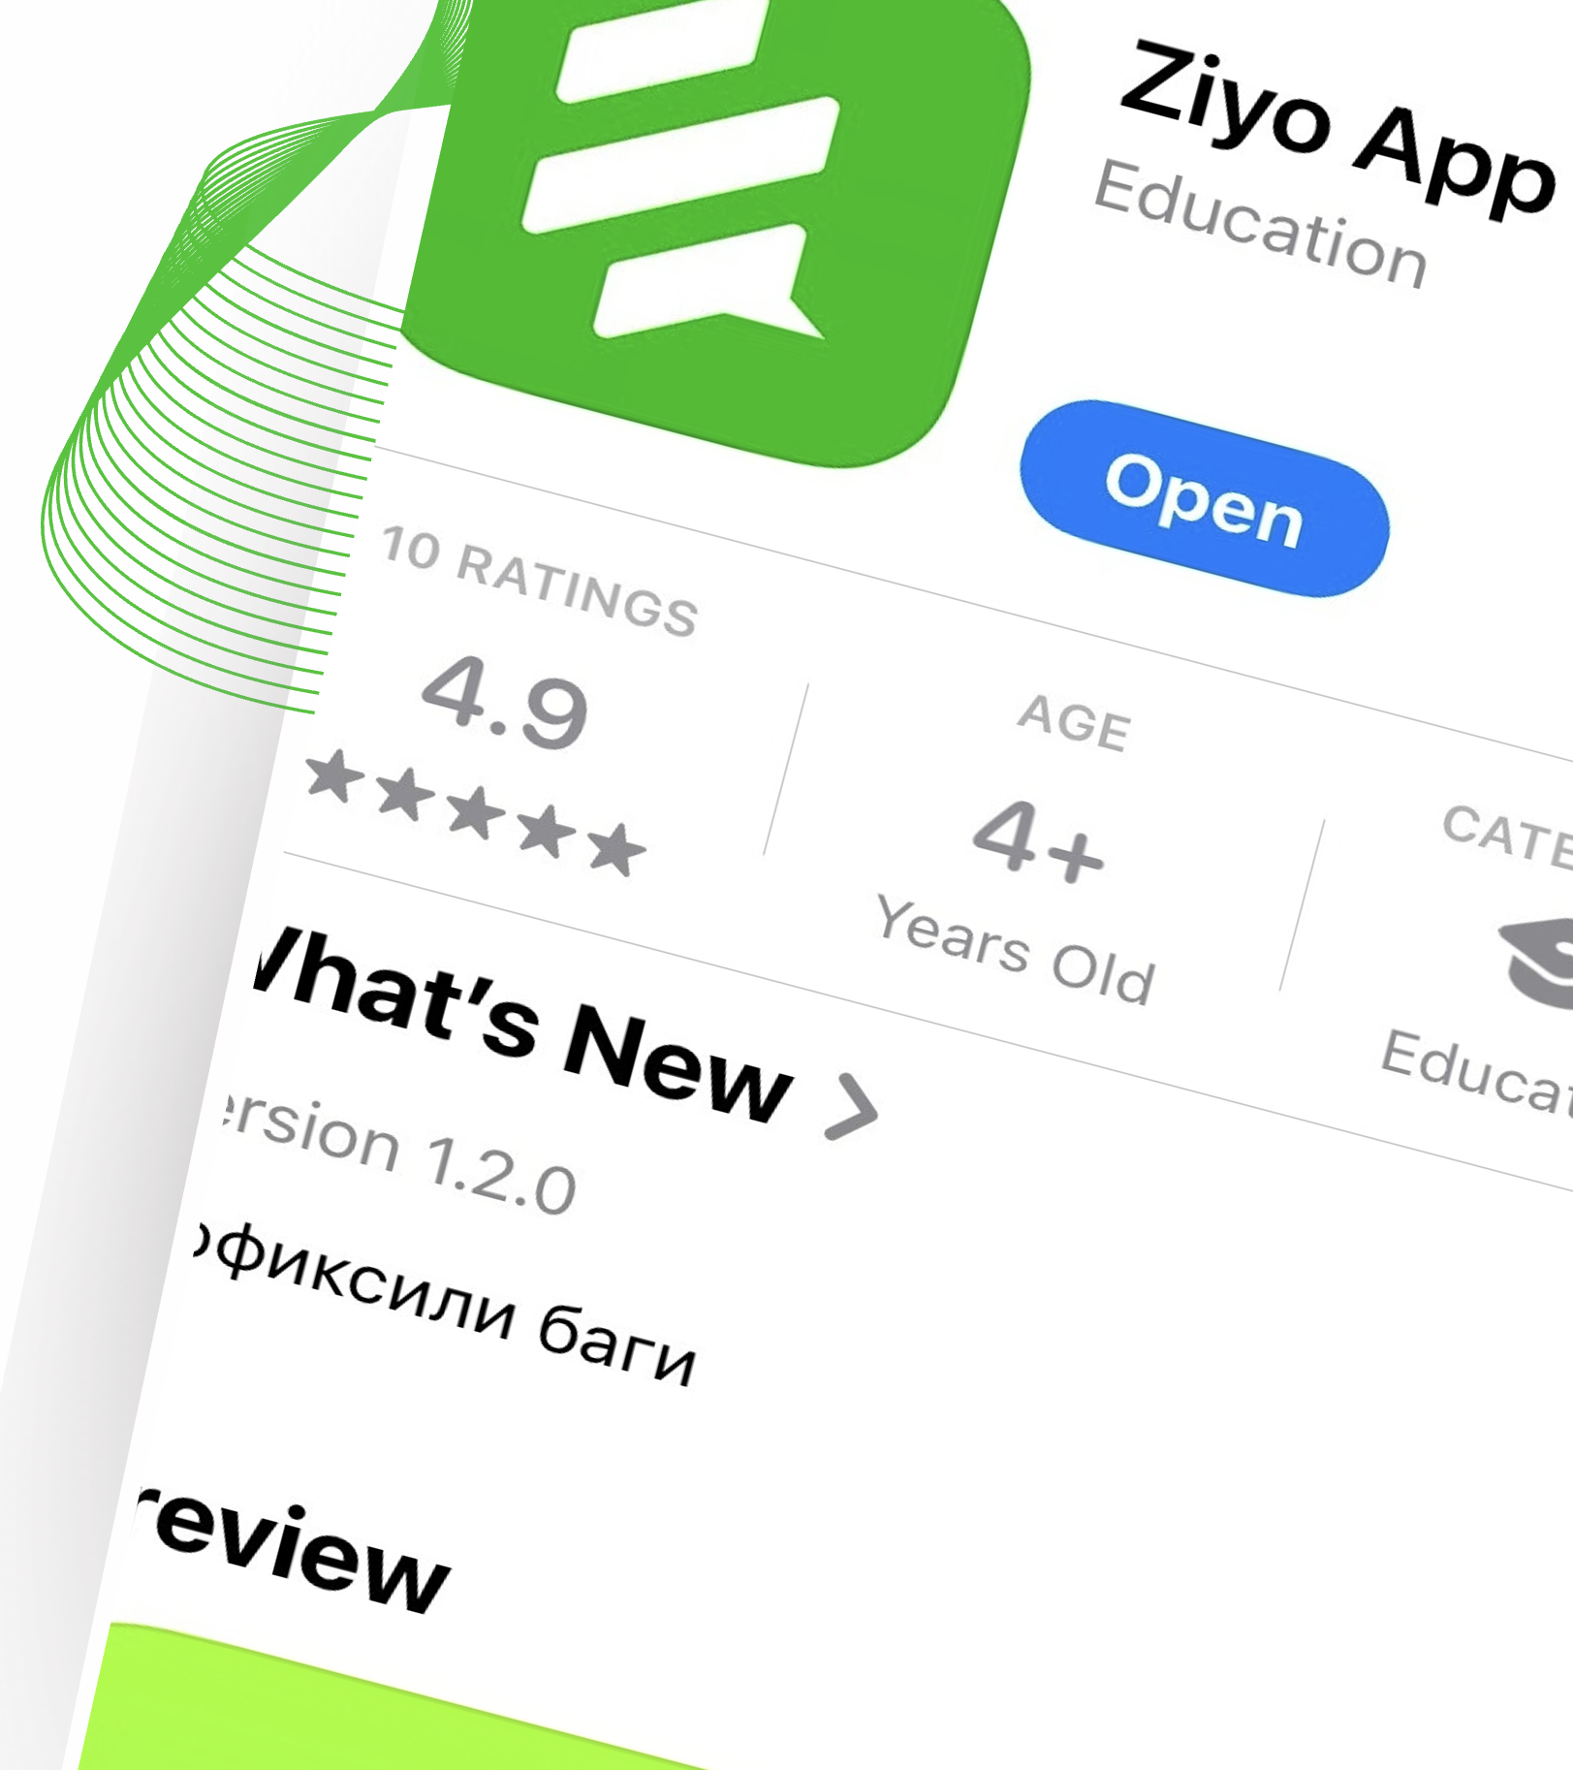
Ziyo App
Product Vision Workshop
Mahsulot konsepsiyasi bo‘yicha seminar
Stefanie, Anja, Pankaj – SAP SE
October 14, 2026

Slide 2
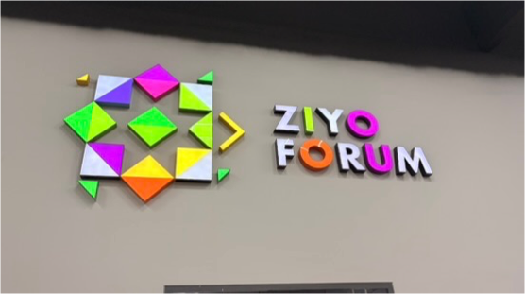
Agenda
01
Welcome! Xush kelibsiz!
Welcome and introductions - 30 min
02
Vision Tasavvur
Presented by Bobur - 15 min
03
Personas Odamlar
The main users for Ziyo App- 20 min
04
Vision Prototype Ko’rish prototipi
Split into 3 teams - 45 min
05
Prototype Presentation Prototip taqdimoti
5 min presentation + 2 questions / team - 21 min
06
Common Ground Umumiy fikr
Wrap-up and next steps - 15 min

Slide 3

Welcome!
Xush kelibsiz!

Slide 4
Icebreaker : Rapid fire Fun
Tanishuv: Tezkor va qiziqarli savollar
2 options
Choose which is more you
2 ta variant
O‘zingizga ko‘proq mos keladigan variantni tanlang.

Slide 5
Morning or Evening person
Ertalabki yoki kechki paytni afzal ko‘radigan inson

Slide 6
Team sports or Gym on your own
Jamoaviy sport yoki sport zalida mustaqil shug‘ullanish

Slide 7
Coffee or Tea
Qahva yoki choy

Slide 8
Telegram or Instagram
Telegram yoki Instagram

Slide 9
Cats or Dogs
Mushuklar yoki itlar

Slide 10
Camping or Hotel
Kemping yoki mehmonxona

Slide 11
Beach or Snow holidays
Sohilda yoki qorli joylarda dam olish

Slide 12
Conclusion - Xulosa:
“At some point we all belong in the same group, we all have similarities, even when in other aspects we are different.
This unity will help us drive the amazing ZIYO APP!”
“Qaysidir ma’noda barchamiz bir guruhga mansubmiz. Boshqa jihatlardan farq qilsak ham, barchamizni birlashtiradigan o‘xshashliklarimiz bor.
Bu birdamlik ajoyib ZIYO APP’ni yanada rivojlantirishimizga yordam beradi!”

Slide 13
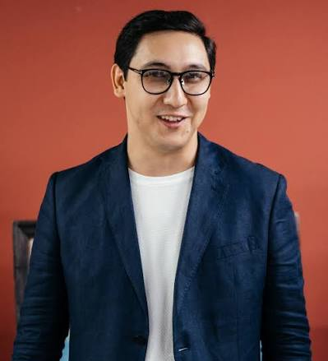
Vision
Tasavvur

Slide 14
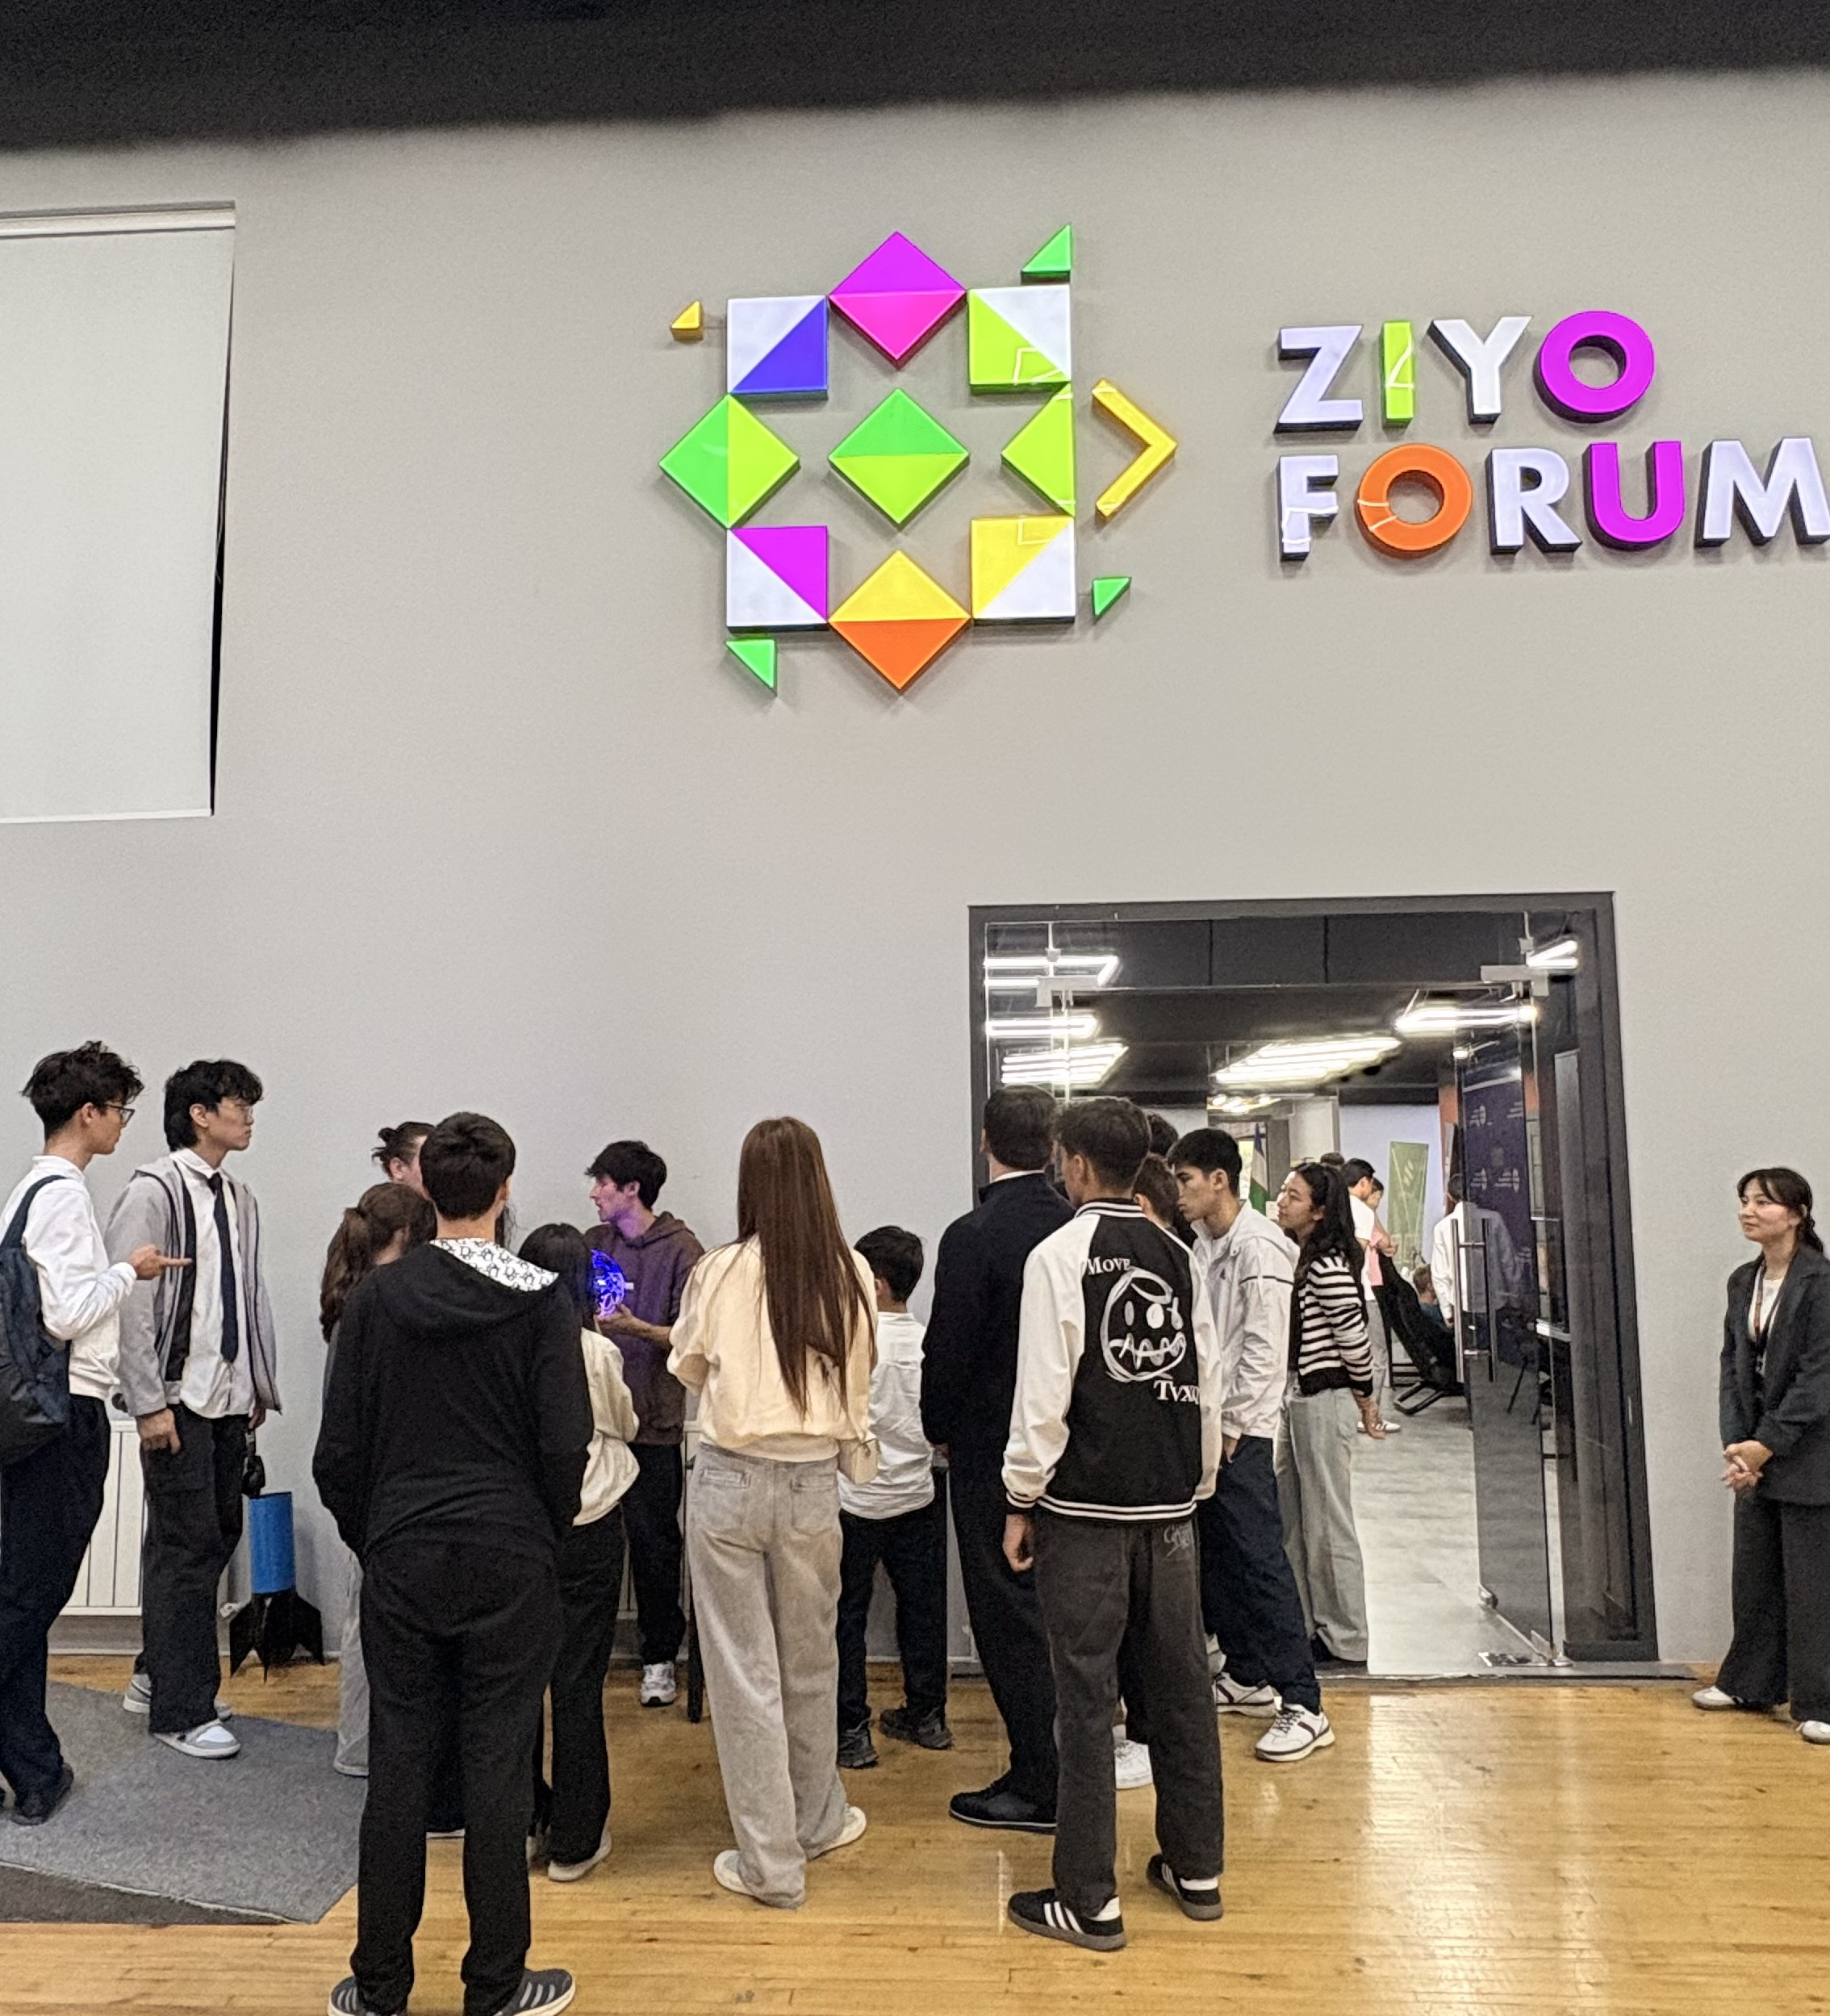
Personas
Odamlar

Slide 15
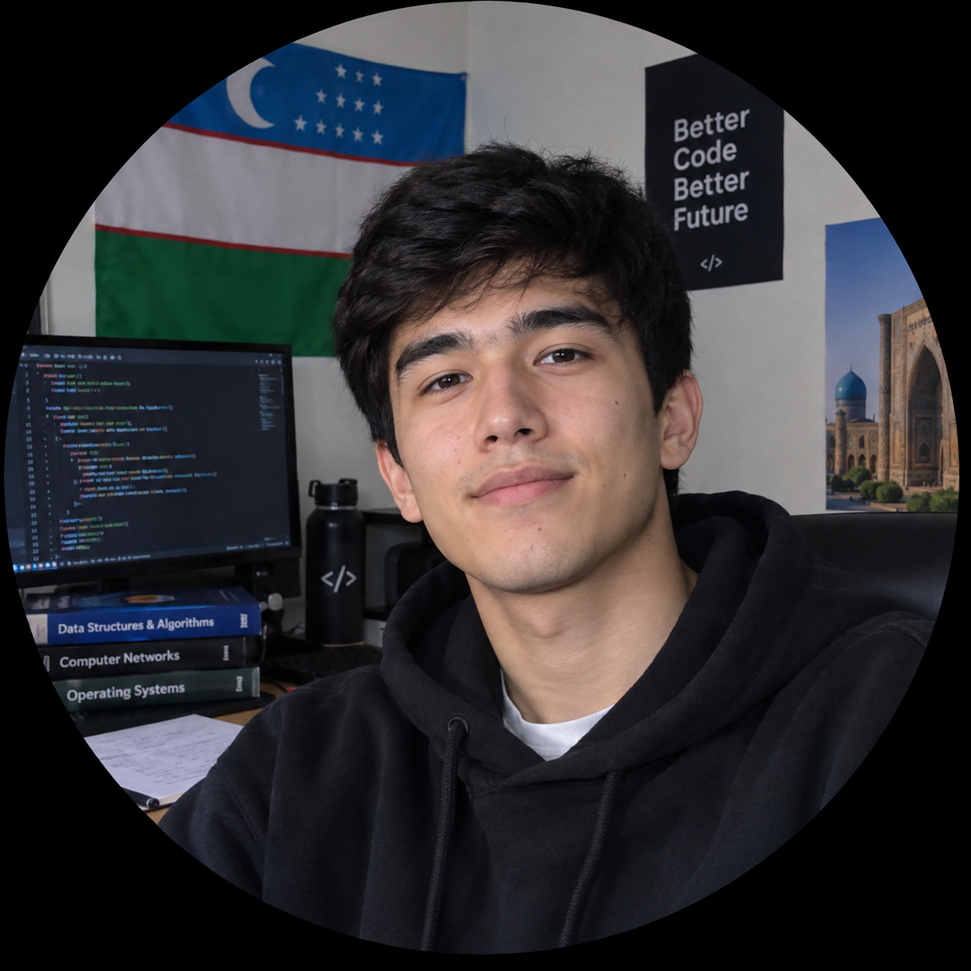
END USER PERSONA
Ziyo Forum · Discovery Research · October 2026
“
I want to quickly and easily find relevant opportunities — in one place, in my language, built for someone like me.
KE
— Doston Toshmatov, 21 · CS Student, Tashkent
Doston Toshmatov
Goals
What He Needs from Ziyo
3rd-Year IT Student
Tashkent State Technical University
• Land a meaningful internship or entry-level tech role in Uzbekistan
• Build a portfolio of real projects that proves his skills
• Develop practical, in-demand skills (web, mobile, data)
• Grow a professional network and find mentors
• One trusted platform aggregating verified internship & job listings
• Clear information on skills and qualifications companies require
• Guidance on CV writing and technical interview prep
• Access to scholarships, grants & early-career programs
AGE
21 years old
LOCATION
Tashkent, Uzbekistan
EDUCATION
BSc Computer Science (Year 3 of 4)
Pain Points Today
Challenges
STATUS
Single, lives with family
• Opportunities fragmented across dozens of channels — no single source
• Most listings require experience he lacks; no path for graduates
• Little transparency on salary, culture, or the actual role
• Russian is often required — a barrier for Uzbek speakers
• Balancing coursework with the time needed to job-search
• Staying motivated when applications go unanswered for weeks
• Knowing which skills to invest in when market signals are unclear
• Building credibility without industry experience to point to
EXPERIENCE
1 freelance project (3 months)
INTERESTS
Mobile Apps
UI Design
Telegram Bots
Chess
Hackathons
Open Source
WHERE HE LOOKS
KEY DESIGN INSIGHT
Telegram
LinkedIn
YouTube
Doston is not passive — he searches every day. The problem is fragmentation, not motivation. Ziyo's opportunity is to become the single trusted source he currently builds herself from dozens of scattered channels.
Coursera
Google Courses
Instagram

Slide 16
FOYDALANUVCHI PORTRETI
Ziyo Forum · Tadqiqot natijalari · Oktyabr 2026
“
Men o‘zimga mos imkoniyatlarni — bir joyda, o‘z tilimda, men uchun yaratilgan platformada — tez va oson topishni xohlayman.
DT
— Doston Toshmatov, 21 · IT talabasi, Toshkent
Doston Toshmatov
Maqsadlar
Ziyodan kutganlar
IT yo‘nalishi, 3-kurs talabasi
Toshkent Davlat Texnika Universiteti
• O‘zbekistonda mazmunli amaliyot yoki boshlang‘ich IT ish topish
• O‘z ko‘nikmalarini isbotlovchi haqiqiy loyihalar portfeli yaratish
• Amaliy va talab yuqori bo‘lgan ko‘nikmalarni rivojlantirish (web, mobil, data)
• Kasbiy tarmoq yaratish va nastavnik topish
• Tekshirilgan amaliyot va ish e’lonlarini jamlagan ishonchli platforma
• Kompaniyalar talab qiladigan ko‘nikma va malakalar haqida aniq ma’lumot
• CV yozish va texnik suhbatga tayyorlanish bo‘yicha yo‘riqnoma
• Stipendiya, grantlar va karyera boshlash dasturlariga kirish
YOSHI
21 yosh
JOYLASHUVI
Toshkent, O‘zbekiston
TA‘LIMI
Kompyuter fanlari, 3-kurs (4 yillik)
HOLATI
Bo‘ydoq, oila bilan yashaydi
Bugungi muammolar
Qiyinchiliklar
TAJRIBASI
1 ta frilanser loyiha (3 oy)
• Imkoniyatlar o‘nlab kanallarda tarqoq — yagona manba yo‘q
• Ko‘p e’lonlar tajriba talab qiladi; bitiruvchilar uchun yo‘l ko‘rsatilmagan
• Maosh, korporativ madaniyat va ish mazmuni haqida shaffoflik kam
• Ko‘pincha ingliz/rus tili talab qilinadi — o‘zbek tilida muloqot qiluvchilar uchun to‘siq
• O‘qish bilan ish qidirishga kerakli vaqtni muvozanatlash
• Haftalar davomida javob kelmasa ham rag‘batlanishni saqlab qolish
• Bozor signallari noaniq bo‘lganda qaysi ko‘nikmaga sarmoya qilishni bilish
• Soha tajribasiz ishonch va obro‘ qozonish
QIZIQISHLARI
Mobil ilovalar
UI Dizayn
Telegram botlar
Shaxmat
Xakatonlar
Ochiq manba
QAYERDAN IZLAYDI
DIZAYN XULOSASI
Telegram
LinkedIn
YouTube
Doston passiv emas — u har kuni qidiradi. Muammo fragmentatsiyada, motivatsiyada emas. Ziyoning imkoniyati — u hozir o‘nlab tarqoq kanallardan o‘zi jamlayotgan yagona ishonchli manbaga aylanish.
Coursera
GitHub
Instagram

Slide 17
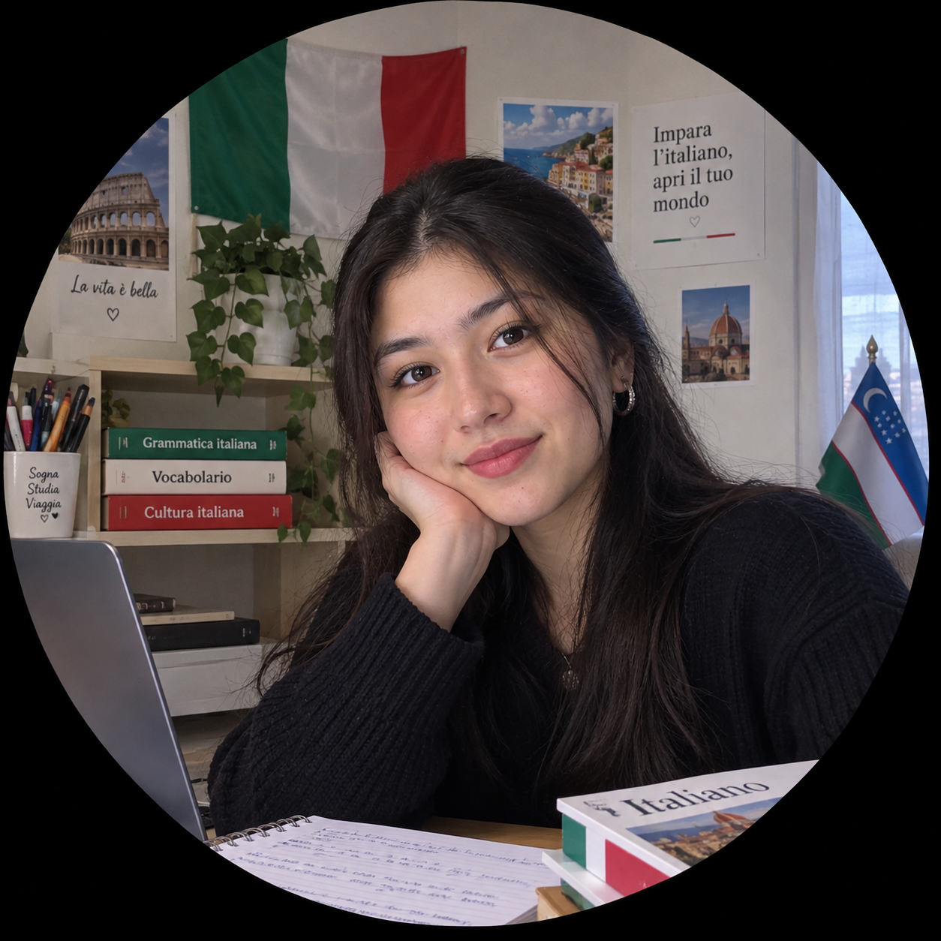
END USER PERSONA
Ziyo Forum · Discovery Research · October 2026
“
There are opportunities everywhere — but spread across so many channels that I usually give up before I find the right one.
— Kamola Ergasheva, 20 · German Language Student, Tashkent
Kamola Ergasheva
Goals
What She Needs from Ziyo
2nd-Year German Language Student
Tashkent State World Languages University
• Reach fluency in and use it in a real career
• Win a scholarship or exchange semester in Germany
• Find a part-time job or internship that uses his languages
• Gain real experience without spending hours searching
• One place that gathers opportunities so she stops scrolling channels
• Personalized matches relevant to language & humanities students
• Deadline reminders so she doesn't miss what matters
• Short, simple applications that take minutes, not hours
AGE
20 years old
LOCATION
Tashkent, Uzbekistan
EDUCATION
BA German Language (Year 2 of 4)
Pain Points Today
Challenges
STATUS
Single, lives in student dormitory
• Opportunities scattered across dozens of Telegram channels
• Gives up when searching takes too long or feels overwhelming
• Misses deadlines because key information is buried in chats
• Few listings feel relevant to a language major
• Low motivation to actively hunt for opportunities
• Hard to separate signal from noise across many channels
• Tends to procrastinate on applications
• Unsure which opportunities actually fit her field
EXPERIENCE
Occasional translation gigs
INTERESTS
German Culture
German Books
Languages
Painting
Music
Travel
WHERE SHE LOOKS
KEY DESIGN INSIGHT
Kamola will not dig for opportunities — if it takes effort, she disengages. For users like her, Ziyo must do the searching: aggregate everything in one place, push relevant matches to her, and make acting on them effortless. Convenience, not more content, converts her.
Telegram
Instagram
YouTube
Uni Chats
Google

Slide 18
FOYDALANUVCHI PORTRETI
Ziyo Forum · Tadqiqot natijalari · Oktyabr 2026
“
KE
Imkoniyatlar hamma joyda — lekin shuncha kanalda tarqalganki, men ko’pincha to‘g‘risini topishdan oldin voz kechaman.
— Kamola Ergasheva, 20 · Nemis tili talabasi, Toshkent
Kamola Ergasheva
Maqsadlar
Ziyodan kutganlar
Nemis tili talabasi, 2-kurs talabasi
O'zbekiston Jahon Tillari Universiteti
• Imkoniyatlarni jamlovchi yagona joy — kanallarni aylanishni to‘xtatish uchun
• Til va gumanitar yo‘nalish talabalari uchun shaxsiylashtirilgan takliflar
• Muhim narsalarni o‘tkazib yubormaydi uchun muddat eslatmalari
• Soat emas, daqiqa sarflanadigan qisqa va oddiy ariza berish
• INemis tilida ravon so‘zlashish darajasiga erishing va uni haqiqiy kasbiy faoliyatingizda qo‘llang
• Germaniyada stipendiya yoki almashinuv dasturi doirasida bir semestr o‘qish imkoniyatini qo‘lga kiriting
• Tillarini qo‘llaydigan qo‘shimcha ish yoki amaliyot topish
• Soatlab qidirib o‘tirmasdan haqiqiy tajriba orttirish
YOSHI
20 yosh
JOYLASHUVI
Toshkent, O'zbekiston
TA'LIMI
Nemis tili bo‘yicha bakalavr (4 yillik dasturning 2-yili)
HOLATI
Bo'ydoq, talabalar yotoqxonasida yashaydi
Bugungi muammolar
Qiyinchiliklar
TAJRIBASI
Vaqti-vaqti bilan tarjima ishlari
• Imkoniyatlar o‘nlab Telegram kanallarida tarqoq
• Qidirish uzoqqa cho‘zilsa yoki qiyin tuyulsa voz kechadi
• Muhim ma’lumot chatlarda ko‘milgan bo‘lgani uchun muddatlarni o‘tkazib yuboradi
• Til yo‘nalishi talabasi uchun mos e’lonlar juda kam
• Imkoniyatlarni faol qidirishga motivatsiya past
• Ko‘p kanallarda muhim ma’lumotni ortiqchasidan ajratish qiyin
• Ariza berishni keyinga qoldirish odati bor
• Qaysi imkoniyatlar uning sohasiga mos kelishini bilmaydi
QIZIQISHLARI
Germaniya madaniyati
Nemischa kitoblar
Tillar
Rangtasvir
Musiqa
Sayohat
QAYERDAN IZLAYDI
DIZAYN XULOSASI
Telegram
Instagram
YouTube
Kamola imkoniyat izlab qazimaydi — harakat talab qilsa, u ulanishdan uziladi. Bunday foydalanuvchilar uchun Ziyo o‘zi qidirishi kerak: hamma narsani bir joyga jamlash, unga mos takliflarni yuborish va ularga amal qilishni osonlashtirish. Uni jalb qiladigan narsa — qulaylik, ko‘proq kontent emas.
Universitet chatlari
Google

Slide 19
Workshop “Rules” Seminar qoidalari
Feel free to talk in your language
O'z tilingizda bemalol gaplashing
Everyone participates
Hamma ishtirok etadi
There’s no right or wrong – all ideas are valuable
To'g'ri yoki noto'g'ri narsa yo'q - barcha g'oyalar qadrlidir
Have fun!
Bahra oling!
Notes:
Tape

Slide 20
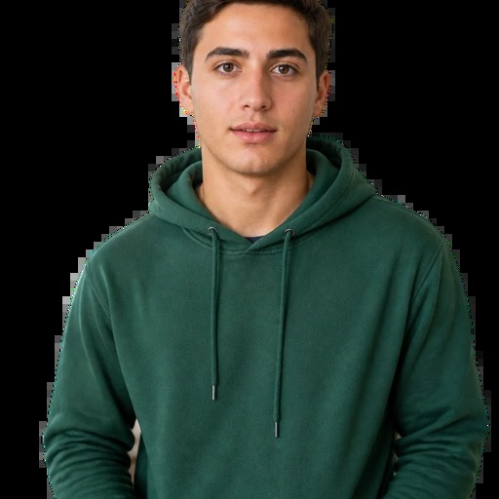
END USER PERSONA
Ziyo Forum · Discovery Research · October 2026
“
I want to study abroad - everyone says it's possible - but I have no idea where to even start or which scholarships I am actually eligible for.
— Asilbek Normatov, 17 · Final-Year School Student, Tashkent
Asilbek Normatov
Goals
What He Needs from Ziyo
Final-Year Secondary School Student
School No. 110, Tashkent
• Get accepted to a reputable foreign university on a full scholarship
• Pass IELTS/ SAT at a competitive score before applications close
• Build a strong profile: grades, extracurriculars, and a standout essay
• Understand exactly what each scholarship requires before he commits
• Scholarships and programs filtered for school leavers and freshmen
• Step-by-step guidance: what to prepare, in what order, by when
• Real stories from students who went abroad straight from school
• Deadline alerts so he never misses a window while finishing exams
AGE
17 years old
LOCATION
Tashkent, Uzbekistan
EDUCATION
11th Grade · Secondary School
GOAL
Bachelor's degree at a foreign university
Pain Points Today
Challenges
• Overwhelming volume of information — no clear starting point
• Most resources are aimed at university students, not school leavers
• Relies on teachers and older cousins for guidance; advice is inconsistent
• Deadlines sneak up while he is focused on final school exams
• Balancing final-year schoolwork with scholarship research and test prep
• Limited experience writing personal statements or navigating portals
• No budget for test fees, prep courses, or application costs
• Parents supportive but unable to guide him through foreign admissions
FUNDING
Needs full scholarship - family cannot self-fund
INTERESTS
Study Abroad
IELTS / SAT
Tech & IT
Gaming
YouTube
Football
WHERE HE LOOKS
KEY DESIGN INSIGHT
Telegram
Instagram
YouTube
Asilbek is at the most critical — and most underserved — decision point of his life. He is motivated but paralysed by complexity and a total lack of a structured starting point. Ziyo's opportunity is to meet him where he is: curate scholarships open to school leavers, sequence the steps for him, and make the path to a foreign university feel achievable, not overwhelming.
School Teachers
Google

Slide 21
FOYDALANUVCHI PORTRETI
Ziyo Forum · Tadqiqot natijalari · Oktyabr 2026
“
Xorijda o’qishni xohlayman — hammasi mumkin deyishadi — lekin qayerdan boshlashni yoki qaysi stipendiyalarga haqiqatan mos kelishimni bilmayman.
— Asilbek Normatov, 17 · Yakuniy sinf o'quvchisi, Toshkent
Asilbek Normatov
Maqsadlar
Ziyodan kutganlar
Yakuniy sinf o'quvchisi
110-maktab, Toshkent
• To'liq stipendiya bilan nufuzli xorijiy universitetga qabul bo'lish
• Ariza muddati tugashidan oldin IELTS yoki SAT'dan raqobatbardosh ball to'plash
• Kuchli profil yaratish: baholar, qo'shimcha faoliyat va ajralib turadigan esse
• Har bir stipendiyaga ariza berishdan oldin nima talab qilishini aniq bilish
• Maktab bitiruvchilari uchun filtrlangan stipendiya va dasturlar
• Bosqichma-bosqich yo'riqnoma: nima tayyorlanadi, qaysi tartibda, qachon
• Maktabdan to'g'ridan-to'g'ri xorijga ketgan talabalarning haqiqiy hikoyalari
• Imtihon topshirayotganda muhim muddatlarni o'tkazib yubormaydi uchun eslatmalar
YOSHI
17 yosh
JOYLASHUVI
Toshkent, O'zbekiston
TA'LIMI
11-sinf · O'rta maktab
MAQSADI
Xorijiy universitetda bakalavriat
Bugungi muammolar
Qiyinchiliklar
MOLIYALASHTIRISH
To'liq stipendiya kerak — oila o'z hisobidan qila olmaydi
• Haddan ortiq ma'lumot — aniq boshlash nuqtasi yo'q
• Ko'p resurslar maktab bitiruvchilariga emas, universitet talabalari uchun mo'ljallangan
• Yo'riqnoma uchun o'qituvchi va katta qarindoshlariga tayanadi; maslahatlar qarama-qarshi
• U yakuniy maktab imtihonlariga e'tibor qaratayotganda muddatlar yaqinlashib qoladi
• Oxirgi sinf darslarini stipendiya qidirish va test tayyorgarligi bilan muvozanatlash
• Shaxsiy bayonnoma yozish yoki portallardan foydalanish tajribasi cheklangan
• Test to'lovlari, tayyorlov kurslari yoki ariza xarajatlari uchun byudjet yo'q
• Ota-onalar qo'llab-quvvatlaydi, lekin xorijiy qabul jarayonida yo'llay olmaydi
QIZIQISHLARI
Xorijda o'qish
IELTS / SAT
Texnologiya
O'yinlar
YouTube
Futbol
QAYERDAN IZLAYDI
DIZAYN XULOSASI
Telegram
Instagram
YouTube
Asilbek hayotidagi eng muhim — va eng kam xizmat ko'rsatilgan — qaror nuqtasida turibdi. U motivlangan, lekin murakkablik va tartibli boshlang'ich nuqtaning yo'qligi uni qiynaydi. Ziyoning imkoniyati — uni bor joyida kutib olish: maktab bitiruvchilari uchun stipendiyalarni tanlash, qadamlarni tartiblab berish va xorijiy universitetga yo'lni mumkin tuyultirishdir.
Maktab o'qituvchilari
Google

Slide 22

Vision Prototype Ko’rish prototipi

Slide 23
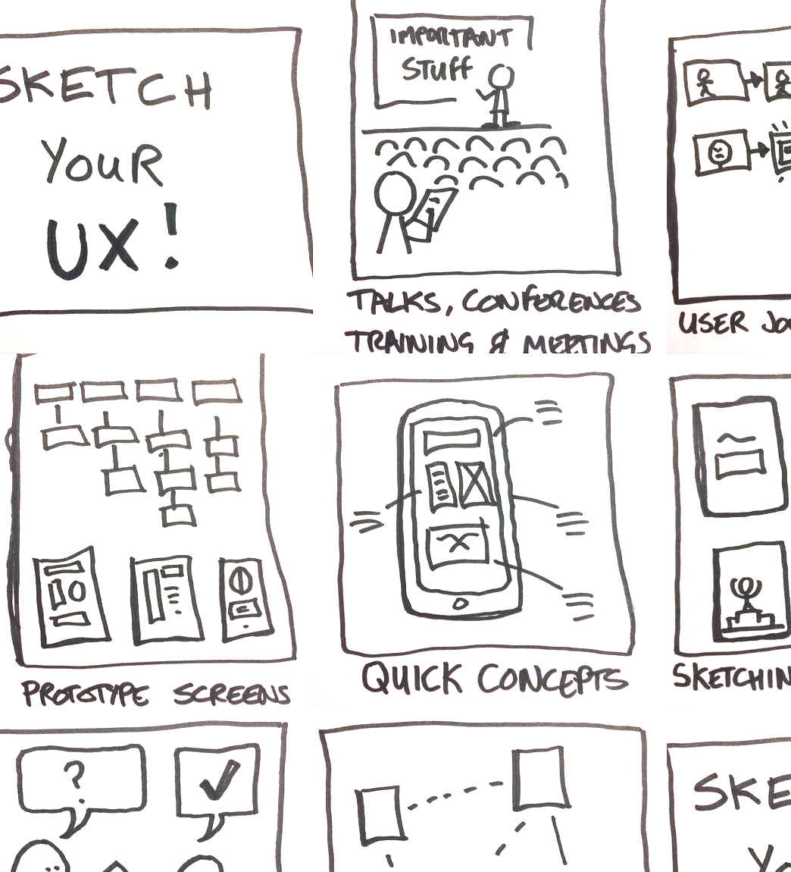


Vision Prototype Ko´rish prototipi

Slide 24
How to create a Vision Prototype Ko´rish prototipini qanday yaratish mumkin?
Goal: Create a vision for Ziyo App. Show how life could be easier and better for your persona in the future.
Think about the persona – Design for their goals, needs, and challenges
Show a better future – What key problems of the persona will be solved?
Think about the content – What do you think they might want to read, do, see?
Create a Motto – A short, inspiring sentence that summarizes your vision
You can use sketches, speech bubbles, headlines, text.
Maqsad: Ziyo ilovasi uchun tasavvur (vizyon) yarating. Kelajakda tanlangan personajingiz hayoti qanday qilib osonroq va yaxshiroq bo‘lishi mumkinligini ko‘rsating.
Personaj haqida o‘ylab ko‘ring – Dizaynni ularning maqsadlari, ehtiyojlari va duch keladigan qiyinchiliklariga moslab yarating.
Yaxshiroq kelajakni tasvirlang – Personajning qanday asosiy muammolari hal etiladi?
Kontent haqida o‘ylab ko‘ring – Ular nimalarni o‘qishni, bajarishni yoki ko‘rishni xohlashlari mumkin?
Shior yarating – Tasavvuringizni jamlab ifodalovchi qisqa va ilhomlantiruvchi jumla.
Eskizlar, so‘z pufakchalari, sarlavhalar va matnlardan foydalanishingiz mumkin.
Notes:
Tape

Slide 25
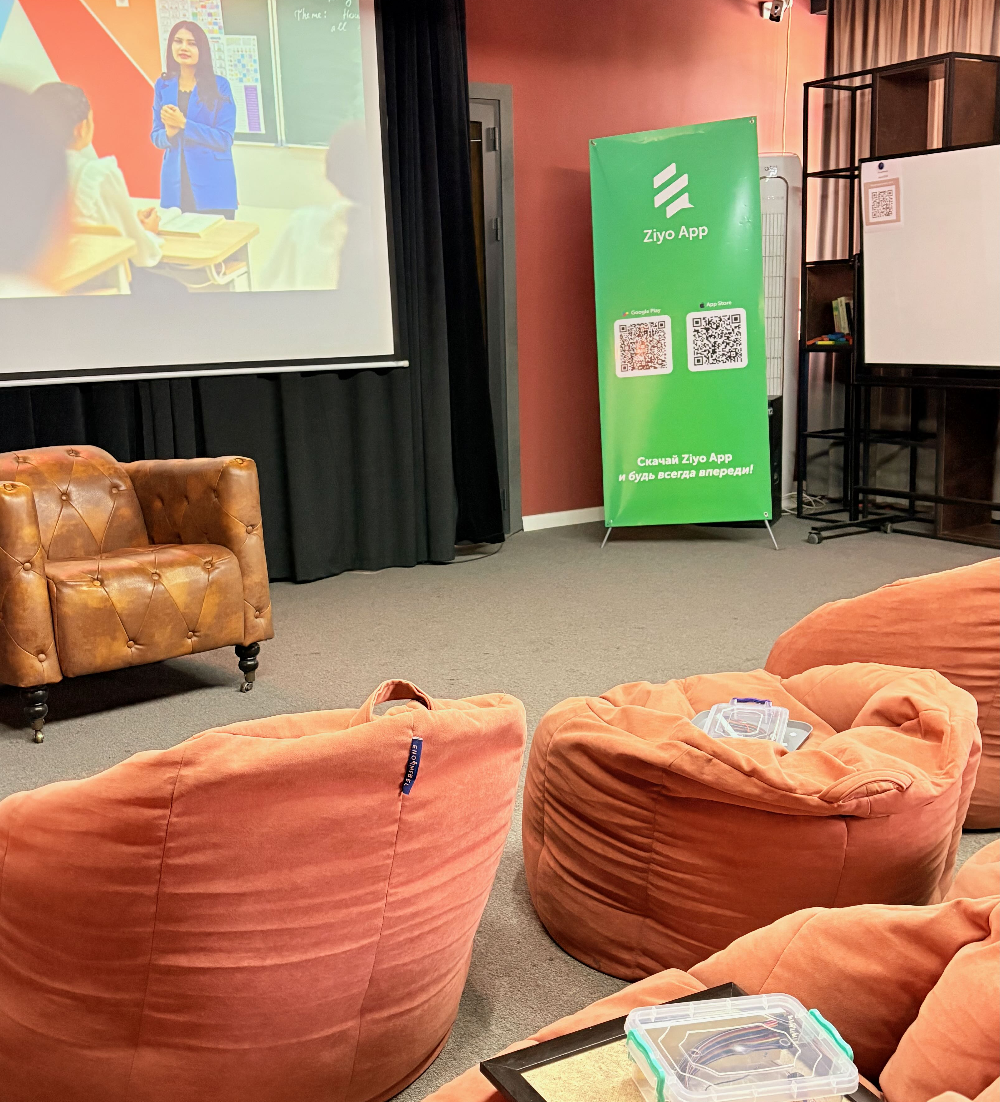
Prototype Presentation
Prototip taqdimoti
You have 5 minutes +
2 minutes for questions & answers
Sizda 5 daqiqa +
savol-javob uchun 2 daqiqa bor.

Slide 26
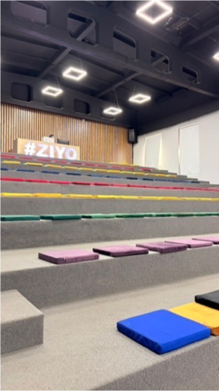
Common Ground Umumiy fikr

Slide 27
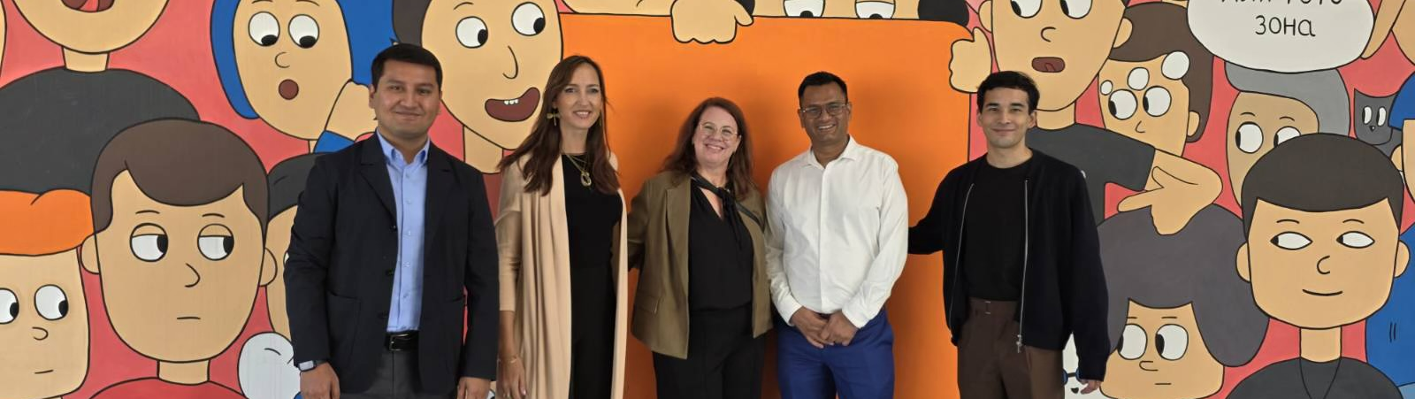
Thank you!
Thank you!
Спасибо
Rahmat

Slide 28




WORKSHOP
MATERIAL
3x Tape
10x Pens
Either black or colorful
3x Scissors

Slide 29
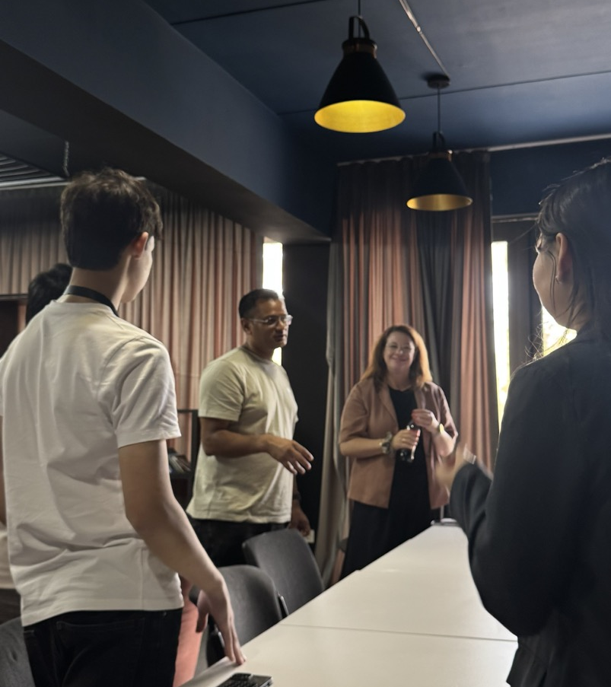
Presentation of Prototypes

Slide 30

Prioritized SoW and Deliverables

Slide 31
Deliverable 2: Product Vision
Establish a shared vision for the future of the Ziyo App platform and create alignment across stakeholders on its purpose, target users, value proposition, and long-term direction
1. Product & UX Assessment / Gap Analysis
5. User Research & Validation Templates
2. Vision Workshop & Documentation
6. Design Principles / Product Manifesto
Participation of key team members required.
Developed collaboratively with the Ziyo team.
3. Product Vision Document
7. Inspirational Design Session
Dependency on joint Product Vision Workshop.
Developed collaboratively with the Ziyo team.
Dependency on availability of UX Designer(s).
4. Target User Personas

Slide 32
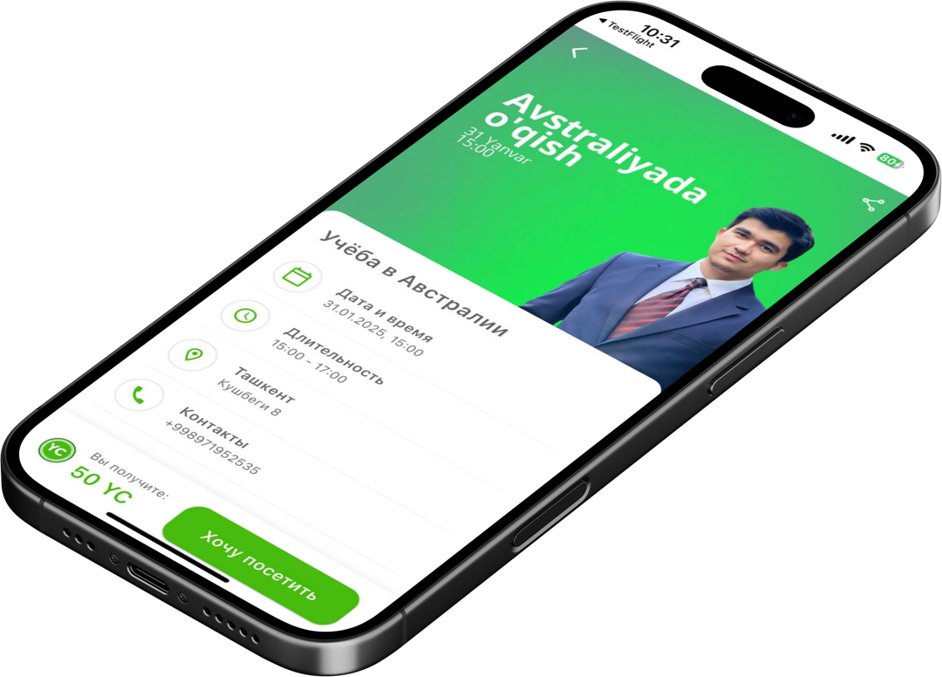
Name, SAP
Month Date, Year

Slide 33
Name, SAP
Month Date, Year

Slide 34
Name, SAP
Month Date, Year

Slide 35
Name, SAP
Month Date, Year

Slide 36

Name, SAP
Month Date, Year

Slide 37
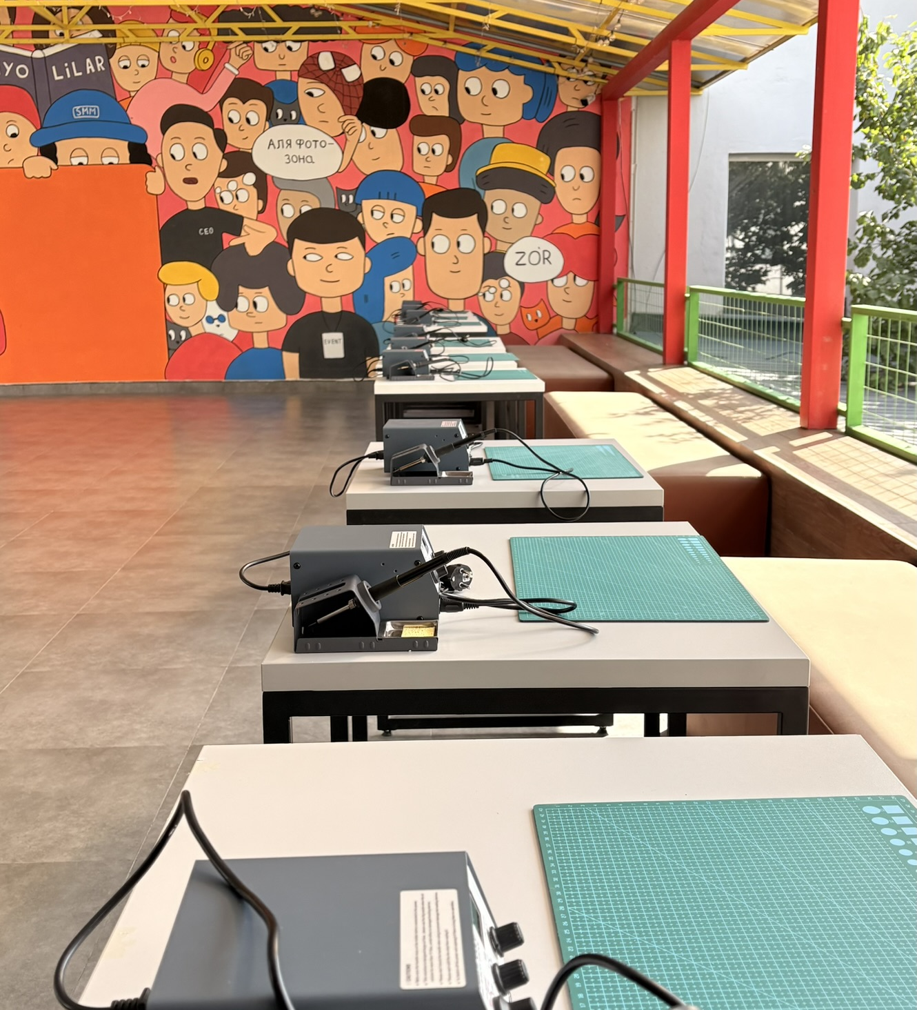
Name, SAP
Month Date, Year

Slide 38
Name, SAP
Month Date, Year

Slide 39
Name, SAP
Month Date, Year

Slide 40
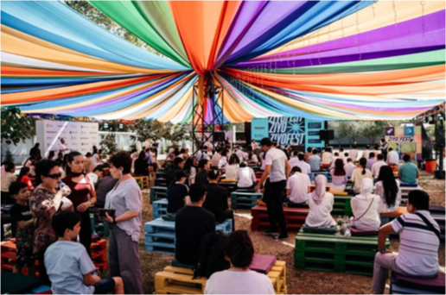
Name, SAP
Month Date, Year

Slide 41
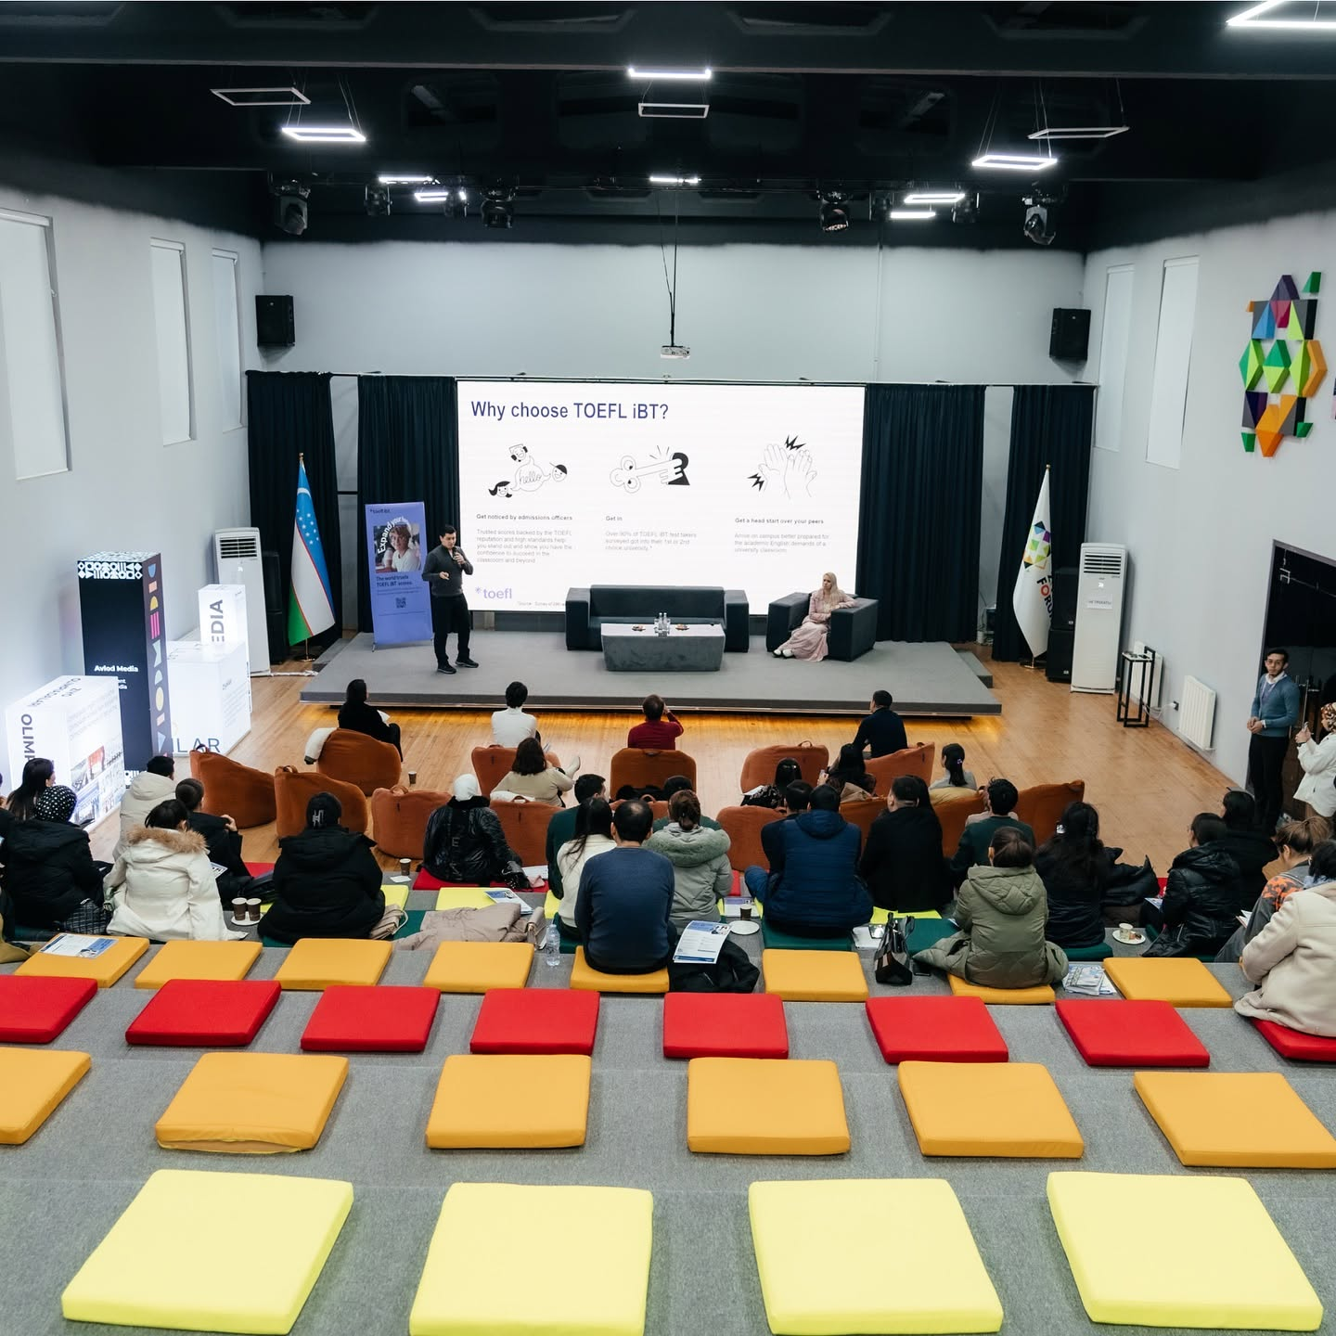
Name, SAP
Month Date, Year

Slide 42
Headline

Slide 43
Headline
Sub-Headline

Slide 44
Headline
Sub-Headline
Name, SAP
Month Date, Year

Slide 45
Agenda
01
Agenda Sample Text
Short description
02
Agenda Sample Text
Add a short description
03
Agenda Sample Text
Add a short description
04
Agenda Sample Text
Add a short description
05
Agenda Sample Text
Add a short description
05
Agenda Sample Text
Add a short description

Slide 46






Logos

Slide 47
Content Strategy
EVENTS
CURATED CONTENT
PARTNERSHIPS
Regular Events
News (e.g. Arlod Media)
Active vs. Non-Active Partners
One-Off Events
Scholarships & Grants
Ambassadors
"Ziyo Cup" Fun Events
Internship Listings
Cross-Funding from Partners?
Podcast
Research Opportunities
Video
Anything Else
Content Sourcing: identify Uzbek-specific needs (e.g. Cybersecurity, STEM, Language)
Ziyo App · Product Vision Workshop · October 2026 · Content Strategy

Slide 48
Info Needed
Usage / View Statistics
List of Events
List of Media Assets
Ambassadors Info
Funding of Events & Media
Ziyo App · Product Vision Workshop · October 2026 · Info Needed

Slide 49
Ideas
Tiering for Partners
"Easy Way to Capture Content" (LD concept)
Visibility for Ambassadors + Feature Partner Orgs
Join Forces on Ziyo App / Rewards → Complete Student Portfolio
Alumni Support & Success Stories
Mentoring / Coaching / Peer-to-Peer Coaching
Ziyo App · Product Vision Workshop · October 2026 · Ideas

