Slide 1
Statistics in R
Session-5

Slide 2
Contents
Accessing data using dplyr
Plotting data using lattice
Quiz

Slide 3
Dplyr

Slide 4
Dataframe
Select age and salary attributes
Select employees who are under 21
Compute the savings of each employee
name | age | salary | expenses
Mac | 21 | 15000 | 600
Ravi | 25 | 18000 | 800
David | 27 | 17000 | 600
Moorey | 43 | 33000 | 1200
Nolan | 33 | 24000 | 900

Slide 5
Dplyr
data_object %>%
function()
Select
Filter
Summarize
name | age | salary | expenses
Mac | 21 | 15000 | 600
Ravi | 25 | 18000 | 800
David | 27 | 17000 | 600
Moorey | 43 | 33000 | 1200
Nolan | 33 | 24000 | 900
Mutate

Slide 6
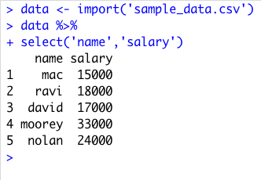
Dplyr
data_object %>%
function()
Select
Select all columns or first two columns or (salary, expenses) column
name | age | salary | expenses
Mac | 21 | 15000 | 600
Ravi | 25 | 18000 | 800
David | 27 | 17000 | 600
Moorey | 43 | 33000 | 1200
Nolan | 33 | 24000 | 900

Slide 7
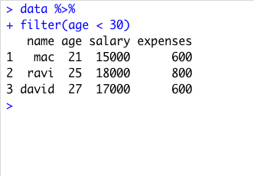
Dplyr
data_object %>%
function()
Filter
Select all employes who are under 30
name | age | salary | expenses
Mac | 21 | 15000 | 600
Ravi | 25 | 18000 | 800
David | 27 | 17000 | 600
Moorey | 43 | 33000 | 1200
Nolan | 33 | 24000 | 900

Slide 8
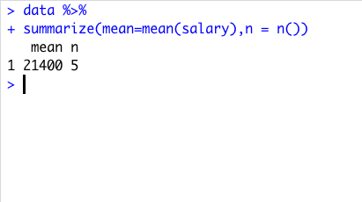
Dplyr
data_object %>%
function()
Summarize
Compute mean for employee salary
name | age | salary | expenses
Mac | 21 | 15000 | 600
Ravi | 25 | 18000 | 800
David | 27 | 17000 | 600
Moorey | 43 | 33000 | 1200
Nolan | 33 | 24000 | 900

Slide 9
Load dataset
Grouping
Summarize
name | age | salary | expenses
Mac | 21 | 15000 | 600
Ravi | 25 | 18000 | 800
David | 27 | 17000 | 600
Moorey | 43 | 33000 | 1200
Nolan | 33 | 24000 | 900
name | age | salary | expenses
Mac | 21 | 15000 | 600
Ravi | 25 | 18000 | 800
David | 27 | 17000 | 600
salary
15000
18000
17000
16677
name | age | salary | expenses
Moorey | 43 | 33000 | 1200
Nolan | 33 | 24000 | 900
salary
33000
24000
28500
LearnAITech.com

Slide 10
lattice

Slide 11
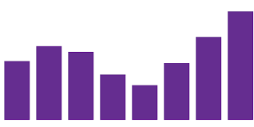
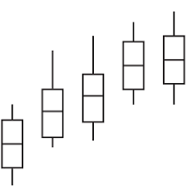
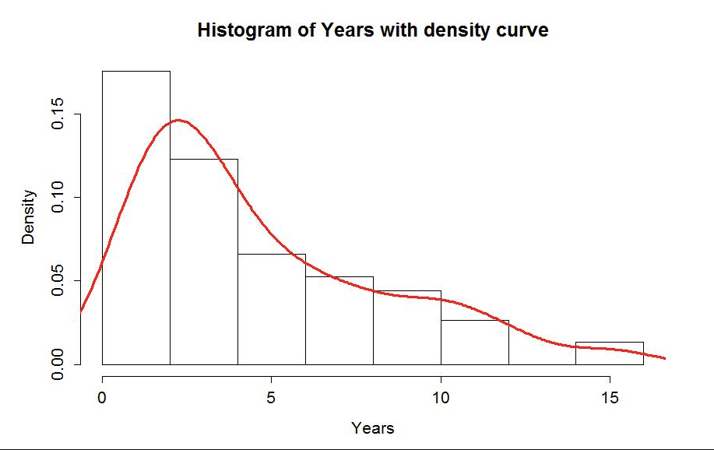
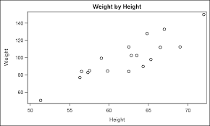
Lattice
graph_type(formula,data=)
Graph type | Desc
barchart | Bar graph
bwplot | Box plot
densityplot | Density plot
histogram | Histogram
xyplot | Scatter plot

Slide 12
Formula
Want to create multiple graphs for each category (if there is any categorical variable)
Plot a single attribute
~ attr_name
~ attr_name | cat_attr_name
Plot a two attributes
attr1_name ~ attr2_name
attr1_name ~ attr2_name | cat_attr_name

Slide 13
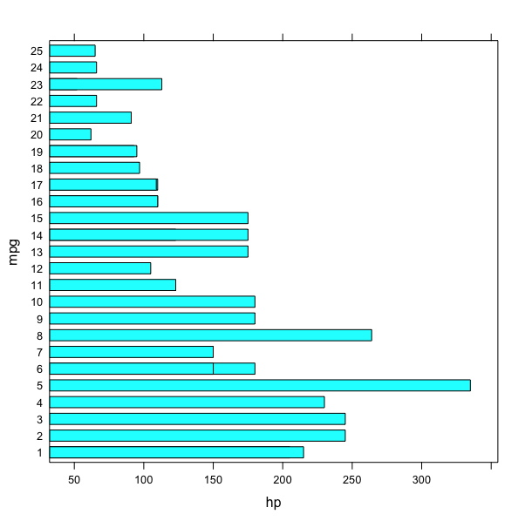
Barchart
Mtcars dataset
barchart(mpg~hp,data=mtcars)

Slide 14
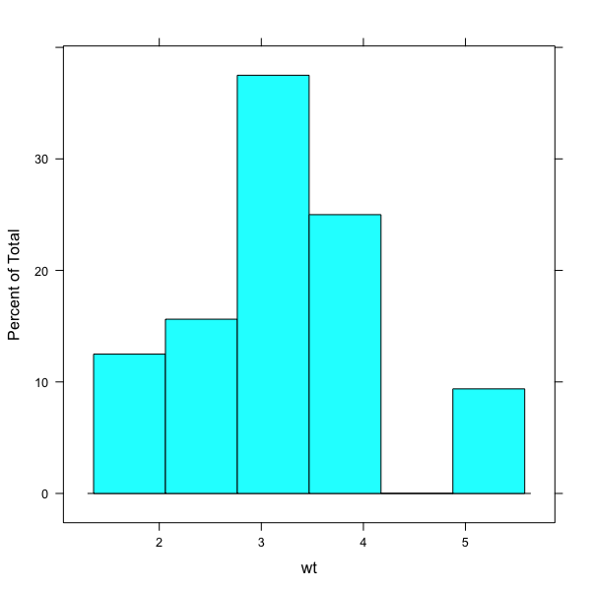
Histogram
library(datasets)
histogram(~wt,data=mtcars)

Slide 15
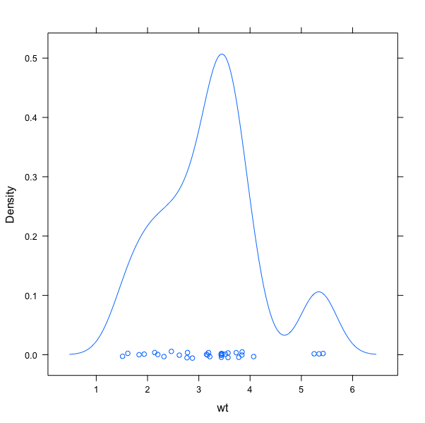
Densityplot
library(datasets)
densityplot(~wt,data=mtcars)

Slide 16
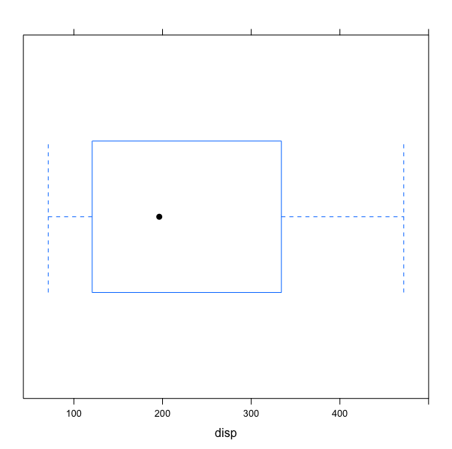
Box plot
library(datasets)
bwplot(~disp,data=mtcars)

Slide 17
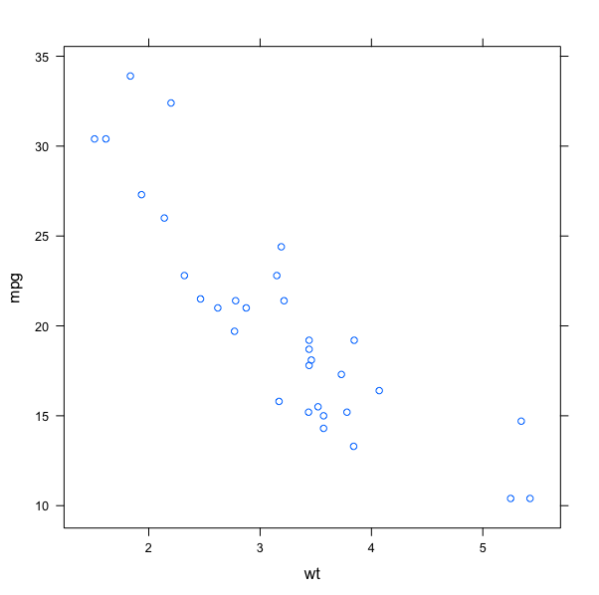
xyplot
library(datasets)
xyplot(mpg~wt,data=mtcars)

Slide 18
Quiz

Slide 19
Thank you
http://bit.ly/content-r

