Slide 1
Statistics in R
Session-2

Slide 2
Contents
Recap (10 mins)
Loop, if-else
Vector (create, access, delete)
Descriptive statistics
Summary
Plotting
Dataframe
Sample/Population

Slide 3

R script
Take three numbers from user (x,u,σ) and compute

Slide 4
Help
sqrt() - To compute square root
exp() - To compute exponential

Slide 5
If-else

Slide 6



If-else
If library is open then I will go to Library.
Condition
Action [True]
If library is open then I will go to Library otherwise I will study at home.
Condition
Action [True]
Action [False]

Slide 7
R script
Check positive and negative number

Slide 8
Loop

Slide 9
Loop
Write ‘some text’ 100 times.
You have series of data and you want to process it.
Target ->100 times
I have written 43
some text
some text
some text
some text
…
…
…
…
...
12 23 34 13 14

Slide 10
R script
Take one number from user and print its multiplication table.

Slide 11
Vector
Data of same type
Create using c() function
Create using seq() function
Create using : operator
Create using rep function
Image: https://slideplayer.com/slide/6614710/

Slide 12
Vector
Access elements from vector
Count elements in vector
Delete elements in vector
Image: https://slideplayer.com/slide/6614710/

Slide 13
Descriptive statistics

Slide 14
Descriptive statistics
Distribution
Central tendency
Dispersion
https://conjointly.com/kb/descriptive-statistics/

Slide 15
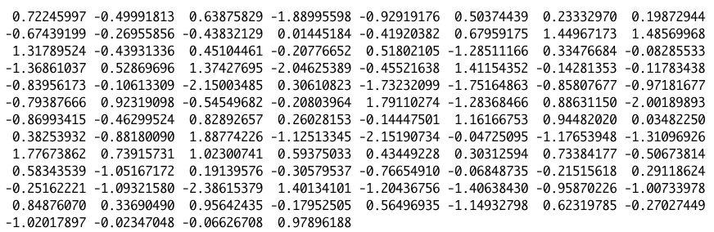
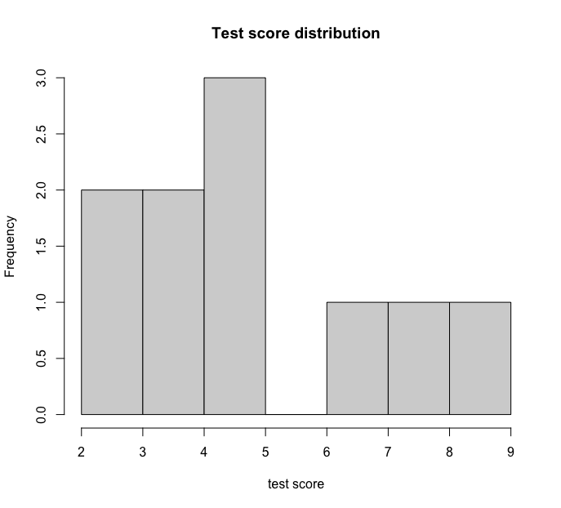
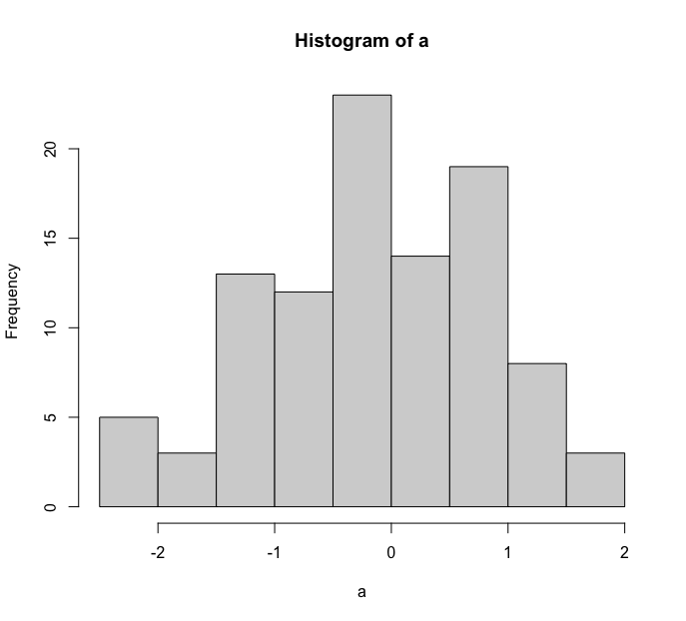
Distribution
Frequency distribution of individual values or range of values
5,7,5,4,3,4,5,3,8,9
Test scores for 10 students

Slide 16
Central tendency
What is the center of distribution?
5,7,5,4,3,4,5,3,8,9
Mean
(5 + 7 +5 + 4 + 3 + 4 + 5 + 3 + 8 + 9)/10 = 5.3
Average
Mode
3 4 5 7 8 9
2 2 3 1 1 1
Most frequently occuring value
Median
3 3 4 4 5 5 5 7 8 9
Middle value in sorted list

Slide 17
Dispersion
How the values are spread in the data?
Range
Range of data
Maximum - minimum
Standard deviation

Slide 18
Standard deviation
175 cm
Person X wants to cross the river.
He has access to the river’s depth data (depth measures at each meter)
180 cm

Slide 19
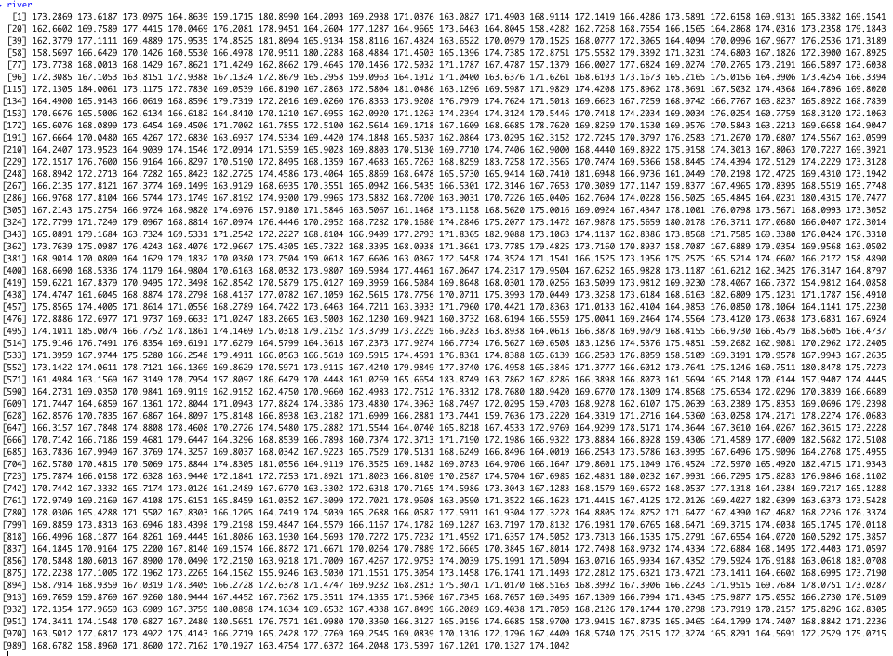

Slide 20
Standard deviation
175 cm
X computed mean of data (170 cm) and decided to cross the river with thought that he will not drown.
180 cm

Slide 21
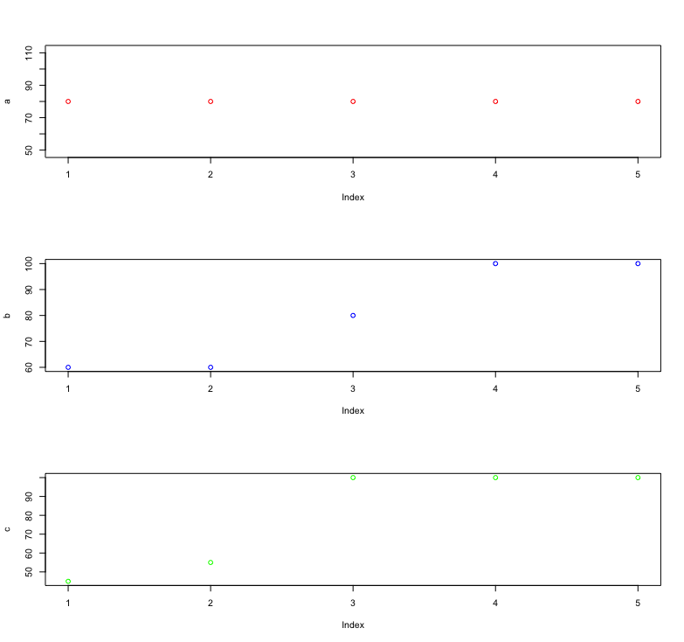
Standard deviation
Mean for all classes is 80
Class A
80 80 80 80 80
SD = 0
Class B
60 60 80 100 100
SD = 20
Class C
45 55 100 100 100
SD = 27.61

Slide 22
Thank you

Slide 23
Thank you
http://bit.ly/3oIiHb2

Slide 24
Practice @datacamp
http://bit.ly/practice-r

