Slide 1
Statistics in R
Session-6

Slide 2
Contents
Normal Distribution
Central limit theorem
Quiz

Slide 3
Normal Distribution

Slide 4
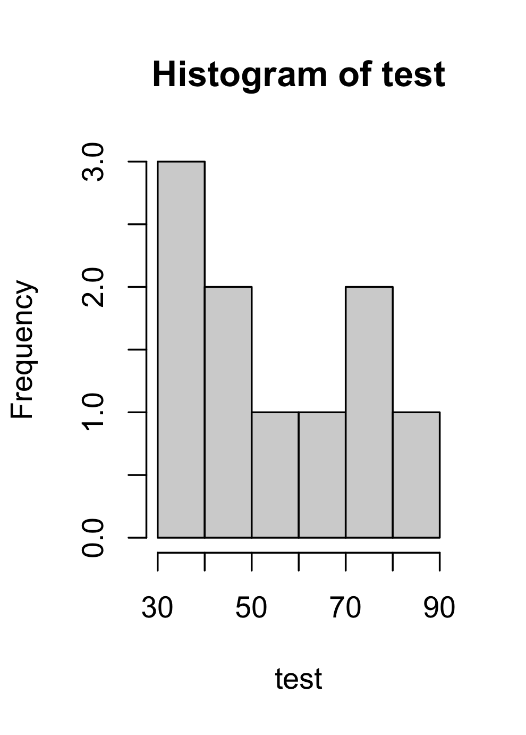
Distribution
Test scores of 10 students out of 100
Questions
What is mean score?
How many of them got less than or equal to 50?
How many of them got higher than or equal to 80?
If a student gets X score then for how many students he got the better test score?

Slide 5
Distribution
Test scores of 10 students out of 100
If a student gets X score then for how many students he got the better test score?

Slide 6
Distribution
[1] 56.26844 73.24661 51.94635 54.46451 56.44043 55.50398 73.33525 60.41886 52.88769 57.77615 81.05177 49.11385 69.43010 67.22300 59.22127
[16] 36.91964 47.55995 62.81985 45.94551 51.62558 67.57688 60.75170 59.78341 58.45357 63.07183 52.29532 54.98907 50.68284 53.10623 53.71678
[31] 51.86648 55.13645 43.28029 49.24425 68.37370 67.72367 61.52411 44.60114 58.27338 63.99415 38.99666 76.32921 76.95709 42.31327 81.20617
[46] 65.97256 36.97965 55.38221 50.95634 53.59854 68.71956 62.05207 61.18919 72.74441 67.06437 53.36207 67.97583 64.26470 77.36011 43.91116
[61] 72.23452 71.17456 68.67093 86.60240 67.05723 56.45881 66.36972 66.99687 54.22995 47.87273 69.67658 53.94076 57.78527 69.22936 66.40686
[76] 63.90719 42.68666 52.70543 73.07294 57.22009 53.15581 60.66210 64.92745 55.25412 56.70426 52.15792 56.43061 66.20525 49.52944 45.94903
[91] 91.30224 50.82510 76.84196 69.59933 57.04537 73.85058 53.61404 38.63163 69.62495 71.88934 51.25638 62.38934 60.43819 50.19983 61.03112
[106] 51.08760 64.56272 74.28302 46.05286 51.24805 52.96165 57.37745 64.16106 70.00706 41.46265 65.02902 61.36354 45.54694 51.62097 60.38418
[121] 60.67057 59.30124 61.55282 52.61038 52.66690 51.60966 61.20325 48.51126 61.96327 70.01785 61.74755 40.64369 77.94245 43.22334 64.49628
[136] 50.09195 58.78783 55.09355 44.84127 69.61331 57.76311 49.95161 63.19921 61.02031 52.99185 100.03492 48.63932 44.61838 53.01276 53.53845
[151] 73.18019 71.81619 79.51563 55.23820 49.40211 44.73964 74.56559 57.54265 51.85659 61.29457 52.14587 66.88474 57.06727 63.91401 62.11477
[166] 66.42730 53.86523 45.73585 51.69396 66.07212 77.78489 56.16869 58.82929 51.51479 58.04688 50.39413 58.15357 88.84975 71.82137 35.41351
[181] 80.86439 56.86433 55.13119 64.43051 66.68353 81.71621 52.89135 65.25009 61.65951 76.90899 57.70455 66.47326 56.43110 65.80727 55.75917
[196] 55.12488 48.11860 74.58676 40.78976 61.59040 53.21937 68.97164 52.31368 70.38567 55.75123 38.51570 66.46461 60.14014 54.48024 57.38555
[211] 53.71811 51.33927 67.44302 67.28114 55.48594 68.63522 53.90163 55.65038 59.85135 68.24982 64.74175 53.48245 66.19512 48.11816 56.75140
[226] 53.82790 61.75244 48.74616 52.44290 56.29542 45.18528 68.00535 48.49881 68.47622 60.62547 72.87806 70.50505 57.06294 58.73722 59.93612
[241] 51.21303 54.98325 65.88532 55.01177 67.82521 57.46977 58.34783 55.03578 59.32860 55.06477 36.18951 68.95625 74.80719 57.59290 58.25809
[256] 53.94323 56.16366 57.90980 47.64944 70.26196 67.48733 64.94314 69.60623 49.45801 67.18625 82.32813 61.50573 53.16356 73.89825 85.95222
[271] 34.24123 71.31019 36.90479 36.04410 41.81188 54.17028 38.37691 65.55993 65.04234 62.86974 42.79767 53.35406 37.23903 81.81768 65.24522
[286] 82.60886 56.26536 59.90782 66.21242 56.17258 55.14241 68.01831 85.02994 51.43770 61.72185 69.28662 47.38747 63.33010 75.67660 52.40014
[301] 57.91750 58.84741 54.93632 69.78974 77.81010 43.93634 49.43597 53.72840 68.85401 63.32790 69.07579 57.85744 53.23525 60.06562 72.00519
[316] 51.19064 52.36984 68.44462 52.99346 48.63069 56.45027 48.97460 52.20818 50.61145 65.28079 51.48238 46.28019 62.45334 61.94775 67.96308
[331] 56.39277 72.64552 61.30827 56.88123 70.50833 70.73102 63.27081 73.61582 47.76629 68.04257 61.81962 69.95225 67.52651 59.36049 77.20304
[346] 52.06971 41.87977 68.78975 54.70887 64.56087 56.07491 46.82069 73.52431 62.25781 56.77756 61.26984 53.50210 65.60681 69.24155 67.36413
[361] 65.19996 56.88273 54.93208 52.43861 61.94697 51.94089 65.29384 44.92138 54.74364 76.72575 48.46230 62.01072 60.67998 50.88920 63.13041
[376] 63.74913 51.91172 56.96467 49.11064 61.56917 60.87238 62.94423 48.07072 81.46430 60.95028 60.87819 73.45084 73.85940 62.33956 63.20531
[391] 56.49497 54.06953 84.10663 45.23643 66.14751 62.93119 58.94790 70.74920 54.59058 44.75234 44.79955 55.44263 65.50712 55.48558 59.80664
[406] 82.58850 64.11088 67.43280 74.78513 60.26665 63.98056 71.44092 64.91254 66.75026 63.97159 46.02159 61.14939 51.84162 72.90609 65.26269
[421] 53.79505 60.75080 60.08359 53.20477 49.55333 46.94688 61.16881 58.78549 82.16532 74.58002 74.84443 62.83866 64.90687 57.54545 53.39982
[436] 71.54813 49.71817 44.00913 65.30547 50.01594 55.80581 59.72133 41.72400 62.26190 49.66938 65.33919 48.31291 60.53085 78.81333 46.40295
[451] 58.94784 54.86976 65.06139 67.25935 56.18704 71.51487 49.89679 64.25830 56.80238 49.95230 77.40518 79.88703 71.47426 65.23586 63.31243
[466] 98.46966 54.18089 60.20525 58.27127 65.95414 59.02291 52.08776 61.78035 68.77702 50.58847 71.46863 65.36018 35.26810 56.48579 38.24791
[481] 75.70730 63.83990 55.47031 57.85427 60.19665 62.00624 52.59808 51.61046 55.86814 68.09525 55.40795 57.41476 65.21978 83.50371 64.89583
[496] 78.66429 47.44132 49.93303 57.86193 66.57463 61.50175 64.50311 71.87261 59.57243 57.04605 72.93078 40.39705 57.08792 53.46235 80.14516
[511] 52.61854 61.28391 59.93821 53.36953 68.46854 64.88050 63.10836 69.49568 64.74837 70.24952 38.71333 62.02626 40.40471 73.82622 51.73216
[526] 53.46878 49.16146 68.53420 63.96680 50.65201 60.05926 35.54161 69.88040 74.98146 57.70865 49.32119 62.69617 58.49777 77.88006 38.25384
[541] 59.85006 64.38637 62.65491 62.89355 72.71231 49.66668 64.34193 77.57018 54.99740 47.34967 54.42002 73.63625 68.17485 44.11804 60.79947
[556] 46.39128 60.93887 65.60764 66.10129 52.50891 76.82532 72.05916 70.05493 69.39641 52.01657 72.33244 60.30695 64.12948 64.36534 65.82973
[571] 55.22162 67.63210 76.36515 70.42665 56.09012 75.01533 61.11017 58.53184 48.11752 72.04054 73.51273 64.18833 63.05644 60.32380 74.84549
[586] 40.89360 79.87792 60.18049 64.94145 63.22312 33.81201 58.06705 36.73623 63.15167 54.32557 76.03333 74.25064 68.61973 70.18000 54.88716
[601] 64.22380 62.10718 58.10443 48.89249 80.19974 45.09049 59.31754 64.12510 76.80825 47.82032 72.75498 49.74964 57.47575 57.21194 62.54495
[616] 70.35971 48.91023 73.15674 62.51587 72.03636 50.12600 68.81727 53.53717 32.14663 42.16661 67.88487 73.87336 62.91832 75.80346 67.19283
[631] 56.14727 65.58124 49.48031 51.73806 66.77741 61.59222 61.62128 59.71270 76.35720 52.59781 50.90218 66.94713 75.22452 56.81243 66.29602
[646] 66.38142 59.69168 45.85317 52.11112 63.82392 50.65204 52.35304 80.66271 66.06140 46.35321 46.44309 66.03939 51.45955 54.37695 64.98618
[661] 60.99173 55.59970 41.61607 58.23820 59.20590 53.74366 76.33580 37.87338 48.34485 58.37855 58.75385 74.68278 58.66752 52.74659 59.83929
[676] 44.20129 60.48609 60.66729 60.92543 74.09193 53.25422 68.55548 71.82604 48.87806 69.28345 57.02961 57.69164 43.01452 57.92936 63.27439
[691] 78.94933 53.48276 53.20743 68.35569 49.85325 51.81940 50.05017 51.53570 66.38686 76.69152 61.86864 65.48366 51.06398 65.76723 68.48197
[706] 52.01601 68.94929 81.21245 63.57375 58.08918 57.91258 46.20827 54.96336 57.23936 61.91931 51.63130 63.25090 75.02995 54.00309 85.59643
[721] 65.47779 56.90104 63.34066 64.55315 55.43176 51.38207 59.68506 73.79813 52.25288 71.27800 55.41785 48.04983 50.42212 62.94725 62.97201
[736] 62.74797 58.22323 56.87425 53.54019 50.60191 54.33368 67.23270 75.56674 43.66573 55.85751 47.01741 52.02441 55.91788 66.14258 59.22578
[751] 68.07605 51.34867 51.20566 69.39225 69.23232 53.11225 74.74331 67.03991 77.86607 64.29375 49.24890 58.70901 64.17626 69.32772 52.12030
[766] 64.11937 65.63499 54.85082 79.27478 61.80231 50.39776 53.15356 61.55019 54.67021 64.50753 60.34005 65.55006 56.09805 61.96777 43.46676
[781] 63.38901 61.71574 37.46101 76.03858 46.32190 52.46348 72.21591 52.65449 53.20863 68.36149 54.21780 56.11828 70.93304 50.14435 41.71537
[796] 48.51277 69.75642 61.05135 59.74146 59.46854 42.38557 69.52185 47.82067 62.52444 71.78089 57.51037 67.18867 66.36242 63.69488 68.10470
[811] 69.73826 51.37115 42.51667 41.61819 66.86839 53.51255 65.87220 54.50861 43.54144 58.55644 79.49557 63.36270 65.96965 58.08987 60.40543
[826] 52.88885 59.19436 52.37271 63.55996 68.54613 77.58228 54.47686 68.30531 59.53908 62.00755 52.43780 52.07016 70.75313 59.31458 53.94424
[841] 59.48563 70.41588 55.88554 63.77173 81.50484 57.30122 69.52007 50.12963 62.36773 78.20777 52.64528 53.66978 51.24986 61.66596 63.90234
[856] 52.09759 56.43871 51.16779 58.28340 79.15153 53.18862 71.81203 72.60088 53.30872 66.26082 50.79182 37.15678 56.06788 53.52517 67.09352
[871] 65.39119 41.62147 67.00651 67.10476 54.94817 55.11779 38.74729 67.06130 42.50507 47.36790 72.77730 82.18994 66.16980 74.56641 48.85659
[886] 62.90125 66.19137 59.34820 51.49085 58.60188 59.26530 61.80886 57.64205 58.23608 66.50189 64.16777 51.69287 52.71977 52.82895 77.56712
[901] 50.49132 53.17970 43.75524 57.00319 64.64818 43.80983 72.70626 60.72943 59.45984 82.91943 67.30111 50.08788 60.16826 64.58705 51.18305
[916] 47.64674 40.42157 55.95558 77.42229 52.22748 51.48466 57.84935 48.58161 60.95200 47.12189 57.90473 60.03604 74.43510 86.38980 57.78622
[931] 66.54480 61.84257 62.38298 68.41950 42.80339 66.82257 53.09522 71.43702 74.27542 73.32285 73.87614 56.95682 59.84656 76.10901 67.00756
[946] 67.77829 49.25191 66.31292 61.00188 60.51162 47.97996 54.74402 54.09930 67.11180 62.26314 59.63594 57.92347 58.27313 53.17098 52.24758
[961] 45.62041 56.11394 71.72463 69.75943 66.07359 71.00226 48.82073 59.82092 54.35795 45.33549 50.78997 71.39734 61.86733 61.76109 65.00865
[976] 45.72222 65.09821 65.69675 56.93082 63.93195 50.30047 70.64693 44.28825 55.09544 74.38666 71.76940 70.51361 61.79989 65.69172 47.20120
[991] 51.17591 64.00931 61.88711 60.01490 57.05465 64.12615 58.40393 56.72710 76.19420 75.39573
Test scores of 1000 students out of 100 in an online course.

Slide 7
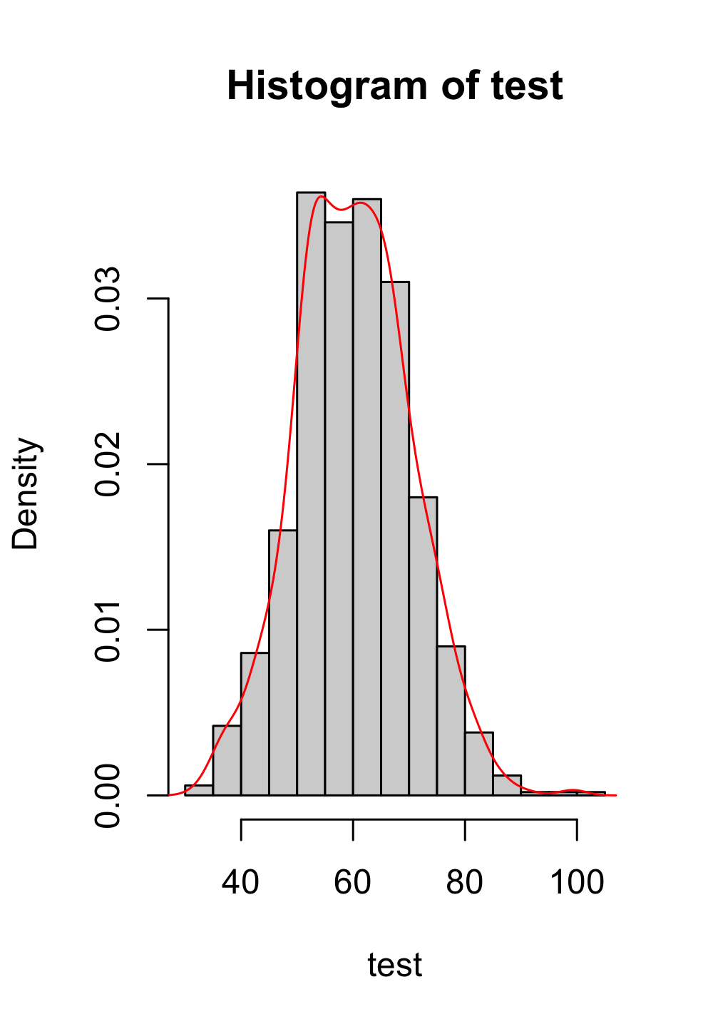
Normal Distribution
[1] 56.26844 73.24661 51.94635 54.46451 56.44043 55.50398 73.33525 60.41886 52.88769 57.77615 81.05177 49.11385 69.43010 67.22300 59.22127
[16] 36.91964 47.55995 62.81985 45.94551 51.62558 67.57688 60.75170 59.78341 58.45357 63.07183 52.29532 54.98907 50.68284 53.10623 53.71678
[31] 51.86648 55.13645 43.28029 49.24425 68.37370 67.72367 61.52411 44.60114 58.27338 63.99415 38.99666 76.32921 76.95709 42.31327 81.20617
[46] 65.97256 36.97965 55.38221 50.95634 53.59854 68.71956 62.05207 61.18919 72.74441 67.06437 53.36207 67.97583 64.26470 77.36011 43.91116
[61] 72.23452 71.17456 68.67093 86.60240 67.05723 56.45881 66.36972 66.99687 54.22995 47.87273 69.67658 53.94076 57.78527 69.22936 66.40686
[76] 63.90719 42.68666 52.70543 73.07294 57.22009 53.15581 60.66210 64.92745 55.25412 56.70426 52.15792 56.43061 66.20525 49.52944 45.94903
[91] 91.30224 50.82510 76.84196 69.59933 57.04537 73.85058 53.61404 38.63163 69.62495 71.88934 51.25638 62.38934 60.43819 50.19983 61.03112
[106] 51.08760 64.56272 74.28302 46.05286 51.24805 52.96165 57.37745 64.16106 70.00706 41.46265 65.02902 61.36354 45.54694 51.62097 60.38418
[121] 60.67057 59.30124 61.55282 52.61038 52.66690 51.60966 61.20325 48.51126 61.96327 70.01785 61.74755 40.64369 77.94245 43.22334 64.49628
[136] 50.09195 58.78783 55.09355 44.84127 69.61331 57.76311 49.95161 63.19921 61.02031 52.99185 100.03492 48.63932 44.61838 53.01276 53.53845
[151] 73.18019 71.81619 79.51563 55.23820 49.40211 44.73964 74.56559 57.54265 51.85659 61.29457 52.14587 66.88474 57.06727 63.91401 62.11477
[166] 66.42730 53.86523 45.73585 51.69396 66.07212 77.78489 56.16869 58.82929 51.51479 58.04688 50.39413 58.15357 88.84975 71.82137 35.41351
[181] 80.86439 56.86433 55.13119 64.43051 66.68353 81.71621 52.89135 65.25009 61.65951 76.90899 57.70455 66.47326 56.43110 65.80727 55.75917
[196] 55.12488 48.11860 74.58676 40.78976 61.59040 53.21937 68.97164 52.31368 70.38567 55.75123 38.51570 66.46461 60.14014 54.48024 57.38555
[211] 53.71811 51.33927 67.44302 67.28114 55.48594 68.63522 53.90163 55.65038 59.85135 68.24982 64.74175 53.48245 66.19512 48.11816 56.75140
[226] 53.82790 61.75244 48.74616 52.44290 56.29542 45.18528 68.00535 48.49881 68.47622 60.62547 72.87806 70.50505 57.06294 58.73722 59.93612
[241] 51.21303 54.98325 65.88532 55.01177 67.82521 57.46977 58.34783 55.03578 59.32860 55.06477 36.18951 68.95625 74.80719 57.59290 58.25809
[256] 53.94323 56.16366 57.90980 47.64944 70.26196 67.48733 64.94314 69.60623 49.45801 67.18625 82.32813 61.50573 53.16356 73.89825 85.95222
[271] 34.24123 71.31019 36.90479 36.04410 41.81188 54.17028 38.37691 65.55993 65.04234 62.86974 42.79767 53.35406 37.23903 81.81768 65.24522
[286] 82.60886 56.26536 59.90782 66.21242 56.17258 55.14241 68.01831 85.02994 51.43770 61.72185 69.28662 47.38747 63.33010 75.67660 52.40014
[301] 57.91750 58.84741 54.93632 69.78974 77.81010 43.93634 49.43597 53.72840 68.85401 63.32790 69.07579 57.85744 53.23525 60.06562 72.00519
[316] 51.19064 52.36984 68.44462 52.99346 48.63069 56.45027 48.97460 52.20818 50.61145 65.28079 51.48238 46.28019 62.45334 61.94775 67.96308
[331] 56.39277 72.64552 61.30827 56.88123 70.50833 70.73102 63.27081 73.61582 47.76629 68.04257 61.81962 69.95225 67.52651 59.36049 77.20304
[346] 52.06971 41.87977 68.78975 54.70887 64.56087 56.07491 46.82069 73.52431 62.25781 56.77756 61.26984 53.50210 65.60681 69.24155 67.36413
[361] 65.19996 56.88273 54.93208 52.43861 61.94697 51.94089 65.29384 44.92138 54.74364 76.72575 48.46230 62.01072 60.67998 50.88920 63.13041
[376] 63.74913 51.91172 56.96467 49.11064 61.56917 60.87238 62.94423 48.07072 81.46430 60.95028 60.87819 73.45084 73.85940 62.33956 63.20531
[391] 56.49497 54.06953 84.10663 45.23643 66.14751 62.93119 58.94790 70.74920 54.59058 44.75234 44.79955 55.44263 65.50712 55.48558 59.80664
[406] 82.58850 64.11088 67.43280 74.78513 60.26665 63.98056 71.44092 64.91254 66.75026 63.97159 46.02159 61.14939 51.84162 72.90609 65.26269
[421] 53.79505 60.75080 60.08359 53.20477 49.55333 46.94688 61.16881 58.78549 82.16532 74.58002 74.84443 62.83866 64.90687 57.54545 53.39982
[436] 71.54813 49.71817 44.00913 65.30547 50.01594 55.80581 59.72133 41.72400 62.26190 49.66938 65.33919 48.31291 60.53085 78.81333 46.40295
[451] 58.94784 54.86976 65.06139 67.25935 56.18704 71.51487 49.89679 64.25830 56.80238 49.95230 77.40518 79.88703 71.47426 65.23586 63.31243
[466] 98.46966 54.18089 60.20525 58.27127 65.95414 59.02291 52.08776 61.78035 68.77702 50.58847 71.46863 65.36018 35.26810 56.48579 38.24791
[481] 75.70730 63.83990 55.47031 57.85427 60.19665 62.00624 52.59808 51.61046 55.86814 68.09525 55.40795 57.41476 65.21978 83.50371 64.89583
[496] 78.66429 47.44132 49.93303 57.86193 66.57463 61.50175 64.50311 71.87261 59.57243 57.04605 72.93078 40.39705 57.08792 53.46235 80.14516
[511] 52.61854 61.28391 59.93821 53.36953 68.46854 64.88050 63.10836 69.49568 64.74837 70.24952 38.71333 62.02626 40.40471 73.82622 51.73216
[526] 53.46878 49.16146 68.53420 63.96680 50.65201 60.05926 35.54161 69.88040 74.98146 57.70865 49.32119 62.69617 58.49777 77.88006 38.25384
[541] 59.85006 64.38637 62.65491 62.89355 72.71231 49.66668 64.34193 77.57018 54.99740 47.34967 54.42002 73.63625 68.17485 44.11804 60.79947
[556] 46.39128 60.93887 65.60764 66.10129 52.50891 76.82532 72.05916 70.05493 69.39641 52.01657 72.33244 60.30695 64.12948 64.36534 65.82973
[571] 55.22162 67.63210 76.36515 70.42665 56.09012 75.01533 61.11017 58.53184 48.11752 72.04054 73.51273 64.18833 63.05644 60.32380 74.84549
[586] 40.89360 79.87792 60.18049 64.94145 63.22312 33.81201 58.06705 36.73623 63.15167 54.32557 76.03333 74.25064 68.61973 70.18000 54.88716
[601] 64.22380 62.10718 58.10443 48.89249 80.19974 45.09049 59.31754 64.12510 76.80825 47.82032 72.75498 49.74964 57.47575 57.21194 62.54495
[616] 70.35971 48.91023 73.15674 62.51587 72.03636 50.12600 68.81727 53.53717 32.14663 42.16661 67.88487 73.87336 62.91832 75.80346 67.19283
[631] 56.14727 65.58124 49.48031 51.73806 66.77741 61.59222 61.62128 59.71270 76.35720 52.59781 50.90218 66.94713 75.22452 56.81243 66.29602
[646] 66.38142 59.69168 45.85317 52.11112 63.82392 50.65204 52.35304 80.66271 66.06140 46.35321 46.44309 66.03939 51.45955 54.37695 64.98618
[661] 60.99173 55.59970 41.61607 58.23820 59.20590 53.74366 76.33580 37.87338 48.34485 58.37855 58.75385 74.68278 58.66752 52.74659 59.83929
[676] 44.20129 60.48609 60.66729 60.92543 74.09193 53.25422 68.55548 71.82604 48.87806 69.28345 57.02961 57.69164 43.01452 57.92936 63.27439
[691] 78.94933 53.48276 53.20743 68.35569 49.85325 51.81940 50.05017 51.53570 66.38686 76.69152 61.86864 65.48366 51.06398 65.76723 68.48197
[706] 52.01601 68.94929 81.21245 63.57375 58.08918 57.91258 46.20827 54.96336 57.23936 61.91931 51.63130 63.25090 75.02995 54.00309 85.59643
[721] 65.47779 56.90104 63.34066 64.55315 55.43176 51.38207 59.68506 73.79813 52.25288 71.27800 55.41785 48.04983 50.42212 62.94725 62.97201
[736] 62.74797 58.22323 56.87425 53.54019 50.60191 54.33368 67.23270 75.56674 43.66573 55.85751 47.01741 52.02441 55.91788 66.14258 59.22578
[751] 68.07605 51.34867 51.20566 69.39225 69.23232 53.11225 74.74331 67.03991 77.86607 64.29375 49.24890 58.70901 64.17626 69.32772 52.12030
[766] 64.11937 65.63499 54.85082 79.27478 61.80231 50.39776 53.15356 61.55019 54.67021 64.50753 60.34005 65.55006 56.09805 61.96777 43.46676
[781] 63.38901 61.71574 37.46101 76.03858 46.32190 52.46348 72.21591 52.65449 53.20863 68.36149 54.21780 56.11828 70.93304 50.14435 41.71537
[796] 48.51277 69.75642 61.05135 59.74146 59.46854 42.38557 69.52185 47.82067 62.52444 71.78089 57.51037 67.18867 66.36242 63.69488 68.10470
[811] 69.73826 51.37115 42.51667 41.61819 66.86839 53.51255 65.87220 54.50861 43.54144 58.55644 79.49557 63.36270 65.96965 58.08987 60.40543
[826] 52.88885 59.19436 52.37271 63.55996 68.54613 77.58228 54.47686 68.30531 59.53908 62.00755 52.43780 52.07016 70.75313 59.31458 53.94424
[841] 59.48563 70.41588 55.88554 63.77173 81.50484 57.30122 69.52007 50.12963 62.36773 78.20777 52.64528 53.66978 51.24986 61.66596 63.90234
[856] 52.09759 56.43871 51.16779 58.28340 79.15153 53.18862 71.81203 72.60088 53.30872 66.26082 50.79182 37.15678 56.06788 53.52517 67.09352
[871] 65.39119 41.62147 67.00651 67.10476 54.94817 55.11779 38.74729 67.06130 42.50507 47.36790 72.77730 82.18994 66.16980 74.56641 48.85659
[886] 62.90125 66.19137 59.34820 51.49085 58.60188 59.26530 61.80886 57.64205 58.23608 66.50189 64.16777 51.69287 52.71977 52.82895 77.56712
[901] 50.49132 53.17970 43.75524 57.00319 64.64818 43.80983 72.70626 60.72943 59.45984 82.91943 67.30111 50.08788 60.16826 64.58705 51.18305
[916] 47.64674 40.42157 55.95558 77.42229 52.22748 51.48466 57.84935 48.58161 60.95200 47.12189 57.90473 60.03604 74.43510 86.38980 57.78622
[931] 66.54480 61.84257 62.38298 68.41950 42.80339 66.82257 53.09522 71.43702 74.27542 73.32285 73.87614 56.95682 59.84656 76.10901 67.00756
[946] 67.77829 49.25191 66.31292 61.00188 60.51162 47.97996 54.74402 54.09930 67.11180 62.26314 59.63594 57.92347 58.27313 53.17098 52.24758
[961] 45.62041 56.11394 71.72463 69.75943 66.07359 71.00226 48.82073 59.82092 54.35795 45.33549 50.78997 71.39734 61.86733 61.76109 65.00865
[976] 45.72222 65.09821 65.69675 56.93082 63.93195 50.30047 70.64693 44.28825 55.09544 74.38666 71.76940 70.51361 61.79989 65.69172 47.20120
[991] 51.17591 64.00931 61.88711 60.01490 57.05465 64.12615 58.40393 56.72710 76.19420 75.39573
Test scores of 1000 students out of 100 in an online course.
Mean = 60.1
Standard deviation = 10.21

Slide 8
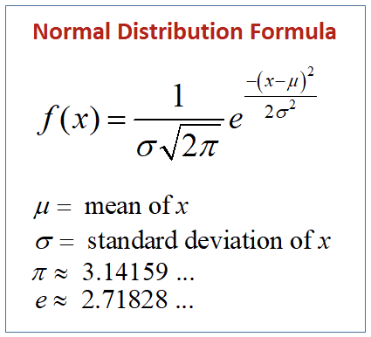
Normal Distribution
Test scores of 1000 students out of 100 in an online course.
No need of data once the distribution is identified. You simply puts the value in the formula and gets the probability.

Slide 9
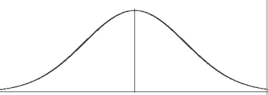
Normal Distribution
Bell curve
50%
50%
mean

Slide 10
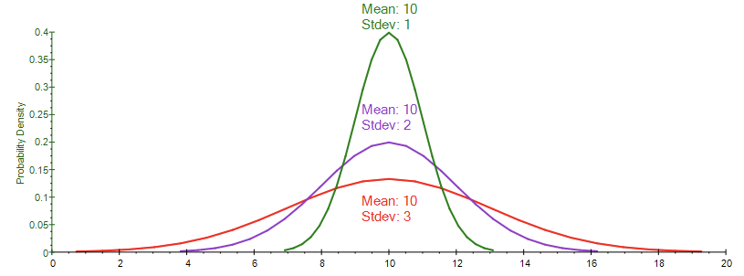

Slide 11
Normal Distribution
Test scores of 1000 students out of 100 in an online course.
Mean = 60.1
Standard deviation = 10.21

Slide 12
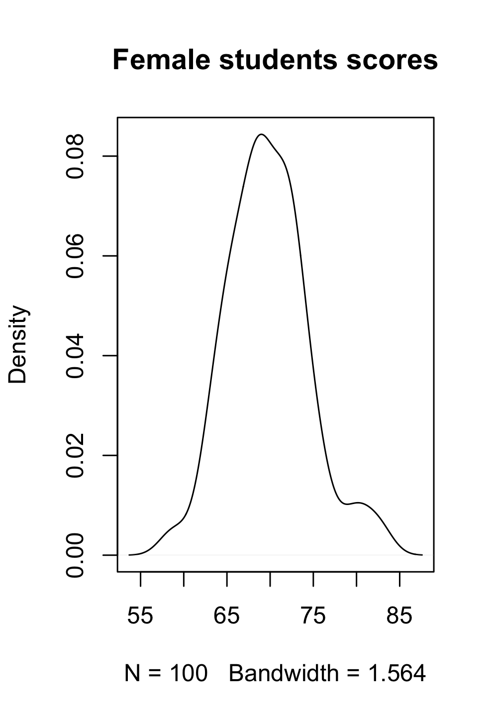
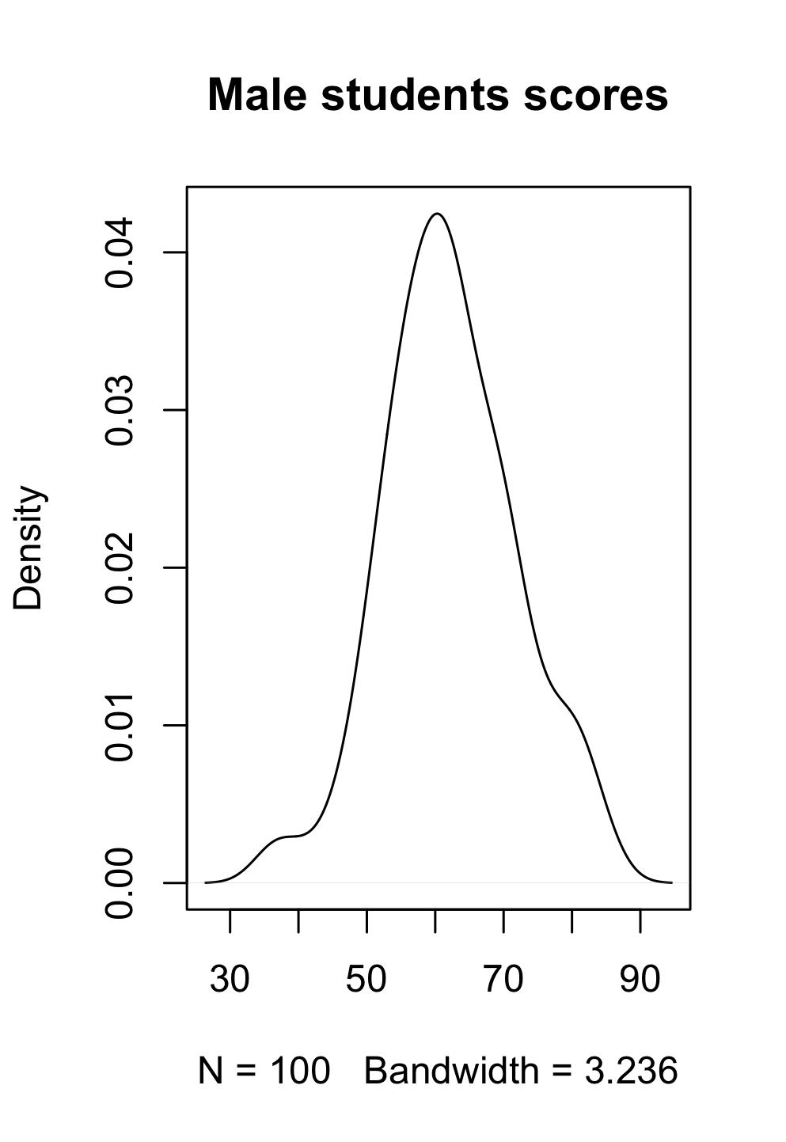
Standard Normal Distribution
How to compare scores from different distribution?
Let’s say a male student got 60 and a female student got 65.
Who got the better scores in their category?
mean = 70
sd = 5
mean = 60
sd = 10

Slide 13

Standard Normal Distribution
Let’s say a male student got 60 and a female student got 65.
Male
mean = 60
sd = 10
Female
mean = 70
sd = 5
μ is the mean of the population.
σ is the standard deviation of the population.

Slide 14
Standard Normal Distribution
Let’s say a male student got 60 and a female student got 65.
Male
mean = 60
sd = 10
Female
mean = 70
sd = 5
μ is the mean of the population.
σ is the standard deviation of the population.
X = 60
X = 65
Z = 0
Z = -1

Slide 15
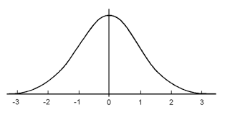
Standard Normal Distribution
Standard normal distribution has mean 0 and standard deviation 1.
μ is the mean of the population.
σ is the standard deviation of the population.

Slide 16
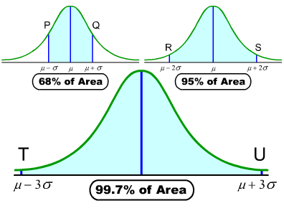
Normal Distribution
μ - σ
μ + σ
μ - 2σ
μ + 3σ
You collected datasets of students height in University X.
μ = 170
σ = 5
165 ----- 175
160 ----- 180
155 ----- 185
Image: https://sites.google.com/a/scholarsnyc.com/college-statistics-weekly-assignments/week-by-week-pacing/module-10-the-normal-distribution

Slide 17
Normal Distribution
What is 99% confidence interval of students’ height in a university( with mean height = 180 and standard deviation 5)
μ = 180
σ = 5
165 ----- 195
Image: https://sites.google.com/a/scholarsnyc.com/college-statistics-weekly-assignments/week-by-week-pacing/module-10-the-normal-distribution

Slide 18
Central limit theorem

Slide 19
Central Limit Theorem
μ = population mean
σ = population standard deviation
Population
sample
sample
sample
sample
sample
.
.
.
sample

Slide 20
Central Limit Theorem
μ = population mean
σ = population standard deviation
Population
mean_1
sample
mean_2
sample
sample
sample
sample
.
.
.
mean_n
sample

Slide 21
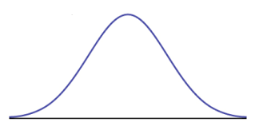
Sampling distribution
mean, standard deviation of sampling distribution
mean_1
mean_2
mean_3
mean_4
…….
mean_n
If your sample is from same population as other sample than there is 99% chance that your sample mean would in
m - 3*sd m + 3 *sd range.

Slide 22
Sampling distribution
mean = ?
standard deviation = ?
mean_1
mean_2
mean_3
mean_4
…….
mean_n
μ = population mean
σ = population standard deviation
Population
mean = μ
standard deviation = σ/ √n

Slide 23
Sampling distribution
Population
Your group collected different samples of size 50 on salary from same population (non-estonian employee working in Tallinn) with mean 10000 and standard deviation 500.
Compute the mean and standard deviation of your sampling distribution
μ = population mean
σ = population standard deviation
Sampling distribution
mean = μ
standard deviation = σ/ √n
μ = 10000
σ = 500

Slide 24
Central Limit Theorem
μ = population mean
σ = population standard deviation
Population
sample
sample
Your sample
sample
sample
sample
.
.
.
There is 99% chance that your sample mean will be in range
m - 3 * s m + 3 * s
sample
μ - 3 * σ √n μ + 3 * σ √n

Slide 25
Central Limit Theorem
μ - 3 * σ √n μ + 3 * σ √n
The mean of male students’ height in university X is 170 and the standard deviation is 10
You collected data of 50 students’ height from same university. What is 99% confidence interval for the students’ height mean from your sample.

Slide 26
Review
Bell curve
Area (1 sd 68, 2 sd 95, 3 sd 99)
Sampling distribution
Sampling distribution = normal(μ, σ²/n)

Slide 27
Thank you
http://bit.ly/content-r

