Slide 1
Statistics in R
Session-3

Slide 2
Contents
Descriptive statistics
Summary
Plotting
Dataframe
Sample/Population

Slide 3
Descriptive statistics

Slide 4
Central tendency
What is the center of distribution?
5,7,5,4,3,4,5,3,8,9
Mean
(5 + 7 +5 + 4 + 3 + 4 + 5 + 3 + 8 + 9)/10 = 5.3
Average
Mode
3 4 5 7 8 9
2 2 3 1 1 1
Most frequently occuring value
Median
3 3 4 4 5 5 5 7 8 9
Middle value in sorted list

Slide 5
Dispersion
How the values are spread in the data?
Range
Range of data
Maximum - minimum
Standard deviation

Slide 6

Standard deviation
175 cm
Person X wants to cross the river.
He has access to the river’s depth data (depth measures at each meter)
180 cm

Slide 7
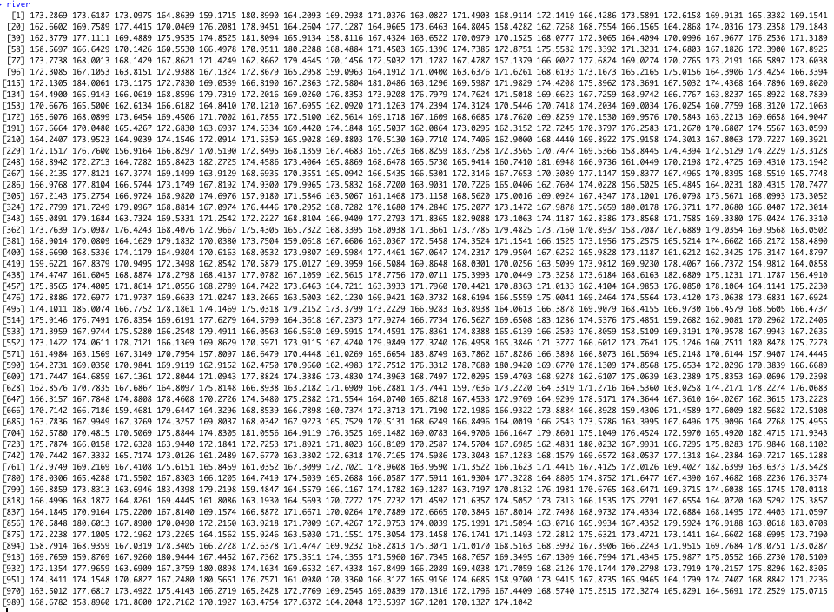

Slide 8
Standard deviation
175 cm
X computed mean of data (170 cm) and decided to cross the river thinking that he will not drown.
180 cm

Slide 9
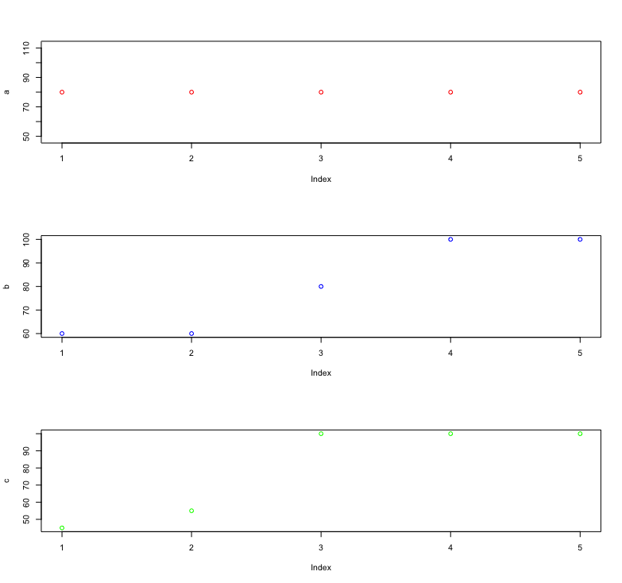
Standard deviation
Mean for all classes is 80
Class A
80 80 80 80 80
SD = 0
Class B
60 60 80 100 100
SD = 20
Class C
45 55 100 100 100
SD = 27.61

Slide 10
Dataframe

Slide 11
Dataframe
Variable
name | age | salary | expenses
Mac | 21 | 15000 | 600
Ravi | 25 | 18000 | 800
David | 27 | 17000 | 600
Moorey | 43 | 33000 | 1200
Nolan | 33 | 24000 | 900

Slide 12
Dataframe
Variable (Vector in R)
name | age | salary | expenses
Mac | 21 | 15000 | 600
Ravi | 25 | 18000 | 800
David | 27 | 17000 | 600
Moorey | 43 | 33000 | 1200
Nolan | 33 | 24000 | 900

Slide 13
Dataframe
Instance
name | age | salary | expenses
Mac | 21 | 15000 | 600
Ravi | 25 | 18000 | 800
David | 27 | 17000 | 600
Moorey | 43 | 33000 | 1200
Nolan | 33 | 24000 | 900

Slide 14
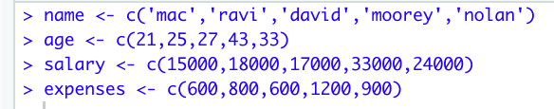
How to create dataframe?
Create vectors for each variables
Name | Age | Salary | Expenses
Mac | 21 | 15000 | 600
Ravi | 25 | 18000 | 800
David | 27 | 17000 | 600
Moorey | 43 | 33000 | 1200
Nolan | 33 | 24000 | 900
Create dataframe using vectors

Slide 15
How to read data in R?
Rio package
install.packages(‘rio’)
install_formats()

Slide 16
Basic operations
Check data types of columns
str()
Check size of datasets (number of instances, number of variables)
dim()
Get variable names
colnames()
Get summary stats for dataset
summary()
Compute variance, correlation, standard deviation
cor(), cov(), sd()
Access a single column
variable_name$column_name

Slide 17
Cars dataset

Slide 18
Assignment

Slide 19
Thank you
http://bit.ly/content-r

Slide 20
Practice @datacamp
http://bit.ly/practice-r

