Slide 1


Exploring Indicators for Collaboration Quality and its Dimensions in Classroom Settings using Multimodal Learning Analytics Pankaj Chejara1, Luis P. Prieto, María Jesús Rodríguez-Triana, Adolfo Ruiz-Calleja, Reet Kasepalu, Irene-Angelica Chounta, and Bertrand Schneider
Tallinn University, Estonia
University of Duisburg-Essen, Germany
Harvard University, USA
PRG1634

Slide 2

Collaborative learning activities integrated in teaching practices.
Teachers are expected to orchestrate and monitor groups.
Collaboration is a high-level construct with multiple aspects [2].
Collaboration
Image: Freepik.com

Slide 3
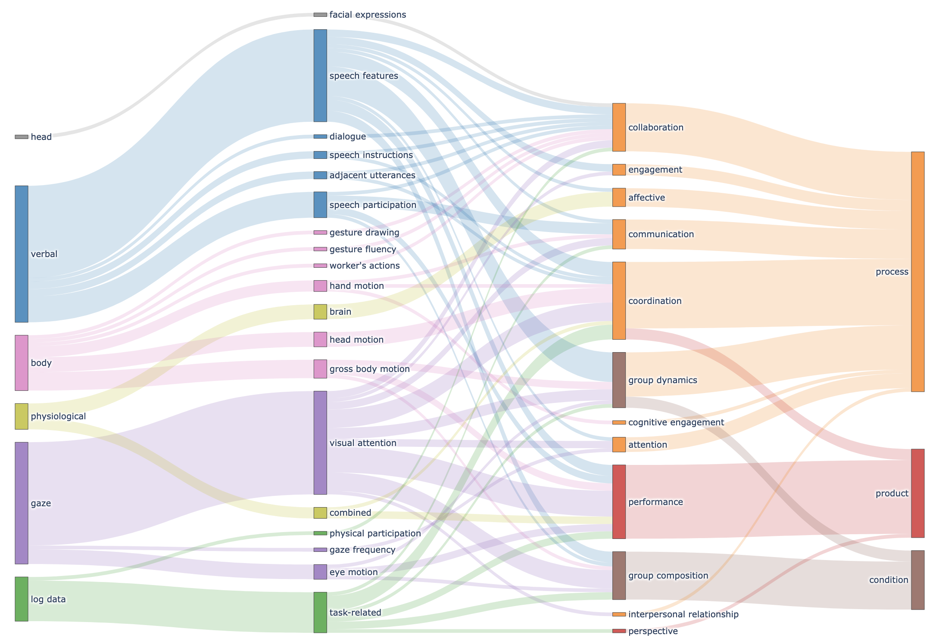
Majority in laboratory settings (Schneider et al., 2021)

Slide 4
RQ1: What are the relationship between multimodal data (video and logs) and collaboration quality and its dimensions of small groups in authentic settings?
RQ2: To what extent, video-log features reveal differences in terms of collaboration quality and its dimensions?
Research Questions

Slide 5

20
69
Estonian upper secondary school classroom
Groups
Students
3
3
Study Context
Subjects
[ Biology, office work, homeroom teacher lessons ]
Teachers

Slide 6


Facial action units
Head orientation
Mouth area region
Video
Web-based tool
Logs
Characters written
Multimodal data
Characters deleted
Features
Data collection

Slide 7
Argumentation
Sustaining mutual understanding
Rummel et al., 2009 rating scheme
30 seconds temporal window
Dimensions score on 5-likert scale [-2,-1,0,1,2]
Collaboration flow
Cooperative orientation
Knowledge exchange
Structuring problem solving and time management
Individual task orientation
Collaboration quality dimension
Annotation

Slide 8
RQ1
Argumentation
Sustaining mutual understanding
Facial action units
Correlation Analysis
Head orientation
Collaboration flow
Mouth area region
Cooperative orientation
Knowledge exchange
Characters written
RQ2
Structuring problem solving and time management
Characters deleted
Clustering Analysis
Individual task orientation
Features
Collaboration quality dimension
Analysis

Slide 9
Inner brow raiser
Vertical head movement
Horizontal head movement
Structuring problem solving
(ρ= -.38)
Collaboration quality
(ρ= .31)
Individual task orientation
(ρ= .31)
Sustaining mutual understanding
(ρ= .30)
Characters
Mouth area
Individual task orientation
(ρ= .31)
Collaboration quality
(ρ= .30)
Argumentation
(ρ= .31)
CORRELATION ANALYSIS RESULTS
Individual task orientation
(ρ= .34)

Slide 10

Vertical head movement
Head movements (nods) as non-verbal cues for understanding (Duncan, 1972).
Participants looking at their laptop’s screen and their group’s member frequently.
CORRELATION ANALYSIS RESULTS
Image: Freepik.com

Slide 11
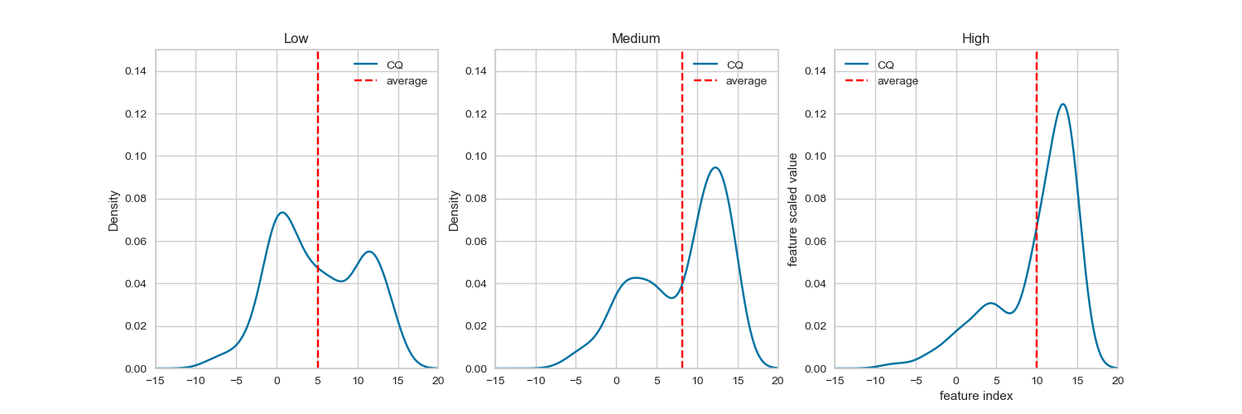
3
Clusters
CLUSTER ANALYSIS RESULTS

Slide 12
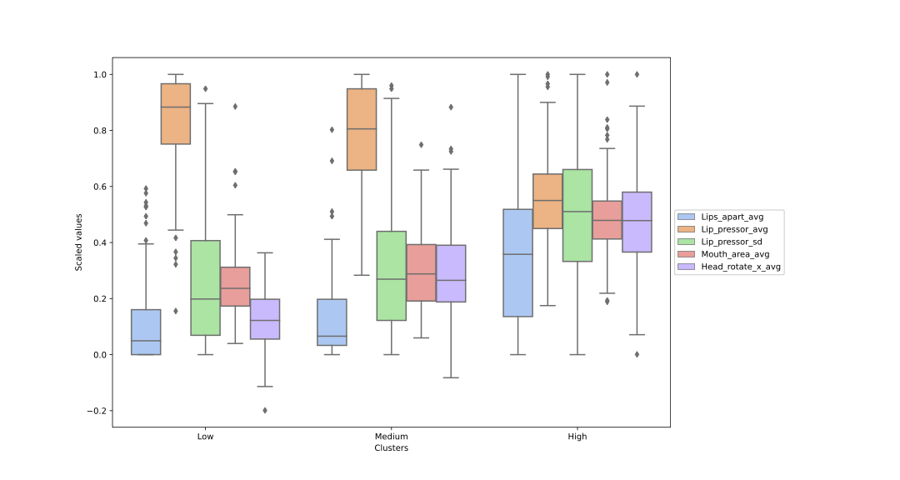
Lips apart ( )
Lip Presser-avg ( )
Lip presser-sd ( )
Mouth area ( )
Vertical head rotation( )
CLUSTER ANALYSIS RESULTS

Slide 13
1
2
3
Seating arrangement might have influenced the results
Limited scope of generalizability
Independent multimodal feature analysis
LIMITATIONS

Slide 14
Explored relationship between multimodal data feature and collaboration quality in classroom settings.
Video features, vertical head movement and mouth area region, emerged as collaboration quality indicators.
Log-based features mainly found to associated with individual task orientation.
Clustering-based analysis revealed potential of video features towards differentiating high/medium/low levels of collaboration quality.
CONCLUSION

