Slide 1


Impact of temporal window size on the generalizability of collaboration quality estimation models developed using Multimodal Learning Analytics
Pankaj chejara¹, Luis p. Prieto¹, Maria jesús rodríguez-triana¹, Adolfo ruiz-calleja¹, Mohammad Khalil²
¹ Tallinn University, Tallinn, Estonia
² University of Bergen, Norway
PRG1634

Slide 2



Introduction
Difficult to orchestrate, monitor and support students in classroom during collaborative learning (Chounta et al., 2015).
Multimodal Learning Analytics research has shown feasibility of estimating collaboration.
Multimodal data sources (Schneider et al., 2015; DiMitri et al., 2018)
Multimodal data fusion (Mu et al., 2020)
Collaboration indicators (Praharaj et al., 2021)
Machine learning model development & evaluation (Chejara et al., 2021)
Temporal window size
Images: www.freepik.com
Notes:
Images:
https://www.freepik.com/free-vector/team-concept-illustration_6170343.htm#query=group%20work&position=42&from_view=search&track=ais
https://www.freepik.com/free-vector/brainstorming-concept-landing-page_5582436.htm#query=group%20work&position=41&from_view=search&track=ais
https://www.freepik.com/free-vector/team-concept-illustration_8961437.htm#query=group%20work&position=26&from_view=search&track=ais

Slide 3

Related work
Single Learning Context
Multimodal data collection
Windowing
Feature extraction & Merging
Model development
Model evaluation
Target construct | Data | Window size | Modeling technique | Evaluation | Paper
Collaboration quality | audio,logs | 30 | SVM | hold-out | Chejara et al., 2021
Collaboration quality | audio,logs | 30 | Random forest | 10-fold CV | Viswanathan et al., 2018
Task performance | audio, video, Kinect | 240 | Neural Network | 4-fold CV | Spikol et al., 2018
Collaboration quality | audio, Video, mouse clicks | 60 | SVM | 10-fold CV | Grover et al., 2016
Collaboration quality | audio | 30 | AdaBoost | 5-fold CV | Smith et al., 2016
Collaboration quality | audio | 30 | SVM, Random Forest | hold-out | Bassiou et al., 2016
Collaboration quality | audio, logs | 30 | Naive Bayes, Decision Tree | 10-fold CV, leave-one-group-out | Martinez-Maldonado et al., 2011
Notes:
Lack of research window size exploration for collaboration modeling across contexts.
Heterogeneity of results motivated to gain a more systematic and broader understanding on

Slide 4
Research questions
RQ1: What is impact of various window sizes (30s, 60s, 90s, 120s, 180s, 240s) on the performance of classification models for collaboration quality ?
RQ2: What is impact of various window sizes (30s, 60s, 90s, 120s, 180s, 240s) on the performance of classification models for collaboration quality dimensions (e.g. argumentation)?
Learning context
Learning space
Lecturer
Participants
Type of learning activity
Learning setting (classroom, lab)
Subject

Slide 5
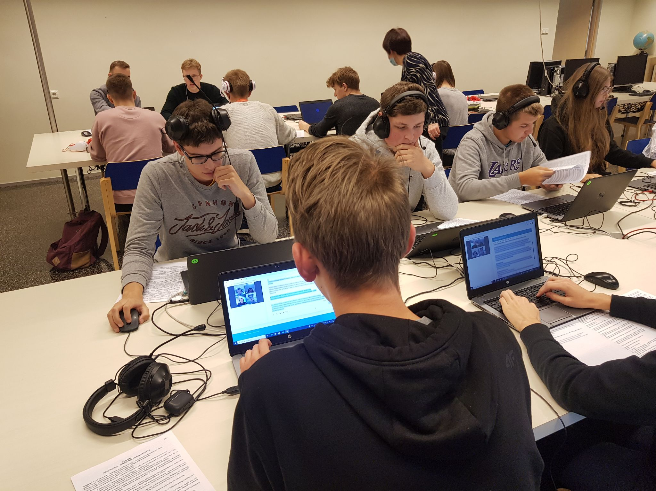




Datasets
Estonian vocational school
3 classroom sessions with collaborative learning activities
26 total students
3 different classrooms
3 different subject teachers
Annotation
Datasets
(Features & Labels)
Feature extraction
Speaking time, Turn-taking,
Use of ‘I’ and ‘We’, Use of Wh-words, character written or deleted
30s, 60s, 90s, 120s,180s,240s

Slide 6
Methods
Annotation
Collaboration quality
Aspects
Communication
Interpersonal relationship
Coordination
Motivation
Joint information processing
Dimensions
Argumentation
Sustaining mutual understanding
Cooperative orientation
Structuring problem solving and time management
Individual task orientation
Knowledge exchange
Collaboration flow
Rummel et al. (2011) rating scheme
Cohen’s Kappa > .65

Slide 7
Methods
Evaluation
Learning context
Learning context
Learning context
Learning context
Dataset
Dataset
Dataset
Dataset
Model development
Model evaluation
Model development
Model validation
K-fold CV
Leave-one-contex-out
Within context performance
Across context performance
Evaluation Metric: AUC ROC
0.5 (chance performance) – 1 (all correct classification)

Slide 8
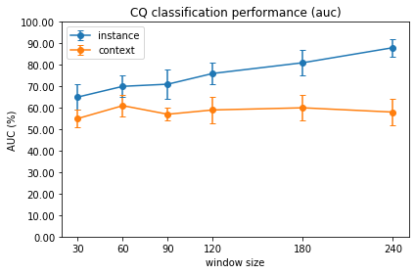
Results
RQ1: What window size improves within and across contexts performance of estimation models for collaboration quality?
Within context performance
Across context performance

Slide 9
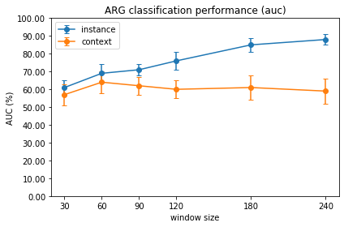
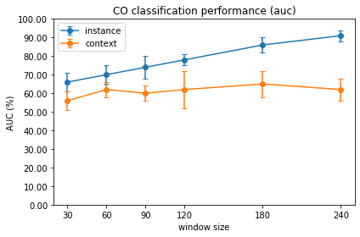
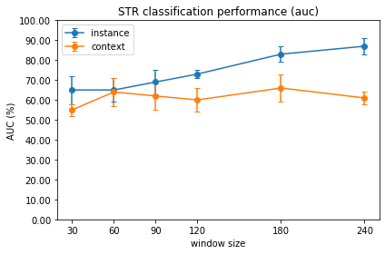
Results
RQ2: What window size improves within and across contexts performance of estimation models for collaboration quality dimensions?
60s for argumentation
180s for cooperative orientation, collaboration flow, knowledge exchange, structuring problem solving, and sustaining mutual understanding.

Slide 10
Limitations
Small dataset size
Criteria for learning context
Specific type of data (audio & log)
Use of specific ML algorithm

Slide 11
Conclusion
Impact of different window sizes (30s, 60, 90, 120,180, 240) on generalizability of collaboration quality models.
Finding-1
A large window (240s) for modeling collaboration quality for similar learning contexts.
Finding-2
A 60s window size for building more generalizable collaboration quality and argumentation classification models.
Finding-3
A window size of 180/240s for modeling joint information processing, interpersonal relationship and coordination aspects.
Novelty
To our knowledge, no such study (for collaboration quality dimensions and multimodal data) has been done yet.
Investigate the impact of window size from generalizability perspective.

Slide 12
Future work
Small dataset size
With a larger dataset from wider range of learning contexts
Criterial for learning context
Specific type of data (audio & log)
Use of other data (e.g., video)
Use of specific ML algorithm
Study using other ML algorithms

Slide 13
Thank you
Pankaj Chejara
pankajch@tlu.ee

Slide 14
References
Irene-Angelica Chounta and Nikolaos M. Avouris. 2015. Towards a Time Series Approach for the Classification and Evaluation of Collaborative Activities. Comput. Informatics 34, 3 (2015), 588–614. http://www.cai.sk/ojs/index.php/cai/article/view/3222
Nikol Rummel, Anne Deiglmayr, Hans Spada, George Kahrimanis, and Nikolaos Avouris. 2011. Analyzing collaborative interactions across domains and settings: An adaptable rating scheme. Springer US, Boston, MA, 367–390.
Worsley, M. and Martinez-Maldonado, R., 2018. Multimodal Learning Analytics' Past, Present, and Potential Futures. CrossMMLA@ LAK, 2.
Daniel Spikol, Emanuele Ruffaldi, Giacomo Dabisias, and Mutlu Cukurova. 2018. Supervised machine learning in multimodal learning analytics for estimating success in project-based learning. Journal of Computer Assisted Learning 34, 4 (2018), 366–377.
Roberto Martínez-Maldonado, Yannis A. Dimitriadis, Alejandra Martínez-Monés, Judy Kay, and Kalina Yacef. 2013. Capturing and analyzing verbal and physical collaborative learning interactions at an enriched interactive tabletop. Int. J. Comput. Support. Collab. Learn. 8, 4 (2013), 455–485. http://dblp.uni-trier.de/db/journals/cscl/cscl8.html#MaldonadoDMKY13
Su Mu, Meng Cui, and Xiaodi Huang. 2020. Multimodal data fusion in learning analytics: A systematic review. Sensors 20, 23 (2020), 6856.
Sambit Praharaj, Maren Scheffel, Hendrik Drachsler, and Marcus Specht. 2021. Literature review on co-located collaboration modeling using multimodal learning analytics—can we go the whole nine yards? IEEE Transactions on Learning Technologies 14, 3 (2021), 367–385.
Bertrand Schneider, Gahyun Sung, Edwin Chng, and Stephanie Yang. 2021. How Can High-Frequency Sensors Capture Collaboration? A Review of the Empirical Links between Multimodal Metrics and Collaborative Constructs. Sensors 21 (2021), 32 pages.
J Smith, H Bratt, C Richey, N Bassiou, E Shriberg, A Tsiartas, C D’Angelo, and N Alozie. 2016. Spoken interaction modeling for automatic assessment of collaborative learning. Proceedings of the International Conference on Speech Prosody 2016-January (2016), 277–281. https://doi.org/10.21437/SpeechProsody.2016-57
Sree Aurovindh Viswanathan and Kurt VanLehn. 2018. Using the Tablet Gestures and Speech of Pairs of Students to Classify Their Collaboration. IEEE Trans. Learn. Technol. 11, 2 (2018), 230–242. https://doi.org/10.1109/TLT.2017.2704099
Nikoletta Bassiou, Andreas Tsiartas, Jennifer Smith, Harry Bratt, Colleen Richey, Elizabeth Shriberg, Cynthia D’Angelo, and Nonye Alozie. 2016. Privacy-Preserving Speech Analytics for Automatic Assessment of Student Collaboration. In Interspeech 2016, 17th Annual Conference of the International Speech Communication Association, Nelson Morgan (Ed.). ISCA, San Francisco, CA, USA, 888–892.https://doi.org/10.21437/Interspeech.2016-1569
Pankaj Chejara, Luis P. Prieto, Adolfo Ruiz-Calleja, María Jesús Rodríguez-Triana, Shashi Kant Shankar, and Reet Kasepalu. 2021. EFAR-MMLA: An Evaluation Framework to Assess and Report Generalizability of Machine Learning Models in MMLA. Sensors 21, 8 (Apr 2021), 2863. https://doi.org/10.3390/s21082863

