Slide 1
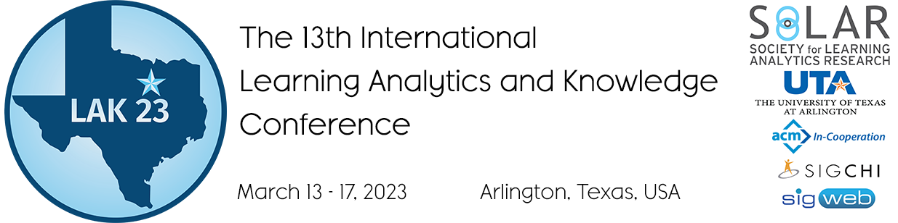
How to Build More Generalizable Models for Collaboration Quality? Lessons Learned from Exploring Multi-Context Audio-Log Datasets using Multimodal Learning Analytics
Pankaj chejara, Luis p. Prieto, Maria jesús rodríguez-triana, Adolfo ruiz-calleja, Reet Kasepalu, Shashi Kant Shankar
Tallinn University, Tallinn, Estonia
PRG1634

Slide 2

Introduction
Multimodal Learning Analytics has enabled a more holistic understanding of collaboration.
Collaboration indicators
Speaking time
Eye-gaze synchrony (Schneider et al., 2015)
Distance between hands (Spikol et al., 2018)
Automated estimation models (Viswanathan et al., 2018; Liu et al., 2021)
Generalizability
Development
Automated estimation models
Physical space
Deployment
Digital space
Interaction space
Learning context
Learning context
"Icon made by Pixel perfect from www.flaticon.com"

Slide 3

Related work
Single Learning Context
MMLA pipeline
Multimodal data collection
Windowing
Feature extraction & Merging
Model development
Model evaluation
Target construct | Data | Window size | Modeling technique | Evaluation | Paper
Collaboration quality | audio,logs | 30 | SVM | hold-out | Chejara et al., 2021
Collaboration quality | audio,logs | 30 | Random forest | 10-fold CV | Viswanathan et al., 2018
Task performance | audio, video, Kinect | 240 | Neural Network | 4-fold CV | Spikol et al., 2018
Collaboration quality | audio, Video, mouse clicks | 60 | SVM | 10-fold CV | Grover et al., 2016
Collaboration quality | audio | 30 | AdaBoost | 5-fold CV | Smith et al., 2016
Collaboration quality | audio | 30 | SVM, Random Forest | hold-out | Bassiou et al., 2016
Collaboration quality | audio, logs | 30 | Naive Bayes, Decision Tree | 10-fold CV, leave-one-group-out | Martinez-Maldonado et al., 2011

Slide 4
Research questions
RQ1: How do collaboration estimation models which are developed using a standard MMLA pipeline perform across different contexts?
RQ2: Which MMLA pipelines offer further improvement in model’s performance across contexts?
RQ3: What is the impact of a pipeline step and contextual features on the model’s performance across contexts?
Learning context
Learning space
Lecturer
Participants
Type of learning activity
Learning setting (classroom, lab)
Subject

Slide 5
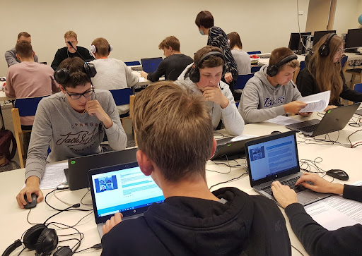



Datasets
Estonian vocational school
14 classroom sessions with collaborative learning activities
105 total students
6 different classrooms
5 different subject teachers
Data collection

Slide 6
Methods
Annotation
Collaboration quality
Aspects
Communication
Interpersonal relationship
Coordination
Motivation
Joint information processing
Dimensions
Argumentation
Sustaining mutual understanding
Cooperative orientation
Structuring problem solving and time management
Individual task orientation
Knowledge exchange
Collaboration flow
Rummel et al. (2011) rating scheme
Cohen’s Kappa > .65

Slide 7
Methods
Modeling
Contextual features
Speech-to-text
Speaking time,
Turn-taking,
Chars written,
Chars deleted,
Freq of “I”, “We”, “wh”
Data collection
Voice activity detection
Writing behavior
Context
Data collection
Pre-processing
Feature extraction

Slide 8
Methods
Modeling
Add contextual features
Hyper-parameter tuning
Outlier handling
Data scaling
Model training
Threshold selection
Pipeline generator
Pipeline-1
Pipeline-2
.
.
.
Contextual features
Generalizability evaluation
Speech-to-text
Speaking time,
Turn-taking,
Chars written,
Chars deleted,
Freq of “I”, “We”, “wh”
Data collection
Voice activity detection
Writing behavior
Pipeline-32
Context
Data collection
Pre-processing
Feature extraction
Model development with different pipelines
Model evaluation

Slide 9
Methods
Evaluation
Learning context
Learning context
Learning context
…
Learning context
Dataset
Dataset
Dataset
…
Dataset
Model development
Model evaluation
Model development
Model evaluation
K-fold CV
Leave-one-context-out
Within context performance
Across context performance

Slide 10
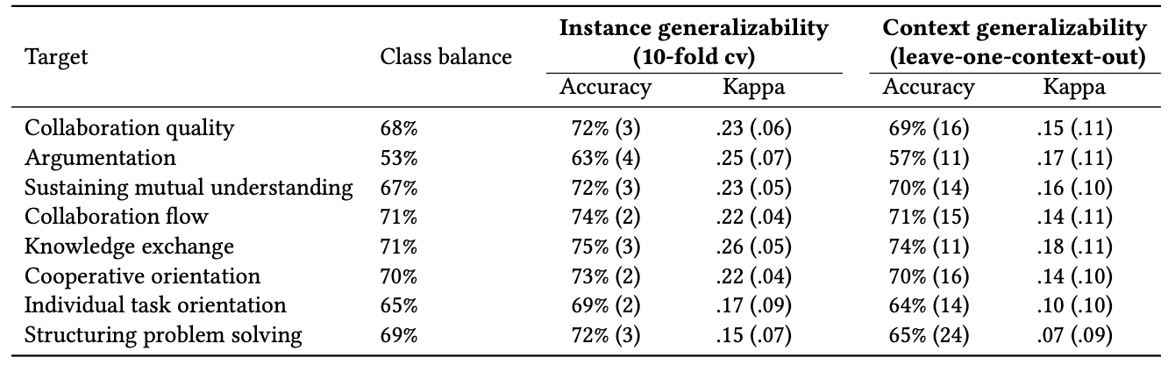
Results
RQ1: How do collaboration estimation models which are developed using a standard MMLA pipeline perform across different contexts?
Kappa going Fair to Poor.

Slide 11
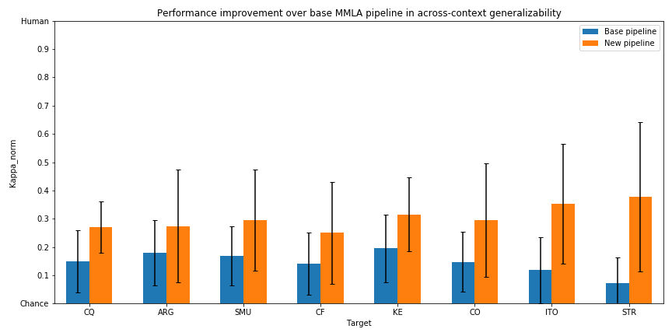
Results
RQ2: Which MMLA pipelines offer further improvement in model’s performance across contexts?
Contextual_features -> Max_abs-> HP -> Threshold

Slide 12
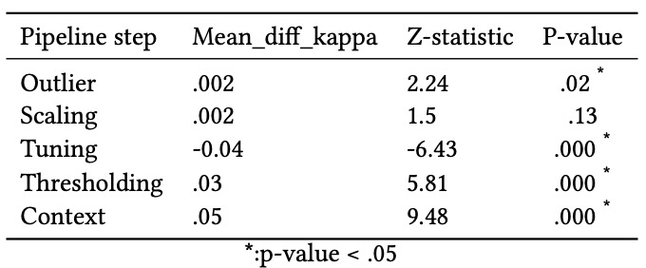
Results
RQ3: What is the impact of a pipeline step and contextual features on the model’s performance across contexts?

Slide 13
Limitations & Future work
Single Estonian school
With a larger dataset from wider range of learning contexts
Criterial for learning context
Specific type of data (audio & log)
Use of other data (e.g., video, speech)
Use of specific ML algorithm
Study using other ML algorithms

Slide 14
Conclusion
Generalizability of collaboration quality estimation models using MMLA typical pipeline.
Explored 32 different pipelines and identified pipelines which improved the generalizability of the models.
Contextual features found to have statistically significant positive impact on the model’s generalizability.
Future goal: Development of an automated guiding system to support teachers in interventions during collaborative learning activities.

Slide 15
Thank you
Pankaj Chejara
pankajch@tlu.ee

Slide 16
References
Irene-Angelica Chounta and Nikolaos M. Avouris. 2015. Towards a Time Series Approach for the Classification and Evaluation of Collaborative Activities. Comput. Informatics 34, 3 (2015), 588–614. http://www.cai.sk/ojs/index.php/cai/article/view/3222
Nikol Rummel, Anne Deiglmayr, Hans Spada, George Kahrimanis, and Nikolaos Avouris. 2011. Analyzing collaborative interactions across domains and settings: An adaptable rating scheme. Springer US, Boston, MA, 367–390.
Worsley, M. and Martinez-Maldonado, R., 2018. Multimodal Learning Analytics' Past, Present, and Potential Futures. CrossMMLA@ LAK, 2.
Daniel Spikol, Emanuele Ruffaldi, Giacomo Dabisias, and Mutlu Cukurova. 2018. Supervised machine learning in multimodal learning analytics for estimating success in project-based learning. Journal of Computer Assisted Learning 34, 4 (2018), 366–377.
Roberto Martínez-Maldonado, Yannis A. Dimitriadis, Alejandra Martínez-Monés, Judy Kay, and Kalina Yacef. 2013. Capturing and analyzing verbal and physical collaborative learning interactions at an enriched interactive tabletop. Int. J. Comput. Support. Collab. Learn. 8, 4 (2013), 455–485. http://dblp.uni-trier.de/db/journals/cscl/cscl8.html#MaldonadoDMKY13
Su Mu, Meng Cui, and Xiaodi Huang. 2020. Multimodal data fusion in learning analytics: A systematic review. Sensors 20, 23 (2020), 6856.
Sambit Praharaj, Maren Scheffel, Hendrik Drachsler, and Marcus Specht. 2021. Literature review on co-located collaboration modeling using multimodal learning analytics—can we go the whole nine yards? IEEE Transactions on Learning Technologies 14, 3 (2021), 367–385.
Bertrand Schneider, Gahyun Sung, Edwin Chng, and Stephanie Yang. 2021. How Can High-Frequency Sensors Capture Collaboration? A Review of the Empirical Links between Multimodal Metrics and Collaborative Constructs. Sensors 21 (2021), 32 pages.
J Smith, H Bratt, C Richey, N Bassiou, E Shriberg, A Tsiartas, C D’Angelo, and N Alozie. 2016. Spoken interaction modeling for automatic assessment of collaborative learning. Proceedings of the International Conference on Speech Prosody 2016-January (2016), 277–281. https://doi.org/10.21437/SpeechProsody.2016-57
Sree Aurovindh Viswanathan and Kurt VanLehn. 2018. Using the Tablet Gestures and Speech of Pairs of Students to Classify Their Collaboration. IEEE Trans. Learn. Technol. 11, 2 (2018), 230–242. https://doi.org/10.1109/TLT.2017.2704099
Nikoletta Bassiou, Andreas Tsiartas, Jennifer Smith, Harry Bratt, Colleen Richey, Elizabeth Shriberg, Cynthia D’Angelo, and Nonye Alozie. 2016. Privacy-Preserving Speech Analytics for Automatic Assessment of Student Collaboration. In Interspeech 2016, 17th Annual Conference of the International Speech Communication Association, Nelson Morgan (Ed.). ISCA, San Francisco, CA, USA, 888–892.https://doi.org/10.21437/Interspeech.2016-1569
Pankaj Chejara, Luis P. Prieto, Adolfo Ruiz-Calleja, María Jesús Rodríguez-Triana, Shashi Kant Shankar, and Reet Kasepalu. 2021. EFAR-MMLA: An Evaluation Framework to Assess and Report Generalizability of Machine Learning Models in MMLA. Sensors 21, 8 (Apr 2021), 2863. https://doi.org/10.3390/s21082863

