Slide 1
Teacher-AI complementarity: From design to implementation and reflection
Pankaj Chejara, Kairit Tammets, Mart Laanpere, Annika Volt, Reet Kasepalu, Edna Milena Sarmiento-Márquez & Linda Helene Sillat
TALLINN UNIVERSITY

Slide 2
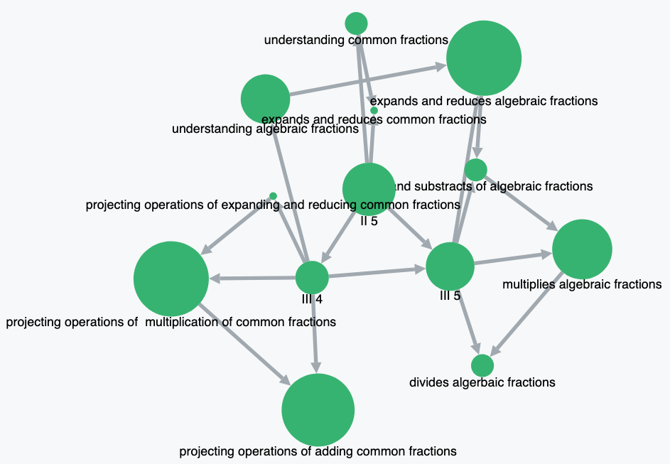
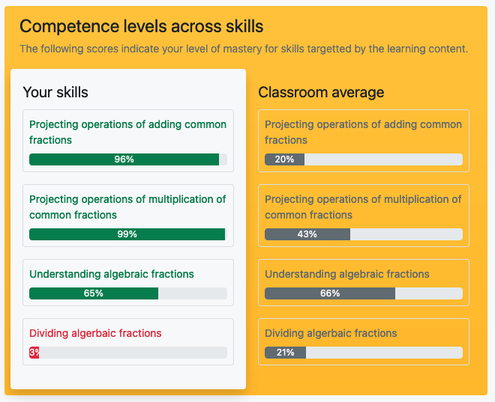



Edu-flex
Goal
To offer a personalized and flexible learning experience to cater to students’ needs.
Skill
Bit
Know
Bit
Design
Instructional Trajectory
Personalised Learning
Think & Discuss
Episode-1
Episode-2
Episode-3
Learning objectives
Strategies
Implementation
Study Materials
Think & Discuss
Learning Activities Tasks
Compulsory task
Open Learner Model, Learning Analytics
Optional task
Recommendation, support
Think & Discuss
Decisions,
Choices
Reflection
Analytics
Reflection
Decision
Domain experts
Teachers
Students
create the domain model
adjust as per the course’s needs
adjust as per learning needs
Implementation
Notes:
Design: DBR over three years of period.
Implemented: Mathematics 9th standard national curriculum
Reflection: Teacher valued feedback on students’ progress/success. Not all students had a positive experience (cognitive load)

Slide 3
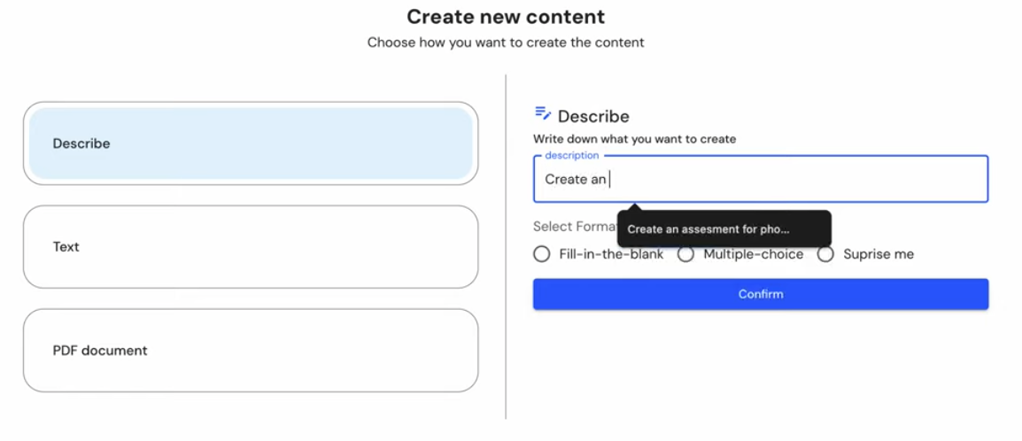
Kool-kit
What is the objective ?
To Support teachers in designing learning plan and learning content grounded in pedagogical models.
Design

Slide 4
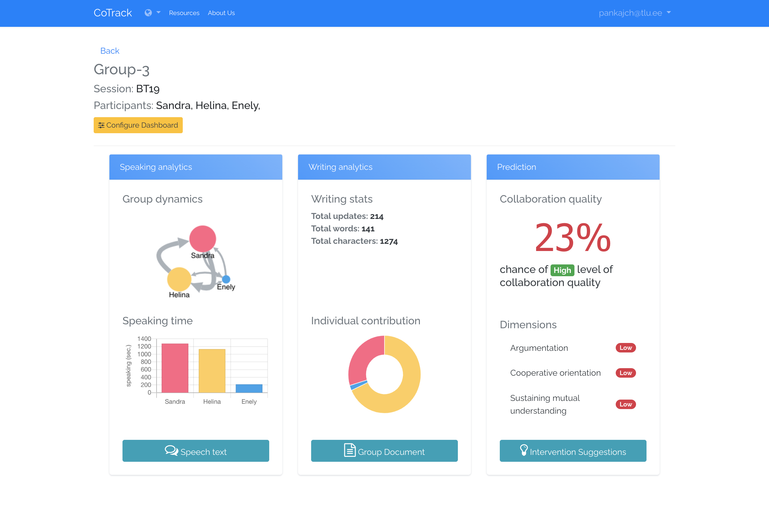
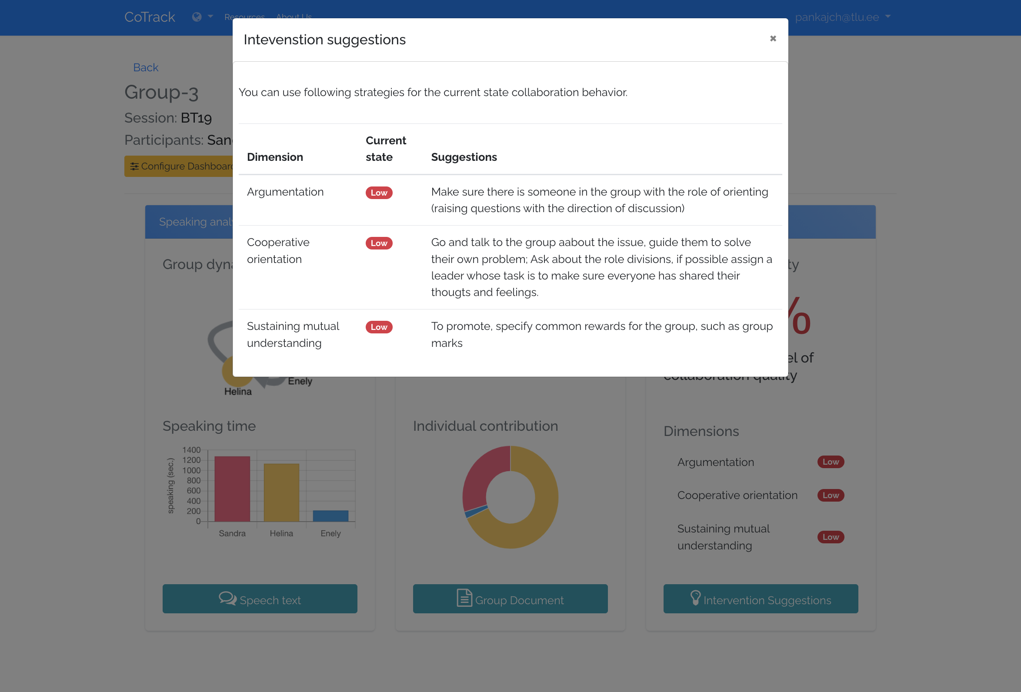
Cotrack
What is the objective ?
To assist teachers in monitoring collaborative learning activities using multimodal learning data.
Design
Implementation
Reflection

Slide 5

Conclusion
Teacher-AI complementarity
Automating routine tasks
Evidence-based insights
Influencing teachers’ skills & knowledge

Slide 6
THANKS !
DO YOU HAVE ANY QUESTIONS?
pankajch@tlu.ee
https://web.htk.tlu.ee/htk/
CREDITS: The icons used in this presentation are from Flaticon.com.

