Slide 1
Sentiments Analysis
Draft 0.1

Slide 2
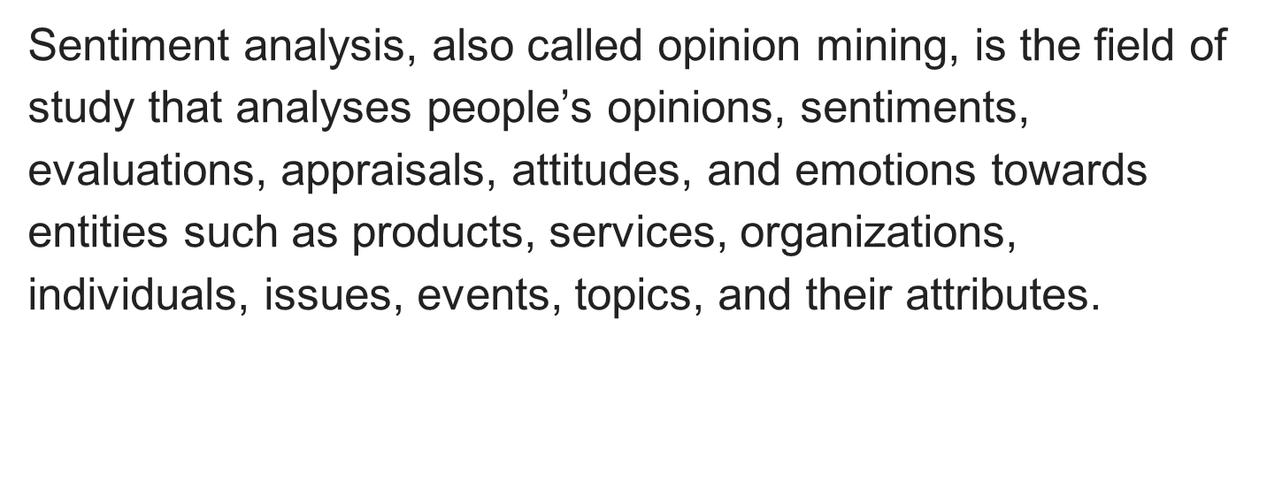
Sentiment Analysis

Slide 3
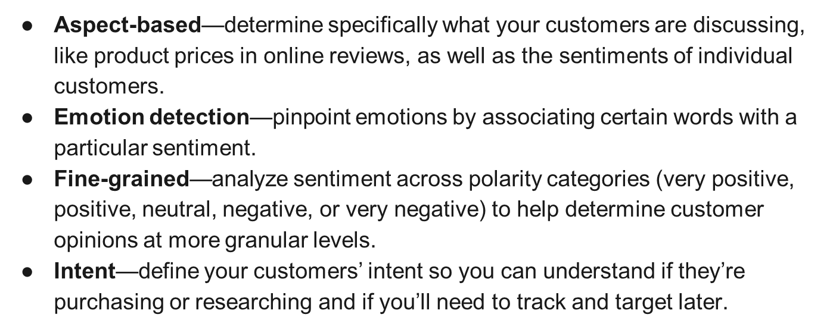
Types of Sentiment Analysis

Slide 4
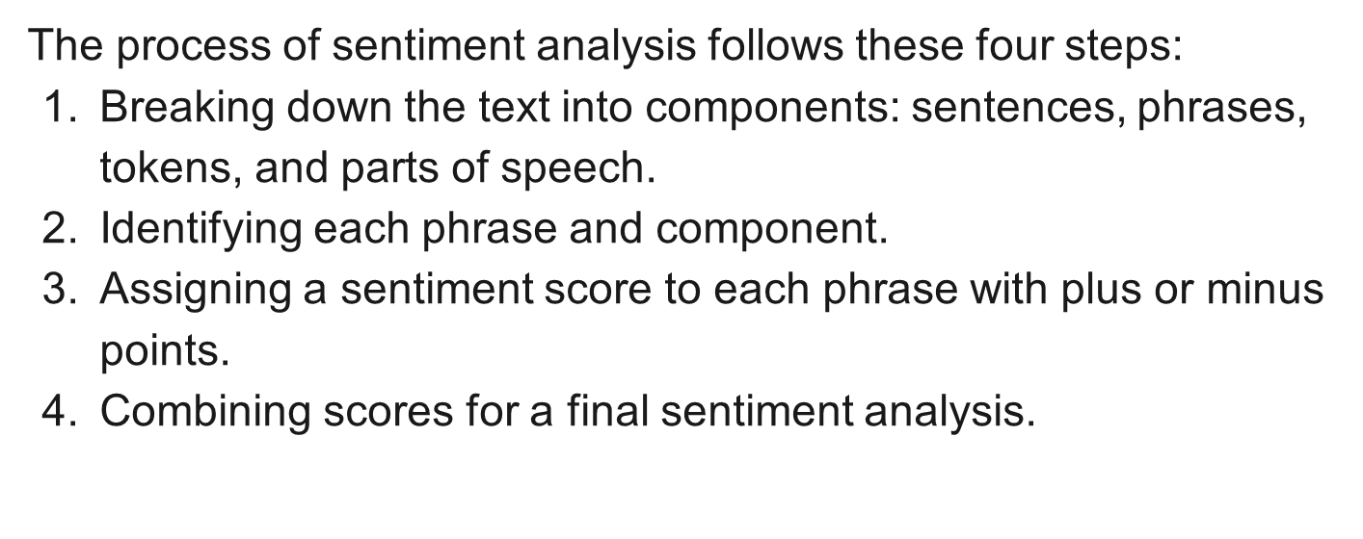

Slide 5
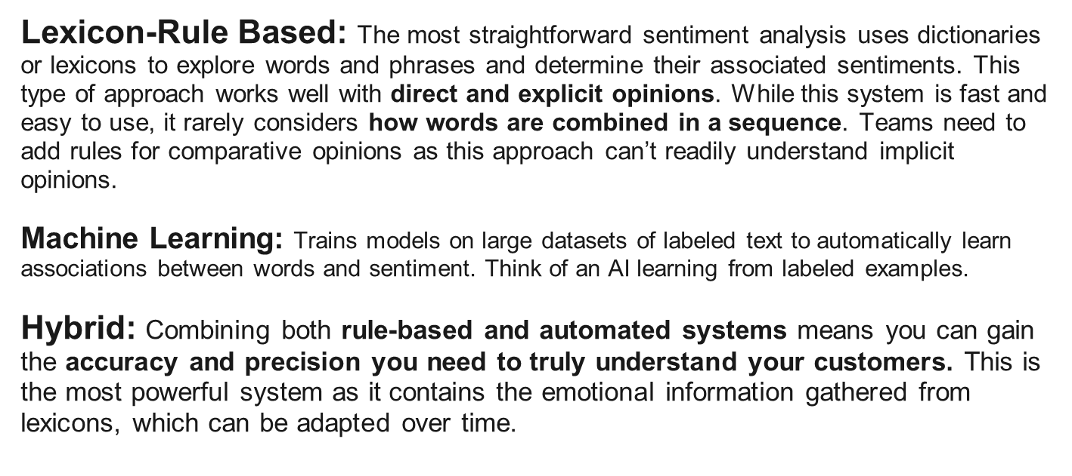
Three Categories

Slide 6
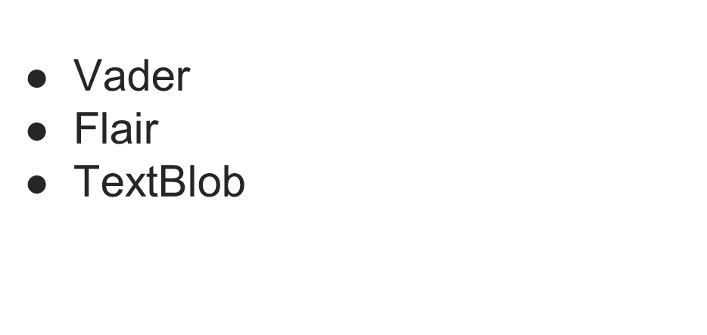
Rule Based Tools
Notes:
Valence Aware Dictionary and sEntiment Reasoner

Slide 7
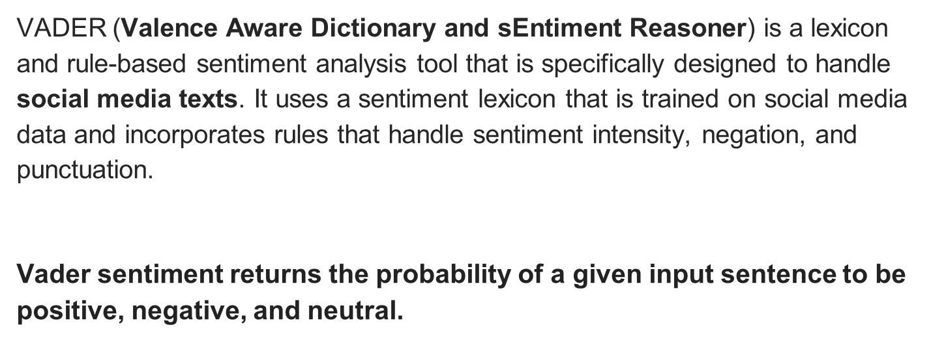
VADER

Slide 8
Vader-Lexicon Based
Lexicon Based Sentiment Analysis
  A big dictionary where each word is labeled with a sentiment, e.g.
  Happy Emotions-(Positive):
    Positive emotions: joy, love, excitement, delight, thrilled, grateful, amused, optimistic, proud
    Sensory words: beautiful, delicious, vibrant, soft, cozy, refreshing, radiant
    Actions: celebrate, succeed, achieve, explore, create, help, inspire, share
  Happy Emotions-(Negative):
    Negative emotions: sadness, anger, fear, disappointment, frustration, boredom, disgust, anxiety
    Descriptive words: dark, bleak, cold, harsh, rough, bitter, messy, broken
    Actions: cry, struggle, fail, worry, blame, doubt, avoid, withdraw
  Neutral Emotions-(Neutral):
    Neutral words: thing, fact, situation, information, objective, data, circumstance, detail
    Verbs: happen, occur, exist, remain, continue, develop, evolve, seem
Notes:
For example, "awesome" usually has a happy face sticker, but in a sarcastic context, it might switch to a blank or even a sad face. Likewise, a word like "cold" could be neutral when describing the weather, but negative when applied to a person's personality.
The key is to use a rich and diverse dictionary with clear definitions and sentiment labels, and then to apply it carefully while considering the surrounding context. This can help you get a good starting point for understanding the overall sentiment of a text, even if it's not always perfect.

Slide 9
Vader-Rules Based
Rules: These are your pre-defined rules for identifying sentiment cues. They can be based on things like:
  Negation: Words like "not," "never," "hardly" can reverse the sentiment of a sentence.
  Intensity: "Very," "really," "extremely" can amplify the sentiment.
  Comparisons: "Better than," "worse than" indicate relative sentiment.
  Figurative language: Sarcasm, metaphors, and irony can be tricky, but rules can help identify them.
Sentence Analyzer: This scans the text, checking for patterns that match the rules.
Sentiment Judge: Based on the matched rules, the analyzer assigns a sentiment score to the sentence.

Slide 10
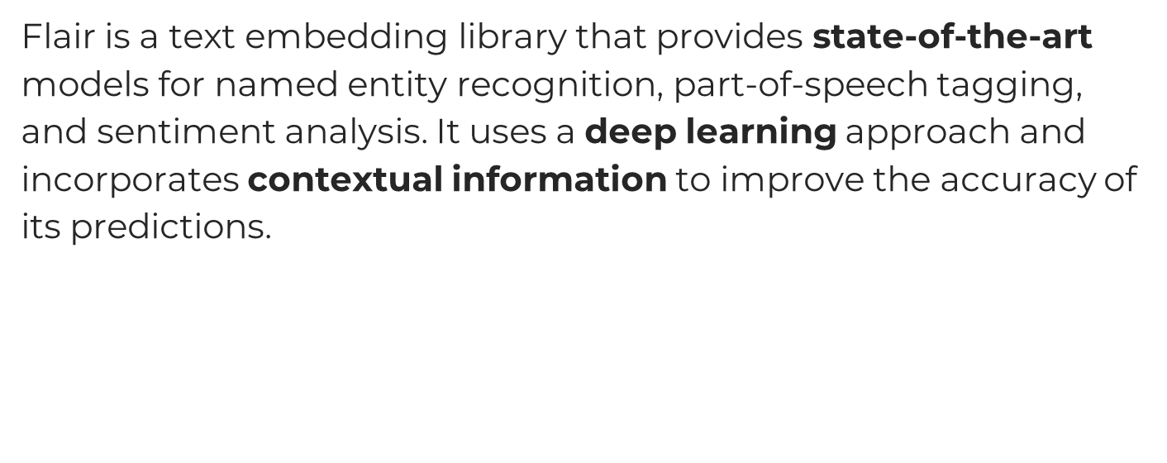
Flair

Slide 11
Flair
Flair is a powerful NLP library that allows you to apply state-of-the-art natural language processing (NLP) models to your text, such as named entity recognition (NER), sentiment analysis, part-of-speech tagging (PoS), special support for biomedical data, sense disambiguation and classification, with support for a rapidly growing number of languages.
Flair’s sentiment classifier is based on a character-level LSTM neural network which takes sequences of letters and words into account when predicting. It’s based on a corpus but in the meantime, it could also predict a sentiment for OOV (Out of Vocab) words including typos

Slide 12
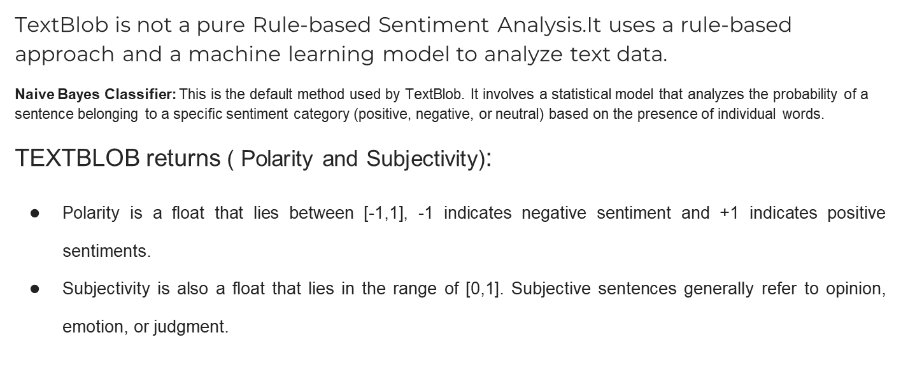
Notes:
Naive Bayes Classifier: This is the default method used by TextBlob. It involves a statistical model that analyzes the probability of a sentence belonging to a specific sentiment category (positive, negative, or neutral) based on the presence of individual words.

Slide 13
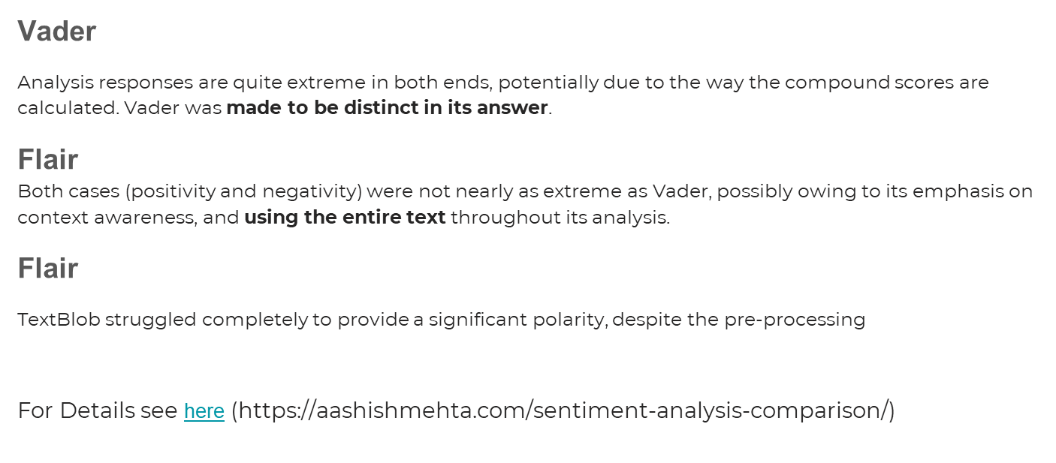
Various results sample tests shows following results
Notes:
Vader vs Flair vs TextBlob - Sentiment Analysis Comparison (aashishmehta.com)

Slide 15
References
Vader vs Flair vs TextBlob - Sentiment Analysis Comparison
https://aashishmehta.com/sentiment-analysis-comparison/
What is sentiment analysis and opinion mining in Azure Cognitive Service for Language? - Azure Cognitive Services | Microsoft Learn
Use the sentiment analysis prebuilt model in Power Automate - AI Builder | Microsoft Learn
AI Builder documentation | Microsoft Learn
What Is a CDP | Microsoft Dynamics 365
Sentiment Analysis in Python: TextBlob vs Vader Sentiment vs Flair vs Building It From Scratch (neptune.ai)

