Slide 1
Sentiments Analysis
Draft 0.1

Slide 2
Sentiment Analysis
Sentiment analysis, also called opinion mining, is the field of study that analyses people’s opinions, sentiments, evaluations, appraisals, attitudes, and emotions towards entities such as products, services, organizations, individuals, issues, events, topics, and their attributes.
Positive Neutral Negative
Notes:
The process of computationally identifying and categorizing opinions expressed in a piece of text,
determine whether the writer's attitude towards a particular topic, product, etc. is positive ,negative, or neutral.

Slide 3
Sentiment Analysis
Depending on your research goal and scope one can choose from different data sources and methods for sentiment analysis. It can be
Surveys
Emails
Online Reviews, social media platforms, blogs, forums, news articles.
Call Center calls
Chatbots
Notes:
Most recent work has involved in extracting THE TEXTUAL INFORMATION IN THE FINANCIAL REPORTS,
As the text may contain more INFORMATION THAN THE NUMERICAL PART in an annual report
Potential Stakeholders are using Sentiment Analysis for forecasting FINANCIAL PERFORMANCE
Researchers are proposing sentiment dictionary to identify and classify the sentiment orientation in CEO letters by utilizing the appraisal theory.
Digging the main corporate social responsibility (CSR)
And forecasting financial performance.

Slide 4
Types of Sentiment Analysis
Overall Sentiment Analysis — the overall sentiment of a document/text.
Sentence Level
Document Level
Aspect-Based Sentiment Analysis(ABSA)— focusing on specific aspects - determine specifically what your customers are discussing, like product prices in online reviews, as well as the sentiments of individual customers.
Fine-grained—analyze sentiment across polarity categories (very positive, positive, neutral, negative, or very negative) to help determine customer opinions at more granular levels.
Intent—define customers’ intent so you can understand if they’re purchasing or researching.
Notes:
The goal is to understand not only the overall sentiment of a document but also the sentiments associated with different aspects or entities mentioned within the text.
Fine Grained:
multiclass: very positive, positive, neutral, negative, or very negative
binary: Postive or Negative
Comparative Sentiment Analysis:
In comparative sentiment analysis, the focus is on understanding sentiment in relation to a specific comparison. For example, determining whether one product is preferred over another based on user reviews.
Temporal Sentiment Analysis:
Temporal sentiment analysis involves analyzing changes in sentiment over time. This can be valuable for tracking trends, monitoring public opinion, and understanding how sentiments evolve in response to events.
Cross-Domain Sentiment Analysis:
Cross-domain sentiment analysis involves building models that can generalize well across different domains or industries. It addresses the challenge of adapting sentiment analysis models to new and diverse datasets.

Slide 5
Process of Sentiment Analysis
The process of sentiment analysis follows these steps:
Transcribe Voice into Text ( if input is voice)
Breaking down the text into components : sentences, phrases, tokens, and parts of speech.
Identifying each phrase and component.
Assigning a sentiment score to each phrase with plus or minus points.
Combining scores for a final sentiment analysis.

Slide 6
Three Categories
Lexicon-Rule Based: The most straightforward sentiment analysis uses dictionaries or lexicons to explore words and phrases and determine their associated sentiments. This type of approach works well with direct and explicit opinions. While this system is fast and easy to use, it rarely considers how words are combined in a sequence. Teams need to add rules for comparative opinions as this approach can’t readily understand implicit opinions.
Machine Learning: Trains models on large datasets of labeled text to automatically learn associations between words and sentiment. Think of an AI learning from labeled examples.
Hybrid: Combining both rule-based and automated systems means you can gain the accuracy and precision you need to truly understand your customers. This is the most powerful system as it contains the emotional information gathered from lexicons, which can be adapted over time.

Slide 7
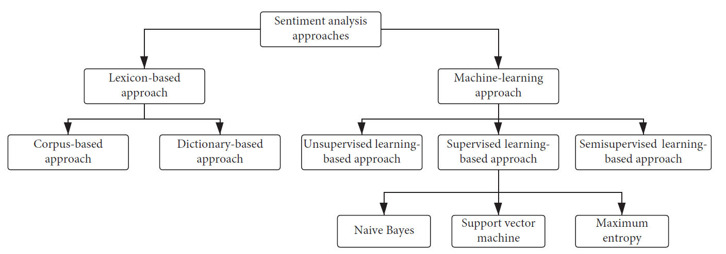
Lexicon Based vs Machine Learning
Notes:
A large collection of written or spoken text data used for linguistic analysis, statistical modeling, and training language models.
Examples: Books, articles, social media posts, transcripts, emails, etc.
Definition: A dictionary or list of words and their associated information, such as:
Meaning: Definitions, synonyms, antonyms.
Grammatical properties: Part-of-speech, conjugation, declension.
Sentiment: Positive, negative, neutral.
Domain specificity: Technical terms, slang, regional vocabulary.

Slide 8
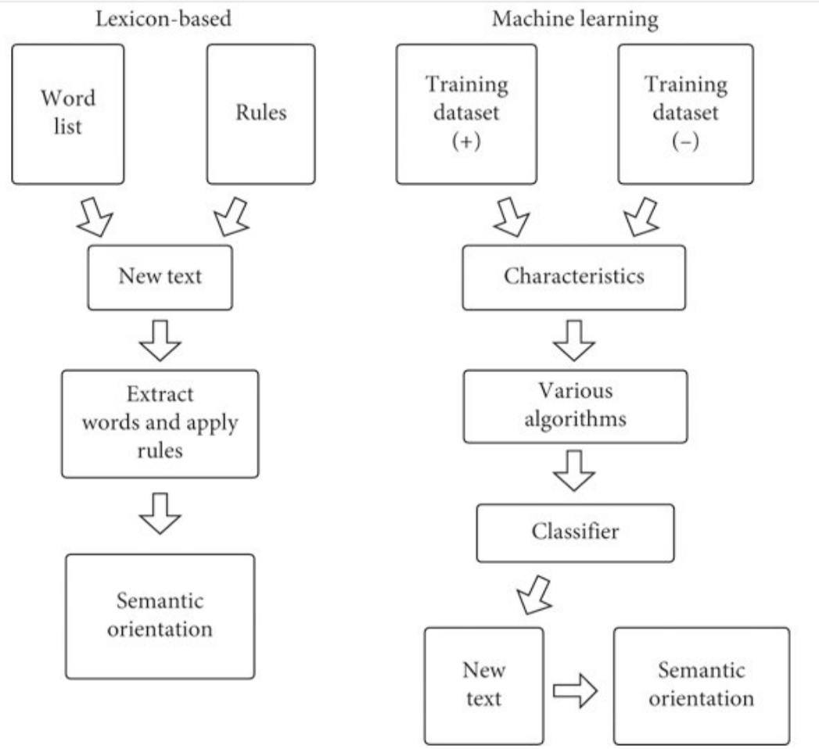
Lexicon Based vs Machine Learning
Various Classification Algorithms
Naive Bayes
Support Vector Machine (SVM)
Logistic Regression
…
Neural Networks
RNN(BiLSTM, …)
CNN
Transformers
Notes:
Factors to consider when choosing an algorithm:
Size and quality of dataset: Larger datasets often benefit from deep learning models.
Complexity of sentiment task: Simple tasks (e.g., polarity detection) may be well-suited for Naive Bayes or logistic regression, while more complex tasks (e.g., aspect-based sentiment analysis) may require SVM or deep learning models.
Interpretability requirements: If understanding the reasoning behind sentiment predictions is important, Naive Bayes, logistic regression, or decision trees may be preferable.
Computational resources: Deep learning models often require more computational power and time to train

Slide 9
Sentiment Analysis Models
Lexicon and Rule based models
Vader
TextBlob (PatternAnalyszer)
Machine Learning
Supervised
DistilBert (Transformers)
Hybrid
Semi-supervised
Flair (RNN)
BERT-WMAL*
* Not part of POC
Notes:
Valence Aware Dictionary and sEntiment Reasoner
Flair is considered hybrid it semi-supervised

Slide 10
VADER – Lexicon - Rule Based
VADER (Valence Aware Dictionary and sEntiment Reasoner) is a lexicon and rule-based sentiment analysis tool that is specifically designed to handle social media texts.
It uses a sentiment lexicon that is trained on social media data, 7500+ words and phrases each assigned a sentiment intensity score (-4 to +4) based on human ratings and linguistic rules.
Includes common slang, emojis, emoticons, and abbreviations often used in social media text.
Notes:
>>"lexicon" refers to the vocabulary or set of words
The algorithm behind VADER is a rule-based approach that combines a pre-built lexicon with a set of grammatical and syntactical rules. The lexicon contains words with associated sentiment scores, indicating how positive, negative, or neutral each word is. The lexicon is enhanced with features to handle aspects such as negation, capitalization, and intensity.
Valence Aware Dictionary (VAD):
This is the core of Vader, containing roughly 8,000 words with assigned sentiment scores:
Intensifiers/down-toners: Words like "very" or "slightly" that modify sentiment intensity.
Slang words and emoticons: Informal language and emojis with associated sentiment.
Punctuation: Exclamation points or ellipses can indicate sentiment strength.

Slide 11
VADER - Rule-Based Heuristics
Punctuation: Adjusts sentiment scores based on exclamation marks, question marks, etc.
Capitalization: Considers all caps words as more intense.
Negation: Reverses sentiment using words like "not," "never."
Intensifiers: "Very," "really," "extremely" can amplify the sentiment
Comparisons: "Better than," "worse than" indicate relative sentiment.
Other rules: Addresses emoticons, emojis, repeated punctuation etc.
Notes:
Key differences from other analyzers:
Lexicon focus: Vader's VAD lexicon plays a central role, but it's complemented by rule-based adjustments and context interpretation.
Adaptive and granular: The lexicon and rules can be customized for specific domains or languages.
Interpretability: The individual scores and word-level analysis offer some transparency into the reasoning behind sentiment prediction.

Slide 12
TEXTBLOB
TextBlob has both Rule-based* and Machine Learning way to analyze Sentiments.
NaiveBayesAnalyzer: Relies on a pre-trained a Naive Bayes classifier, trained on a large corpus of text data with labeled sentiment scores.
PatternAnalyzer: It relies on a pre-defined dictionary (lexicon) of words and phrases associated with sentiment scores.
* In this POC we are using Pattern Analyzer
Notes:
TextBlob is a Python library used to perform NLP tasks like tokenization, POS-Tagging, Words inflection, Noun phrase extraction, lemmatization, N-grams, and sentiment Analysis( PatternAnalyzer, NaiveBayesAnalyzer)
NaiveBayesAnalyzer employs a statistical machine learning approach, specifically the Naive Bayes algorithm.
This means it learns to associate words and phrases with sentiment classes (positive, negative, neutral) based on their statistical patterns in training data.
Naive Bayes Assumption: It makes the "naive" assumption that features are independent, meaning the occurrence of one feature doesn't affect the probability of another.
When to Consider NaiveBayesAnalyzer:
When you prefer a statistical, data-driven approach to sentiment analysis.
When you have access to a large corpus of labeled training data for the domain or language style you're working with.
When you need probabilistic outputs to understand confidence levels in sentiment predictions.

Slide 13
TextBlob Pattern Analyzer
Lexical Lookup: Looks up each word in the lexicon and retrieve its sentiment score.
Part-of-Speech Weighting: Giving more importance to sentiment-bearing words like adjectives and adverbs.
Negation Handling: "not," "never“ reverses the sentiment of subsequent words.
Modifiers: Intensifiers (e.g., "very," "extremely") and downtoners (e.g., "slightly," "somewhat") that adjust sentiment strength.
Sentence-Level Aggregation
Document-Level Aggregation
Notes:
Polarity: Like PatternAnalyzer, it outputs a polarity score ranging from -1 (extremely negative) to +1 (extremely positive).
Subjectivity: It also provides a subjectivity score ranging from 0 (very objective) to 1 (very opinionated).
Key Points:
Rule-Based: PatternAnalyzer primarily relies on rules and patterns defined in its lexicon and algorithms, rather than statistical learning like Naive Bayes.
Context Sensitivity: It has some ability to capture context and nuances in language, but not to the same extent as more advanced techniques.
Domain-Specific Adaptation: You can potentially customize the lexicon or rules for domain-specific sentiment analysis.
Potential Biases: It's important to be aware of potential biases in the lexicon or rules, as they can influence sentiment results.
When to Consider PatternAnalyzer:
When you need more control over the sentiment analysis process and want to understand the underlying rules and patterns.
When you're dealing with domain-specific language or unusual patterns of sentiment expression.
When you want to experiment with different lexicons or rule sets.

Slide 14
Demo VADER and TEXTBLOB

Slide 15
FLAIR (Forward-Looking Attentive Inference Recurrent Neural Network)
FLAIR is a powerful NLP library that allows you to apply state-of-the-art natural language processing (NLP) models to your text, such as named entity recognition (NER), sentiment analysis, part-of-speech tagging (PoS), special support for biomedical data, sense disambiguation and classification, with support for a rapidly growing number of languages.
Flair's sentiment analysis model utilizes a stacked bidirectional (BiLSTM) architecture extension of recurrent neural network (RNN) LSTM architecture.
Notes:
* Flair's sentiment analysis model utilizes a stacked bidirectional LSTM (BiLSTM) architecture extension of recurrent neural network (RNN) architecture.
* Character Embeddings: representing each character in a word as an embedding vector
* Bidirectional LSTM Layers: Flair employs multiple layers of bidirectional LSTMs. Bidirectional LSTMs process input sequences in both forward and backward directions, capturing contextual information effectively.
* Hidden States: The hidden states generated by the BiLSTM layers contain information about the context of each character in the input sequence, allowing the model to understand the relationships between characters and words.
* Training: The model is trained using labeled data, where the weights of the network are adjusted to minimize the difference between predicted sentiment scores and the ground truth labels.

Slide 16
Flair ( Change)
Each character in a word as an embedding vector (Character Embeddings)
Flair employs multiple layers of bidirectional LSTMs.
Bidirectional LSTMs process input sequences in both forward and backward directions, capturing contextual information effectively.
The hidden states generated by the BiLSTM layers contain information about the context of each character in the input sequence, allowing the model to understand the relationships between characters and words.
The model is trained using labeled data, where the weights of the network are adjusted to minimize the difference between predicted sentiment scores and the ground truth labels. (Training)

Slide 17
Various results sample tests shows following results
Vader
Analysis responses are quite extreme in both ends, potentially due to the way the compound scores are calculated. Vader was made to be distinct in its answer.
TextBlob
TextBlob struggled completely to provide a significant polarity, despite the pre-processing
Flair Both cases (positivity and negativity) were not nearly as extreme as Vader, possibly owing to its emphasis on context awareness, and using the entire text throughout its analysis.
For Details see here (https://aashishmehta.com/sentiment-analysis-comparison/)
Notes:
Vader vs Flair vs TextBlob - Sentiment Analysis Comparison (aashishmehta.com)

Slide 18
Advanced Transformer based deep learning models
At present we have seen that models and method for Sentiment Analysis using Linear Regression, Support Vector Machines(SVM), Convolution Neural Networks (CNN), Recurrent Neural Networks (RNN), LSTM (Long Short Term Memory), and hybrid.

Slide 19
DistilBert (distilbert-base-uncased-finetuned-sst-2-English)
DistilBERT is a smaller and faster version of BERT that leverages a technique called knowledge distillation to achieve comparable performance while significantly reducing model size and computation costs.
*BERT: Bidirectional Encoder Representations Transformers
Notes:
we have seen that models and method for Sentiment Analysis using Linear Regression, Support Vector Machines(SVM), Convolution Neural Networks (CNN), Recurrent Neural Networks (RNN), LSTM (Long Short Term Memory), and hybrid.
Overall, the BERT model represents a major breakthrough in the field of NLP, building on the success of the Transformer model introduced in “Attention is all you need.” Its ability to capture the context and meaning of words within a sentence, combined with its pre-training on a large corpus of data, has enabled it to achieve state-of-the-art results on a wide range of NLP tasks.

Slide 20
DistilBert (distilbert-base-uncased-finetuned-sst-2-English)
Model: distilbert-base-uncased-finetuned-sst-2-English: This model is a fine-tune of DistilBERT-base-uncased ( accuracy of 91.3) which is smaller and faster version than BERT
finetuned-sst-2-English: Model further trained on a specific dataset ( The Stanford Sentiment Treebank version
Model: SamLowe/RoBERTa-base-go_emotions
Optimized BERT pretraining approach
Trained on the "go_emotions" dataset, based on Reddit data and containing ~670,000 text samples labeled with 28 different emotions.
*BERT: Bidirectional Encoder Representations Transformers
Notes:
Overall, the BERT model represents a major breakthrough in the field of NLP, building on the success of the Transformer model introduced in “Attention is all you need.” Its ability to capture the context and meaning of words within a sentence, combined with its pre-training on a large corpus of data, has enabled it to achieve state-of-the-art results on a wide range of NLP tasks.
DistilBERT is a smaller and faster version of BERT that leverages a technique called knowledge distillation to achieve comparable performance while significantly reducing model size and computation costs.

Slide 21
FLAIR vs DistilBert
FLAIR: Has multiple pre-trained contextual embedding models like ELMo* and Sentence-BERT*, focusing on capturing word meaning within the context of a sentence. It also allows the use of classic word embeddings like Glove or FastText.
Can be trained on various pre-trained contextual embeddings and fine-tuned on any labeled sentiment dataset. . Requires less computational power and memory compared to distilbert-base-uncased-finetuned-sst-2-english due to its smaller model size.
DistilBERT: Relies on the DistilBERT architecture, a smaller and faster version of BERT pre-trained on a massive corpus of text data.
Comes with pre-trained on a specific dataset like SST-2 for sentiment analysis, offering high accuracy for similar tasks but possibly requiring further fine-tuning for generalizability.
*ELMo: Embeddings from Language Models, is a technique for generating contextual word embeddings
*Sentence-BERT: l technique for generating sentence-level embeddings using the pre-trained BERT language model
Notes:
ELMo: Embeddings from Language Models, is a technique for generating contextual word embeddings, meaning each word gets a unique representation based on its surrounding context in a sentence. This differs from traditional word embeddings like Word2Vec or GloVe, which assign a static meaning to each word regardless of its context.
Benefits of ELMo:
Contextual Awareness: ELMo captures the nuances of how words are used in different contexts, leading to more accurate representations.
Improved Performance: ELMo has achieved state-of-the-art performance on various NLP tasks like sentiment analysis, question answering, and text classification.
Flexibility: ELMo provides different options for combining embeddings, allowing you to tailor the representations to your specific needs.
Limitations of ELMo:
Computational Cost: Training and using ELMo requires more computational resources compared to simpler word embedding techniques.
Domain Dependence: Pre-trained ELMo models might not be optimal for specific domains and might require fine-tuning.

Slide 22
References
Anticipating Corporate Financial Performance from CEO Letters, Siqi Che¹, Wenzhong Zhu² ,and Xuepei Li³
Utilizing Sentiment Analysis
Vader vs Flair vs TextBlob - Sentiment Analysis Comparison
https://aashishmehta.com/sentiment-analysis-comparison/
What is sentiment analysis and opinion mining in Azure Cognitive Service for Language? - Azure Cognitive Services | Microsoft Learn
Use the sentiment analysis prebuilt model in Power Automate - AI Builder | Microsoft Learn
AI Builder documentation | Microsoft Learn
What Is a CDP | Microsoft Dynamics 365
Sentiment Analysis in Python: TextBlob vs Vader Sentiment vs Flair vs Building It From Scratch (neptune.ai)

