Slide 1

MSPM’S Deogiri Institute of Engineering and Management Studies, Aurangabad Department of Computer science and Engineering Subject: Heart Attack Prediction Name: Aditya Thombare [36140]
Akshay Bagul [36141]
Mayur Borse [36143]
Shubham Jadhav [36145]
Class: [TE B]

Slide 2
Abstract
Heart related diseases are the main reason for a huge number of death in the world over the last few decades and has emerged as the most life-threatening disease, not only in India but in the whole world. So, there is a need of reliable, accurate and feasible system to diagnose such diseases in time for proper treatment. Machine Learning algorithms and techniques have been applied to various medical datasets to automate the analysis of large and complex data.
Many researchers, in recent times, have been using several machine learning techniques to help the health care industry and the professionals in the diagnosis of heart related diseases. In this presents of various models based on such algorithms and techniques and analyze their performance. Models based on supervised learning algorithms such as Support Vector Machines (SVM), K-Nearest Neighbour (KNN).

Slide 3
Algorithm & Techniques
Support Vector Machine.
K – Nearest Neighbour.

Slide 4
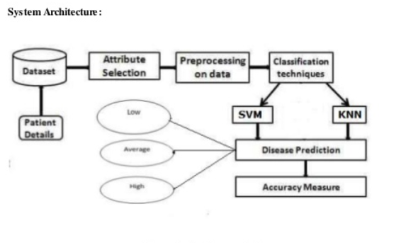
Architecture diagram

Slide 5
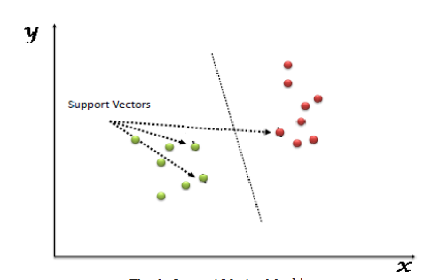
Support vector machine
SVM is a supervised machine learning algorithm which can be used for classification or regression problems.

Slide 6
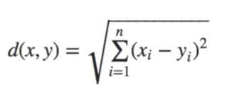
K – Nearest neighbour
The k-nearest neighbors (KNN) algorithm is a simple, easy-to-implement supervised machine learning algorithm that can be used to solve both classification and regression problems.
Euclidean distance formula =
x , y = co-ordinate sample space.
D = represent the sample used in training,

Slide 7
Thank you!

