Slide 1

MSPM’S Deogiri Institute of Engineering and Management Studies, Aurangabad Department of Computer science and Engineering Subject: farming robot Name: Vaibhav Tate[36125]
Hrugved Chavan[36136] Class: [TE B]

Slide 2
Abstract
Now a days agricultural field is suffering from many problems . In this era of technology this problems can be solved effectively with the means of self-learning robots which reduce the human efforts and do farming in effective , healthy way.
The robot will perform many basic agricultural activities like seed sowing , watering , spraying fertilizers etc.
The robot will be controlled through a mobile app which will have a navigation panel and various buttons for various activities.

Slide 3
Literature survey

Slide 4
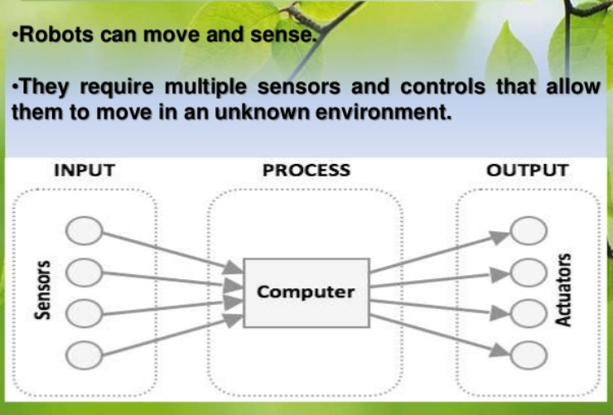
How the robot can work

Slide 5
Robot have five parts
Sensors
Controller/Aurdino
Actutaor
Arm
End effector

Slide 6
Aurdino
It is also called as mini computer .
control function is the brain of computer.
Controller allow the robot to be networked to the other system so that it may work together other machines and process.
Aurdino is main component of function.

Slide 7
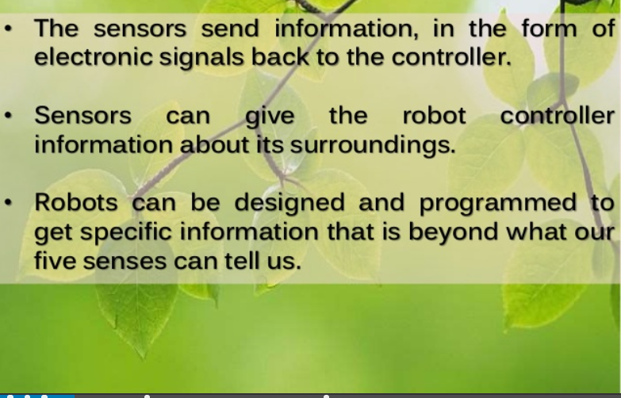
sensors

Slide 8
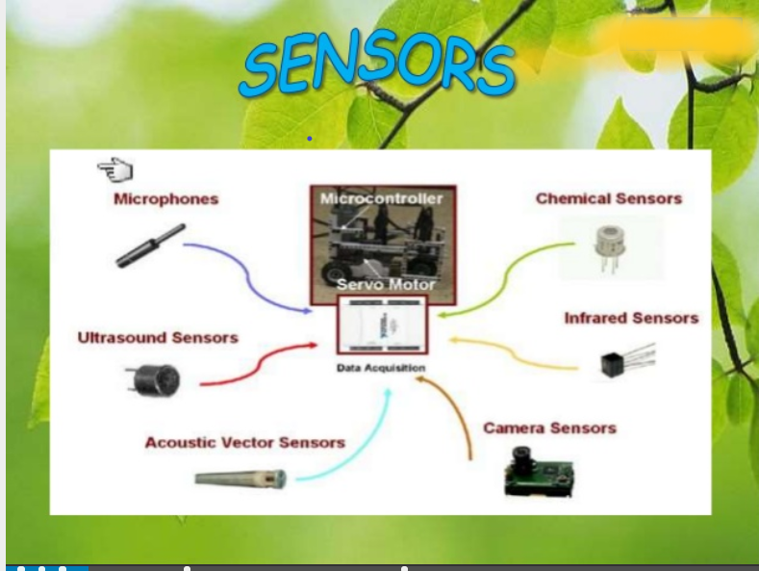
Sensors used

Slide 9
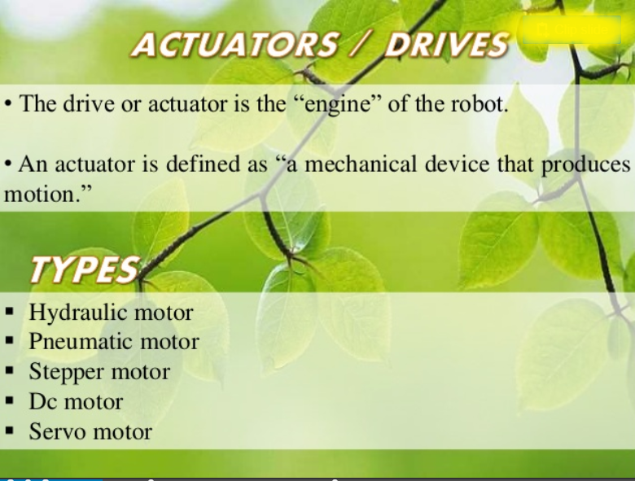

Slide 10
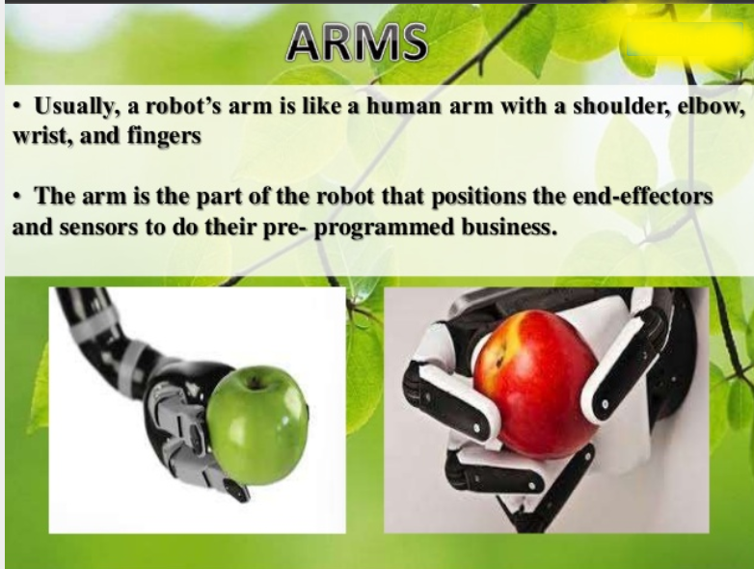

Slide 11
Thank you!

