Slide 1
Face Recognition: A Literature Survey
Presented By: Pranav .M. Neel

Slide 2
Contents
Introduction
Why do we need face recognition?
Biometrics
Face Recognition by Humans
Challenge in Face Recognition
Variation in pose
Variation in illumination
Early Work/Modern Work
Aspects of face recognition
Approaches use for recognition
EIGENFACE TECHNOLOGY
PDBNN
Video-based Face Recognition
Evaluation of face recognition systems
Face Recognition Grand Challenge

Slide 3
Why do we need it?
Easy way to discover criminals
Video Surveillance
Portal Control
Investigations
Smart Cards
Devices log-on
ATM cards
Entertainment
Video Games
Human-robot/computer-interaction

Slide 4
Biometrics
Consists of methods for uniquely recognizing humans based upon one or more intrinsic physical or behavioral traits. In computer science, in particular, biometrics is used as a form of identity access management and access control. It is also used to identify individuals in groups that are under surveillance.

Slide 5
Face recognition by humans
Relevant studies in psychophysics and neuroscience that will help with the design of face recognition systems:
People remember faces more easy than other objects.
People focus in odd features (eg. Hears).
People rank facial features.

Slide 6
Challenge in Face Recognition
Illumination variation
Images of the same face look different because the change of the light.
Pose Variation
Same face in different angles could give a different output.

Slide 7
Early work
Use techniques base on 2D pattern recognition.
Use measured attributes of features (distance-measuring algorithms). These determined the distances between important features like eyes and compared these distances to the distances on known faces in the database.
Performance is poor with variations of the same face and size, is not accurate.
Does well with variations in intensity.

Slide 8
Modern Work
Appearance-based model, heavily tested with large databases, with positive outcomes.
Feature-based models has been successful as well, and more accurate in the two challenges( light and pose variation)
Techniques for feature extraction are not adequate, for example, it won’t detect if an eye is close or not.

Slide 9
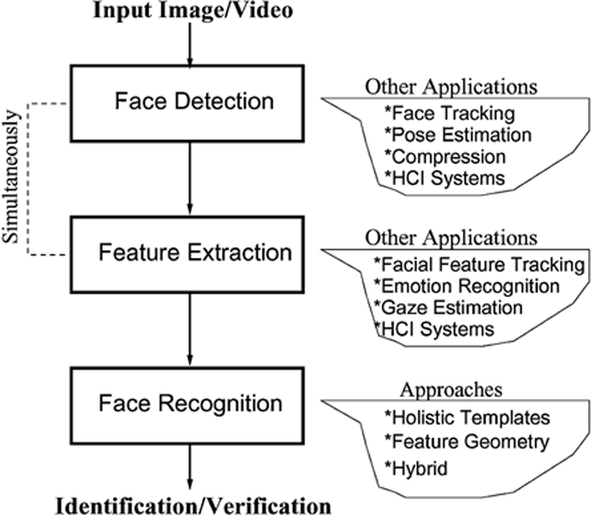
Aspects of face recognition

Slide 10
Aspects of face recognition, continued
Face detection: Locating the faces in an image or video sequence.
Feature extraction: Finding the location of eyes, nose, mouth, etc.
Face recognition: Identifying the face(s) in the input image or video.
Identification/Verification: The system needs to confirm or reject the claimed identity of the input face.

Slide 11
Face Detection
First step of any system.
Two statistics are important: positives (also referred to as detection rate) and false positives (reported detections in non-face regions).
Multiview-based methods for face detection are better than invariant feature methods when is used for head rotations.
Appearance-based methods have achieved the best results in face detection, compared to feature-based and template-matching methods.

Slide 12
Feature extraction
Three types of approaches:
Generic methods based on edges, lines, and curves.
Feature-template-based methods that are used to detect facial features such as eyes.
Structural matching methods that take into consideration geometric constraints on features.
Is the most important step for face recognition, even the most complete methods need to know the exact location of the feature for normalization.
First methods use template model that emphasized in some features.

Slide 13
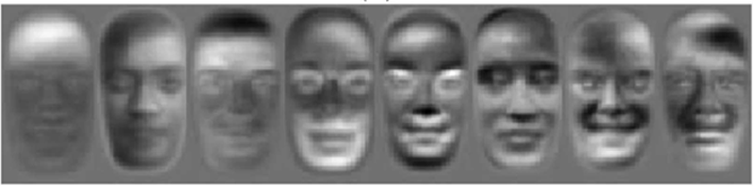
EIGENFACE
The first successful method for facial recognition.
Take an input image and then projecting into a new dimension called “facespace”.

Slide 14
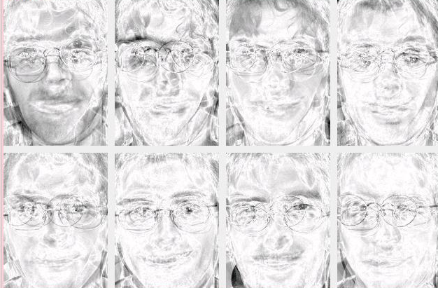

EIGENFACE continued
To identify a face, the algorithms do:
Registration: Transformed the input image to “facespace”, then is saved in a new representation.
Eigenpresentation: Every face in the database is encoded into a representation call template. principal component analysis (PCA) is used to encode face images and capture face features.
Identification: this last step is done by comparing the input image with the ones in the database using the templates, and then selecting the best match

Slide 15
NEURAL NETWORK
What is it?
Is a mathematical model or computational model that is inspired by the structure and/or functional aspects of biological neural networks.
NN technology gives computer systems an amazing capacity to actually learn from input data.
It’s easy to train a neural network with samples which contain faces, but it is much harder to train a neural network with samples which do not, and the number of “non-faces” is too large.

Slide 16
NN on face recognition
It has a filter at the beginning of the process that scan the whole image, and take each portion to see if the face exist in each window.
Merging all this pieces after the filter help the NN to eliminate false detections.
NN has a high level of accuracy when the images has lighting conditions.

Slide 17
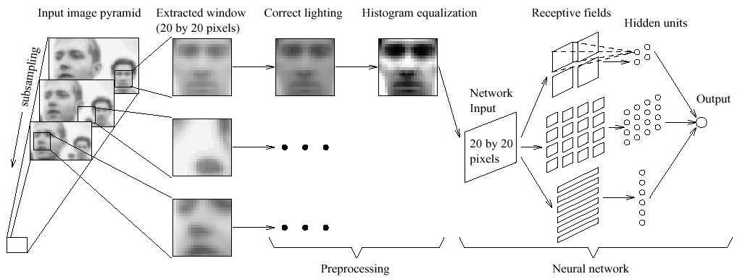
Example of NN

Slide 18
PDBNN
A fully automatic face detection recognition system based on a neural network.
A proposed fully automatic face detection and recognition system based on Probabilistic Decision-Based Neural Networks has been proposed.
It consists of three modules: A face detector, eye localizer, and face recognizer.
The PDBNN uses only the up side of the face; the reason to not use the mouth is to avoid the expressions that cause motion around the mouth.

Slide 19
Thank you

