Slide 1

MSPM’S Deogiri Institute of Engineering and Management Studies, Aurangabad Department of Computer Science and Engineering Subject:Seminar Topic:Personality Detection using Handwritting Analysis Submitted by Shruti Deshpande(36133) Under the Guidance of Mr. Pankaj Durole Asst.Prof.Department of CSE (Deogiri Institute Engineering and Management Studies) 2019-2020

Slide 2
Introduction
Handwriting also termed as brain-writing is a useful measure in identifying the characteristic personality traits of an individual.
The analysis is done for specific features of the sample for determining various characteristic behavioural traits of the person.
The proposed tool will compliment the graphologists to increase their speed and efficiency in the analysis process.

Slide 3
Approach Used
Machine learning approach like KNN with incremental learning, will be implemented to improve the efficiency of the tool.
Artificial neural network algorithm is used for classification.

Slide 4
Algorithms used for Analysis
Polygonalization
Thresholding Algorithm
Template Matching
Artificial Neural Network

Slide 5
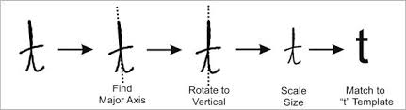
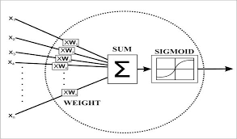
Template Matching
Artificial Neural Network

Slide 6
Parameters used for Analysing
Baseline
Letter Slant
Height of ‘t’ bar
Margin

Slide 7
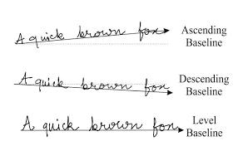
Baselines | Corresponding traits
Ascending(rising upwards) | Optimistic
Descending(slanting downwards) | Pessimistic
Level(Straight) | Balanced
Baseline
Types of Baseline

Slide 8
Slant Characteristics
Slant | Corresponding trait
Extreme left | Fear of the future, defensive, early rejection.
Extreme right | Lack of self-control, impulsive, unrestrained, intense, very expressive, low frustration tolerance.
Left | Reflective, independent, not sympathetic, difficulty in adapting and expressing emotions.
Right | Expressive, confidence in convictions, freedom of thought, extrovert, future orientation.
vertical | Head controls over heart, independent emotional nature, and works independently.

Slide 9
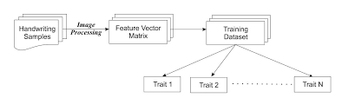
Process Flow Diagram for Generation of Training Dataset

Slide 10
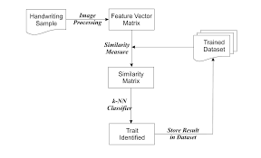
Trait Identification Based on Trained Data

Slide 11
Conclusion
This project has proposed a methodology to predict the accurate personality traits of an individual from the features extracted from handwriting using a machine learning approach.
The proposed system can be used as a complementary tool by the graphologist to improve the accuracy of handwriting analysis and also make the process fast.

Slide 12
THANK YOU!!

