Slide 1
Welcome
09/10/2019
Topic Name:-Smart voting system with face
recognition
Presented By-Sonali Nare
Guided By-

Slide 2
CONTENT
Introduction
Literature Survey
Brief on System
Conclusion
References

Slide 3
Introduction
Now a day in India two types of method are used for voting. The first method is secret ballot paper, in which lots of paper are used and second method is EVM (electronic voting machine) which is used since 2003.
we have to propose a method or way for online voting that is more secure than the existing system. In this proposed project face detection and recognition concept is used to identify the exact person.
There are three levels of verification were used for the voters in our proposed system. The first one is Unique id number verification, second level of verification is election commission id or voter card number, if your election commission id number is correct then you have to go for third level of security which is the main security level where the system recognize the face of the real voter from the current database of face images given by the election commission. If the captured image is matched with the respective image of the voter in the database, then a voter can cast their vote in the election. as you have to know that in existing system is not much more secure because in existing system security level is only voter card so any one can give other person vote with voter card but here we proposed a way for voting which is more secure than existing system.

Slide 4
Literature Survey
The past work done in this domain involves reviewing the already present algorithms and comparison for these algorithms based on various features and conditions such a the kind of database used, and neural network-based image processing system used for the identification of the facial features [1,6]. The amount of distortion and attenuation plays a big role in generating a clear and transparent image in a localized area of the image frequency as it would be important aspect while capturing the image and processing of it to accurately match it with one that is present in the database

Slide 5
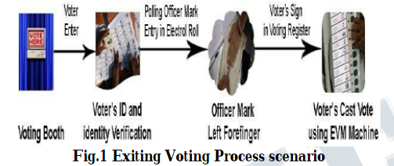
Brief on System
EXISTING SYSTEM:
In the current voting system, the ballet machines where used in which the symbols of various political parties are displayed. When we press the button with the respective party’s (political party) symbol the voting is done. The chance of fake person casting their vote is more in the existing system. The voting person may use the fake voting card and cast his vote, this may cause problem. In the existing system, the person has to travel long places to his constituency to cast his vote. Therefore, we need an effective method to identify the fake voters during voting. So, the

Slide 6
PROPOSED SYSTEM:
In this project we are working with three different security levels :-
Level1: -Unique id number (UID) [4]. At the time of voter registration system will request for the unique id from the voter. The entered unique id is verified from the database provide by the election commission.
Level2: Election commission id card number. In the second level of verification, the voter has to enter the election commission id or voter’s id number. The entered id number is verified from the database provide by the election commission.
Level3: - Face recognition with respective election commission id number .In this level, Eigen face algorithm is used to verify the facial image of the voters from the database provided by the election commission.

Slide 7
The main concept of Face algorithm is to follow the appearance –based approach to face recognition . It is used to capture the variation in a collection of face images and this information is use to encode the particular images of individual faces. Then the encoded images of individual faces are compared with the collection of face images in a holistic manner. The faces itself form a basis set of all images used to construct the covariance matrix. The formed smaller set of basis images are used to represent the original training images which produces dimension reduction. By comparing how faces are represented by the basis set, the classification can be achieved.

Slide 8
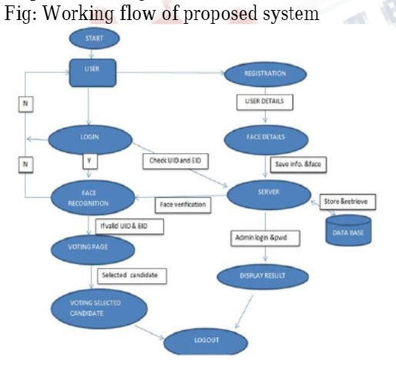

Slide 9
i) Every New User in the India is first register for Voting. So, our first step is registration
ii). At that time of Registration System Capture, the Face of the user by using Web Camera and Store the Face sample in the Server Database for Security Purpose.
iii). At the time of election, we will use three level of security first one is unique I verification second one is voter id verification third one is face recognition.
iv). System will be checking whatever unique id and voter id entered by the voter is correct or not.
v). If unique id or voter id is correct than system will take image of voter and compare with the respective image of database or server.
vi). If the image in database is matching with the captured image of the voter, then he/she is allowed to cast is vote.
vii). On the voting page all the party whatever party contest in the election symbols /buttons will be there. Voter can cast his /her vote in the election.
viii). As soon as voter will give vote the id of voter logout automatically so we can say that a voter can give only one vote.
ix). On counting form only election commission authorized user can login with the secure id and password if both id and password is correct then voting process will be continuing.

Slide 10
Conclusion
As we see that existing voting system has many defects such as lengthy process, time taking, not secure, bogus voting, no security level but now we can say that our approach is more useful and secure from the existing system. Since, we are using three level of security in this proposed system the false voters can be easily identified. The facial authentication technique is very much useful in identifying the fraud voters, so we can avoid the bogus votes during election commission

Slide 11
References
[1]A. Baumberg, “Reliable feature matching across widely separated views”, in CVPR, 2000
[2] F. Song, D. Zhang, J. Wang, H. Liu, and Q. Tao, "A parameterized direct LDA and its application to face recognition," Neurocomputing, Vol.71, 2007.

Slide 12
THANK YOU

