Slide 1
Welcome
15/10/2018
Predicting Football Results Using
Machine Learning Techniques
Presented By -Sayali Salunke(36134)
Prithviraj Jangle(36137)
Guided By-Prof.P.H.Durole.

Slide 2
CONTENT
Introduction
Literature Survey
Brief on System
Conclusion
References

Slide 3
INTRODUCTION:
In recent years, new types of data have been collected for many games in various countries, such as play-by-play data including information on each shot or pass made in a match.
The collection of this data has placed Data Science on the forefront of the football industry with many possible uses and applications:
• Match strategy, tactics, and analysis
• Identifying players’ playing styles
• Player acquisition, player valuation, and team spending
• Training regimens and focus
• Injury prediction and prevention using test results and workloads
• Performance management and prediction
• Match outcome and league table prediction
• Tournament design and scheduling
• Betting odds calculation

Slide 4
LITERATURE SURVEY:
Literature Survey
Artificial Neural Networks (ANNs) (Grossberg, 1988) are perhaps the most commonly applied approach among ML mechanisms to the sport result prediction problem. Thus, for this review, we focus on studies that have applied ANNs. An ANN usually contains interconnected components (neurons) that transform a set of inputs into a desired output (Witten, et al., 2011). See figure 2 for an example of an ANN structure. The power of ANN comes from the non-linearity of the hidden neurons in adjusting weights that contribute to the final decision. ANN output often relies on input features and other components associated with the network, such as these weights. The ANN model is constructed after processing the training dataset that contains the features used to build the ANN classification model.

Slide 5
In other words, weights associated with interconnected components are continuously changing to accomplish high levels of predictive accuracy. These changes are performed by the ANN algorithm to fulfill the desired model’s accuracy given earlier by the user. This may lead in some cases to the problem of overfitting, as well as wasting computing resources such as training time and memory (Mohammad, et al., 2014). An appealing feature of ANNs is that they are quite flexible in terms of how the class variable is defined e.g. whether it is probability of victory (e.g. McCabe & Travanthan, 2008), or whether two classes are used e.g. with home goals and away goals represented in the two different classes (e.g. Arabzad et al., 2014). Figure 2. Example structure of an ANN with 4 input nodes in the input layer, 5 hidden nodes in the hidden layer and one output node in the output layer (Mohamed et al., 2015, p.252)

Slide 6
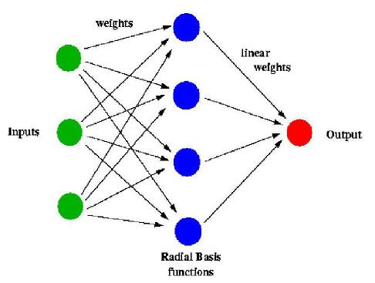
Purucker (1996) conducted one of the initial studies on predicting results in the National Football League (NFL) using an ANN model.

Slide 7
BRIEF ON SYSTEM:
Main match events-
Goals
Shots
Passes
Crosses
Possessions
Penalties & Free Kicks
Cards
Corners

Slide 8
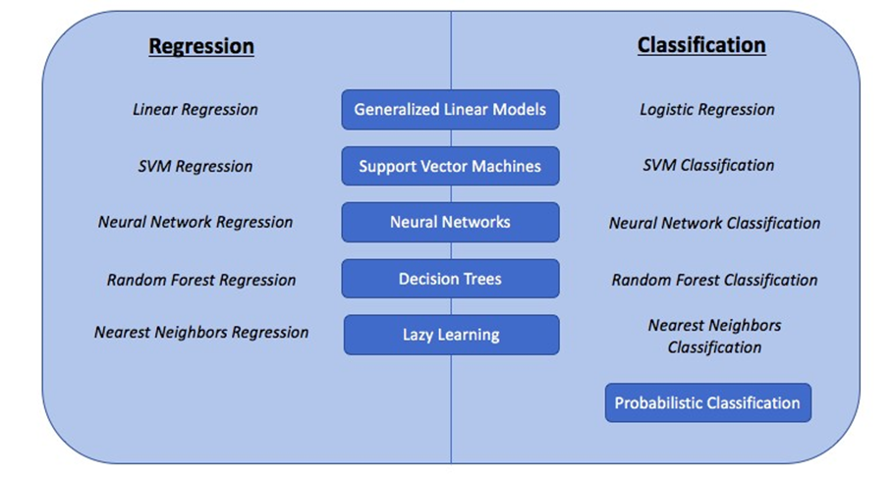
In following ways this problem can be solve

Slide 9
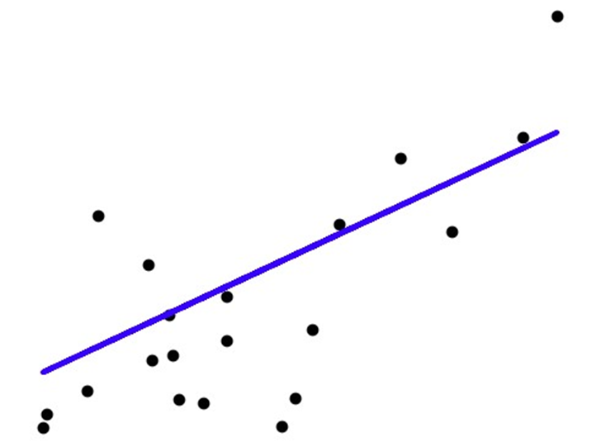
1)Generalized Linear Models
Figure : Linear Regression technique

Slide 10
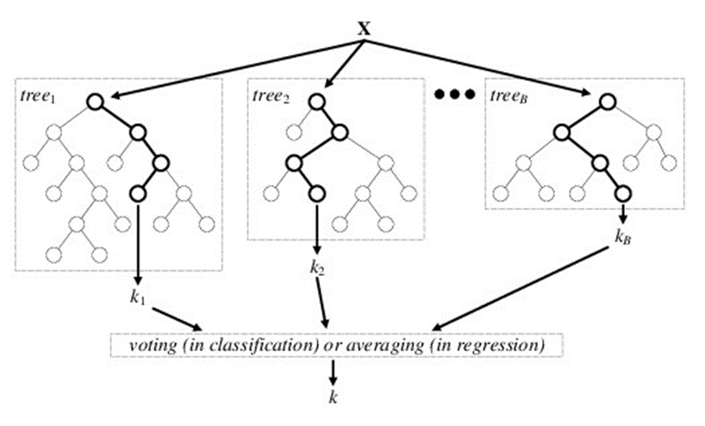
2) Decision Trees:
Figure: Random Forest technique

Slide 11
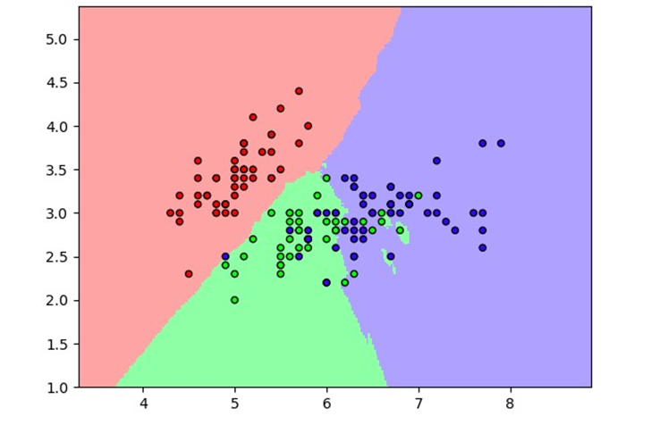
3) Lazy learning:
Figure : k-Nearest-Neighbors classification

Slide 12
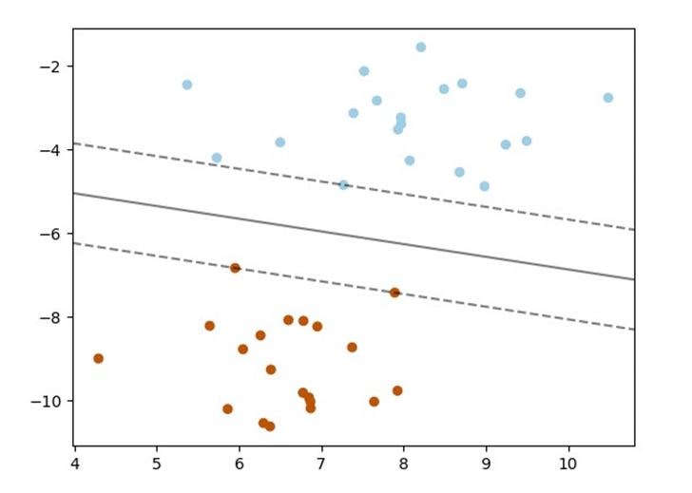
4)Support Vector Machines
Figure : SVM Hyperplane for classification

Slide 13
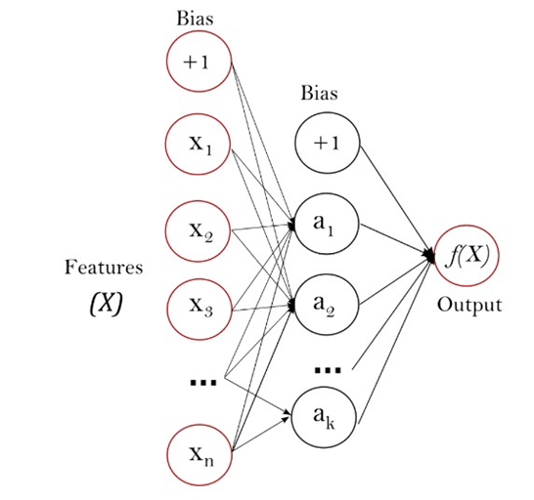
5)Neural Network models
Figure : Neural Network diagram

Slide 14
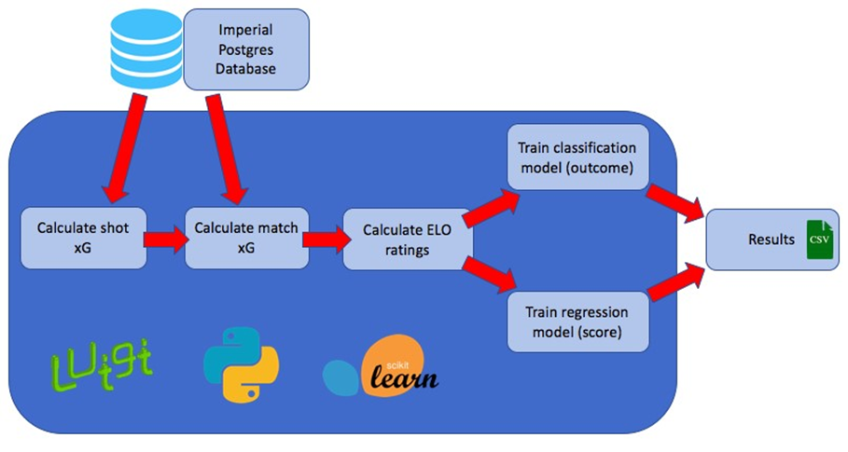
General pipeline

Slide 15
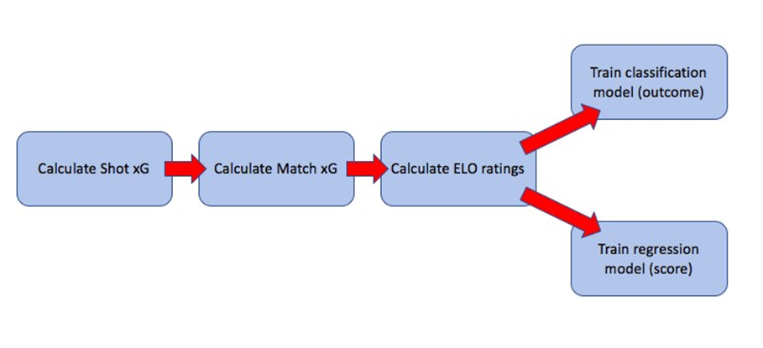
DESIGN
Model components-

Slide 16
Testing
Mean Absolute Error
Root Mean Squared Error
Accuracy

Slide 17
CONCLUSION:
Our main objective of building an expected goals model by exploring different Machine Learning techniques has been accomplished. Indeed, we used modern Machine Learning algorithms such as Neural Networks, Random Forest and Support Vector Machines techniques to generate match outcome and match score predictions.
We managed to find and improve a database containing enough information to generate expected goals metrics, through both shots and other in-game statistics, and ELO team ratings.
A model training and testing pipeline was built to quickly and easily tweak our model and try different hypotheses, using Luigi to link our different model components together.
.

Slide 18
We have also compared our predictions to benchmark methods in order to better understand our models’ predictive performance. We have crucially found that our expected goals models achieve a similar performance to bookmakers’ odds, and that using expected goals instead of actual goals in traditional models such as the Dixon & Coles model, helps achieve better predictive performance

Slide 19
References:
https://www.sciencedirect.com/science/article/pii/S2210832717301485
https://www.researchgate.net/publication/319937079_A_Machine_Learning_Framework_for_Sport_Result_Prediction
https://www.northeastern.edu/rise/presentations/machine-learning-on-sports-prediction/

Slide 20
Thank you

