Slide 1
CONCURRENCY IN GOLANG
GOROUTINES & CHANNELS

Slide 2
OUTLINE OF THE PRESENTATION
7/28/2023
CONCURRENCY VS PARALLELISM
WHY DO WE NEED CONCURRENCY
HOW DOES GO IMPLEMENT CONCURRENCY
THREADS VS GOROUTINES
BEHIND THE SCENES
CODE-SNIPPETS
CONCLUSION
Presentation by Pankaj Gupta

Slide 3
CONCURRENCY VS PARALLELISM
Often the two terms are used interchangeably but actually are different
PARALLEL | CONCURRENT
Parallel – Separate hardware allocated to two tasks so that they are actually running alongside each other Example – Two tasks running on different cores in a multi-core processor | Concurrent – Start time and end time is same. Often, the impression for end user is that they ran in parallel but that’s not the case. Context switching is involved to manage overlap between start time and end time. Example – Multitasking on a single core machine
Presentation by Pankaj Gupta

Slide 4
WHY DO WE NEED CONCURRENCY
Better throughput
Beyond a point, adding hardware capacity becomes impractical
Existing resources must be optimized to fullest
Presentation by Pankaj Gupta

Slide 5
HOW DOES GO IMPLEMENT concurrency
Go has an inbuilt concept of go-routines for implementing concurrency and a mechanism called channel for communication between them
Goroutine is lightweight execution thread in the Go programming language and a function that executes concurrently with the rest of the program.
Go routines can be conceptually understood as similar to threads
If goroutines need to interact with each other by sharing information, they need to use channels.
Presentation by Pankaj Gupta

Slide 6
Threads vs goroutines
PARAMETERS | THREADS | GOROUTINES
Creation | Heavyweight and slow | Lightweight and fast
Memory Usage | High | Low
Scheduling | Managed by OS | Managed by the Go runtime
Context Switching | Slow | Fast
Concurrency | Complex and Error Prone | Safe and easy to use
Scalability | Limited by number of available processors | High
Presentation by Pankaj Gupta

Slide 7
BEHIND THE SCENES (Abstracted)
Go Runtime - Manages execution of go programs including memory management, goroutine creation, channel operations, OS interaction etc
Go Scheduler - Responsible for managing Goroutines and scheduling them onto OS threads for execution. The Go scheduler handles the distribution of Goroutines across logical processors (P) and ensures optimal utilization of available processors.
Run queue - Used by the Go scheduler to store and manage Goroutines that are ready to run. Each logical processor (P) has its own run queue, and the scheduler schedules Goroutines from these queues onto the corresponding OS thread.

Slide 8
BEHIND THE SCENES (Abstracted)
Logical Processor (P) – Virtual processors managed by Go Scheduler. Created by Go Runtime at startup which acts a layer of indirection between goroutines and OS threads. Go Scheduler schedules goroutines into P’s run queues after which scheduler maps P into smaller OS threads.
Stealing – Distribution and balancing of workload between logical processors done by scheduler.
Spinning - Goroutine waits for a short period before getting scheduled again, as opposed to blocking or yielding the processor.
Garbage collector – Memory management

Slide 9
CODE SNIPPET - GOROUTINES
WITHOUT GOROUTINE
WITH GOROUTINES
package main
import "fmt"
func main() {
fmt.Println("Hello world")
}
package main
import "fmt“
func display1() {
fmt.Println("Hello world1")
}
func display2() {
fmt.Println("Hello world2")
}
func main() {
go display1()
go display2()
}
Presentation by Pankaj Gupta

Slide 10
package main
import (
"fmt"
"sync"
)
var wg sync.WaitGroup
func display1() {
fmt.Println("Hello world1")
wg.Done()
}
func display2() {
fmt.Println("Hello world2")
wg.Done()
}
func main() {
fmt.Println("Hello main")
go display1()
wg.Add(1)
go display2()
wg.Add(1)
fmt.Println("Hello main 2")
wg.Wait()
}
Presentation by Pankaj Gupta

Slide 11
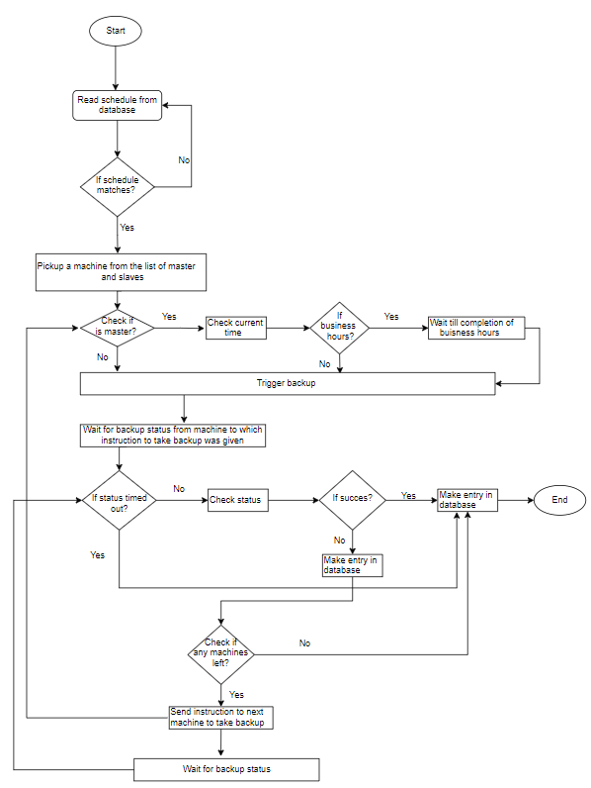
Presentation by Pankaj Gupta

Slide 12
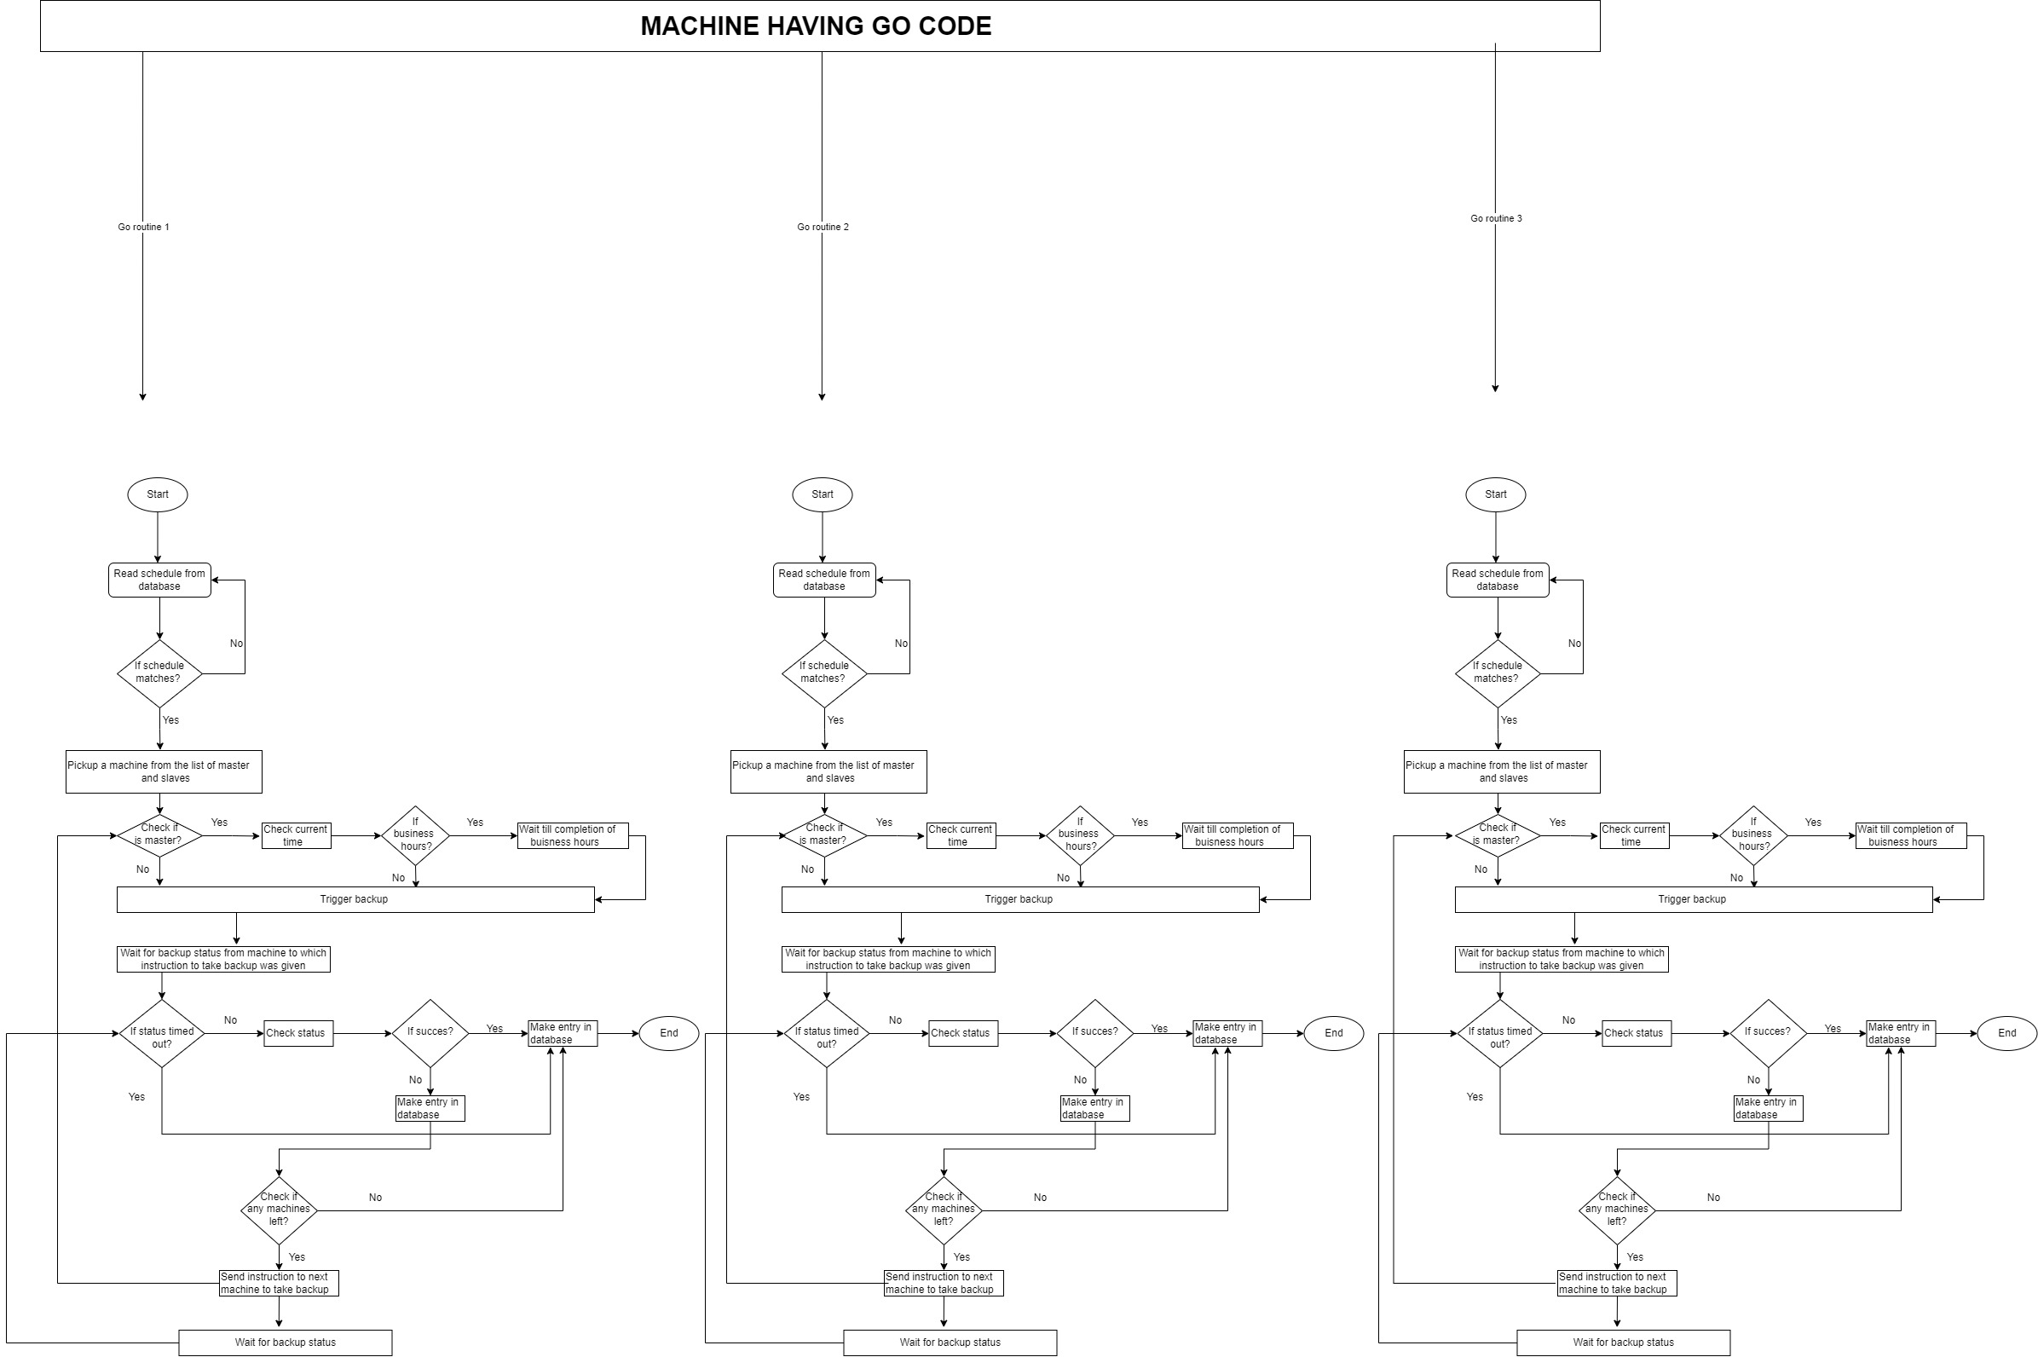
for{ I := 0;i<len(list_of_db_names)-1;i++ go take_backup(list_of_db_names[i]) }
Presentation by Pankaj Gupta

Slide 13
CODE SNIPPET - CHANNELS
package main
import (
"fmt"
"sync"
)
var ch = make(chan string, 5)
var wg sync.WaitGroup
func display1() {
fmt.Println("Hello world1")
ch <- "channel string"
}
func display2() {
fmt.Println("Hello world2")
str := <-ch
fmt.Println(str)
wg.Done()
}
func main() {
fmt.Println("Hello main")
go display1()
wg.Add(1)
go display2()
fmt.Println("Hello main 2")
wg.Wait()
}
Presentation by Pankaj Gupta

Slide 14
PRESENTATION CONCLUDES FEEDBACK & Questions…?
conclusion
Don't communicate by sharing memory; share memory by communicating
Presentation by Pankaj Gupta

