Slide 1

Central Data Science User Growth & Retention CR30 Retention Model

Slide 2
On the Menu Today…
Business Problem – Customer Retention
Design Framework
Customer Segmentation
Multiclass – Churn definition
Dependent Variable creation
Feature Reduction - Multiclass
Model Performance parameters
Strategic Inferencing
Strategic (CHI* + CLM 5.0 + Merchant Journeys + Others)
*Customer Happiness index

Slide 3
Define business problem [Agenda set]
Why churn model was required and some data/visualization to back it up.
Design framework:
1. How new/repeat/react customers were segmented and some data to back it up why they were segmented since they show different behavior.
2. How dependent variable is created. Talk about its design construct. How thresholds were decided , idea behind it. Also, why 5 classes are required as compare to simple binary class problem. Why we took only one snapshot and not multiple different month’s snapshots.
3. What model will do . How many different models we build ? How it will work. [multiclass// multi-label]
Features used in the model // talk about them // how we fetched them any challenge or new framework used to build them?
Feature reduction techniques used in the model . How were they different to implement in multiclass classification model . How we boiled down to final variables. [Can include excel in appendix]
Model performance .What was previous version of this model and how we redefined it.How we are going to target , its strategy and what all we are sharing on top of this.

Slide 4


Problem Statement
Business problem:
Customer retention is a metric that measures customer loyalty, or the ability for an organization to keep its customers over time.
Retention reflects customer satisfaction, repurchase behavior, customer engagement and emotional ties to a brand.
Improve customer retention by identifying the right target audience
Strategic Solution:
Develop data science model on customer behaviour and interactions after segmenting monthly active users (MAU) into 3 different categories – New | Repeat | React
Churn criteria: Update the churn definition to identify churn customers not only transaction behaviour but also their app activity
Existing Churn Def.
Modified Churn Def.
Customers who have not transacted in 30 days
Different Classes of churn based on the inactivity with respect to Transactions, app activity & drops in transaction/engagement
Note: MAU refers to customers who have performed at least 1 successful transaction in that particular month

Slide 5

Retention N30: Probability of churn in next 30 days
6.8 Mn
7.5 Mn
15.9 Mn
2.0 Mn
39.4 Mn
~71.8Mn
~9.5%
~10.5%
~22.4%
~2.8%
~54.9%
Monthly Active Customers
No Trans No App Activity
(Class -4)
No Trans App Activity Only
(Class – 3)
Drop in Transaction/ GMV
(Class – 2)
Good Customers
(Class – 0)
Drop in App Activity
(Class – 1)
5 Classes based on customers transaction & app activity
3 customer segments based on their app behaviour
Customers who have not transacted and don’t have any app activity in the performance month are selected in this class
This class has been given the highest priority because of no activity in both domains
This class has reduced by ~1.5% since
Customers who have not transacted and but have certain app activity in the performance month are selected in this class
This class has been given the second highest priority because of no transactions
Subsequent drop in transactions with respect to GMV and Counts. This makes a 3X3 grid of GMV and Trans Count.
Subsequent drop in transactions with respect to app opens and clicks This makes a 3X3 grid of open and Clicks.
Remaining MAU customers are considered as good customers.
They have > 0 % GMV & Trans growth along with >-25% app activity
Trans
Clicks
7.1 Mn
New
H-H | H-M
M-H
H-H
58.4%
Repeat
53.5 Mn
GMV
Opens
53.5%
54.5%
54.9%
React
11.3 Mn
~0.7% is the increment in this segment in last 4 months
(MAU)
<= 0%
Growth is selected for D2
<= -25%
Growth is selected for D1
% Good customer trend in last 4 months

Slide 6
Customer Segmentation
Determine homogeneous groups (segments) showing similar customer profile within the group, and distinctly different event rate across groups
The multiple segmented models work simultaneously on the respective sub-populations and predict more accurately than a single model.
New
Signup in last 6 months with1 successful transactions
26%
01
18%
Event Rate %
02
Population %
15.7%
5%
9.8%
Repeat
03
React
Customers active in current month but not active in last month
74.5%
Customers active in current month and active in previous month as well
Repeat
New
React
Overall Event Rate
9.5%

Slide 7
Design Construct - Drop in App Engagement(1/3)
MAU Month (Snapshot)
Snapshot
(Observation Period)
(Performance Period)
Last 3months
Next
Month
Last 3months
Next
Month
No. of app opening in the performance month
Avg. of app clicks in last 3m
No. of app clicks in the performance month
Avg. of app opening in last 3m
Calculate app opening growth
Calculate app clicks growth
Growth % | May‘23 | Apr'23 | Mar'23 | Feb'23 | Jan'23 | Dec'22
-100% - <= -50% | 14 | 18 | 20 | 15 | 15 | 18
-50% - <= -25% | 26 | 32 | 34 | 26 | 28 | 32
-25% - <= 0% | 40 | 47 | 50 | 40 | 43 | 49
0 - <=25% | 55 | 62 | 64 | 53 | 58 | 64
25% - <= 50% | 67 | 74 | 75 | 64 | 68 | 74
>50% | 100 | 100 | 100 | 100 | 100 | 100
Growth % | May'23 | Apr'23 | Mar'23 | Feb'23 | Jan'23 | Dec'22
-100% - <= -50% | 26 | 24 | 23 | 24 | 25 | 24
-50% - <= -25% | 43 | 39 | 38 | 38 | 42 | 40
-25% - <= 0% | 60 | 56 | 55 | 55 | 60 | 58
0 - <=25% | 72 | 67 | 67 | 66 | 71 | 70
25% - <= 50% | 80 | 77 | 76 | 75 | 79 | 78
>50% | 100 | 100 | 100 | 100 | 100 | 100
Percentile dist. divided into H/M/L based on domain knowledge and selected H-H
Growth
Thresholds
< -25% → High
- 25% --- 25% →Med
> 25% → Low
App Opened | High | Medium | Low | Grand Total
High | 15.25% | 1.44% | 4.86% | 21.56%
Medium | 10.08% | 9.34% | 4.66% | 24.08%
Low | 4.64% | 10.41% | 39.31% | 54.37%
Grand Total | 29.97% | 21.20% | 48.83% | 100.00%
Customers included in H-H
Class – 1
Drop in App Engagement

Slide 8
Design Construct - Drop in GMV/Transactions (2/3)
Snapshot
Snapshot
Last 3months
Next
Month
Last 3months
Next
Month
Total GMV in the
performance month
Total transactions in the performance month
Avg. total GMV in last 3m
Avg. total transactions in last 3m
Calculate GMV growth
Calculate transactions growth
Growth % | May‘23 | Apr'23 | Mar'23 | Feb'23 | Jan'23 | Dec'22
-100% - <= -50% | 44 | 43 | 44 | 48 | 56 | 53
-50% - <= -25% | 54 | 52 | 54 | 57 | 65 | 61
-25% - <= 0% | 62 | 60 | 62 | 65 | 72 | 69
0 - <=25% | 69 | 67 | 68 | 71 | 77 | 74
25% - <= 50% | 74 | 72 | 73 | 75 | 80 | 78
>50% | 100 | 100 | 100 | 100 | 100 | 100
Growth % | May'23 | Apr'23 | Mar'23 | Feb'23 | Jan'23 | Dec'22
-100% - <= -50% | 36 | 34 | 34 | 37 | 44 | 43
-50% - <= -25% | 47 | 44 | 44 | 46 | 54 | 52
-25% - <= 0% | 62 | 58 | 58 | 59 | 67 | 65
0 - <=25% | 71 | 67 | 67 | 68 | 74 | 72
25% - <= 50% | 79 | 76 | 76 | 76 | 81 | 80
>50% | 100 | 100 | 100 | 100 | 100 | 100
Percentile dist. divided into H/M/L based on domain knowledge and selected H-H, H-M, M-H
Growth
Thresholds
< -50% → High
- 0% --- 50% →Med
> 50% → Low
App Opened | High | Medium | Low | Grand Total
High | 31.92% | 8.38% | 4.32% | 44.62%
Medium | 2.60% | 8.50% | 6.83% | 17.93%
Low | 2.09% | 8.32% | 27.03% | 37.45%
Grand Total | 36.61% | 25.20% | 38.18% | 100.00%
Customers included in H-H | H – M | M - H
Class – 2
Drop in GMV/ Transactions Engagement

Slide 9




Design Construct - Non-Transacting (W & W/O App Activity)(3/3)
Class – 3
Customer active on app
Class – 0 Good Customers
Left at the end of dependent variable creation
1 Month
Snapshot
Performance Month
No Transactions in the Performance period
Class – 4
Customer Inactive on app

Slide 10
Design Construct - Final Dependent Variable
Final Dependent
Variable
Cust_ID | Class 4 | Class 3 | Class 2 | Class 1 | Class 0 | Final_dependent
100 | 1 | 0 | 1 | 0 | 0 | 4
101 | 0 | 1 | 0 | 0 | 0 | 3
102 | 0 | 0 | 1 | 1 | 0 | 2
103 | 0 | 0 | 0 | 1 | 0 | 1
104 | 0 | 0 | 0 | 0 | 0 | 0
105 | 0 | 1 | 1 | 1 | 0 | 3
Inactive: No Transactions
and App Inactive
D4
Inactive: No Transactions
and App active
Cust_ID | Class 4 | Class 3 | Class 2 | Class 1 | Class 0
100 | 1 | 0 | 1 | 0 | 0
101 | 0 | 1 | 0 | 0 | 0
102 | 0 | 0 | 1 | 1 | 0
103 | 0 | 0 | 0 | 1 | 0
104 | 0 | 0 | 0 | 0 | 0
105 | 0 | 1 | 1 | 1 | 0
Cust_ID | Final_dependent
100 | 4
101 | 3
102 | 2
103 | 1
104 | 0
105 | 3
D3
Drop in GMV/Transactions
D2
Drop in App
Engagement
Multi-label Classification
Can have multiple classes at once.
Classes are non- mutually exclusive
Classes can be predicted individually as binary classification or using
multi-output classifier.
Multi-Class Classification
Can have only one output class at once.
The classes are mutually exclusive.
SoftMax function is applied on final layer to select class having highest probability.
D1

Slide 11






Features coverage
mobile_recharge_pg_page_land_growth
qr_scans_open_growth
mobile_recharge_page_land_growth
App Activity
23 Attributes
Transaction Activity
RU_MB_prepaid_avg_gmv_Growth_Rate
RU_DTH_avg_gmv_Growth_Rate
RU_INS_txn_cnt_Growth_Rate
Customer Service
130 +
Distinct Attributes
35 Attributes
Days_since_last_complaint
num_tickets_opened
avg_resolution_time
Distinct Attributes: 40
Features selected:
Transaction
Failure
Customer Demographics
12.0%
App
50.0%
27 Attributes
Txn Activity
35.0%
Customer
Demographics
Txn_f_num_failed_txns
Txn_f_UPI_failed_txns
Txn_f_unique_L1_issue
12 Attributes
CST
13.0%
Popular city
Age
Tenure

Slide 12
Feature Reduction Techniques – Multiclass modifications
DQ
Encoding/Imputation
F – Score*
PSI
Bivariate Analysis*
Information Value*
IV after Encoding*
Correlation
FI using random Variable
Model Iterations
*
These are the techniques which are used differently to reduce the features in multi-class classification model

Slide 13
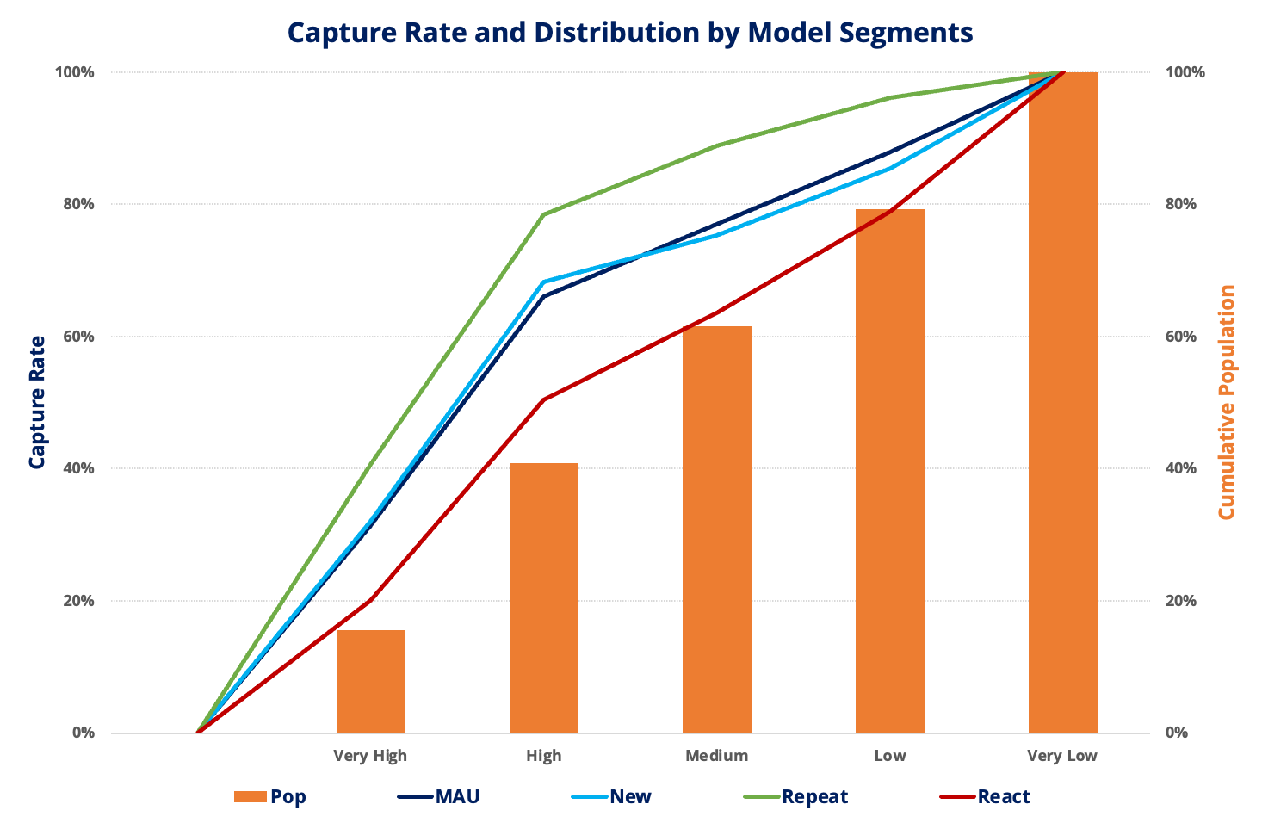
Retention N30 New Model Validation
Multi-Segment Multi-Class ML model for precision targeting
3 customer segments based on their app behaviour
5 Classes based on customers transaction & app activity
Probability of Churn along with Severity in next 30 days
*Out-of-Time (OOT) Validation results for MAU over performance

Slide 14
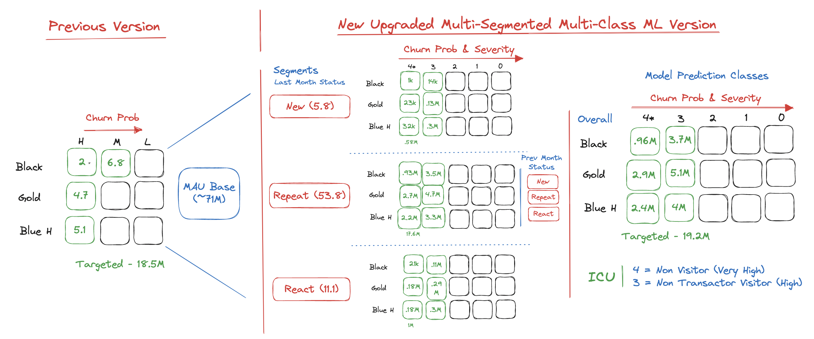
Targeting Strategy
Differential channel, communication and treatment as per Micro-Segment
*Black/Gold/Blue-H correspond to Pro-Max/Pro/Classic-High respectively

Slide 15
Inferencing – Output Schema
customer_id | Group | affluence_score | cltv | loyalty_tier | global_cluster | total_transactions | total_sessions | if_txn_before_10 | city_tier | is_merchant | top_spending_category | top_spend_decreasing_category | top_visiting_category
1000001019 | Very_high | 4 | 7 | PF Pro Max | 2.LOYALIST | 4 | 480 | 1 | Tier-3 | 0 | Recharge | Recharge | RU_Telecom
1000004016 | Very_high | 6 | 6 | PF Pro | 4.ATTENTION-SEEKER | 3 | 40 | 0 | Tier-1 | 0 | Education | Grocery | Deals
1000006001 | High | 4 | 5 | PF Pro | 3.PROMISOR | 3 | 271 | 1 | Tier-3 | 0 | Deals | Online Food Delivery | Deals
1000021238 | High | 5 | 7 | PF Pro Max | 2.LOYALIST | 1 | 13 | 1 | Tier-2 | 0 | Utilities | Grocery | RU-Transit
1000028110 | High | 3 | 4 | PF Pro | 3.PROMISOR | 2 | 282 | 1 | Tier-3 | 0 | Recharge | Recharge | RU_Telecom
1000034761 | Very_high | 4 | 3 | PF Pro | 4.ATTENTION-SEEKER | 1 | 1 | 0 | Tier-2 | 0 | Recharge | null | RU_Telecom
1000048271 | High | 3 | 5 | PF Pro | 3.PROMISOR | 10 | 1149 | 0 | Tier-2 | 1 | Recharge | Utilities | Deals
1000059545 | High | 2 | 2 | PF Pro | 3.PROMISOR | 1 | 272 | 0 | Others/Missing | 0 | Recharge | null | RU_Telecom
1000069663 | Very_high | 2 | 2 | PF Pro | 3.PROMISOR | 1 | 297 | 0 | Others/Missing | 0 | Utilities | Recharge | RU_Household
1000080902 | High | 4 | 4 | PF Classic High | 6.NAPSTER | 2 | 11 | 1 | Tier-3 | 0 | Travel | null | RU_Telecom
1000146878 | High | 4 | 7 | PF Pro | 2.LOYALIST | 3 | 334 | 0 | Metro | 1 | Recharge | Travel | RU-Transit
1000196445 | Very_high | 3 | 6 | PF Pro | 2.LOYALIST | 1 | 359 | 1 | Metro | 0 | Restaurant | Restaurant | RU_Household

