Slide 1

Forgiveness/Kshma
The Practical Aspect

Slide 2
What is Kshama, Forgiveness?
  Absence or lack of anger is Kshama
  To reduce anger, win over depression and stress - leads to hope, peace, compassion and self confidence
  Remain in your own nature is Kshma

Slide 3
Who do we Kshama
  Self
    I get angry when this situations occur
    I lost control over myself when i see that
    I hurt myself when i am angry, unforgiving, cruel, pathetic, deprived or sad
  Others
    Because of my kids i got angry
    Because he/she do not listen to me, respect me, not pay attention to me, treats me bad, did not follow what say
    Other situations like: flight got late , tsunami, earthquake, weather or and other person who makes me angry

Slide 4
अध्यात्म की क्षमा :
Kshama is the true nature(swabhav) of our soul (Atma) so if you are in bebhav you are collection Karma.
  अधयात्म में क्षमा का कोई स्थान नहीं है तुम एक शुद्ध आत्मा हो और कर्म हे दुःख और सुख तुम्हारी आत्मा मे उत्पन्न करने वाले है कर्म तुम्हारे नहीं है सिर्फ आत्मा हे तुम हो!! इसलिए क्षमा का भी कोई स्थान नहीं है
  अगर कोई तुमे कुछ बुरा वचन कहता है तो वह तो पुत्गल के ही परमाणु है- जेसे मुनि की निंदा और प्रशंशा में मुनि सदा समय भाव रखते है
  अगर तुहारे शरीर को तकलीफ देता है तो शरीर तो तुम्हारा नहीं है जेसे - मुनि सुकमाल स्वामी को तो ३ दिन तक सियालनी खाती रही पर वे अपने स्वरूप से नहीं डिगे.

Slide 5
Practical 5 steps of Kshma
  Step 1
  Accept that injustice happen to you and I am victim but I will not take this presser on my soul of anger – I will try to resolve it
  Look at your kashya closely – I got carried away when i watch movie
  I cannot see the injustice
  Other person krodh make me angry too
  I see kids crying for no reason
  Someone make mess
  Watching news
  Listening radio
  Coworkers remarks
  Someone point out my mistakes

Slide 6

  Step 2
  Look your kashay krodh as a separate element from your soul by coloring it green bubbly thick and smelly liquid
  Take control and fight your anger
  Commit to yourself that you will do whatever it takes to feel better
  This Kashya make your away from the peace which your soul deserve

Slide 7
  Step3
  See and believe that green liquid kashya making your soul dirty and poisoned day by day.
  Each day if you are caring the load of kashya on your soul and each day it’s getting thicker
  Krodh and kashya make other emotion and senses infected too:
  When you are sad it seems sky is crying
  Krodh make your cruelty, ego, passion, affected too
  Krodh affect your body too – give you many long term disease- diabetes, blood presser, heart disease and etc
  You cannot concentrate on your work, family and social life even your sleep is disillusioned and stressful.

Slide 8
  Step4
  Watch your soul when the situation occur.
  Do not make your self carried away stay close to your self.
  If you don’t like somebody and his/her talk – make this effort –you will not be affected today
  Do not think about his/her words can hurt you
  Do not support you anger or justify your behavior
  If you see some injustice think there is nothing injustice in this world ...everybody has to bear his/her own karma but be sympathetic to the sufferer and pray for his/her mental peace.

Slide 9
  Step 5- Scan your krodh at some point of time प्रतिक्रमण (no matter somebody make you do it or you hurt somebody’s feeling in rage) and ask for forgiveness and erase it “मिथ्या हो ”
  Gartha – Tell your sin in front of your Guru, or friend you trust, God
  Prakkhyaan- I will promise to not to replete the mistake.
  Pashchit- Take a upwass, any kinds of vert to erase it

Slide 10
Gandhi’s Top 10 Fundamentals
  1.Change yourself: You must be the change you want to see in the world.
  2. You are in control: Nobody can hurt me without my permission.
  3. Forgive and let it go: The weak can never forgive. Forgiveness is the attribute of the strong.
  4. Without action you aren’t going anywhere: An ounce of practice is worth more than tons of preaching.
  5. Take care of this moment: I do not want to foresee the future. I am concerned with taking care of the present. God has given me no control over the moment following.
  6. Everyone is human: I claim to be a simple individual liable to err like any other fellow mortal. I own, however, that I have humility enough to confess my errors and to retrace my steps.

Slide 11
  7. Persist: First they ignore you, then they laugh at you, then they fight you, then you win.
  8. See the good in people and help them: I look only to the good qualities of men. Not being faultless myself, I won’t presume to probe into the faults of others.
  9. Be congruent, be authentic, be your true self: Happiness is when what you think, what you say, and what you do are in harmony.
  10. Continue to grow and evolve: Constant development is the law of life, and a man who always tries to maintain his dogmas in order to appear consistent drives himself into a false position.
  Forgiveness is about personal power. Amend your grievance story to remind you of the heroic choice to forgive. Anger is the lead emotion to destroy the peace. It makes nervous both

Slide 12
Benefits of forgiveness on body and soul
  In Ayurveda- digestion is metaphorically metabolic process, we receive, process, and incorporate all of the material of our daily lives.
  Experiencing emotional or physical trauma- does not get thoroughly processed through healthy emotional channels, or you do not allow yourself to experience pain and grief and let them pass
  Thoughts, feelings, and experiences are matter – with weight and space - which can hang heavy around us.
  Undigested emotions crowd your heart- Will be noticeable - from our bodies, our speech, our sleep patterns, our interactions with our co-workers and loved ones.
  Have you ever made a confession, or had a good cry, after which you literally felt *lighter*? no mistake - that was the metabolic process in action.

Slide 13
Uttam Kshma
  Sahdu ki kshma – they believe that atma is different from any other
  They do not have the feeling of “Krodh”
  Being mad is a Vibav not the swabahv
  Karma ka uday make the situations not the human being

Slide 14
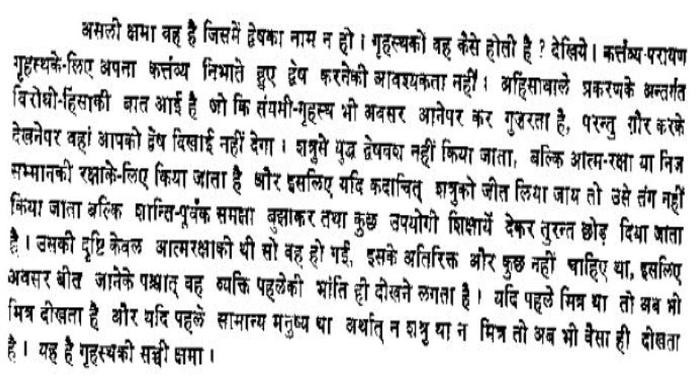

Slide 15
  हे आत्मन तू अपने आप को मत सता तू तो ज्ञानमय ईश्वर सम परम पवत्र है और सब विवादों से परे है अपने महान आश्वर्य को देखो और उसकी रक्षा करो अपने पर दया करो और और अपने आप को क्षमा करो अपने आप में क्षमा आयगी तो उतम क्षमा बनेगी.
  मैं दुसरे जीवों के कुसूर को बिलकुल माफ़ केर देता होऊं ये द्रस्ती अपने आप में हो, ये विशवास अपने आप में हो तो वह मिथ्यात्व है जेसे लोग कहते है "मैंने क्षमा कर दिया अरे वह क्षमा नहीं है उत्तम क्षमा हो तो अपने को क्षमा की मति बना देती है अपने आपकी दिया में सबकी दया आ जायगी जो अपने आप को सहज स्वरूप के दर्शन में लगने की लिया लालायित है उसके लिए दुसरे की अपराधो में लगने से क्या ?
  वह दुसरे के अपराधों को दिल में रखेगा क्या ? दुसरे की क्षमा सहज बन जाएगी

Slide 16
उत्तम क्षमा

