Slide 1

Learning How To learn : Powerful mental tool to help you master tough subject
BY: Pankaj kale

Slide 2
Modes of Learning
Forming chunks for learning
Illusion of competence
Procrastination and Tools to overcome it

Slide 3
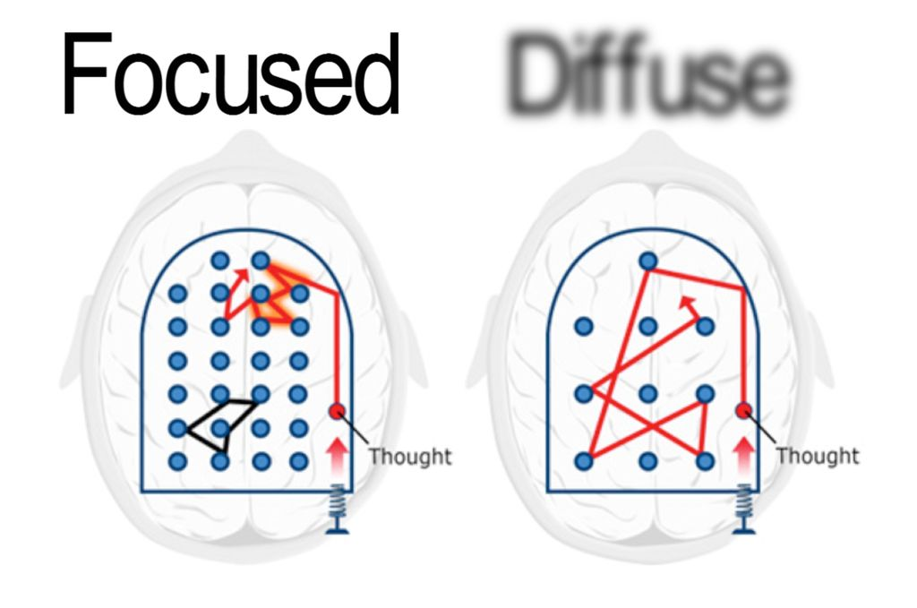
Modes of Learning :
• Focused
• Diffused
• To learn something new – go back and forth between the FOCUS and DIFFUSE Modes
• Learning something difficult takes TIME!
• Path to EXPERTISE is built bit by bit
• Learning changes the structure of the brain

Slide 4
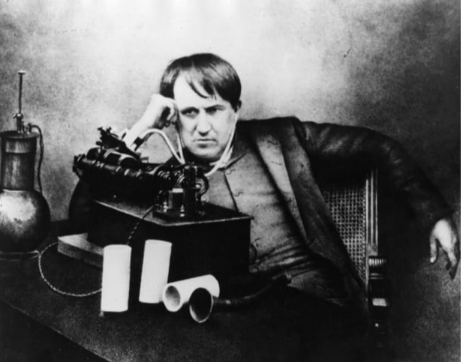

Slide 5



Think about it…
How do you SWITCH from Focused to Diffuse mode?

Slide 6
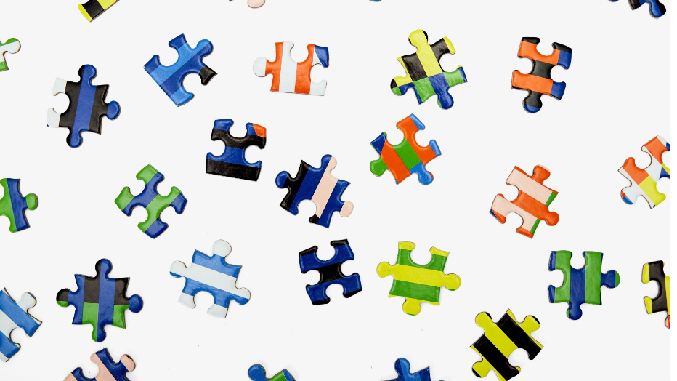

Chunking
Pieces of information bound together through meaning
Packages of information your brain can easily access
Chunking = Efficient BRAIN

Slide 7

How to form Chunks?
Focus on the information.
Understand basic/main ideas “You want your brain to become used to the idea that just knowing how to use a particular problem-solving technique isn’t enough – you also need to know when to use it.” Oakley, p.75.
Focus , practice and Repetition.

Slide 8

Illusion of competence
Recall – Learn far more and at much deeper level.
Mini-Testing – Making sure you are learning and not fooling yourself.

Slide 9
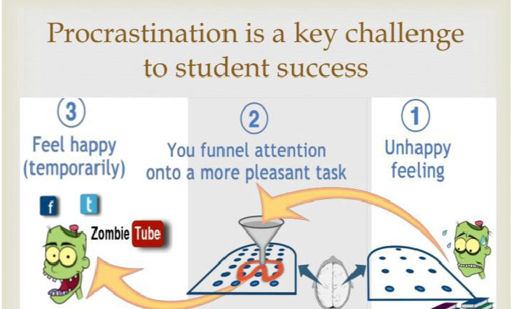
PROCRASTINATION
Brain’s pain-center activates when we think about something we don’t want to do
Making a choice to “procrastinate” gives temporary relief (ONLY)

Slide 10
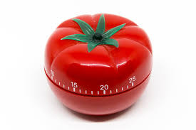
POMODORO TECHNIQUE
25 Minute
No Interruption
Focus
Reward

Slide 11
Key Takeaways :
Start using focused and diffused mode.
Create chunks of information and make bigger chunks of information.
Use techniques like pomodoro to avoid procrastination and learn difficult subjects.

Slide 12
THANK YOU !

