Slide 1
MANUFACTURING
Assignment

Slide 2
Use Case –Manufacturing
Block
Mill
Tooth
Make a part ( Job ) by destructive manufacturing
Example – Tooth made from composite block based on dentist’s prescription
Mill in the diagram is machine which takes a block of material and creates the required shape
Mill is connected and controlled by application running on a computer connected to it
Milling stations are IoT enabled and track machine status updates and job status updates . Examples below
Cancel Job based on dentist’s request
Mill state changes from making to calibration
Monitor voltage supply , temperature of mill

Slide 3
Use Case –Manufacturing Elaboration
There can be multiple instances of mills based on throughput requirements
There is a main component which controls the working of the stations
Start Mill
Stop Mill
Cancel Job
Switch To Calibration
Receive Temperature as continues stream
Maintain normal and prioritized jobs
Mill and main component communicate via messages, events and commands
Job updates and machine updates are stored in a database for further analytics
Data transmitted is encrypted
Database access is passport protected
Main
Mill
Mill
Mill
Mill
Mill

Slide 4
Solution Design
Normal Messages
Priority Messages
Component
Abstract class to
support different
Types of components
Thread Safe
collections
has
inherits
Main
Mill
One main to many mills
Messages
Commands
Events
Streams
Store job updates
and machine updates

Slide 5
Solution Design
Producer
Queue
Consumer
Listen
Insert
Listen
In our example main and mill can act as producer as well as consumer

Slide 6
Component Technicals
Main
Maintains concurrent normal and priority queue.
C# doesn’t have priority queue so two queue needed ( or create our own using LinkedList )
Maintains callback to mills
Issues commands, messages and events
Stores updates in the database
Implemented as a class type
Mill
Process jobs
Publish job updates via messages and events
Publish machine updates via messages and events
Issues commands like calibrate
Issues temperature data stream to monitor it’s health
Implemented as a class type
Message
Header – Sender, Date, priority , feedback, encrypt
Implemented has a record type, immutable
Body – content
Implemented has a record type, immutable

Slide 7
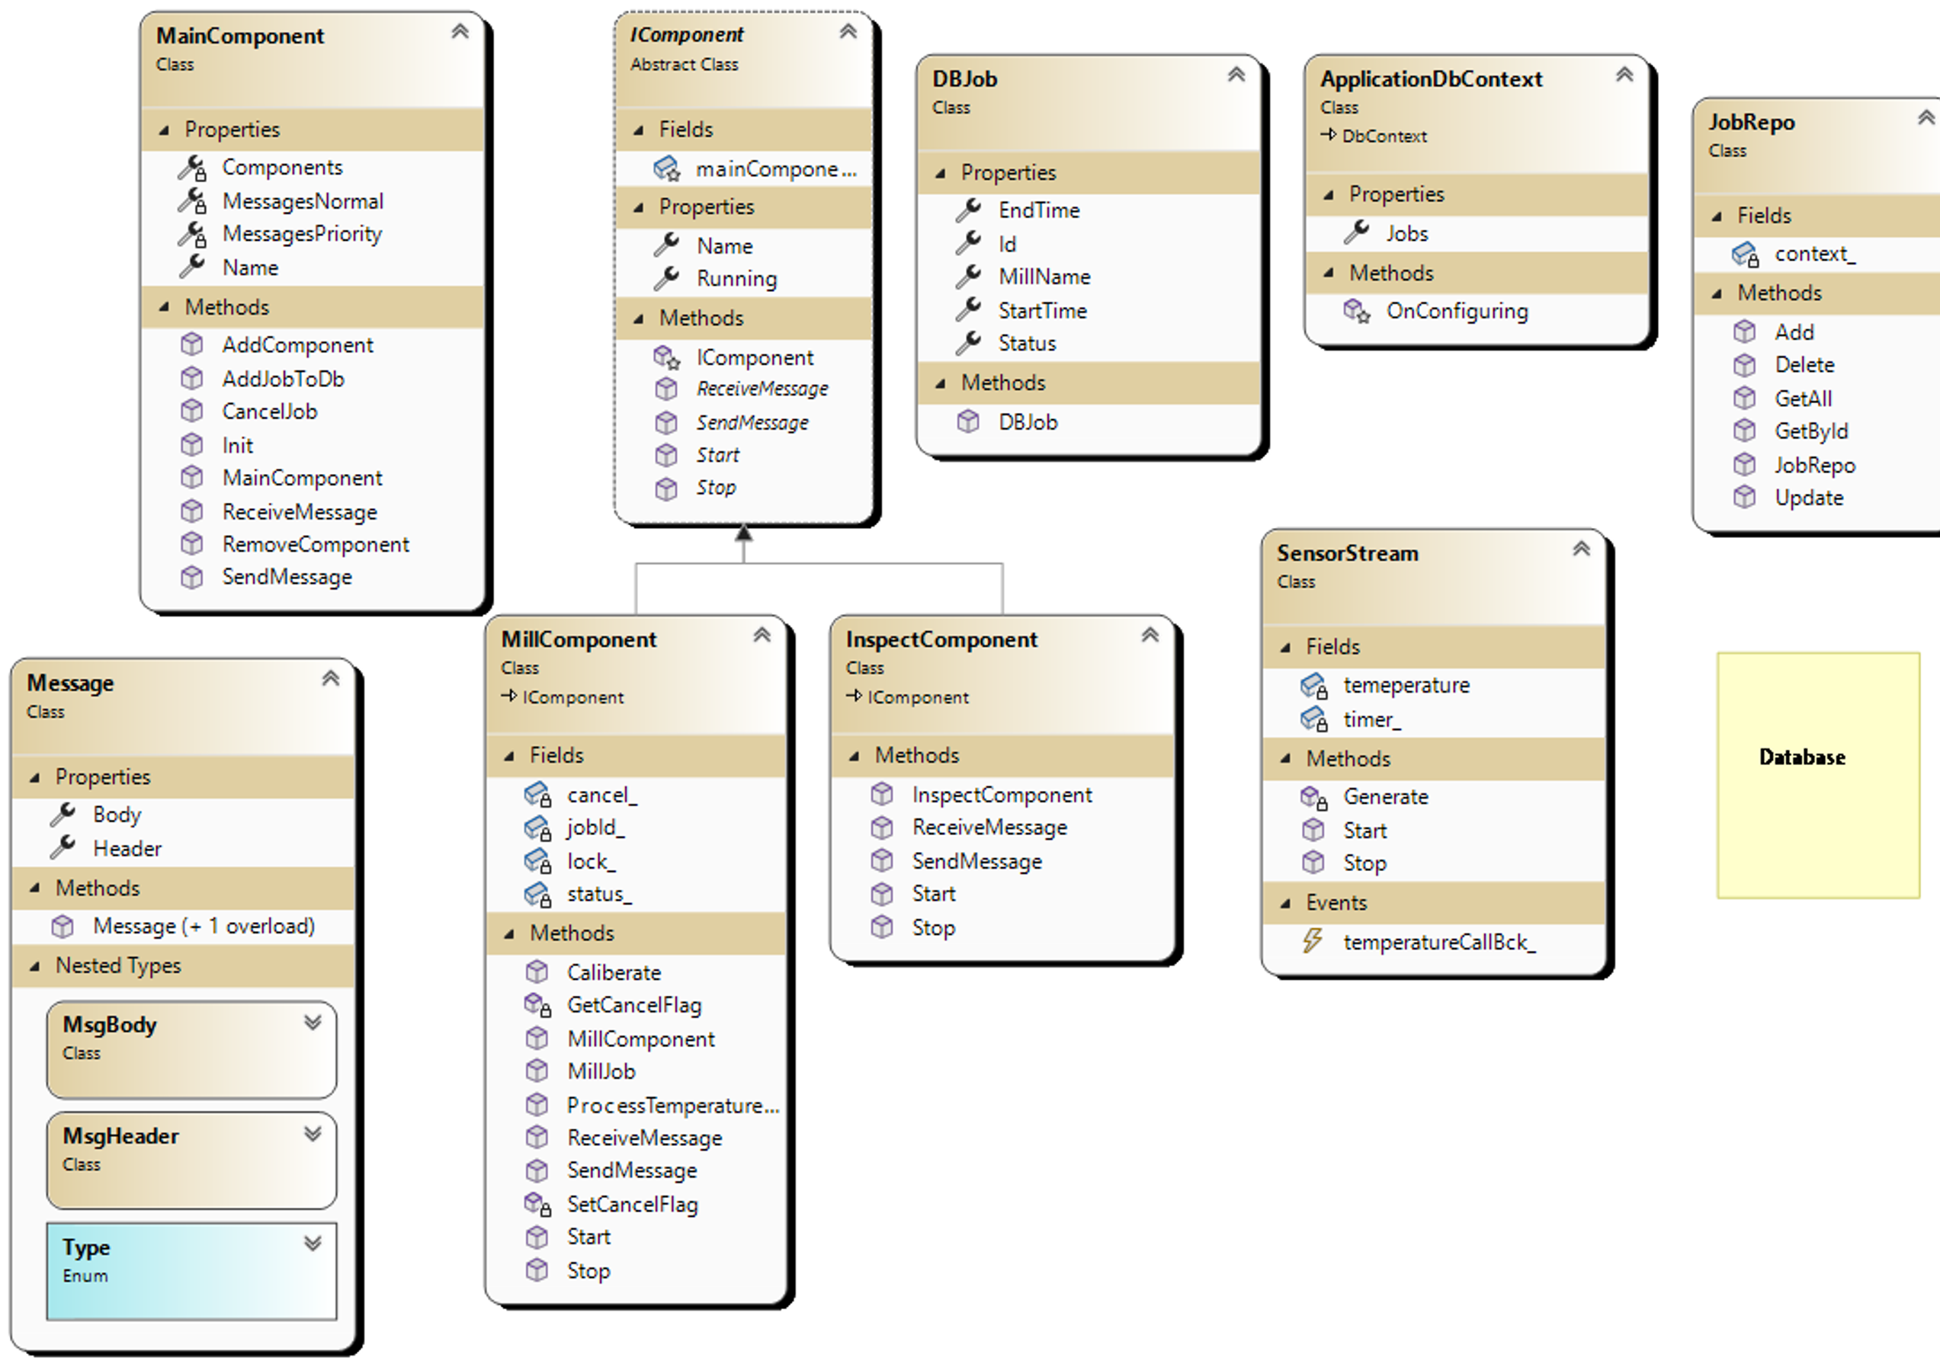
Class Diagram

