Slide 1
MANUFACTURING
Assignment

Slide 2
Use Case –Manufacturing
Block
Mill
Tooth
Make a part ( Job ) by destructive manufacturing
Example – Tooth made from composite block based on dentist’s prescription
Mill in the diagram is machine which takes a block of material and creates the required shape
Mill is connected and controlled by application running on a computer connected to it
Milling stations publish machine status updates and job status updates
Mill is connected to a main component and communicates to it via messages

Slide 3
Use Case –Manufacturing Elaboration
There can be multiple instances of mills based on throughput requirements
Following use cases are coded
Start Mill
Stop Mill
Cancel Job
Switch To Calibration
Receive Temperature as continues stream
Maintain normal and prioritized jobs
Mill and main component communicate via
Messages ( Calibrate)
Events (start ,stop)
Commands ( cancel )
Job updates are stored in a database for further analytics
Data transmitted is encrypted
Database access is controlled via public private key
Main
Mill
Mill
Mill
Mill
Mill

Slide 4
Solution Design/HLD
Normal Messages
Priority Messages
Component
Abstract class to
support different
Types of components
Thread Safe
collections
Uses
Encryption service
inherits
has
Main
Mill
Store job updates
One main to many mills
Messages
Commands
Events
Streams

Slide 5
Solution Design
Producer
Queue
Consumer
Listen
Insert
Listen
In our example main and mill both can act as producer as well as consumer

Slide 6
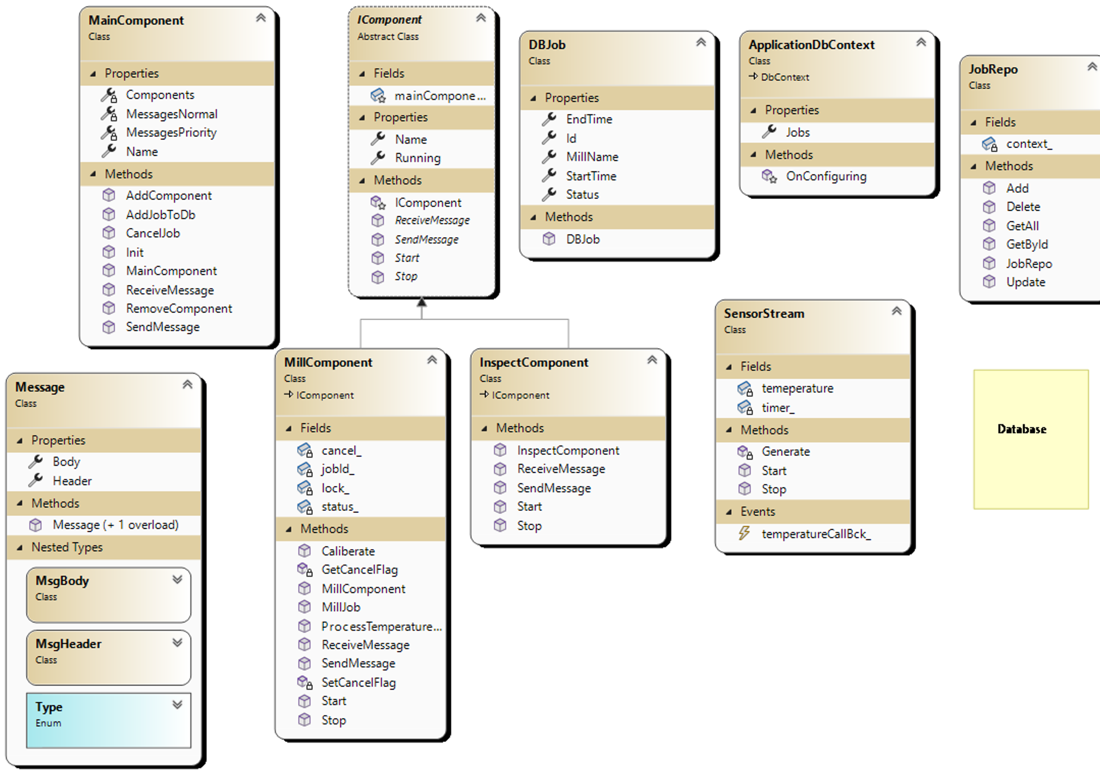
Class Diagram

Slide 7
LLD and implementation notes
Main
Maintains concurrent normal and priority queue.
C# doesn’t have priority queue so two queue used ( or create our own using LinkedList )
Maintains callback to mills
Issues commands, messages and events
Stores updates in the database
Implemented as a class type
Mill
Process jobs
Publish job updates via messages and events
Publish machine updates via messages and events
Issues commands like calibrate
Issues temperature data stream to monitor it’s health
Implemented as a class type
Message
Header – Sender, Date, priority , feedback, encrypt
Implemented has a record type, immutable
Body – content
Implemented has a record type, immutable

Slide 8
LLD and implementation notes
Encryption
Transmitted data can be encryption and decrypted using the class provided
Integration to message structure is not fully done
Database
Data at can be encrypted
Uses Entity Framework as ORM tool which makes is agnostic to specific RDBMS choice
Depending on the use case can also use non relational DB or combination of both
In current SQLite is used and, on every run, new db file is created to demo
Multi-threading and responsiveness
Async wait for responsiveness and threads for performance are used
Sleeps are used to demo the functionality
Test
Tests are written in program.cs
In real project, we can a google test , NUnit test projects
Configuration
Appsettings.json and configuration builder is used . Instead, settings could have been used as well

Slide 9
THANK YOU
Much more could be done to make this a real project application….

