Slide 1
SAMPLING
METHODS
UTKARSH KULSHRESTHA

Slide 2
Populations vs. Samples
Who = Population:
  all individuals of interest
  US Voters, Dentists, College students, Children
What = Parameter
  Characteristic of population
Problem: can’t study/survey whole pop
Solution: Use a sample for the “who”
  subset, selected from population
  calculate a statistic for the “what”
Notes:
Sampling makes research possible
Samples should be representative of the population – characteristics of the sample participants accurately reflect the characteristics of the population.

Slide 3
Types of Sampling
Simple Random Sampling
Stratified Random Sampling
Cluster Sampling
Systematic Sampling
Representative Sampling (Can be stratified random or quota sampling)
Convenience or Haphazard Sampling
Sampling with Replacement vs. Sampling without Replacement

Slide 4
Types of Statistics
Descriptive statistics:
  Organize and summarize scores from samples
Inferential statistics:
  Infer information about the population based on what we know from sample data
  Decide if an experimental manipulation has had an effect
Notes:
Descriptive stats are procedures used for organizing and summarizing scores in a sample so that we can describe or communicate about variables of interest.
Note: applies only to the sample (says nothing about how accurately the data may reflect what goes on in the population).
E.g. – mean (average), mode, median, frequency distribution
Use sample statistics to “infer” something about relationships in the entire population. Assumes sample is representative of population.
Procedures designed to test whether we would be likely to find the same results with another sample drawn from the same population – in fact, mathematically tests whether the sample results would be obtained if all possible samples from the population were tested. Also, attempts to rule out chance as an explanation for the results - that results reflect real relationships that exist in the population and aren’t random or “lucky”. (We’ll get to this at the end of the semester and next semester).
But before you can describe or evaluate a relationship using statistics, you need to design your study so that your research question can be addressed. This is where research design and methodology come in.

Slide 5
THE BIG PICTURE OF STATISTICS
Theory
Question to answer / Hypothesis to test
Design Research Study
Collect Data
(measurements, observations)
Organize and make sense of the #s
USING STATISTICS!
Depends on our goal:
Describe characteristics Test hypothesis, Make conclusions,
organize, summarize, condense data interpret data, understand relations
DESCRIPTIVE STATISTICS INFERENTIAL STATISTICS

Slide 6
Types of Variables
Quantitative
  Measured in amounts
  Ht, Wt, Test score
Discrete:
  separate categories
  Letter grade
Qualitative
  Measured in categories
  Gender, race, diagnosis
Continuous:
  infinite values in between
  GPA
Notes:
Can be quantitative (measured in amounts)
e.g., height, weight, test score, ratings.
Or qualitative (categorical)
e.g., gender, race, diagnosis.

Slide 7
Scales of Measurement
Nominal Scale: Categories, labels, data carry no numerical value
Ordinal Scale: Rank ordered data, but no information about distance between ranks
Interval Scale: Degree of distance between scores can be assessed with standard sized intervals
Ratio Scale: Same as interval scale with an absolute zero point.

Slide 8
SAMPLING
A sample is “a smaller (but hopefully representative) collection of units from a population used to determine truths about that population” (Field, 2005)
Why sample?
  Resources (time, money) and workload
  Gives results with known accuracy that can be calculated mathematically
The sampling frame is the list from which the potential respondents are drawn
  Registrar’s office
  Class rosters
  Must assess sampling frame errors
Notes:
Sampling frame errors: university versus personal email addresses; changing class rosters; are all students in your population of interest represented?

Slide 9
SAMPLING……
What is your population of interest?
    To whom do you want to generalize your results?
      All doctors
      School children
      Indians
      Women aged 15-45 years
      Other
Can you sample the entire population?
Notes:
How do we determine our population of interest?
Administrators can tell us
We notice anecdotally or through qualitative research that a particular subgroup of students is experiencing higher risk
We decide to do everyone and go from there
3 factors that influence sample representativeness
Sampling procedure
Sample size
Participation (response)
When might you sample the entire population?
When your population is very small
When you have extensive resources
When you don’t expect a very high response

Slide 10
SAMPLING…….
3 factors that influence sample representative-ness
    Sampling procedure
    Sample size
    Participation (response)
When might you sample the entire population?
    When your population is very small
    When you have extensive resources
    When you don’t expect a very high response

Slide 11
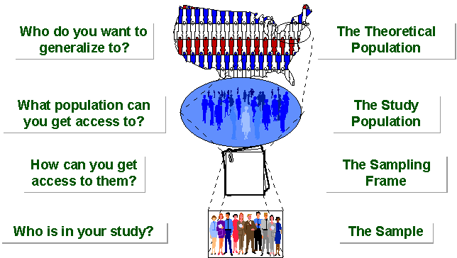
SAMPLING BREAKDOWN
Notes:
Picture of sampling breakdown

Slide 12
SAMPLING…….
STUDY POPULATION
SAMPLE
TARGET POPULATION

Slide 13
Types of Samples
Probability (Random) Samples
Simple random sample
  Systematic random sample
  Stratified random sample
  Multistage sample
  Multiphase sample
  Cluster sample
Non-Probability Samples
  Convenience sample
  Purposive sample
  Quota
Notes:
Two general approaches to sampling are used in social science research. With probability sampling, all elements (e.g., persons, households) in the population have some opportunity of being included in the sample, and the mathematical probability that any one of them will be selected can be calculated. With nonprobability sampling, in contrast, population elements are selected on the basis of their availability (e.g., because they volunteered) or because of the researcher's personal judgment that they are representative. The consequence is that an unknown portion of the population is excluded (e.g., those who did not volunteer). One of the most common types of nonprobability sample is called a convenience sample – not because such samples are necessarily easy to recruit, but because the researcher uses whatever individuals are available rather than selecting from the entire population.
Because some members of the population have no chance of being sampled, the extent to which a convenience sample – regardless of its size – actually represents the entire population cannot be known

Slide 14
SIMPLE RANDOM SAMPLING
Applicable when population is small, homogeneous & readily available
All subsets of the frame are given an equal probability. Each element of the frame thus has an equal probability of selection.
It provides for greatest number of possible samples. This is done by assigning a number to each unit in the sampling frame.
A table of random number or lottery system is used to determine which units are to be selected.

Slide 15
SIMPLE RANDOM SAMPLING….
Estimates are easy to calculate.
Disadvantages
If sampling frame large, this method impracticable.
Minority subgroups of interest in population may not be present in sample in sufficient numbers for study.

Slide 16
SYSTEMATIC SAMPLING
Systematic sampling relies on arranging the target population according to some ordering scheme and then selecting elements at regular intervals through that ordered list.
Systematic sampling involves a random start and then proceeds with the selection of every kth element from then onwards. In this case, k=(population size/sample size).
It is important that the starting point is not automatically the first in the list, but is instead randomly chosen from within the first to the kth element in the list.
A simple example would be to select every 10th name from the telephone directory (an 'every 10th' sample, also referred to as 'sampling with a skip of 10').

Slide 17
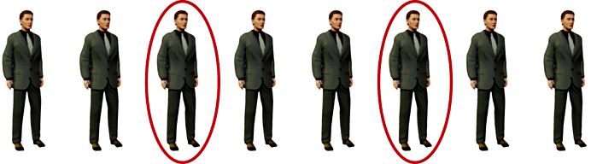
SYSTEMATIC SAMPLING……
As described above, systematic sampling is a method, because all elements have the same probability of selection (in the example given, one in ten). It is not 'simple random sampling' because different subsets of the same size have different selection probabilities - e.g. the set {4,14,24,...,994} has a one-in-ten probability of selection, but the set {4,13,24,34,...} has zero probability of selection.

Slide 18
SYSTEMATIC SAMPLING……
ADVANTAGES:
Sample easy to select
Suitable sampling frame can be identified easily
Sample evenly spread over entire reference population
DISADVANTAGES:
Sample may be biased if hidden periodicity in population coincides with that of selection.
Difficult to assess precision of estimate from one survey.

Slide 19
STRATIFIED SAMPLING
Where population embraces a number of distinct categories, the frame can be organized into separate "strata." Each stratum is then sampled as an independent sub-population, out of which individual elements can be randomly selected.
Every unit in a stratum has same chance of being selected.
Using same sampling fraction for all strata ensures proportionate representation in the sample.
Adequate representation of minority subgroups of interest can be ensured by stratification & varying sampling fraction between strata as required.

Slide 20
STRATIFIED SAMPLING……
Finally, since each stratum is treated as an independent population, different sampling approaches can be applied to different strata.
Drawbacks to using stratified sampling.
First, sampling frame of entire population has to be prepared separately for each stratum
Second, when examining multiple criteria, stratifying variables may be related to some, but not to others, further complicating the design, and potentially reducing the utility of the strata.
Finally, in some cases (such as designs with a large number of strata, or those with a specified minimum sample size per group), stratified sampling can potentially require a larger sample than would other methods

Slide 21
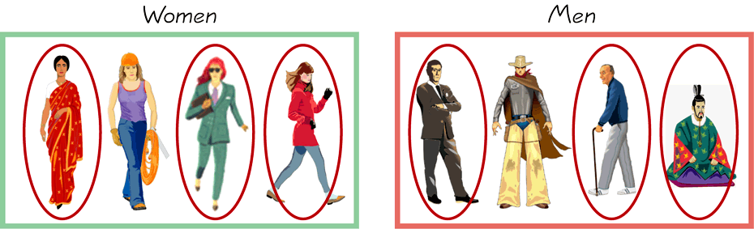
STRATIFIED SAMPLING…….
        Draw a sample from each stratum

Slide 22
CLUSTER SAMPLING
Cluster sampling is an example of 'two-stage sampling' .
First stage a sample of areas is chosen;
Second stage a sample of respondents within those areas is selected.
Population divided into clusters of homogeneous units, usually based on geographical contiguity.
Sampling units are groups rather than individuals.
A sample of such clusters is then selected.
All units from the selected clusters are studied.

Slide 23
CLUSTER SAMPLING…….
Advantages :
Cuts down on the cost of preparing a sampling frame.
This can reduce travel and other administrative costs.
Disadvantages: sampling error is higher for a simple random sample of same size.
Often used to evaluate vaccination coverage

Slide 24
CLUSTER SAMPLING…….
Identification of clusters
  List all cities, towns, villages & wards of cities with their population falling in target area under study.
  Calculate cumulative population & divide by 30, this gives sampling interval.
  Select a random no. less than or equal to sampling interval having same no. of digits. This forms 1st cluster.
  Random no.+ sampling interval = population of 2nd cluster.
  Second cluster + sampling interval = 4th cluster.
  Last or 30th cluster = 29th cluster + sampling interval

Slide 25
CLUSTER SAMPLING…….
Two types of cluster sampling methods.
One-stage sampling. All of the elements within selected clusters are included in the sample.
Two-stage sampling. A subset of elements within selected clusters are randomly selected for inclusion in the sample.

Slide 26
Difference Between Strata and Clusters
Although strata and clusters are both non-overlapping subsets of the population, they differ in several ways.
All strata are represented in the sample; but only a subset of clusters are in the sample.
With stratified sampling, the best survey results occur when elements within strata are internally homogeneous. However, with cluster sampling, the best results occur when elements within clusters are internally heterogeneous

Slide 27
CONVENIENCE SAMPLING
Sometimes known as grab or opportunity sampling or accidental or haphazard sampling.
A type of nonprobability sampling which involves the sample being drawn from that part of the population which is close to hand. That is, readily available and convenient.
The researcher using such a sample cannot scientifically make generalizations about the total population from this sample because it would not be representative enough.
For example, if the interviewer was to conduct a survey at a shopping center early in the morning on a given day, the people that he/she could interview would be limited to those given there at that given time, which would not represent the views of other members of society in such an area, if the survey was to be conducted at different times of day and several times per week.
This type of sampling is most useful for pilot testing.
In social science research, snowball sampling is a similar technique, where existing study subjects are used to recruit more subjects into the sample.

Slide 28
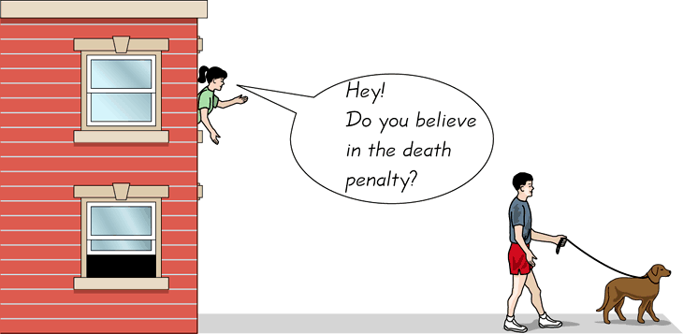
CONVENIENCE SAMPLING…….
  Use results that are easy to get

Slide 29
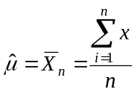
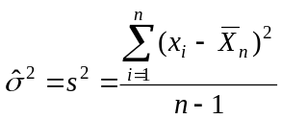
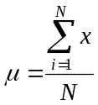
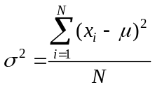
Statistical Inference
The process of making guesses about the truth from a sample.
Sample statistics
Truth (not observable)
Sample (observation)
*hat notation ^ is often used to indicate “estimate”
Population parameters
Make guesses about the whole population

Slide 30
Interval Estimation
Population Mean: σ Known
Population Mean: σ Unknown
Determining the Sample Size
Population Proportion

Slide 31
Margin of Error and the Interval Estimate
A point estimator cannot be expected to provide the
exact value of the population parameter.
An interval estimate can be computed by adding and
subtracting a margin of error to the point estimate.
Point Estimate +/− Margin of Error
The purpose of an interval estimate is to provide
information about how close the point estimate is to
the value of the parameter.

Slide 32
Margin of Error and the Interval Estimate
The general form of an interval estimate of a
population mean is

Slide 33
Interval Estimate of a Population Mean:
σ Known
In order to develop an interval estimate of a population mean, the margin of error must be computed using either:
  the population standard deviation σ , or
  the sample standard deviation s
σ is rarely known exactly, but often a good estimate can be obtained based on historical data or other information.
We refer to such cases as the σ known case.

Slide 34
Interval Estimate of a Population Mean:
σ Known
There is a 1 − α probability that the value of a
sample mean will provide a margin of error of
or less.
Sampling
distribution
of
α/2
1 - α of all
values
α/2
μ

Slide 35

Interval Estimate of a Population Mean:
σ Known
Sampling
distribution
of
1 - α of all
values
α/2
α/2
interval
does not
include μ
μ
interval
includes μ
interval
includes μ
[------------------------- -------------------------]
[------------------------- -------------------------]
[------------------------- -------------------------]

Slide 36
Interval Estimate of a Population Mean:
σ Known
Interval Estimate of μ
where: is the sample mean
1 -α is the confidence coefficient
z_{α/2} is the z value providing an area of
α/2 in the upper tail of the standard
normal probability distribution
σ is the population standard deviation
n is the sample size

Slide 37
Interval Estimate of a Population Mean:
σ Known
Interval Estimate of μ
where: is the sample mean
1 -α is the confidence coefficient
z_{α/2} is the z value providing an area of
α/2 in the upper tail of the standard
normal probability distribution
σ is the population standard deviation
n is the sample size

Slide 38
Meaning of Confidence
Because 90% of all the intervals constructed using
will contain the population mean,
we say we are 90% confident that the interval
includes the population mean μ.
We say that this interval has been established at the
90% confidence level.
The value .90 is referred to as the confidence
coefficient.

Slide 39
Interval Estimate of a Population Mean:
σ Known
Example: Discount Sounds
Discount Sounds has 260 retail outlets throughout
the United States. The firm is evaluating a potential
location for a new outlet, based in part, on the mean
annual income of the individuals in the marketing
area of the new location.
A sample of size n = 36 was taken; the sample
mean income is $41,100. The population is not
believed to be highly skewed. The population
standard deviation is estimated to be $4,500, and the
confidence coefficient to be used in the interval
estimate is .95.

Slide 40
Interval Estimate of a Population Mean:
σ Known
Example: Discount Sounds
95% of the sample means that can be observed
are within + 1.96 of the population mean μ.
The margin of error is:
Thus, at 95% confidence,
the margin of error is $1,470.

Slide 41
Interval Estimate of a Population Mean:
σ Known
Example: Discount Sounds
Interval estimate of μ is:
$41,100 + $1,470
or
$39,630 to $42,570
We are 95% confident that the interval contains the
population mean.

Slide 42
Interval Estimate of a Population Mean:
σ Known
Example: Discount Sounds
Interval estimate of μ is:
$41,100 + $1,470
or
$39,630 to $42,570
We are 95% confident that the interval contains the
population mean.

Slide 43
Interval Estimate of a Population Mean:
σ Known
Adequate Sample Size
In most applications, a sample size of n = 30 is
adequate.
If the population distribution is highly skewed or
contains outliers, a sample size of 50 or more is
recommended.

Slide 44
Interval Estimate of a Population Mean:
σ Known
Adequate Sample Size (continued)
If the population is not normally distributed but is
roughly symmetric, a sample size as small as 15
will suffice.
If the population is believed to be at least
approximately normal, a sample size of less than 15
can be used.

Slide 45
Interval Estimate of a Population Mean:
σ Unknown
If an estimate of the population standard deviation σ cannot be developed prior to sampling, we use the sample standard deviation s to estimate σ .
This is the σ unknown case.
In this case, the interval estimate for μ is based on the t distribution.
(We’ll assume for now that the population is normally distributed.)

Slide 46
t Distribution
William Gosset, writing under the name “Student”,
is the founder of the t distribution.
Gosset was an Oxford graduate in mathematics
and worked for the Guinness Brewery in Dublin.
He developed the t distribution while working on
small-scale materials and temperature experiments.

Slide 47
t Distribution
The t distribution is a family of similar probability
distributions.
A specific t distribution depends on a parameter
known as the degrees of freedom.
Degrees of freedom refer to the number of
independent pieces of information that go into the
computation of s.

Slide 48
t Distribution
A t distribution with more degrees of freedom has
less dispersion.
As the degrees of freedom increases, the difference
between the t distribution and the standard
normal probability distribution becomes smaller
and smaller.

Slide 49
t Distribution
For more than 100 degrees of freedom, the standard
normal z value provides a good approximation to
the t value.
The standard normal z values can be found in the
infinite degrees ( ) row of the t distribution table.

Slide 50
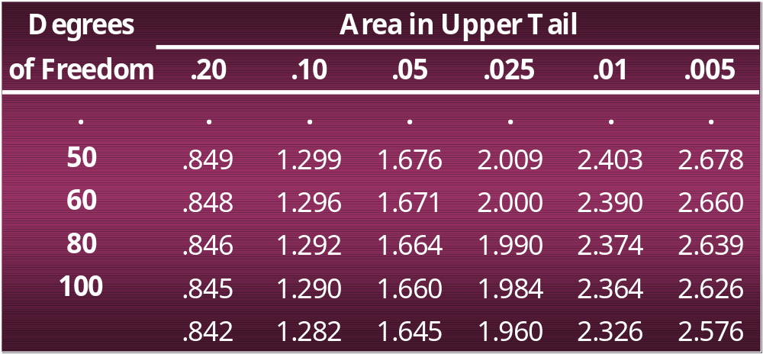
t Distribution
Standard normal
z values

Slide 51
Interval Estimate of a Population Mean:
σ Unknown
Interval Estimate
where: 1 -α = the confidence coefficient
t_{α/2} = the t value providing an area of α/2
in the upper tail of a t distribution
with n - 1 degrees of freedom
s = the sample standard deviation

Slide 52
Interval Estimate of a Population Mean:
σ Unknown
Example: Apartment Rents
A reporter for a student newspaper is writing an
article on the cost of off-campus housing. A sample of
16 one-bedroom apartments within a half-mile of
campus resulted in a sample mean of $750 per month
and a sample standard deviation of $55.
Let us provide a 95% confidence interval estimate
of the mean rent per month for the population of one-
bedroom efficiency apartments within a half-mile of
campus. We will assume this population to be
normally distributed.

Slide 53
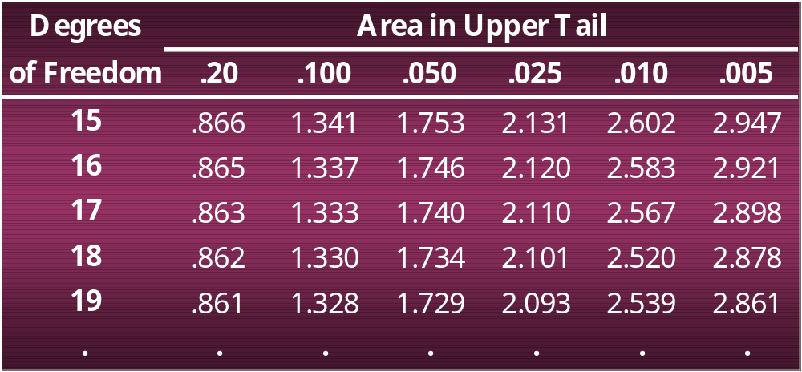
Interval Estimate of a Population Mean:
σ Unknown
At 95% confidence, α = .05, and α/2 = .025.
t_{.025} is based on n − 1 = 16 − 1 = 15 degrees of freedom.
In the t distribution table we see that t_{.025} = 2.131.

Slide 54
Interval Estimate of a Population Mean:
σ Unknown
Interval Estimate
Margin
of Error
We are 95% confident that the mean rent per month
for the population of one-bedroom apartments within
a half-mile of campus is between $720.70 and $779.30.
27

Slide 55
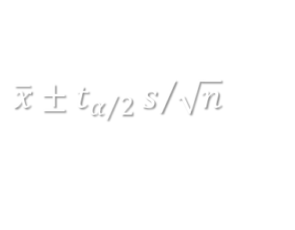
Interval Estimate of a Population Mean:
σ Unknown
Adequate Sample Size
In most applications, a sample size of n = 30 is
adequate when using the expression to
develop an interval estimate of a population mean.
If the population distribution is highly skewed or
contains outliers, a sample size of 50 or more is
recommended.

Slide 56
Interval Estimate of a Population Mean:
σ Unknown
Adequate Sample Size (continued)
If the population is not normally distributed but is
roughly symmetric, a sample size as small as 15
will suffice.
If the population is believed to be at least
approximately normal, a sample size of less than 15
can be used.

Slide 57
Summary of Interval Estimation Procedures
for a Population Mean
Can the
population standard
deviation σ be assumed
known ?
Yes
No
Use the sample
standard deviation
s to estimate s
σ Known
Case
Use
Use
σ Unknown
Case

Slide 58
Sample Size for an Interval Estimate
of a Population Mean
Let E = the desired margin of error.
E is the amount added to and subtracted from the
point estimate to obtain an interval estimate.
If a desired margin of error is selected prior to
sampling, the sample size necessary to satisfy the
margin of error can be determined.

Slide 59
Sample Size for an Interval Estimate
of a Population Mean
Margin of Error
Necessary Sample Size

Slide 60
Sample Size for an Interval Estimate
of a Population Mean
The Necessary Sample Size equation requires a
value for the population standard deviation σ .
If σ is unknown, a preliminary or planning value
for σ can be used in the equation.
1. Use the estimate of the population standard
deviation computed in a previous study.
2. Use a pilot study to select a preliminary study and
use the sample standard deviation from the study.
3. Use judgment or a “best guess” for the value of σ .

Slide 61
Sample Size for an Interval Estimate
of a Population Mean
Example: Discount Sounds
Recall that Discount Sounds is evaluating a
potential location for a new retail outlet, based in
part, on the mean annual income of the individuals in
the marketing area of the new location.
Suppose that Discount Sounds’ management team
wants an estimate of the population mean such that
there is a .95 probability that the sampling error is
$500 or less.
How large a sample size is needed to meet the
required precision?

Slide 62
Sample Size for an Interval Estimate
of a Population Mean
At 95% confidence, z_{.025} = 1.96. Recall that σ = 4,500.
A sample of size 312 is needed to reach a desired
precision of + $500 at 95% confidence.

Slide 63
Interval Estimate
of a Population Proportion
The general form of an interval estimate of a
population proportion is

Slide 64
Interval Estimate
of a Population Proportion
The sampling distribution of plays a key role in
computing the margin of error for this interval
estimate.
The sampling distribution of can be approximated
by a normal distribution whenever np > 5 and
n(1 – p) > 5.

Slide 65

Interval Estimate
of a Population Proportion
Normal Approximation of Sampling Distribution of
Sampling
distribution
of
α/2
1 - α of all
values
α/2
p

Slide 66
Interval Estimate
of a Population Proportion
Interval Estimate
where: 1 -α is the confidence coefficient
z_{α/2} is the z value providing an area of
α/2 in the upper tail of the standard
normal probability distribution
is the sample proportion

Slide 67
Interval Estimate
of a Population Proportion
Example: Political Science, Inc.
Political Science, Inc. (PSI) specializes in voter polls
and surveys designed to keep political office seekers
informed of their position in a race.
Using telephone surveys, PSI interviewers ask
registered voters who they would vote for if the
election were held that day.

Slide 68
Interval Estimate
of a Population Proportion
Example: Political Science, Inc.
In a current election campaign, PSI has just found
that 220 registered voters, out of 500 contacted, favor
a particular candidate. PSI wants to develop a 95%
confidence interval estimate for the proportion of the
population of registered voters that favor the
candidate.

Slide 69
Interval Estimate
of a Population Proportion
where: n = 500, = 220/500 = .44, z_{α/2} = 1.96
= .44 + .0435
PSI is 95% confident that the proportion of all voters
that favor the candidate is between .3965 and .4835.

Slide 70
Sample Size for an Interval Estimate
of a Population Proportion
Margin of Error
Solving for the necessary sample size, we get
However, will not be known until after we have selected the sample. We will use the planning value
p* for .

Slide 71
Sample Size for an Interval Estimate
of a Population Proportion
Necessary Sample Size
The planning value p* can be chosen by:
1. Using the sample proportion from a previous sample of the same or similar units, or
2. Selecting a preliminary sample and using the
sample proportion from this sample.
3. Use judgment or a “best guess” for a p* value.
4. Otherwise, use .50 as the p* value.

Slide 72
Sample Size for an Interval Estimate
of a Population Proportion
Example: Political Science, Inc.
Suppose that PSI would like a .99 probability that
the sample proportion is within + .03 of the
population proportion.
How large a sample size is needed to meet the
required precision? (A previous sample of similar
units yielded .44 for the sample proportion.)

Slide 73
Sample Size for an Interval Estimate
of a Population Proportion
At 99% confidence, z_{.005} = 2.576. Recall that p* = .44.
A sample of size 1817 is needed to reach a desired
precision of + .03 at 99% confidence.

Slide 74
Sample Size for an Interval Estimate
of a Population Proportion
Note: We used .44 as the best estimate of p in the
preceding expression. If no information is available
about p, then .5 is often assumed because it provides
the highest possible sample size. If we had used
p = .5, the recommended n would have been 1843.

Slide 75
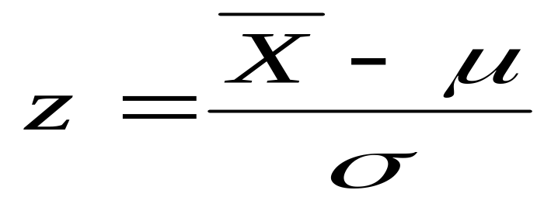
Z-score Review
A sample mean (X-bar) approximates a population mean (μ)
The standard error provides a measure of
  how well a sample mean approximates the population mean
  determines how much difference between X-bar and μ is reasonable to expect just by chance
The z-score is a statistic used to quantify this inference
obtained difference between data and hypothesis/standard distance expected by chance

Slide 76
What’s the problem with z?
Need to know the population mean and variance!!! Not always available.

Slide 77
What is the t statistic?
“Cousin” of the z statistic that does not require the population mean (μ) or variance (σ²)to be known
Can be used to test hypotheses about a completely unknown population (when the only information about the population comes from the sample)
Required: a sample and a reasonable hypothesis about the population mean (μ)
Can be used with one sample or to compare two samples

Slide 78
What is the t statistic?
“Cousin” of the z statistic that does not require the population mean (μ) or variance (σ²)to be known
Can be used to test hypotheses about a completely unknown population (when the only information about the population comes from the sample)
Required: a sample and a reasonable hypothesis about the population mean (μ)
Can be used with one sample or to compare two samples

Slide 79
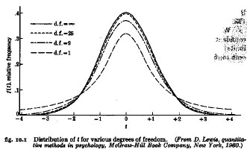
The t Distribution
We use t when the population variance is unknown (the usual case) and sample size is small (N<100, the usual case). If you use a stat package for testing hypotheses about means, you will use t.
The t distribution is a short, fat relative of the normal. The shape of t depends on its df. As N becomes infinitely large, t becomes normal.

Slide 80
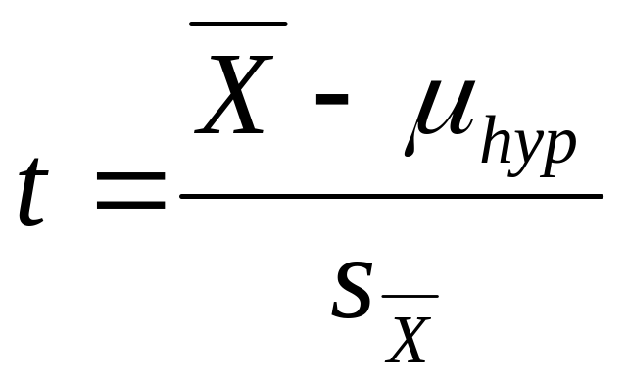
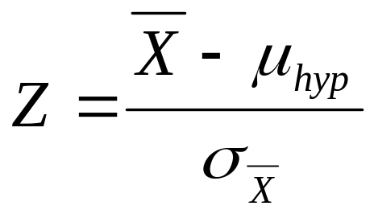
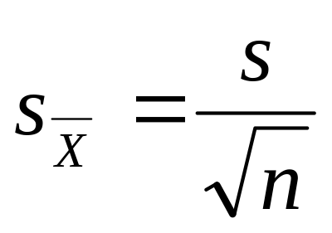
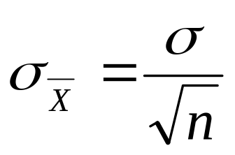
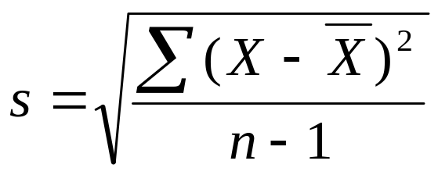
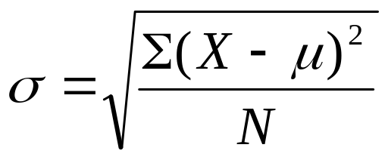
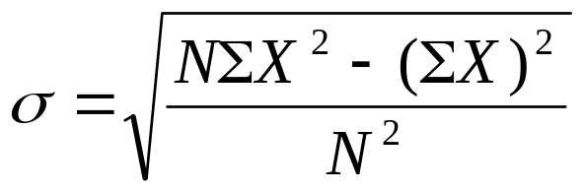
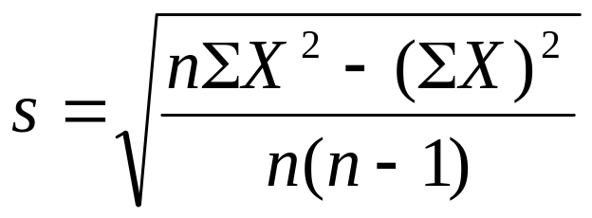
From Z to t…
Note lowercase “s”.

Slide 81
Thank You…..!!!!!
Any Questions ?????

