Slide 1
A galaxy of stars in matrix form. Each star is at 1-point distance from another
Spaceship has to move from pos(x1,y2) to pos(x2,y2).
Spaceship can travel only in horizontal or vertical direction
At W locations, wormholes exist along with stars. Using the wormhole allows instant (0-point) travel between 2 locations
Find the optimal path to travel between (x1,y1) and (x2,y2)
5 < M,N < 1000000
(0, 0)
 |  |  |  |  |  |  | (x,y)
 | (a,b)
 |  |  |  | X
 |  |  | (m,n)
1
1
(m, n)

Slide 2
1 -> (Number of test cases)
10 50 1 -> (M, N, W )
0 0 10 20 -> (X1, Y1, X2, Y2)
5 5 10 10 -> Wormhole which is at (5,5) and can move to (10, 10) instantaneously

Slide 3
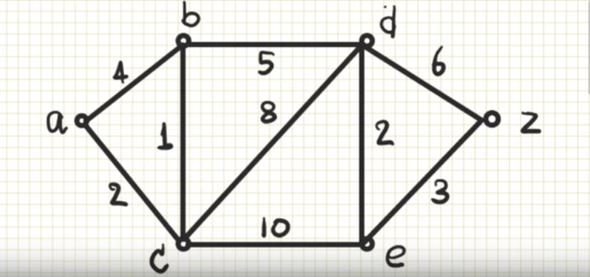

Slide 4
