Slide 1
IITK Talk
Pankaj Singh - 2021

Slide 2
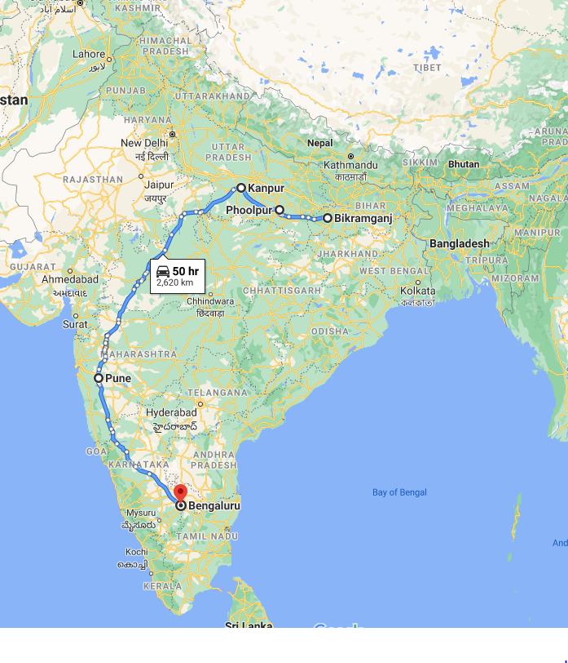
India-Trajectory
Place | Description
Bikramganj, Bihar | Place of origin
Phoolpur, UP | Schooling
Kanpur, UP | IIT Kanpur
Pune, Maharashtra | TELCO, first job
Bangalore, Karnataka | Infosys, Aditi, last job in India

Slide 3







US-Trajectory
Microsoft
UW
Microsoft

Slide 4
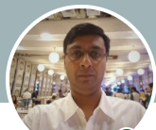
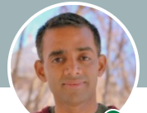
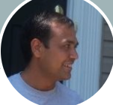
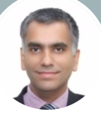
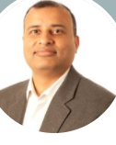
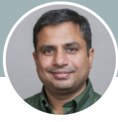
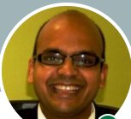
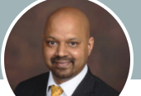
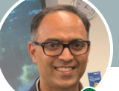
Partners in crime
Interesting events | Guides
Phoolpur -> IIT Kanpur | Paras
Having fun | Golu, Kasera, Dinesh, Satish, Sharad
Mechanical -> Software | Vineet
Learning for fun | Nikhil
Microsoft -> UW | Jayant

