Slide 1
IITK Talk
Pankaj Singh - 2021

Slide 2
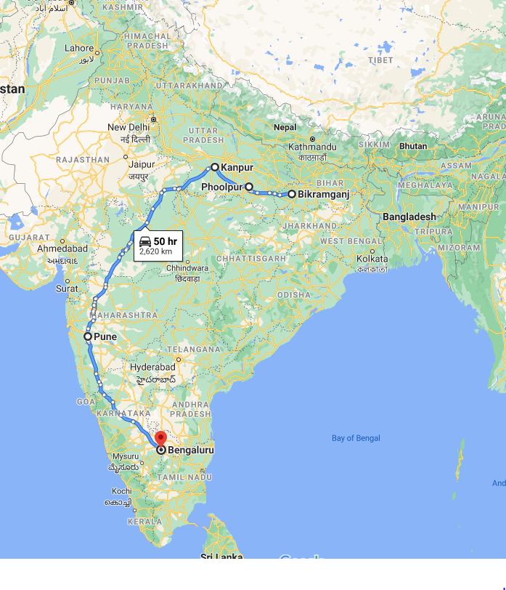
India-Trajectory
Place | Description
Bikramganj, Bihar | Place of origin
Phoolpur, UP | Schooling
Kanpur, UP | IIT Kanpur
Pune, Maharashtra | TELCO, first job
Bangalore, Karnataka | Infosys, Aditi, last job in India

Slide 3
US- Trajectory
Microsoft
Commerce (Paypal)
UW
Foster MBA
Microsoft
Azure
Bing
Computational Finance MS

Slide 4
Acknowledgements
Interesting points | Guides
Phoolpur -> IIT Kanpur | Paras
Having fun | Golu, Kasera, Dinesh, Satish, Sharad
Mechanical -> Software | Vineet
Learning without purpose | Nikhil
Microsoft -> UW | Jayant

