Slide 1
Airtame

Slide 2
1. Synchronization problem
Implement (preferably in C/C++) a simple client server system that uses UDP UNIX sockets to synchronise two machines. The client will connect to the server, and every second will print out the difference between its time and the server time. Submit a compilable version of the system, which will result in the two binaries for the server and the client. Please explain the solution to the problem

Slide 3
Solution(1)
First clients request the server for a timestamp
Server Sends its time stamp. When that packet is received at the client, it stores the difference between the given timestamp and its own clock as t1.
The client then sends a packet to the server with its own timestamp. The server sends the difference between the timestamp and its own clock back to the client as t2.
t1 and t2 both include the "travel time" t of the
packet plus the time difference between the clocks d.
Assuming that the travel time is the same in both
Directions, we can derive these equation
t1 = t - d
t2 = t + d
t1 + d = t2 – d
d = (t2 - t1)/2

Slide 4
Solution(2)
There is signal based timer in the client which wakes up every 1 sec and synchronizes the time with server.
UDP connection is established with unix socket APIs
Unix call are managed through a common API which is used by both client and server program.
Makefile generates two binary server and clients.

Slide 5
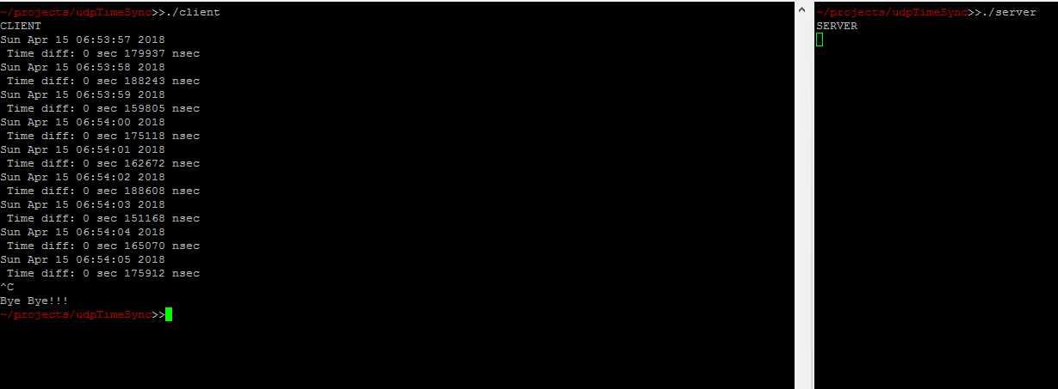
Output Snapshot

Slide 6
2. Software update
Imagine that your company is making a "headless" embedded device, which needs to be updated frequently and remotely. Moreover, you're targeting enterprise audience, meaning that you will deal with big numbers of devices. Describe at least 2 methods to do over-the-air upgrades for your device, detailing the advantages and disadvantages of each. At the end, conclude which solution you would choose to implement, and why?
Following up the previous question, which filesystems, you are aware of, suit the purpose and what are their advantages and disadvantages?

Slide 7
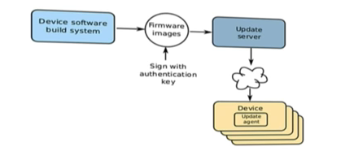
OTA Update Component

Slide 8
Asymmetric Partition
There is a small partition containing recovery image which is loaded when we want to OTA.
System downtime
Not good for unreliable environment
Used in Android before Nougat
bootloader
OS Image
User Data
Recovery Image

Slide 9
Symmetric Update(Dual Bank)
Flash is partitioned at time of manufacture
Non active partition is updated and switched when rebooted
Safe and easy to implement
Root file system stateless i.e. read only
Size of partition ? Waste of space
2 copy of image is maintained
Android after nougat
Platforms : Mendor.io, resign.io provides system
bootloader
OS Image
User Data
OS Image 2

Slide 10
OSTree
Sort of Git for filesystem
Hash based meta data for files, content-addressed-object store
Support for parallel installing more than just 2 bootable roots
Transactional upgrades and rollback for the system
fully atomic and safe upgrades
QT, RPM etc
Not fully adopted

Slide 11
Other
Package based
Rpm, dpkg
Container Based
docker

Slide 12
conclusion
Solution to use depend upon exact requirements and goals
Dual bank approach is best viable solution as Flash memory are getting cheaper.
In Enterprise environment, device can easily update to new image and switch to new partition
Seamless atomic upgrade

Slide 13
Filesystem
RAM File System
Initrd, initramfs
Disk File System
Ext2, ext3, ext4,
Flash File system
MTD, JFFS

Slide 14
MTD
MTD stands form Memory Technology Device
Created to have abstraction layer between the hardware specific device drivers and higher-level applications
MTD devices can easily be partitioned
These partitions can be used fro different purposes like boot code area, kernel image, data partitions etc
The MTD partitions can be described by – Specifying in board device tree – In kernel code (Hard code) – Through kernel command line (Modification)
Each partition becomes a separate MTD device

