Slide 1
Problem Statement
We need to connect a number of sensors of the same kind to our robot. The expected output of each sensor is 10 Hz and we can talk to those sensors using TTL level RS232 connection. The sensor supports only the 9600 bps speed. To get the data from sensor (5 bytes) we need to send a command (1 byte). From the moment the command is sent, it can take up to ~70 milliseconds to get the data.
Unfortunately, we don't have 10 RS232 ports on our main computer. We have one RS232 port, one I2C and one SPI port available. We also have up to two interrupt lines available.
An additional constraint is that we cannot trigger sensors with a broadcast message. In other words, we need functionality to trigger them in a sequence.
The task is to find a scalable hardware/software solution to gather data from all sensors

Slide 2

Timing Analysis
10Hz, 10 fix per second
9600bps, 960 Bytes in a sec, ~I ms
1 Byte write and 5 byte read, 70 ms delay
Maximum time of getting a fix = 76 ms
Maximum num of fix on 9600 bps line in a sec = ~12 fix
Notes:
Diagram from google

Slide 3
Challenges with RS232
Only point to point communication
Limited Distance - 50 ft or less
Susceptible to Noise as single ended
Not Multi-drop - can only connect one RS-232 device per port

Slide 4
HW Solution
Multidrop connection
RS-232 Serial Adaptor Hub
RS-232 Serial Port Multiplexer / bridge/ switch
Serial device servers
Microcontroller bases Serial Controller
Sensor Network
Notes:
A lot of ready to use components are available and provide drivers for os if needed

Slide 5
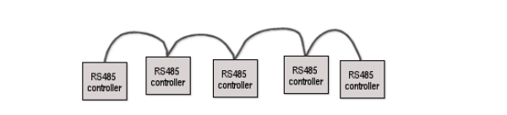
Multidrop connection(1)
RS232-RS485 converter needed, hacks are there to use RS232 in multidrop but unreliable
RS485 can support upto 256 device
Daisy Chain connection
Each device has a Device ID which is configurable
11 bit MDB / ICP protocol, 1 Extra mode bit is used to switch between address and data
Notes:
Diagram from google

Slide 6
Multidrop connection(2)
Read a fix
Linux kernel provides the serial_rs485 structure to handle RS485 communications
At a time only one sensor is accessible
Slower, For 10 device multidrop, as one fix takes around ~100ms only one fix per second can be acquired
Costly and inconvenient serial cabling
write <device address>
write <read_command>
read < data_bits>
Notes:
https://www.kernel.org/doc/Documentation/serial/serial-rs485.txt

Slide 7
Multiport Serial Boards/Cards/Adapters
Install on the ISA or PCI bus
Support in kernel is built with CONFIG_SERIAL_8250_EXTENDED flag
Can handle high Speed traffic
Board can handle the interrupts arising from device, no waste of CPU

Slide 8
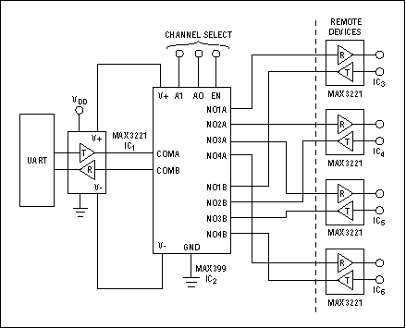
Serial Multiplexer
Tx and Rx lines can be multiplexed over MUX
Addition line driver are needed for power load
Device Selection – Channel Select
Top level protocol
write <channel select>
write <read command>
read < data>
Notes:
This diagram used as it is from internet

Slide 9
Serial Controller
Custom Design
Microcontroller can buffer the data
Can over limitation of slow sensor
Firmware can be designed to support wide range of commands such power off, power on
Firmware can also be used for sensor health monitoring, raising interrupt on failure
Parallel control
Interrupt Line
R232 <-> GPIO
microcontroller
(Firmware)
Sensor-01
UART Over RS232
Sensor-02
Sensor-10

Slide 10
Software Challenges
Sensor can appear as a serial device or hide behind one serial device
Sensor connection topology can change
Can support multiple topology
Number of sensor can grow or decrease
Sensor can be of different type
Sensor can turn faulty
Sensor read is slower and blocking i.e 70 ms to perform one read

Slide 11
Software Solution
Proposed Solution can handle all the challenges
It can support N number of client concurrently without blocking
Design can also support all or any of the hardware solution
Sensor fix means 5 byte of data read from sensor
Client1
Client2
Client
Interface Library
Sensor daemon
Sensor Driver
Kernel Module
Kernel Module(TTY driver) optional
Serial Interconnect/Multidrop / Custom Controller
Hardware
S1
S2
S3
Sn

Slide 12
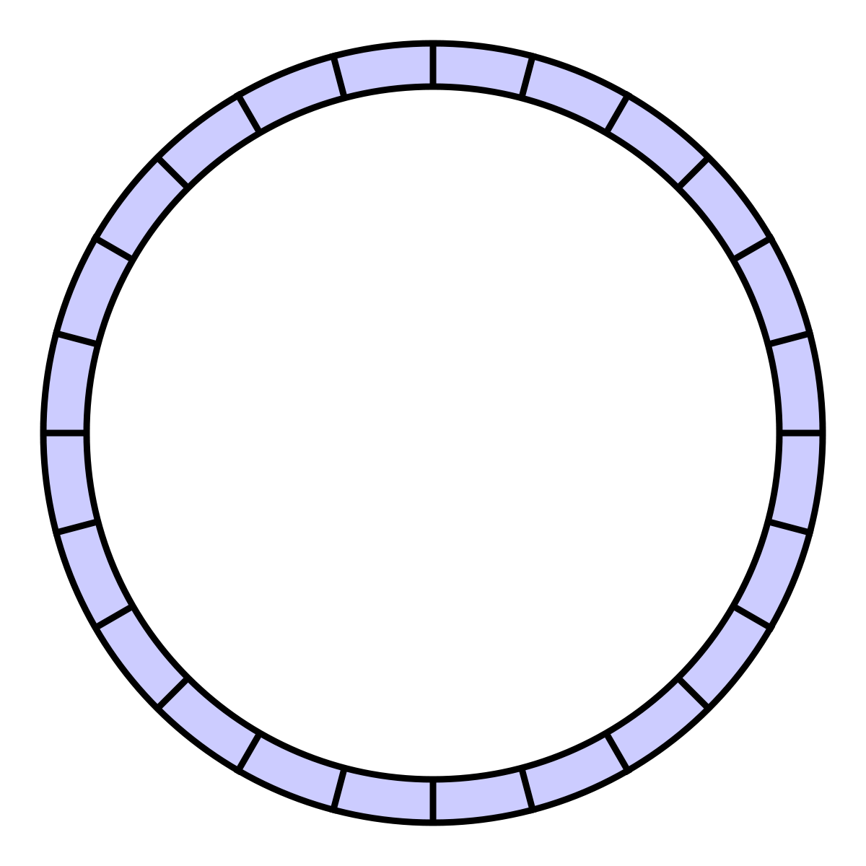
Sensor demon(1)
Service or background process
Makes sensor read and write asynchronous, fast
Four major component's are
Ring Buffer cache to store the sensor fix
Main thread to service clients
Data read thread to read data from sensors
Broadcast thread to send a batch of sensor data to clients
data_read_thread
Main Thread
Ring Buffer
Broadcast thread

Slide 13
Sensor Daemon(2)
data_read thread wakes after every 1 sec, collects the data from sensor and update the cache
Main thread own the cache buffer, manages the meta data and services the general clients
Ring buffer access is synchronized by locks
Initialization
Reads the configuration file
Calls the low level sensor API
Initializes the ring buffer and worker threads
Initializes meta data

Slide 14
Configuration file
4
1 /dev/pts/5 0 0
2 /dev/pts/5 0 0
3 /dev/pts/5 0 0
4 /dev/pts/5 0 0
It provides number of sensor connected
For each sensor
Sensor num to uniquely identify
HW identifies,
Can be path, or device address or combination
Decoded by low level driver
Configuration mode so that
Sensor daemon can identify the interconnect topology
Sensor Type
If incase need arises to support different type of sensor

Slide 15
Sensor Driver
Consistent Interfaces to sensor daemon
Calls HW interconnect specific low level driver
Stores the configuration mode and sensor type information and provides a unique id to sensor daemon
Sensor Driver Interface
Serial driver
Multidrop driver
uController driver
typedef enum {
CONFIG_MODE_DIRECT_SERIAL,
CONFIG_MODE_SERIAL_HUB,
CONFIG_MODE_MULTI_DROP,
CONFIG_MODE_CONTROLLER,
CONFIG_MODE_CUSTOM_BOARD,
}SENSOR_CONFIG_MODE;

Slide 16
Low level Driver
Line specific configuration information
Low level protocol handling
Read and write sequence
Device identification
Speed configuration
Linux kernel exports the serial driver as file and provides API to configure various properties
Module to configure specific driver

Slide 17
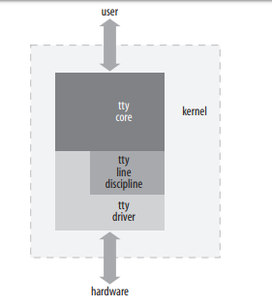
Kernel Driver
Linux kernel provides interface to extend a serial device as tty driver.
It has inbuilt support for various line type and protocol, and specification

Slide 18
Serial Controller (SW)
Sensor daemon can be extended as a main firmware for microcontroller
uC with listen command on serial line from host
Handles serial driver
uC vendor libraries can be used to implement the low level driver functioning
Or bit Banging can be applied another alternatative

Slide 19
Implementation
File Name | Description
Makefile | Make to build the code
sensor.config | Config file for 4 sensor connected over serial adpater
client.cpp | Sample client to access the sensors
sensor_daemon.cpp | Sensor daemon core implementation
sensor_daemon.h
sensor.cpp | Abstracted sensor interface calling serial driver
sensor.h
serial.cpp | user space driver for serial commination over Linux tty device
serial.h
util.h | Utility macros
emulator.cpp | Simple sensor emulator

Slide 20
Testing Demo
Two serial ports are piped and bidirectional communication channel is established
Emulator program running on one end provides a response of 5 byte once it receives a specific read command
It adds a counter with every response e.g “XXX10”
Software solution is attached on the other end
Test Client
Software Solution
Sensor Emulator

Slide 21
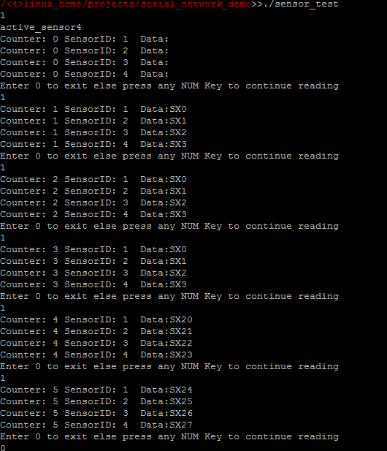

Demo Output
At first no response, as read was still happening
Then first 4 responses
Again 4 as a continues call, but takes 100ms even to get 1 fix from sensor
Latest fix after some time

