Slide 1
Real-Time Video-Based Attendance System
Submitted by
Pankaj Kumar Bijarniya
18010127
Under the Supervision and Guidance of-
Dr. Navanath Saharia

Slide 2
Introduction
Real-Time Video-Based Attendance System is Software for taking attendance by recognizing the faces of the students.
When students come in front of the camera or from recorded video it takes attendance of the student.
Stores the details of the student in the MySQL database using the flask framework of python.
The System stores the student details on attendance like Teacher’s Email, Date, Batch, Semester, Subject, Name, Roll Number, Time of attendance, etc.

Slide 3
System/Software used
Open CV: for recognize the face, human body etc.
Python Language: for writing the code of openCV and webcam access
Flask Framework: for integrate the software with the website
MySQL Database: for store all the attendence and user details into database
HTML, CSS, JS, Bootstrap: for website UI/UX

Slide 4
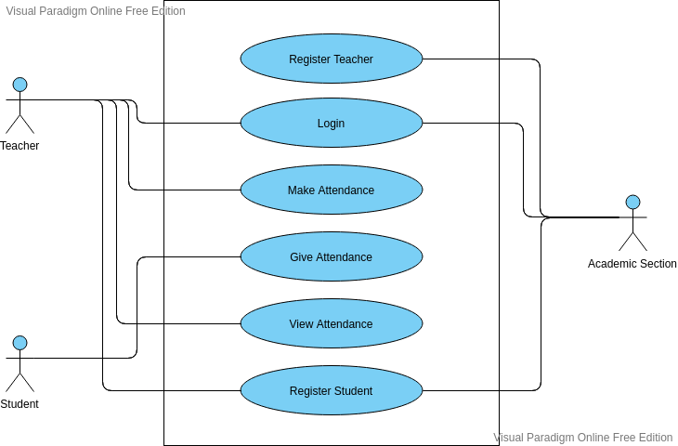
UML Diagram

Slide 5
Implementation
Python should be installed in our system
Flask Python Web framework should be installed in our system
MySQL and Python-Mysql packages should be installed in our system
Open-CV should be installed in our system
Dlib python package should be installed in our system

Slide 6
Files and Folders required
App.py file for eriting all the flask, database, python, open-CV related code
Template folder for put all the HTML website structure related files
Static folder for put all the media files
RegImg folder to put images of the student using student registation form

Slide 7
Teacher Function:
Registration of the teachers by the academic section and storing the related data into database like teacher’s email, name, password etc.
So the teacher can log in to take the attendance by putting some details like which batch, semester and subject he/she wants to take attendance.

Slide 8
Attendance Function:
After putting the details of the attendance by the teacher the camera is on or we can put a video of the class for the attendance.
With the webcam or video when the system identifies the student and puts the related attendance details into the database like Teacher’s email, batch, semester, subject, date, name of the student, roll number and time of attendance, etc.

Slide 9
Student Function:
Registration of the students is done by the teacher or the academic section with some fields like image, name, roll number, Batch etc.

Slide 10
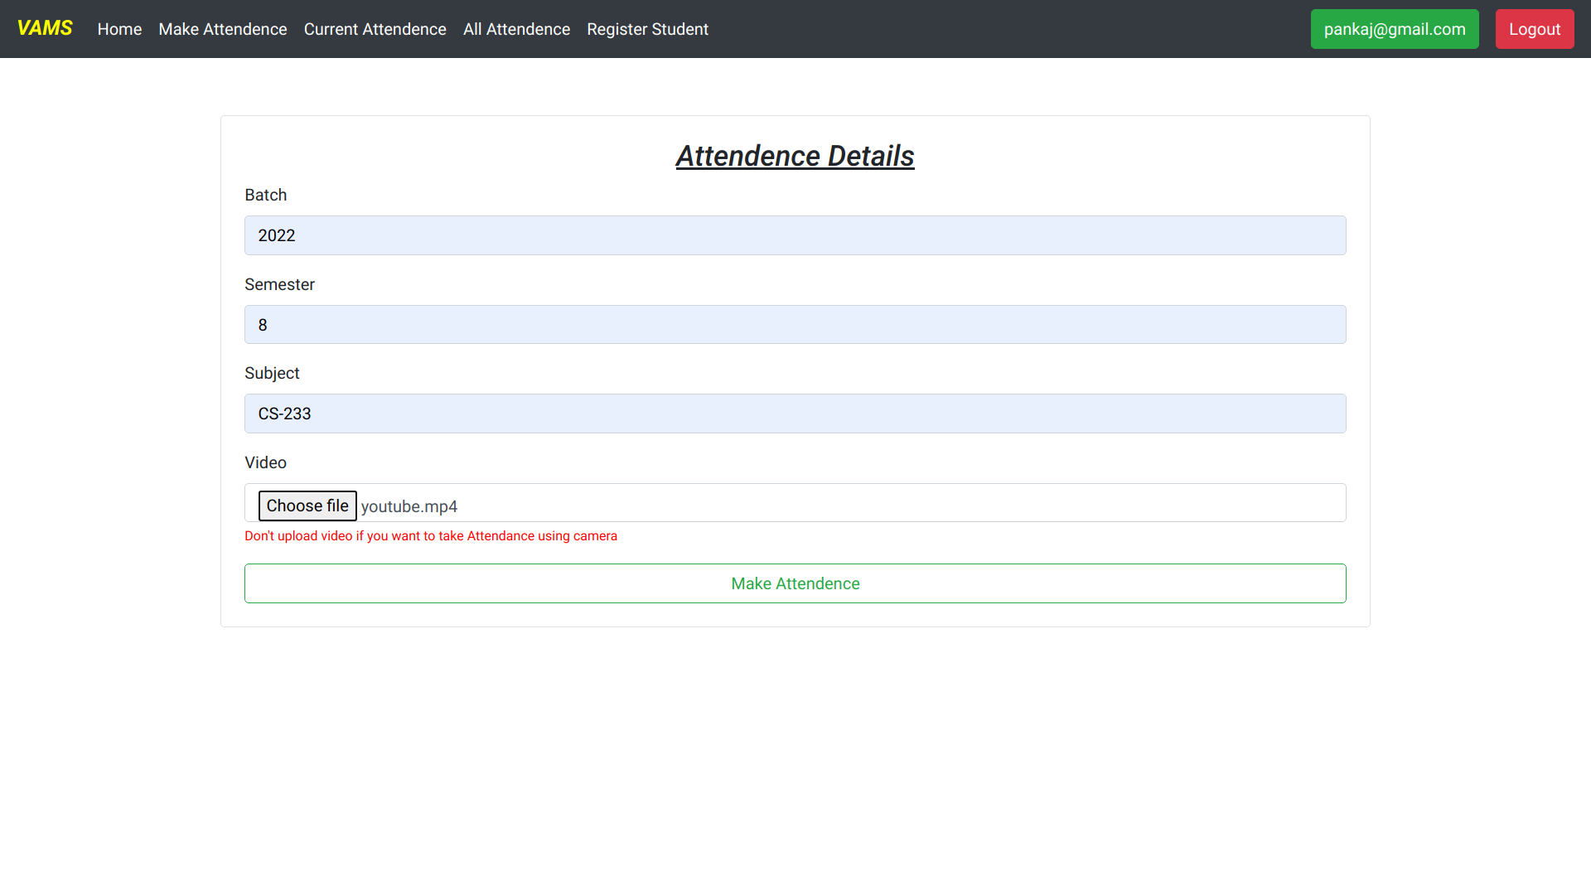
Result analysis

Slide 11
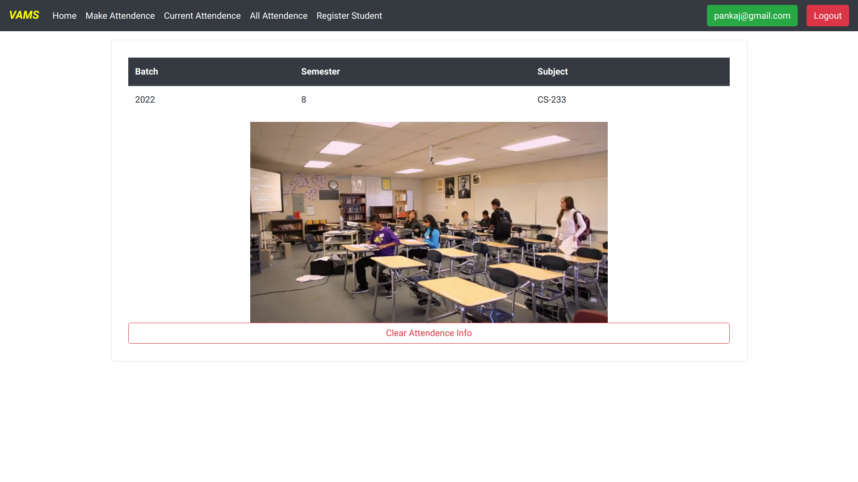
Result analysis

Slide 12
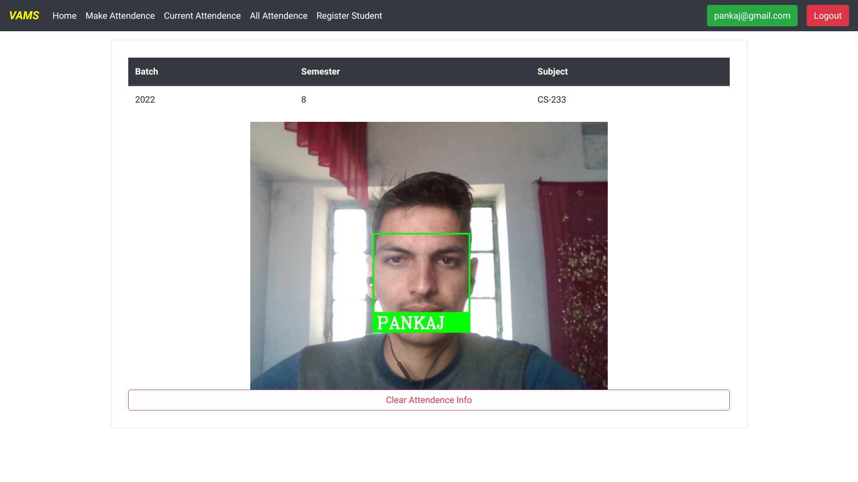
Result analysis

Slide 13
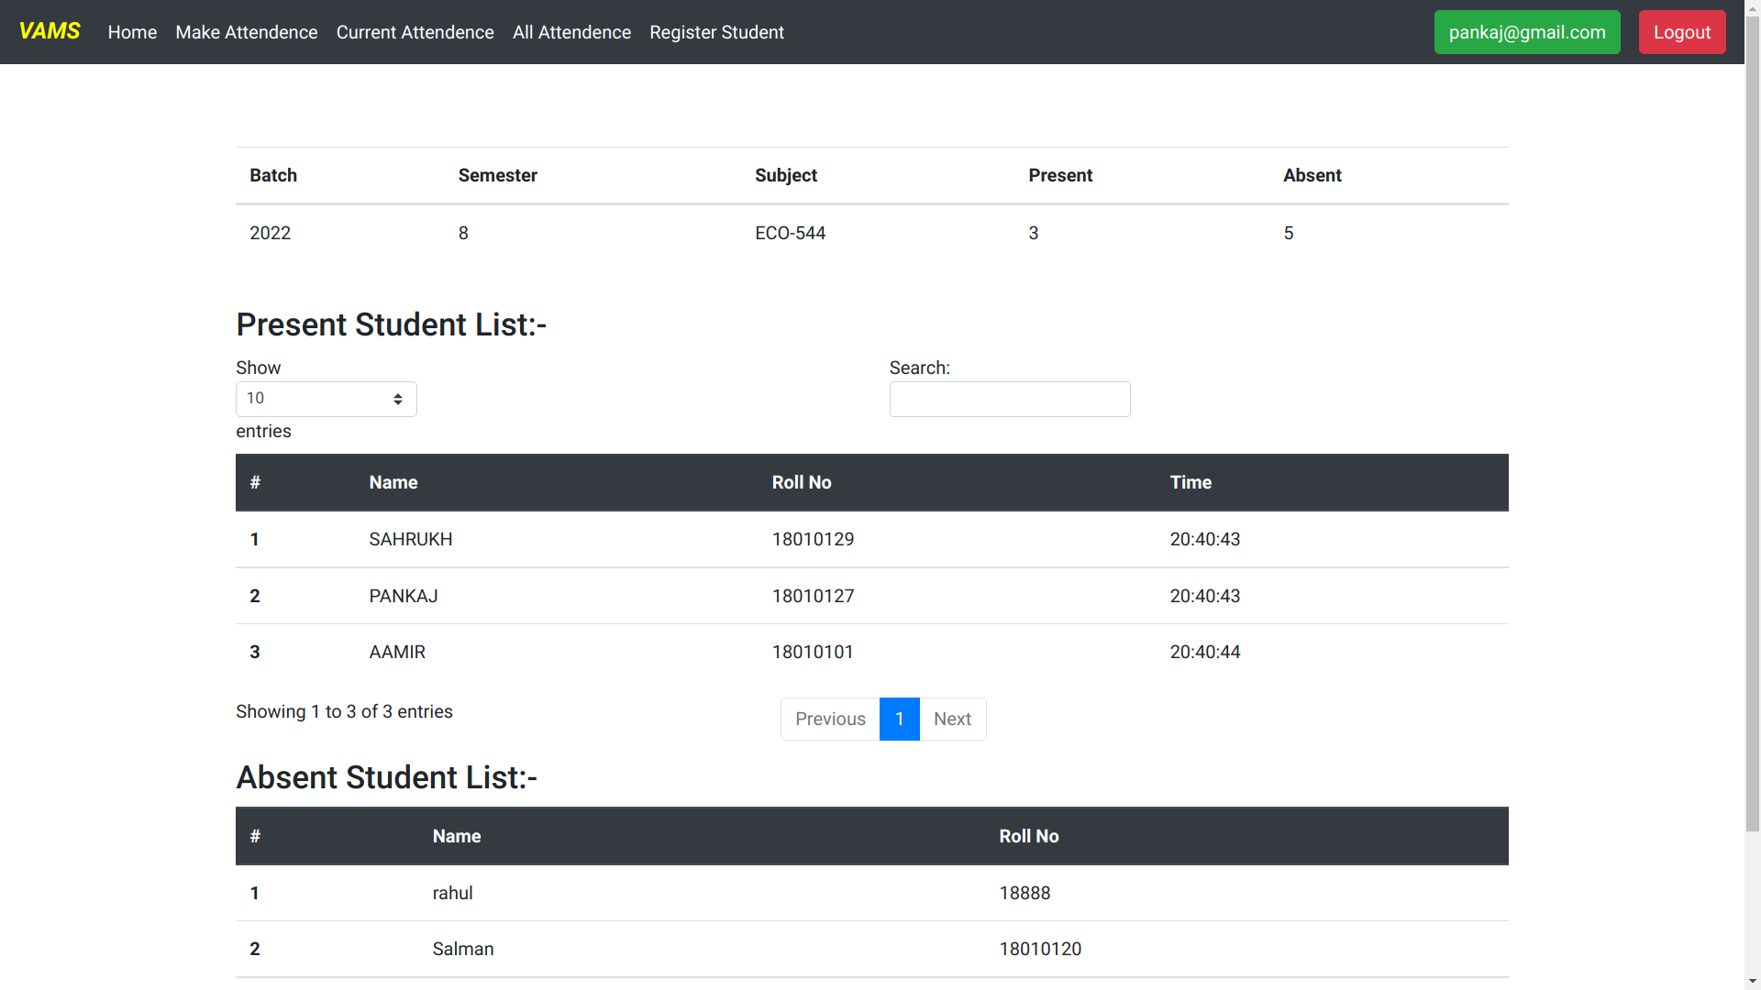
Result analysis

Slide 14
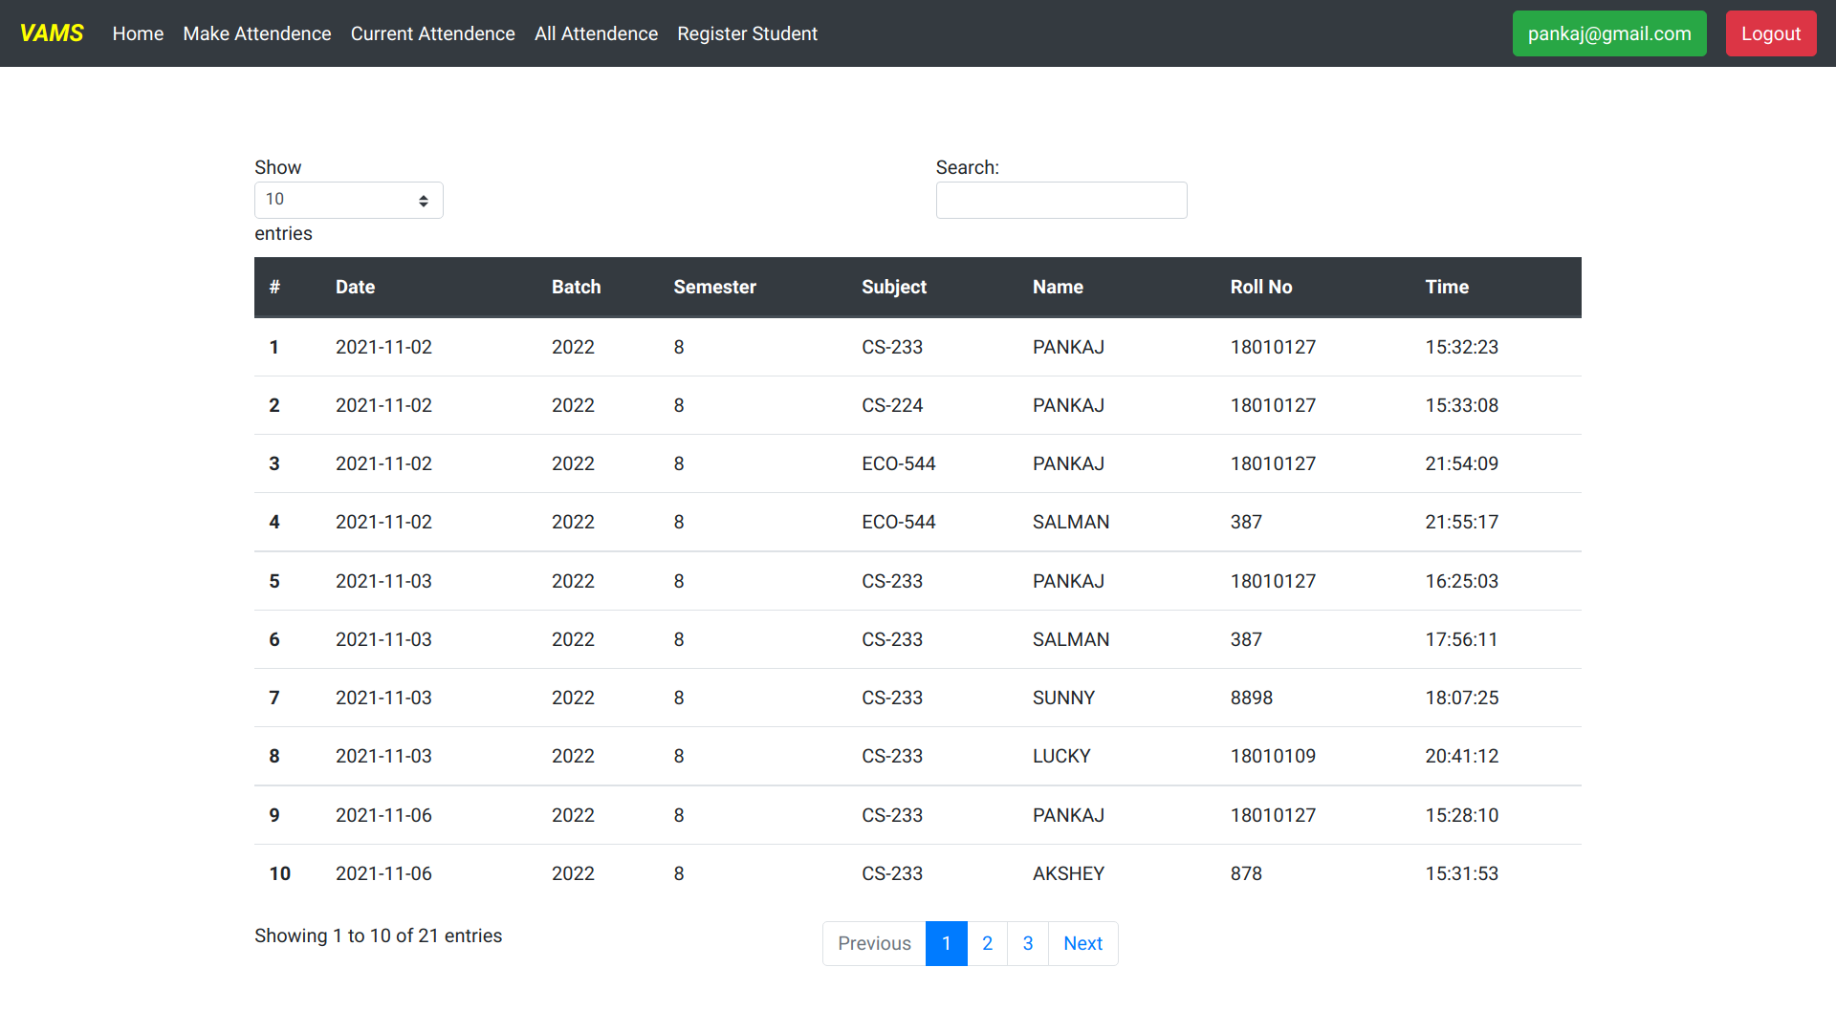
Result analysis

Slide 15
Conclusion
Real-Time Video-Based Attendance System is used to mark the attendance for multiple students at the same time and store in the database so teachers can easily analyze the attendance of their class students.
It is very easy to set up the system because it is web-based software so just need to register students and teachers to start operating the system to take attendance.

Slide 16
Thank You

