Slide 1
SALES MANAGEMENT SYSTEM
TEAM MEMBERS
Inisha Maharjan (THA079BEI012)
Nischal Dangol (THA079BEI016)
Pankaj Kumar Mehta (THA079BEI018)
Pramit Khatri (THA079BEI020)
Department of Electronics and Computer Engineering
Institute of Engineering, Thapathali Campus
February 18, 2024

Slide 2
OUTLINE OF PRESENTATION
Background and Introduction
Problem Definition and Motivation
Objective of the Project
Literature Review
Methodology
Project Description
Result and Analysis
Conclusion and Future Enhancement
References

Slide 3
BACKGROUND – [1]
The application “Byapar” is based on a Data Management System.
“Byapar” acts as a platform for managing inventory and transactions.
“Byapar” will primarily serve local businesses by offering digital management.
“Byapar” has an easy-to-understand design as it doesn't demand a lot of technical expertise.

Slide 4
BACKGROUND – [2]
“Byapar” mainly focuses on offering safe data records.
“Byapar” increases the organization's overall productivity ensuring that it is well-managed.

Slide 5
Problem Definition and Motivation
The project mainly focuses on ways to eliminate the old-fashioned ways of the sales management.
The project aims to build an application that helps to manage the inventory and transactions of a business.
Inspired by the sales management system of large departmental stores like Big Mart, Sales Berry, and Bhatbhateni.
Motivated by the necessity for real-world implementation.
A comparable application for small local businesses is to be created.

Slide 6
OBJECTIVE OF THE PROJECT
To study and understand the concept of DBMS and GUI development and C++.
To make user-friendly and easy to use application for sales management.

Slide 7
LITERATURE REVIEW – [1]
Manual Systems: Used paper-based records, balance sheets, and rudimentary systems.
Early Computer Systems: Emergence of computers in the late 20th century led to automation of basic sales processes.
Mainframes: Businesses started using mainframes to manage inventory and orders.
1980s: Popular programs like Lotus 1-2-3 and Microsoft Excel for organizing and analyzing sales data.

Slide 8
LITERATURE REVIEW – [2]
ERP Systems: Merged various business functions into a single software.
1990s: Point-Of-Sale (POS) systems revolutionized retail industry with real-time inventory management and purchase tracking.
Post-1990s: Cloud-based solutions, CRM software, and mobile technology became mainstream.

Slide 9
LITERATURE REVIEW – [3]
Related softwares:
SAP: Founded in 1972, offers ERP software for sales, inventory, transactions, and billing.
Oracle: Founded in 1977, also offers ERP solutions.
Quickbooks: Launched in 1983, designed for small and medium-sized businesses.
NetSuite: An integrated cloud-based ERP system for sales, inventory, and financial transactions.

Slide 10
METHODOLOGY- [1]
Header Files
Header files store predefined functions in C++.
Various header files used: iostream, wx.h, tuple.h, array.h, vector.h, mysql_connection.h, string.h, iomanip.h, fstream.h.
Graphical User Interface (GUI)
GUI is a system of interactive visual components for computer software.
It displays objects that convey information and represent actions that the user can take.
GUI acts as the front page of the project, improving usability and understanding of the application.

Slide 11
METHODOLOGY – [2]
Database Management System (DBMS)
DBMS are software systems used to store, retrieve, and run queries on data.
It manages the data, the database engine, and the database schema.
DBMS offer benefits over traditional file systems, including flexibility and a more complex backup system.
DBMS is the backbone of the project, as every product details are stored in the database.

Slide 12
METHODOLOGY – [3]
Tools and Environment
Visual Studio Code: A development environment used for writing and debugging C++ code.
wxWidgets: A widget toolkit and tools library for creating graphical user interfaces for cross-platform applications.
XAMPP: A free and open-source cross-platform web server solution stack package developed by Apache Friends.

Slide 13
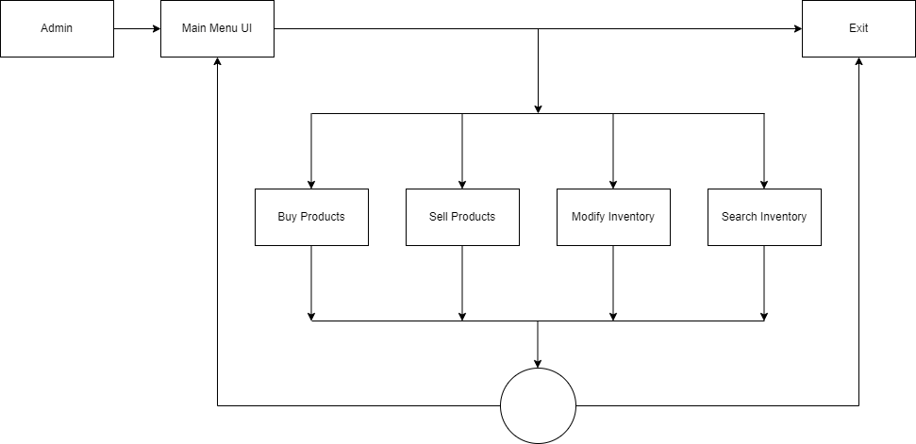
PROJECT DESCRIPTION – [1]
Fig 1: System Architecture

Slide 14
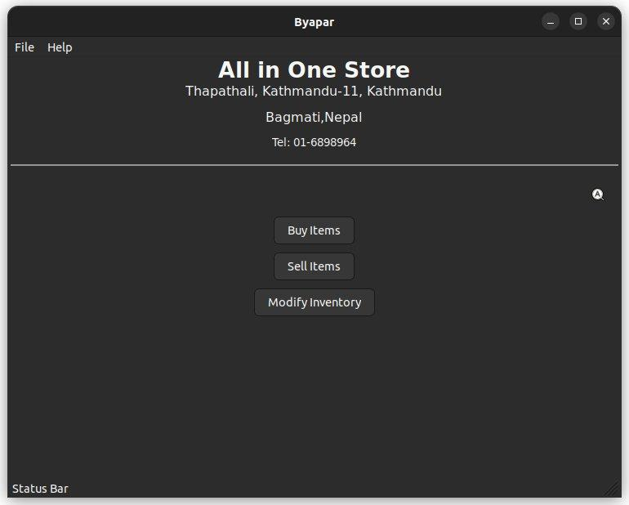
PROJECT DESCRIPTION – [2]
Fig 2: Main Menu Window

Slide 15
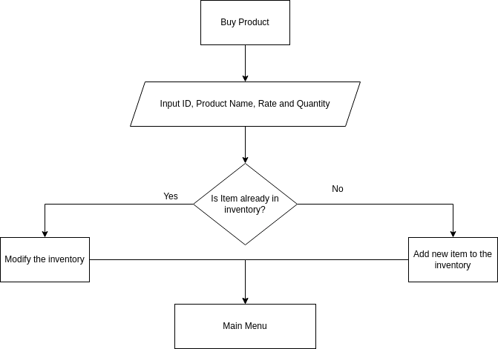
PROJECT DESCRIPTION – [3]
Fig 3: Flowchart Of Buy Products

Slide 16
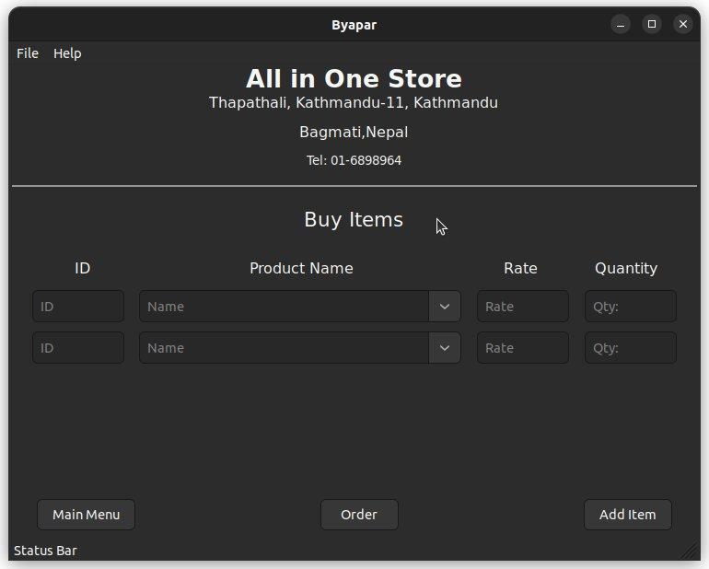
PROJECT DESCRIPTION – [4]
Fig 4: Buy Items Window

Slide 17
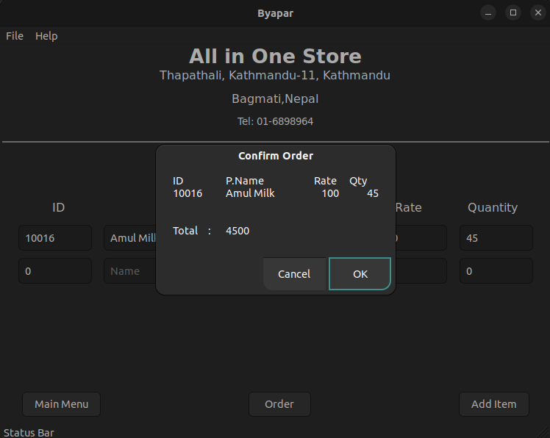
PROJECT DESCRIPTION – [5]
Fig 5: Window While Buying

Slide 18
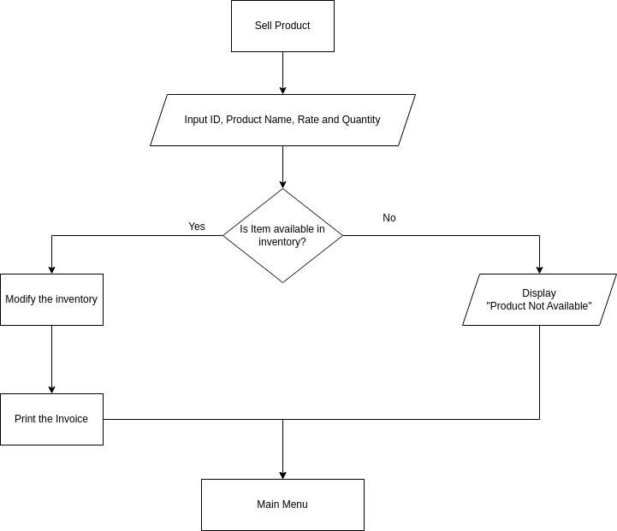
PROJECT DESCRIPTION – [6]
Fig 6: Flowchart Of Sell Items

Slide 19

PROJECT DESCRIPTION – [7]
Fig 7: Sell Items Window

Slide 20
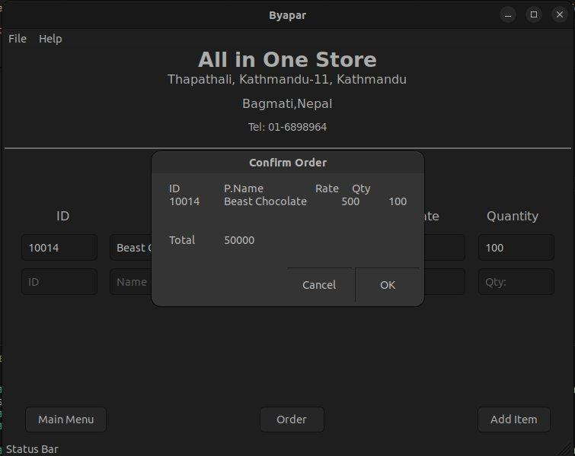
PROJECT DESCRIPTION – [8]
Fig 8: Window While Confirming Sales

Slide 21
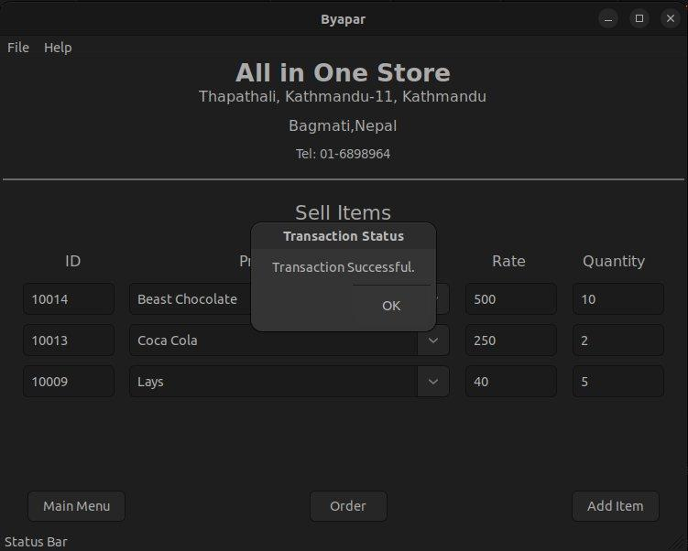
PROJECT DESCRIPTION – [9]
Fig 9: Window After Selling

Slide 22
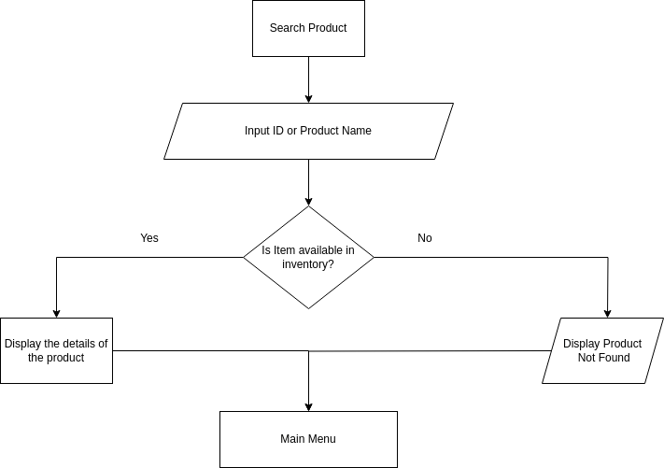
PROJECT DESCRIPTION – [10]
Fig 10: Flowchart Of Search Inventory

Slide 23
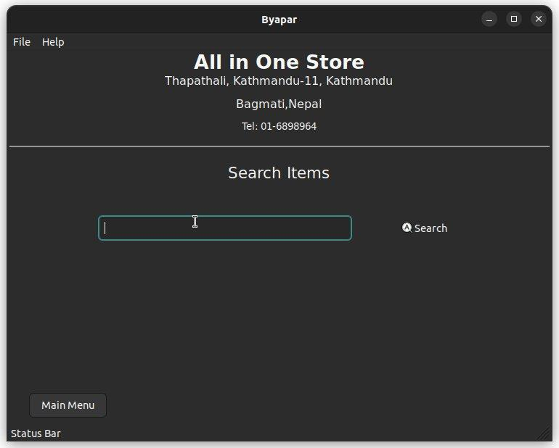
PROJECT DESCRIPTION – [11]
Fig 11: Search Items Window

Slide 24
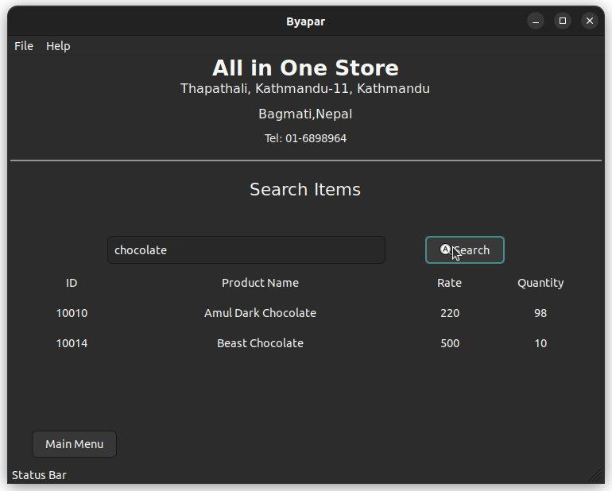
PROJECT DESCRIPTION – [12]
Fig 12: Window After Searching Items

Slide 25
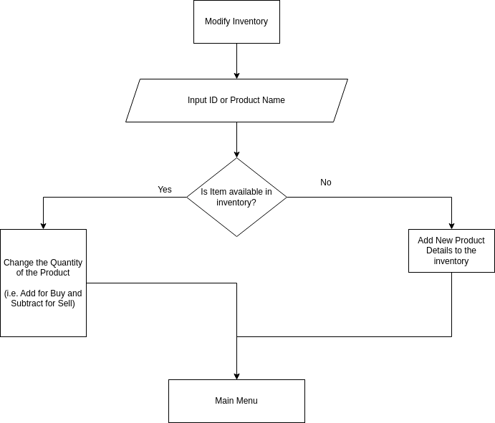
PROJECT DESCRIPTION – [13]
Fig 13: Flowchart Of Modify Inventory

Slide 26
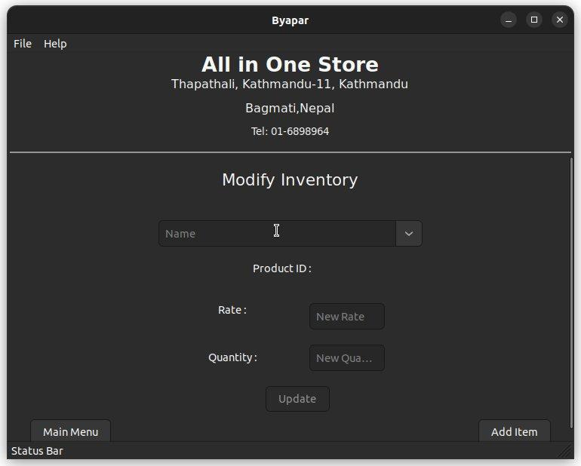
PROJECT DESCRIPTION – [14]
Fig 14: Modify Inventory Window

Slide 27
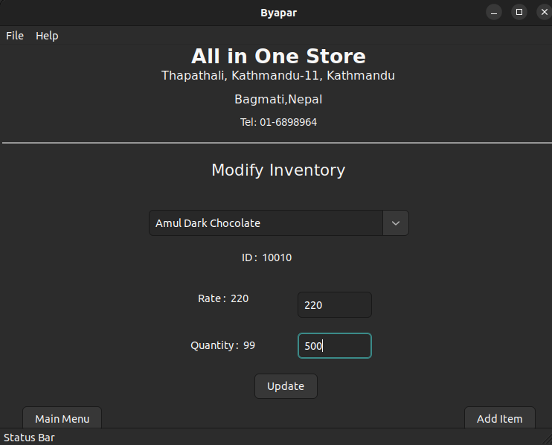
PROJECT DESCRIPTION – [15]
Fig 15: Windows While Modifying

Slide 28
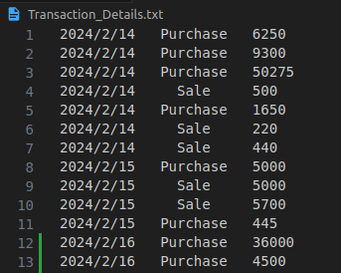
PROJECT DESCRIPTION – [16]
Fig 16: Transaction Details

Slide 29
RESULT AND ANALYSIS
The system features a C++-developed GUI for user-friendly interaction.
Efficient inventory/product data management with transaction history.
Database management is done using C++ and MariaDB.
Enhances organization’s performance and scalability.
The system's user-friendly interface prioritizes user experience.
Ensures data integrity and security.

Slide 30
CONCLUSION
Utilizes C++'s performance, efficiency, and vast libraries for scalable solutions.
Uses GUI frameworks like wxWidgets for intuitive, user-friendly interfaces.
Requires consideration of database connectivity libraries and error handling with MariaDB.
Despite limitations, well-designed SMS offers high performance, platform independence, and easy integration.

Slide 31
LIMITATION
Complexity of CRM concept hinders efficient customer interaction management.
Inadequate error handling and C++ implementation issues can affect system reliability and usability.
Lack of profit and loss analysis, despite transaction records, can cause user issues.

Slide 32
FUTURE ENHANCEMENT
Incorporating additional features like bill issuing, monthly profit and loss calculation.
Adding card and QR payment modes.
Enhancing customer relationship management and order processing.

Slide 33
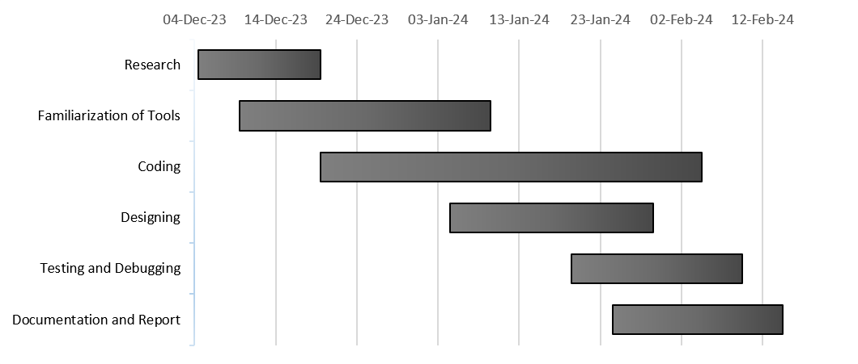
Gantt Chart

Slide 34
REFERENCES – [1]
[1] Sage Software, "History and Evolution of CRM," [Online]. Available: https://www.sagesoftware.co.in/blogs/history-and-evolution-of-crm-2/.
[2] D. Edwards, "The history and evolution of CRM," 30 December 2020. [Online]. Available:https://www.techtarget.com/searchcustomerexperience/infographic/The-history-and-evolution-of-CRM.
[3]McCue, "The History of ERP," 12 August 2020. [Online]. Available:https://www.netsuite.com/portal/resource/articles/erp/erp-history.shtml.

Slide 35
REFERENCES – [2]
[4] D. Rivera, "A Brief History of POS Systems," 16 August 2023. [Online]. Available: https://fitsmallbusiness.com/history-of-pos-systems/.
[5] J. Sullivian, "The Evolution of CRM: Then vs. Now," [Online]. Available: https://www.business-software.com/blog/the-evolution-of-crm/.
[6] SAP, "SAP: A 50-year history of success," [Online]. Available: https://www.sap.com/about/company/history.html.

Slide 36
REFERENCES – [3]
[7] M. Hall, "Oracle Corporation," Dec 30 2008. [Online]. Available: https://www.britannica.com/topic/Oracle-Corporation.
[8] Intuit, "Accounting Software for Small and Growing Businesses," 2022. [Online]. Available: https://quickbooks.intuit.com/global/accounting-software/.
[9] 2024. [Online]. Available: https://www.netsuite.com/portal/aboutus.shtml.

