Slide 1


Project: SQL Data Analysis and Visualization with Power BI for FDA
By: PANKAJ MISHRA

Slide 2
The project involves conducting a comprehensive analysis of drug approval trends, segmentation patterns based on drug marketing status, product analysis by dosage form, and exploration of therapeutic classes and approval trends. This analysis will be carried out using SQL queries, and the results will be visualized using Power BI to provide meaningful insights for decision-making. Key objectives include determining the number of drugs approved each year, identifying top and bottom years for approvals, exploring approval trends by sponsors, ranking sponsors based on approvals, segmenting products based on Marketing Status, analyzing dosage form distribution and successful forms, investigating yearly trends related to successful forms, analyzing drug approvals by therapeutic evaluation code, and visualizing approval trends and segmentation patterns through Power BI visualizations

Slide 3
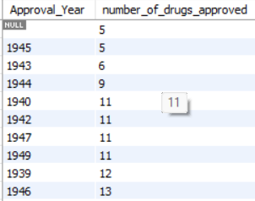
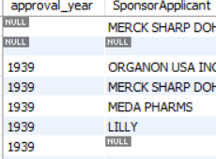
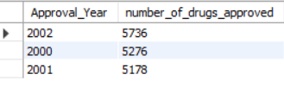
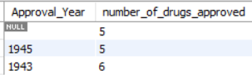
Task 1:Identify approval trend

Slide 4
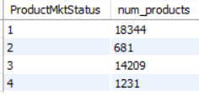
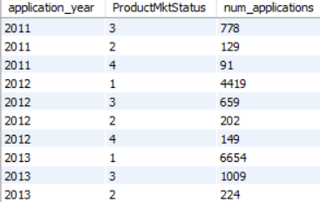
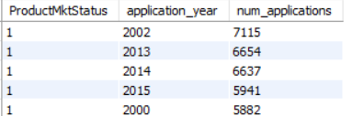
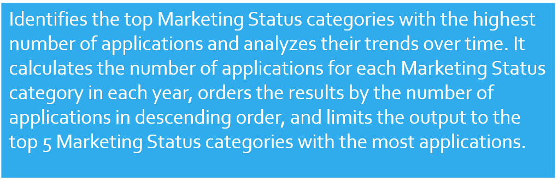
Task 2: Group products based on MarketingStatus

Slide 5
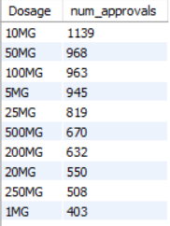
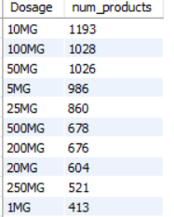
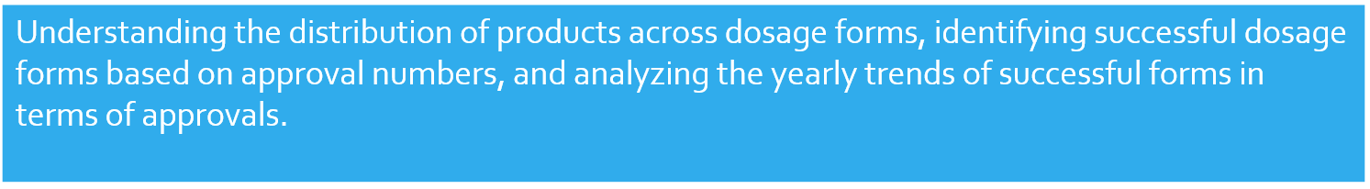
Task 3: Products by dosage form

Slide 6
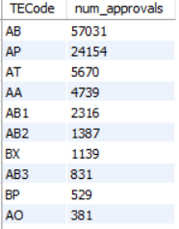
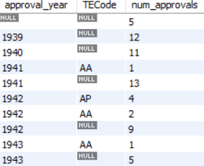
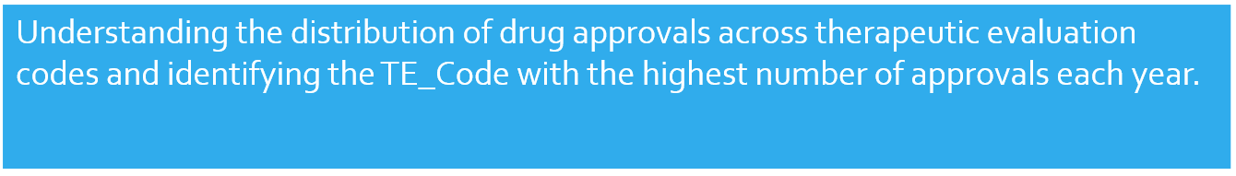
Task 4: drug approvals based on therapeutic evaluation code (TE_Code)

Slide 7
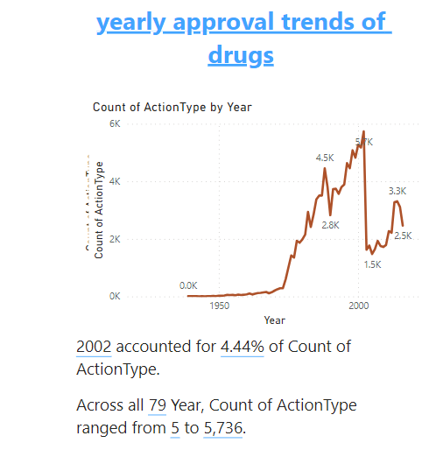

Slide 8
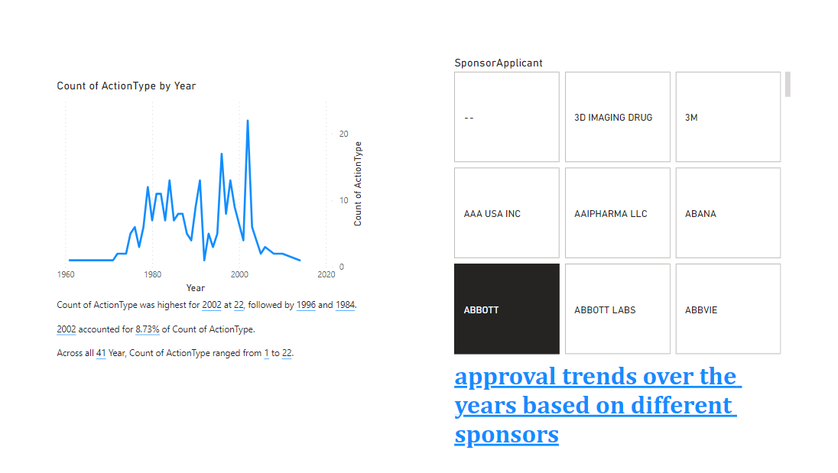

Slide 9
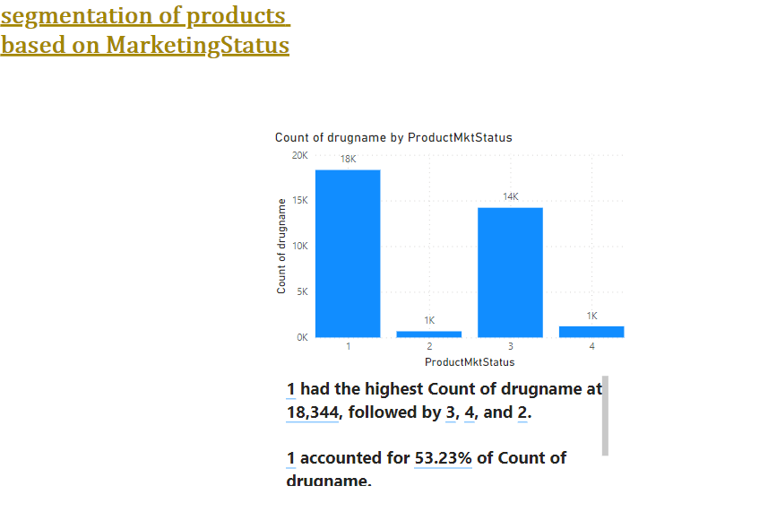

Slide 10
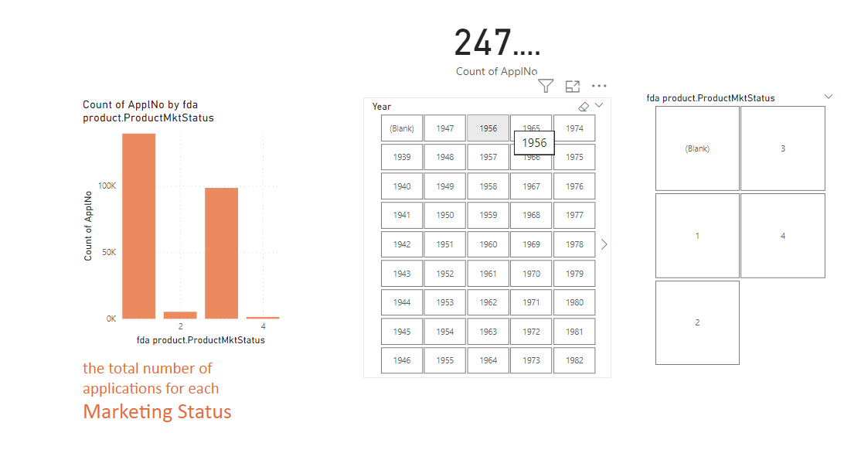

Slide 11
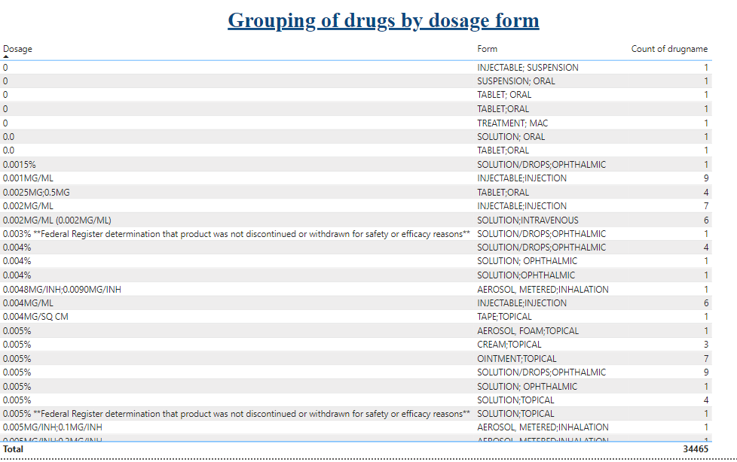

Slide 12
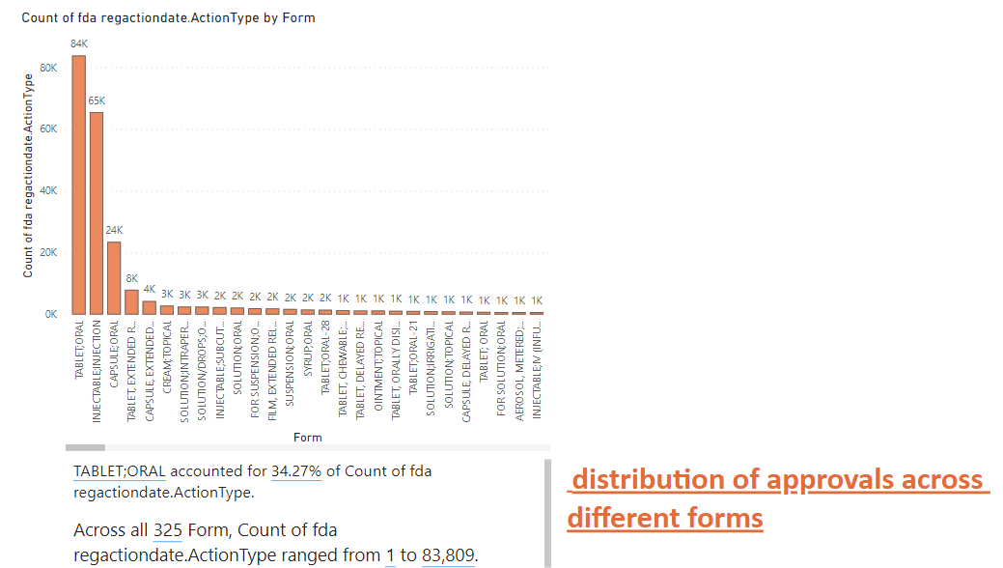

Slide 13
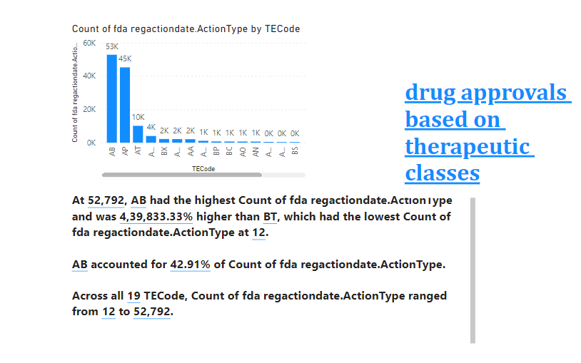

Slide 14
The project's overarching goal is to furnish actionable insights and visual representations that enhance decision-making and comprehension of drug approval dynamics and market trends.

