Slide 1



BLOCKCHAIN
M.sc(Cs)-I Sem-I 2021-2022
A17. Harshal Thombare
A23. Pankaj Pendavale
A55. Vivek Raut
A58. Shivansh Sharma

Slide 2
HISTORY
Cryptographer David Chaum first proposed a blockchain-like protocol in his 1982 dissertation "Computer Systems Established, Maintained, and Trusted by Mutually Suspicious Groups. Further work on a cryptographically secured chain of blocks was described in 1991 by Stuart Haber and W. Scott Stornetta.They wanted to implement a system wherein document timestamps could not be tampered with. In 1992, Haber, Stornetta, and Dave Bayer incorporated Merkle trees to the design, which improved its efficiency by allowing several document certificates to be collected into one block. Under their company Surety, their document certificate hashes have been published in The New York Times every week since 1995.
The first decentralized blockchain was conceptualized by a person (or group of people) known as Satoshi Nakamoto in 2008. Nakamoto improved the design in an important way using a Hashcash-like method to timestamp blocks without requiring them to be signed by a trusted party and introducing a difficulty parameter to stabilize the rate at which blocks are added to the chain. The design was implemented the following year by Nakamoto as a core component of the cryptocurrency bitcoin, where it serves as the public ledger for all transactions on the network.

Slide 3
What Is a Blockchain?
A blockchain is a distributed database that is shared among the nodes of a computer network
Block Block Block Block Block Block Block Block Block Block
Composition of Block
DATA: It can be any data you want to keep in blockchain in secure way. Commonly in case of Bitcoin, ledger is kept where info about transaction of bitcoin is kept.
OWN HASH : It’s a HashCode that is generated by a authorized machine for a newly created block.
Previous Block Hash :Here HashCode of previous block is stored or the block after which our newly created block will be stored
OWN
HASH
DATA
PREVIOUS
BLOCK
HASH

Slide 4
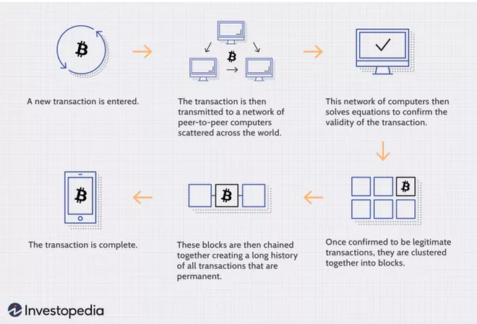
How Does a Blockchain Work?
Methodology Involved
Hash:Hash is a code that can be generated by a one way function called hash function.
Proof-of-Work : It is way to ensure that a computer has done a significant amount of work that the outcome is a legitimate.
Peer-to-Peer confirmation: After outcome consensus should be made among all machines or nodes involved in Blockchain .

Slide 5

Types of Blockchain
Bitcoins
Public Blockchains
Ethereum
R3
Blockchains
Consortium Blockchains
Corda
Private Blockchains
Monax
Multichain

Slide 6

High level of security.
Hacking threat reduced.
Transparency of transactions increased.
No payment for intermediaries services.
Different levels of accessibility.
Faster transactions.

Slide 7
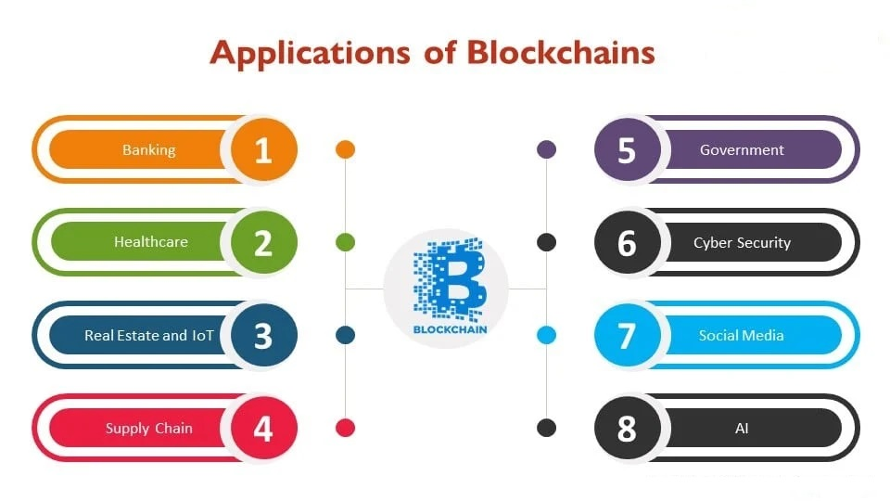

Slide 8


Summary:
Blockchain is a shared,replicated ledger technology.
IBM supports an open standards,open source,
open governance Blockchain.
Blockchain can open up business networks by taking
out,cost,improving efficiencess and increase
accessibility
Blockchain addresses an exciting and topical set of business challenges,which cross every industry
Blockchain is a shared,replicated ledger technology.
IBM supports an open standards , open source , open governance Blockchain .
Blockchain can open up business networks by taking out,cost,improving efficiencess and increase accessibility.
Blockchain addresses an exciting and topical set of business challenges,which cross every industry

Slide 9


