Slide 1
Python Session 5.1 – Class iNHERITANCE

Slide 2
Inheritance
class inheritance mechanism allows multiple base classes, a derived class can override any methods of its base class or classes
class DerivedClassName(BaseClassName):
<statement-1>
.
.
.
<statement-N>
When the class object is constructed, the base class is remembered. This is used for resolving attribute references: if a requested attribute is not found in the class, the search proceeds to look in the base class. This rule is applied recursively if the base class itself is derived from some other class.

Slide 3
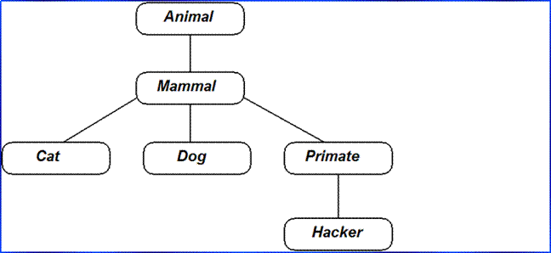

Slide 4
class name(superclass):
statements
Example:
class Point3D(Point): # Point3D extends Point
z = 0
Python also supports multiple inheritance
class name(superclass, ..., superclass):
statements
(if > 1 superclass has the same field/method, conflicts are resolved in left-to-right order)

Slide 5
Parent class
class Parent: # define parent class
parentAttr = 100
def __init__(self):
print "Calling parent constructor"
def parentMethod(self):
print 'Calling parent method‘
def setAttr(self, attr):
Parent.parentAttr = attr
def getAttr(self):
print "Parent attribute :", Parent.parentAttr
Child class
class Child(Parent): # define child class
def __init__(self):
print "Calling child constructor"
def childMethod(self):
print 'Calling child method'
Objects instance creation
c = Child() # instance of child
c.childMethod() # child calls its method
c.parentMethod() # calls parent's method
c.setAttr(200) # again call parent's method
c.getAttr() # again call parent's method

Slide 6
Calling Superclass Methods
methods: class.method(object, parameters)
constructors: class.__init__(parameters)
class Derived(Base):
z = 0
def __init__(self, x, y, z):
Base.__init__(self, x, y)
self.z = z
def translate(self, dx, dy, dz):
Base.translate(self, dx, dy)
self.z += dz

Slide 7
Exercise
Define a class named Shape and its subclass Square.
The Square class has an init function which takes a length as argument.
Both classes have a area function which can print the area of the shape where Shape's area is 0 by default.
Hints:
To override a method in super class, we can define a method with the same name in the super class.

