Slide 1
Python

Slide 2
Major Versions of Python
“Python” or “CPython” is written in C/C++
- Version 2.x
- Version 3.x
“Jython” is written in Java for the JVM
“IronPython” is written in C# for the .Net environment
PyPy written in python

Slide 3
Development Environments
PyDev with Eclipse
Emacs
Vim
PyCharm
Idle

Slide 4
Interactive shell
Great for learning the language
Great for experimenting with the library
Great for testing your own modules
Two variations: IDLE (GUI), python (command line)
Type statements or expressions at prompt:
>>> print "Hello, world"
Hello, world
>>> x = 12**2
>>> x/2
72
>>> # this is a comment

Slide 5
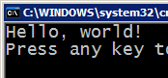



Compiling and interpreting
Many languages require you to compile (translate) your program into a form that the machine understands.
Python is instead directly interpreted into machine instructions.
compile
execute
source code
Hello.java
byte code
Hello.class
output
interpret
source code
Hello.py
output

Slide 6
Strings
string: A sequence of text characters in a program.
Strings start and end with quotation mark " or apostrophe ' characters.
Examples: "hello" "This is a string" "This, too, is a string. It can be very long!"
len(string) - number of characters in a string
(including spaces)
str.lower(string) - lowercase version of a string
str.upper(string) - uppercase version of a string
str.split(char) - Split a string
str.startswith(string)

Slide 7
"hello"+"world" "helloworld" # concatenation
"hello"*3 "hellohellohello" # repetition
"hello"[0] "h" # indexing
"hello"[-1] "o" # (from end)
"hello"[1:4] "ell" # slicing
len("hello") 5 # size
"hello" < "jello" 1 # comparison
"e" in "hello" 1 # search
'single quotes' """triple quotes""" r"raw strings"

Slide 8
Expressions
expression: A data value or set of operations to compute a value.
Examples: 1 + 4 * 3
42
Arithmetic operators we will use:
+ - * / addition, subtraction/negation, multiplication, division
% modulus, a.k.a. remainder
** exponentiation
precedence: Order in which operations are computed.
* / % ** have a higher precedence than + - 1 + 3 * 4 is 13
Parentheses can be used to force a certain order of evaluation. (1 + 3) * 4 is 16

Slide 9
Integer division
When we divide integers with / , the quotient is also an integer.
3 52
4 ) 14 27 ) 1425
12 135
2 75
54
21
More examples:
35 / 5 is 7
84 / 10 is 8
156 / 100 is 1
The % operator computes the remainder from a division of integers.
3 43
4 ) 14 5 ) 218
12 20
2 18
15
3

Slide 10
Real numbers
Python can also manipulate real numbers.
Examples: 6.022 -15.9997 42.0 2.143e17
The operators + - * / % ** ( ) all work for real numbers.
The / produces an exact answer: 15.0 / 2.0 is 7.5
The same rules of precedence also apply to real numbers: Evaluate ( ) before * / % before + -
When integers and reals are mixed, the result is a real number.
Example: 1 / 2.0 is 0.5
The conversion occurs on a per-operator basis.
7 / 3 * 1.2 + 3 / 2
2 * 1.2 + 3 / 2
2.4 + 3 / 2
2.4 + 1
3.4

Slide 11
Variables
variable: A named piece of memory that can store a value.
Usage:
Compute an expression's result,
store that result into a variable,
and use that variable later in the program
assignment statement: Stores a value into a variable.
Syntax:
name = value
Examples: x = 5
gpa = 3.14
x 5 gpa 3.14
A variable that has been given a value can be used in expressions.
x + 4 is 9

Slide 12
print
print : Produces text output on the console.
Syntax:
print "Message"
print Expression
Prints the given text message or expression value on the console, and moves the cursor down to the next line.
print Item1, Item2, ..., ItemN
Prints several messages and/or expressions on the same line.
Examples:
print "Hello, world!"
age = 45
print "You have", 65 - age, "years until retirement"
Output:
Hello, world!
You have 20 years until retirement

Slide 13
Lists
A compound data type:
[0]
[2.3, 4.5]
[5, "Hello", "there", 9.8]
[]
Flexible arrays, not Lisp-like linked lists
a = [99, "bottles of beer", ["on", "the", "wall"]]
Same operators as for strings
a + b, a*3, a[0], a[-1], a[1:], len(a)
Item and slice assignment
a[0] = 98
a[1:2] = ["bottles", "of", "beer"]
-> [98, "bottles", "of", "beer", ["on", "the", "wall"]]
del a[-1] # -> [98, "bottles", "of", "beer"]

Slide 14
Lists can be heterogeneous
a = ['spam', 'eggs', 100, 1234, 2*2]
Lists can be indexed and sliced:
a[0] → spam
a[:2] → ['spam', 'eggs']
Lists can be manipulated
a[2] = a[2] + 23
a[0:2] = [1,12]
a[0:0] = []
len(a) → 5

Slide 15
Use len() to get the length of a list
>>> names = [“Ben", “Chen", “Yaqin"]
>>> len(names)
3
Use [ ] to index items in the list
>>> names[0]
‘Ben'
>>> names[1]
‘Chen'
>>> names[2]
‘Yaqin'
>>> names[3]
Traceback (most recent call last):
File "<stdin>", line 1, in <module>
IndexError: list index out of range

Slide 16
>>> a = range(5) # [0,1,2,3,4]
>>> a.append(5) # [0,1,2,3,4,5]
>>> a.pop() # [0,1,2,3,4]
5
>>> a.insert(0, 42) # [42,0,1,2,3,4]
>>> a.pop(0) # [0,1,2,3,4]
5.5
>>> a.reverse() # [4,3,2,1,0]
>>> a.sort() # [0,1,2,3,4]

Slide 17
Dictionaries
Hash tables, "associative arrays"
d = {"duck": "eend", "water": "water"}
symbol_to_name = {
"H": "hydrogen",
"He": "helium",
"Li": "lithium",
"C": "carbon",
"O": "oxygen",
"N": "nitrogen"
}
Lookup:
d["duck"] -> "eend"
d["back"] # raises KeyError exception
Delete, insert, overwrite:
del d["water"] # {"duck": "eend", "back": "rug"}
d["back"] = "rug" # {"duck": "eend", "back": "rug"}
d["duck"] = "duik" # {"duck": "duik", "back": "rug"}

Slide 18
Keys, values, items:
d.keys() -> ["duck", "back"]
d.values() -> ["duik", "rug"]
d.items() -> [("duck","duik"), ("back","rug")]
Presence check:
d.has_key("duck") -> 1; d.has_key("spam") -> 0
Values of any type; keys almost any
{"name":"Guido", "age":43, ("hello","world"):1, 42:"yes", "flag": ["red","white","blue"]}
Duplicate keys are not allowed
Duplicate values are just fine

Slide 19
Keys must be immutable:
numbers, strings, tuples of immutables
these cannot be changed after creation
reason is hashing (fast lookup technique)
not lists or other dictionaries
these types of objects can be changed "in place"
no restrictions on values
Keys will be listed in arbitrary order
again, because of hashing

Slide 20
Operators
Many logical expressions use relational operators:
Logical expressions can be combined with logical operators:
r
Operator | Meaning | Example | Result
== | equals | 1 + 1 == 2 | True
!= | does not equal | 3.2 != 2.5 | True
< | less than | 10 < 5 | False
> | greater than | 10 > 5 | True
<= | less than or equal to | 126 <= 100 | False
>= | greater than or equal to | 5.0 >= 5.0 | True
Operator | Example | Result
and | 9 != 6 and 2 < 3 | True
or | 2 == 3 or -1 < 5 | True
not | not 7 > 0 | False

Slide 21
Control Structures
if condition:
statements
[elif condition:
statements] ...
else:
statements
while condition:
statements
for var in sequence:
statements
break
continue

Slide 22
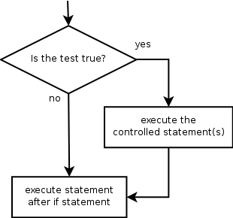
If
if statement: Executes a group of statements only if a certain condition is true. Otherwise, the statements are skipped.
Syntax:
if condition:
statements
Example:
gpa = 3.4
if gpa > 2.0:
print "Your application is accepted."
>>> if not smiles:
... print "The SMILES string is empty"
...
The “else” case is always optional

Slide 23
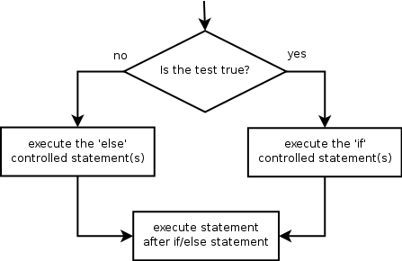
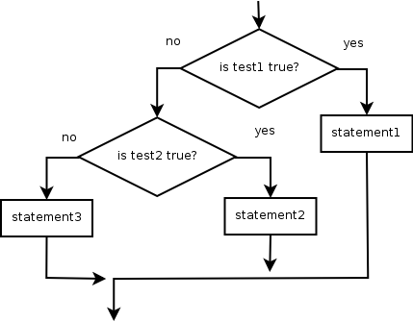
if/else
if/else statement: Executes one block of statements if a certain condition is True, and a second block of statements if it is False.
Syntax:
if condition:
statements
else:
statements
Example:
gpa = 1.4
if gpa > 2.0:
print "Welcome to Mars University!"
else:
print "Your application is denied."
Multiple conditions can be chained with elif ("else if"):
if condition:
statements
elif condition:
statements
else:
statements

Slide 24
Example 1.
x = int(raw_input("Please enter #:"))
if x < 0:
x = 0
print 'Negative changed to zero'
elif x == 0:
print 'Zero'
elif x == 1:
print 'Single'
else:
print 'More'
Example 2.
if (ben <= 5 and chen >= 10 or chen == 500 and ben != 5):
print “Ben and Chen“
Example 3
if (3 <= Time <= 5):
print “Office Hour"

