Slide 1

Platform
Consolidation
API Gateway & Modular Monolith Architecture
Executive Briefing | Architecture Team

Slide 2

The Problem
Current state creates operational risk and slows delivery
Port Conflicts
Multiple apps competing for the same ports cause deployment failures and downtime
No Single Entry Point
Clients manage connections to 4–5 separate services with no unified API surface
Duplicated DB Logic
Each app maintains its own connection pools, models, and migration scripts
Scaling Bottleneck
Tightly coupled codebases make independent deployment and scaling impossible

Slide 3
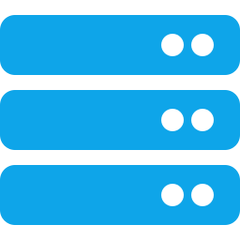

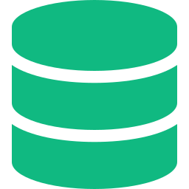

The Solution
A unified API gateway with a modular monolithic backend
API Gateway
Port Isolation
Shared DB Layer
Enforced Boundaries
Single entry point on port 3000 proxying to isolated modules
Each module on its own port (4001–4005) — zero conflicts
One connection pool, schema-per-module isolation
Cross-module access only via approved contract functions

Slide 4
Architecture: Before & After
BEFORE
AFTER
Client
Client
API Gateway :3000
App A :3000
→
App B :3000
:4001
:4002
:4003
:4004
:4005
App C :3000
App D :3000
App E :3000
Shared DB — Schema per Module
DB (tangled)

Slide 5

Port Isolation Strategy
Every module runs on a dedicated port — zero deployment conflicts
Service | Port | Route Prefix | Role
API Gateway | 3000 | / | Routing, Auth, Rate Limiting
Module A | 4001 | /api/app-a/* | User Management
Module B | 4002 | /api/app-b/* | Product Catalog
Module C | 4003 | /api/app-c/* | Order Management
Module D | 4004 | /api/app-d/* | Notifications
Module E | 4005 | /api/app-e/* | Analytics
Docker Compose orchestrates all services — single command startup, health checks built in

Slide 6

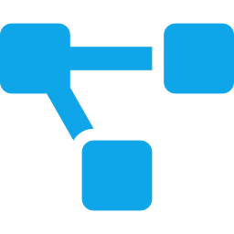

Modular Monolithic Database
One server, logically isolated schemas, shared connection pool
Schema-per-Module
PostgreSQL
CREATE SCHEMA app_a, app_b … each module owns its tables
app_a
Enforced Boundaries
app_b
PostgreSQL roles prevent cross-schema access at the DB level
app_c
Data Contracts
app_d
Approved functions for cross-module queries — no rogue JOINs
app_e
Single Pool
shared
Shared connection pool with scoped clients — efficient and simple

Slide 7



Benefits & Impact
1
0
Single Entry Point
Port Conflicts
Unified API for all consumers
Dedicated ports per module
60%
5×
Less DB Boilerplate
Faster Onboarding
Shared pool & models
Clear module boundaries

Slide 8

Implementation Roadmap
Week 1–2
Monorepo Setup
Restructure into workspaces, move apps to modules/, set up build tooling
Week 2–3
Gateway & Ports
Build API gateway, assign dedicated ports, add health checks and Docker Compose
Week 3–5
DB Refactor
Extract shared connection pool, create schemas per module, migrate models
Week 5–6
Testing & Rollout
Integration tests, schema isolation validation, staged deployment
Total estimated effort: 6 weeks with 2 engineers — zero downtime migration path

Slide 9
Ready to Consolidate
Proposed next steps
Approve architecture approach & timeline
Allocate 2 engineers for 6-week sprint
Begin Phase 1 — monorepo restructure

