Slide 1

Airlines

Slide 2

Ferry

Slide 3

Packages

Slide 4

Visa

Slide 5

Mobile

Slide 6

Insurance

Slide 7

Bus

Slide 8

EcPay

Slide 9

Hotel

Slide 10
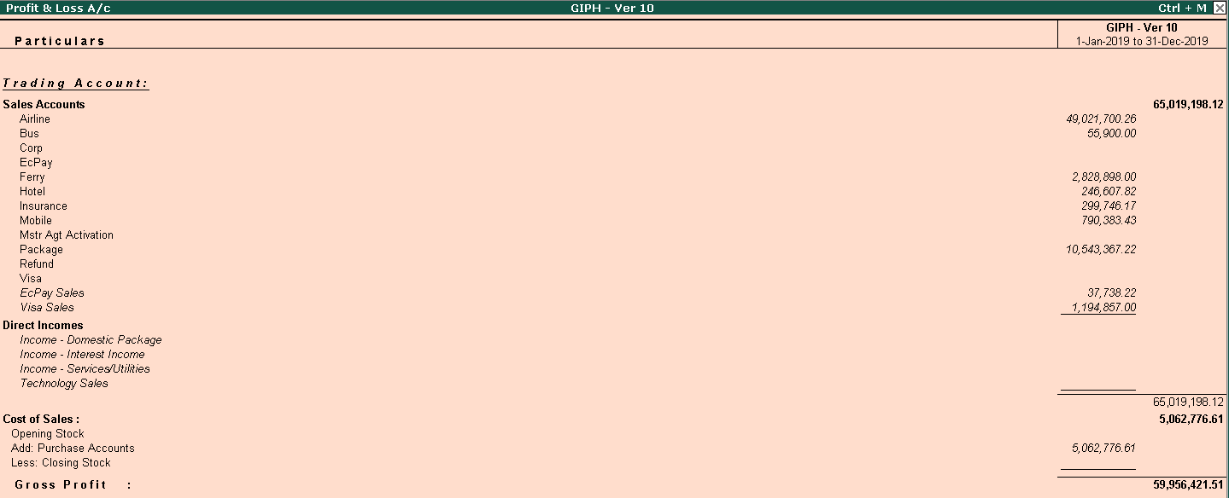
Consolidated - 2019

Slide 11
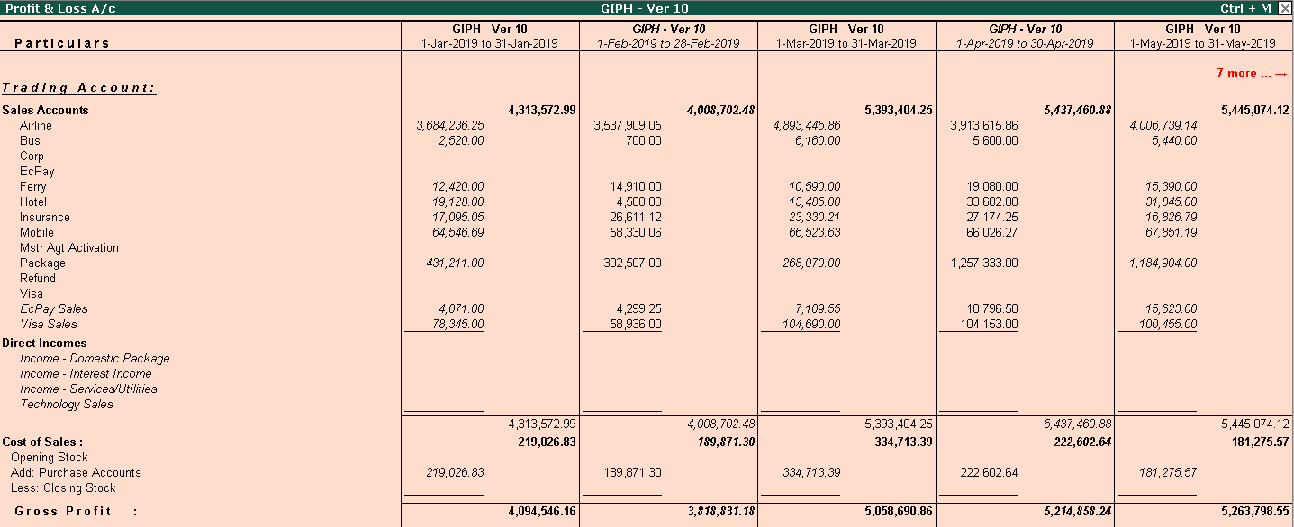
Consolidated – Jan – May 2019

Slide 12
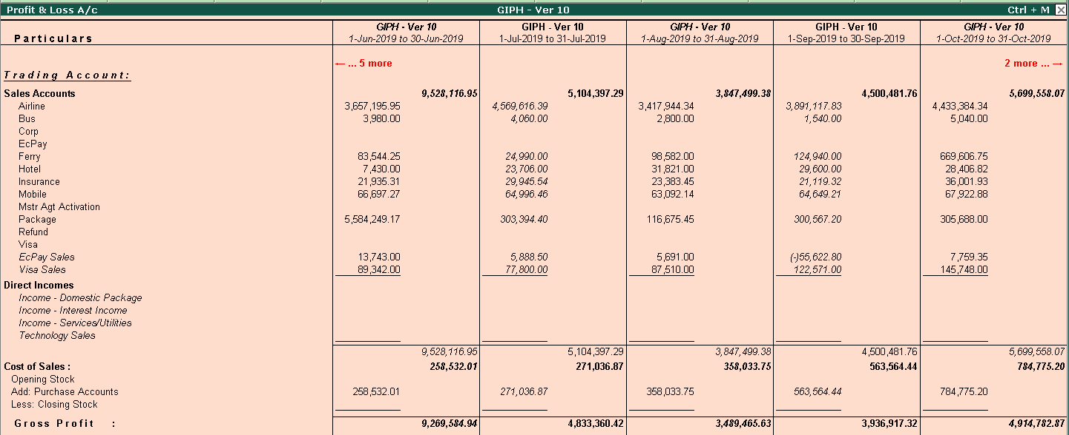
Consolidated – Jun to Oct 2019

Slide 13
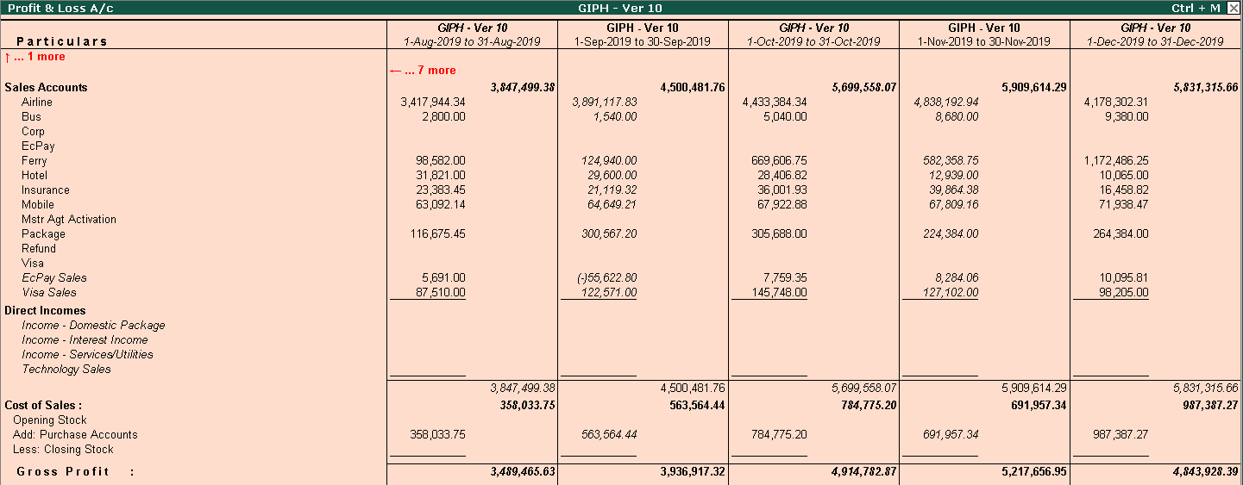
Consolidated – Aug to Dec 2019

