Slide 1
GIPH Migration

Slide 2
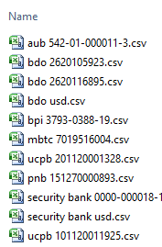
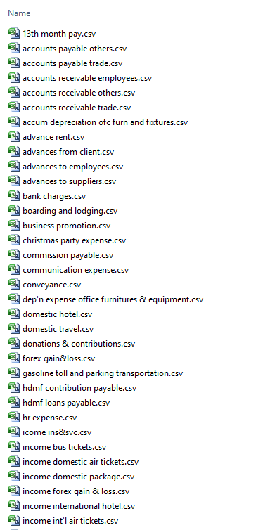
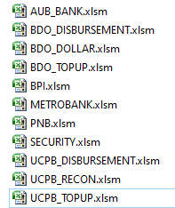
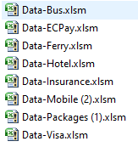
Source Data - 1
Bank Reconciliation
Product Information
Detailed transaction
Excel Files
Bank Statements
Product
AUB
BDO Disbursement
BDO Dollar
BDO Topup
BPI
Metrobank
PNB
Security
UCPB Disbursement
UCPB Recon
UCPB Topup
Excel Files
Monthly Reports
Product
Airline
Hotel
Mobile
Ferry
Insurance
Packages
EcPay
Visa
Bus
Other data (scattered)
BOS’s System
Receipts - Accounts Receivable
Payments - Accounts Payable
Journal – Adjustments
Contra – Interbank transfer
Purchase - Adv to Suppliers
Sales – Adv from Customers
Bank Transaction – Bank Book

Slide 3
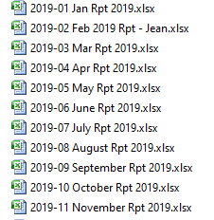
Source Data - 2
Monthly Reports
Data in the monthly reports

Slide 4
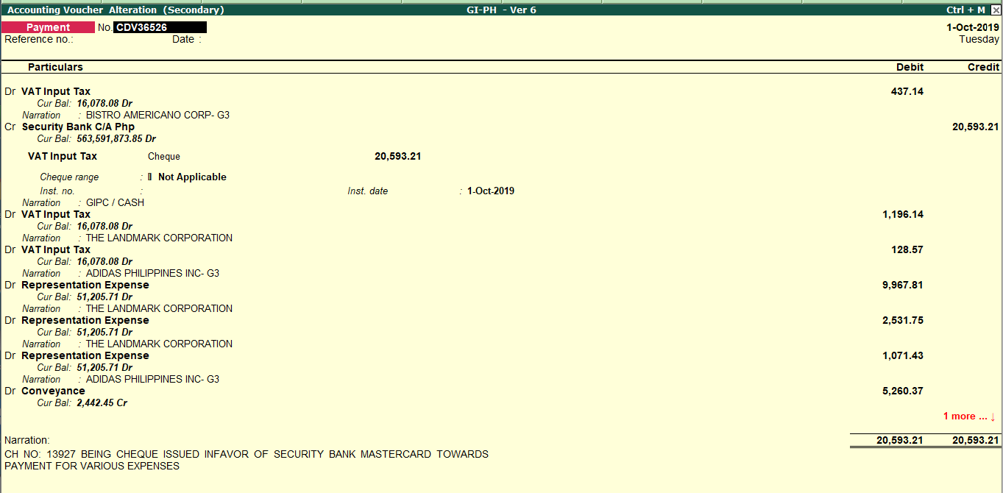
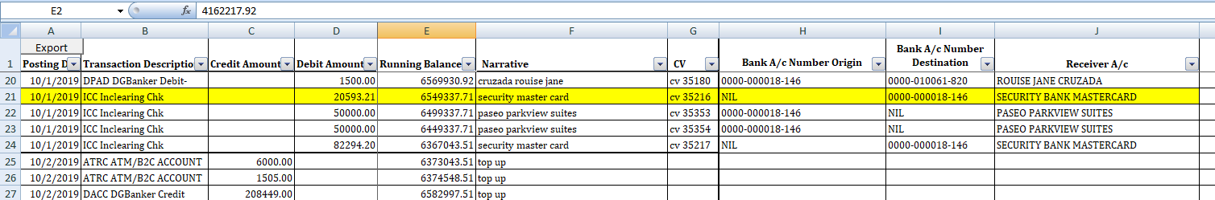
Composition of Accounting Transaction
Transaction in Tally from Ibos’s System
Bank Statement
From the bank statement it is not possible to generate a complete payment transaction

Slide 5
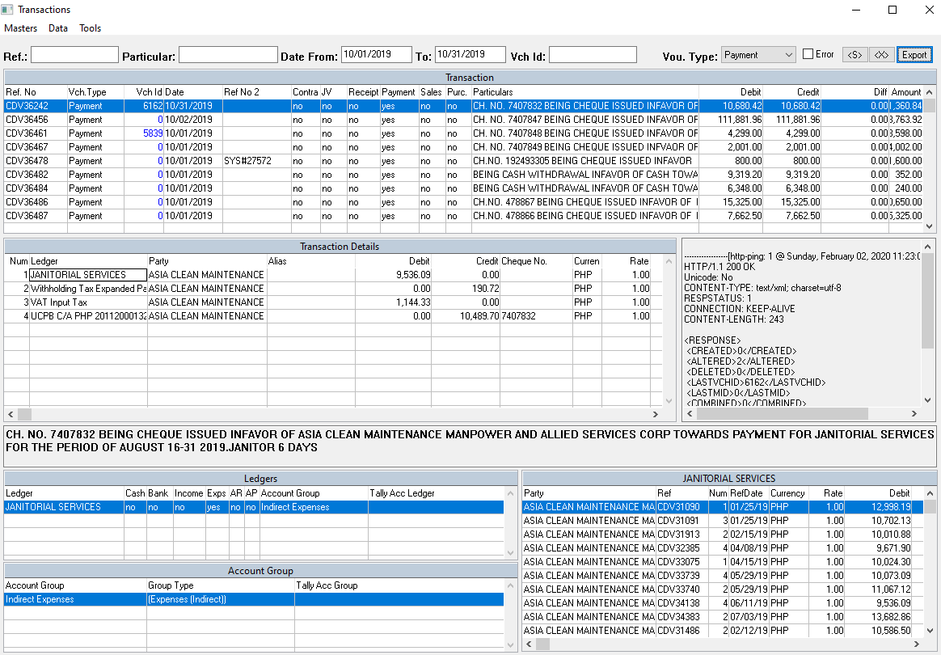
Auto posting of Accounting Transaction - 1
Interface to collect data generate Tally Transaction
Excel file from Ibos’s System
Transaction in Tally
For bank reconciliation
Bank Statement

Slide 6
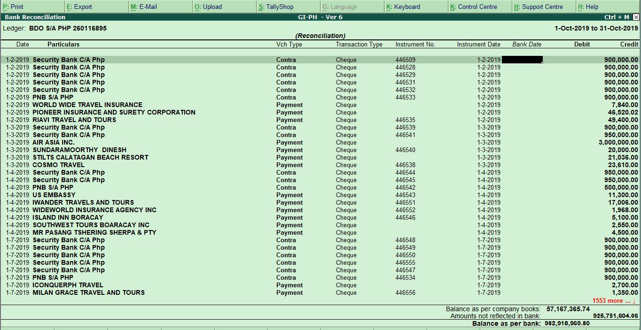
Composition of Accounting Transaction - 2
Bank Reconciliation

Slide 7
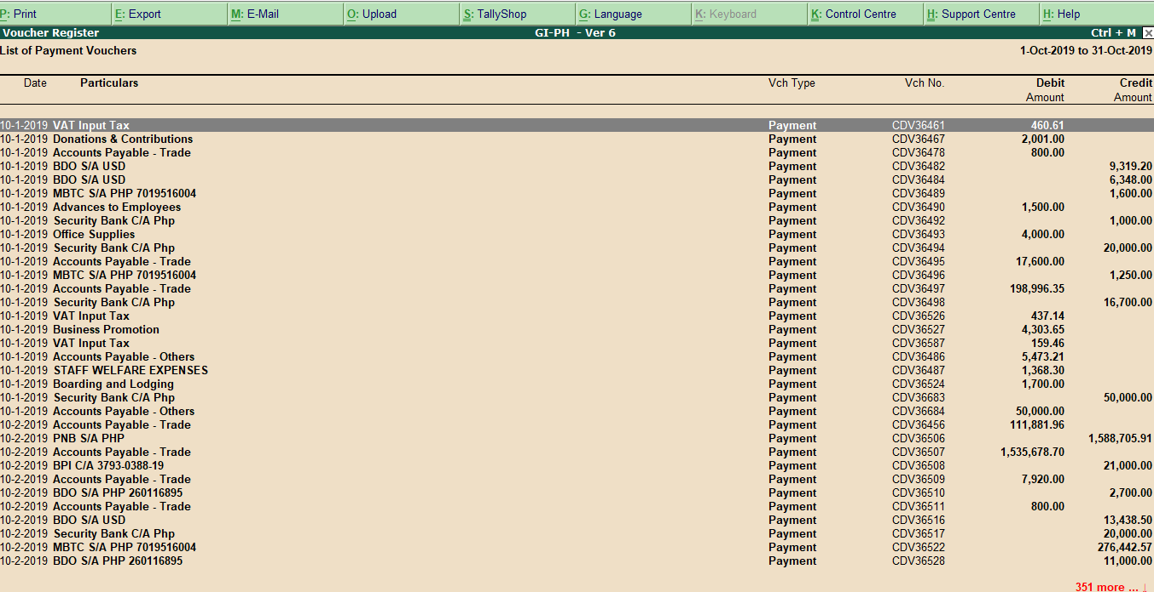
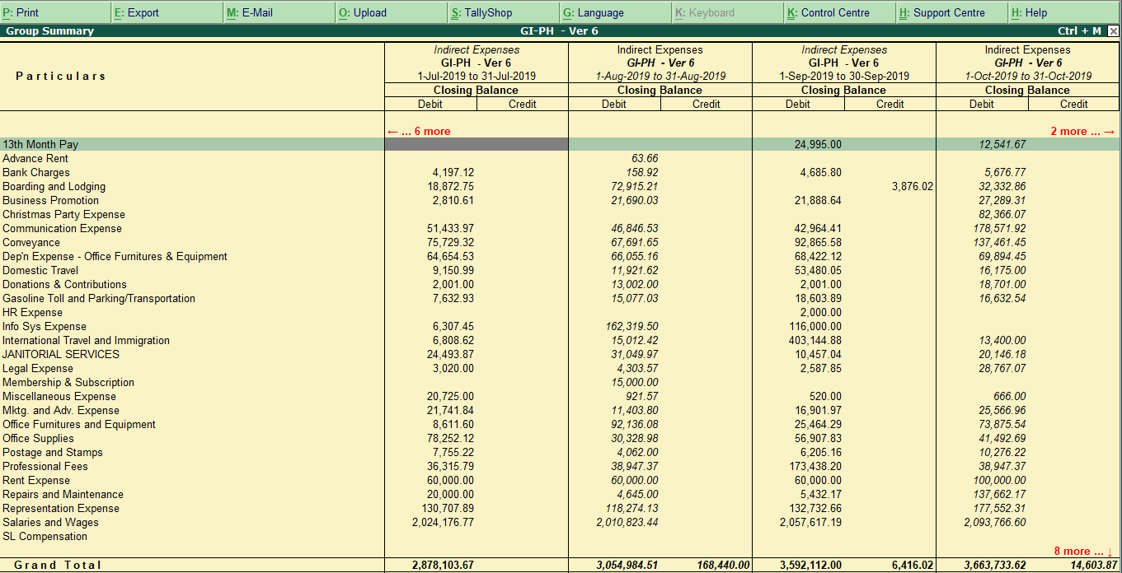
Auto posting of Accounting Transaction - 4
Payment transaction in Tally
Trial Balance

Slide 8
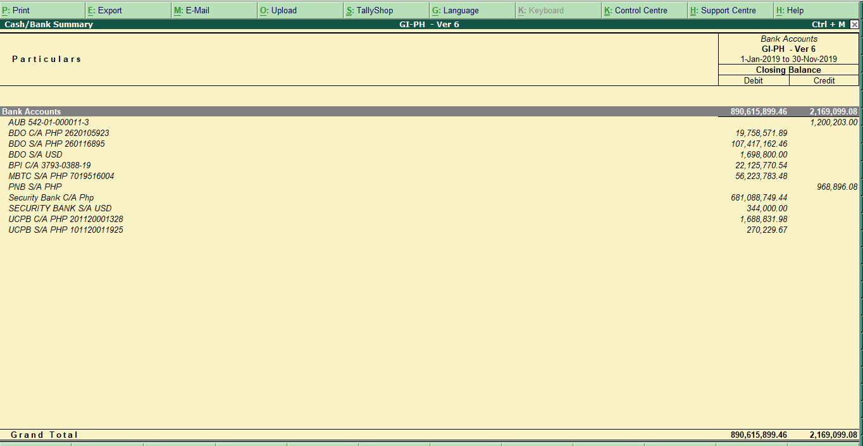
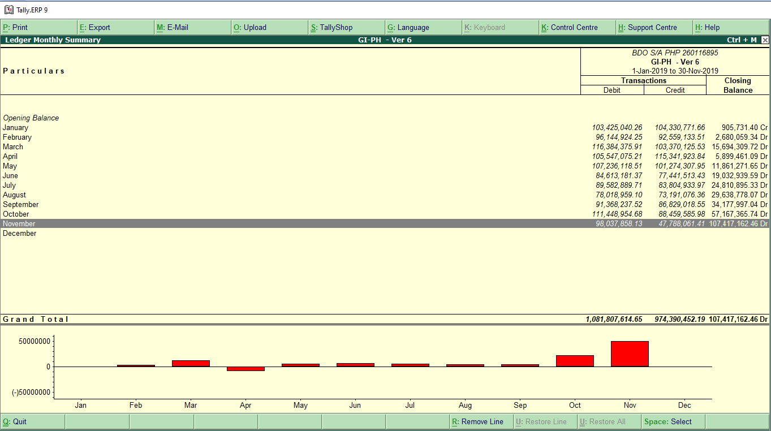
Composition of Accounting Transaction - 3
Bank wise figures in Tally
Monthly Banking Transaction in Tally

Slide 9
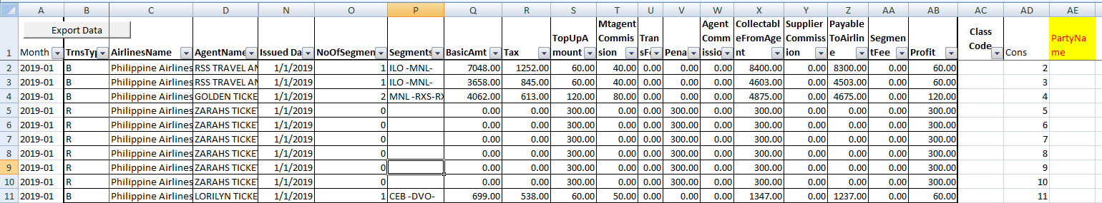
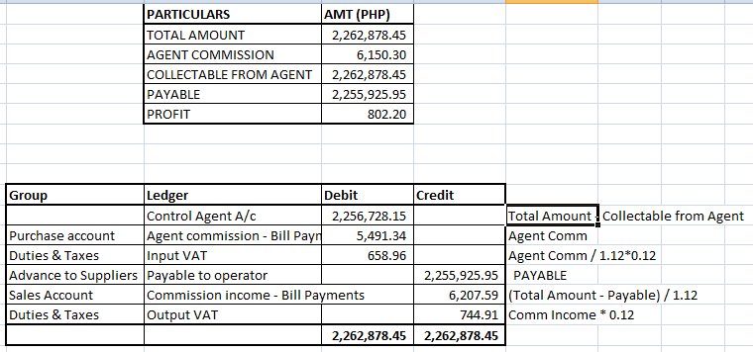
Auto posting of Product Transaction - 1
Product Data from Excel Sheets
Composition of Transaction

Slide 10
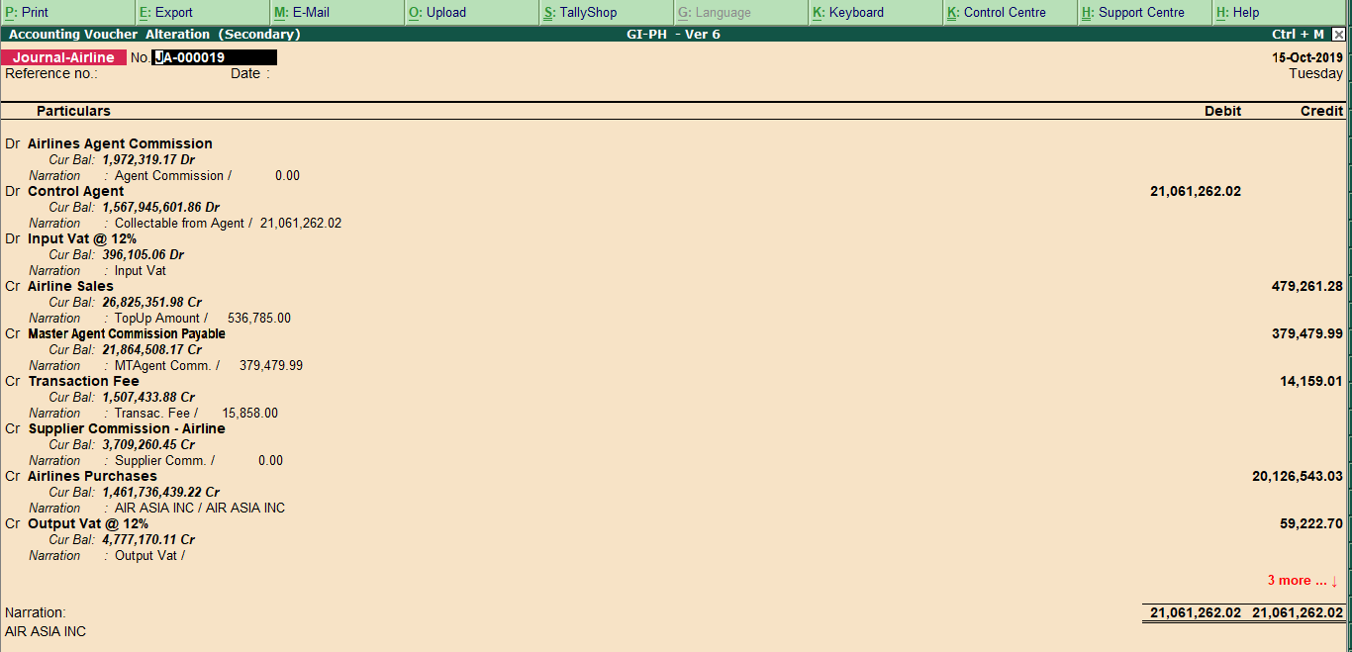
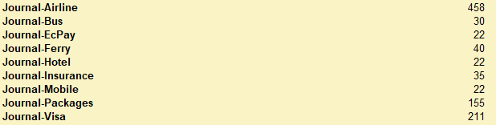
Auto posting of Product Transaction - 2
Tally Transaction
Number of Transaction in a Year

Slide 11
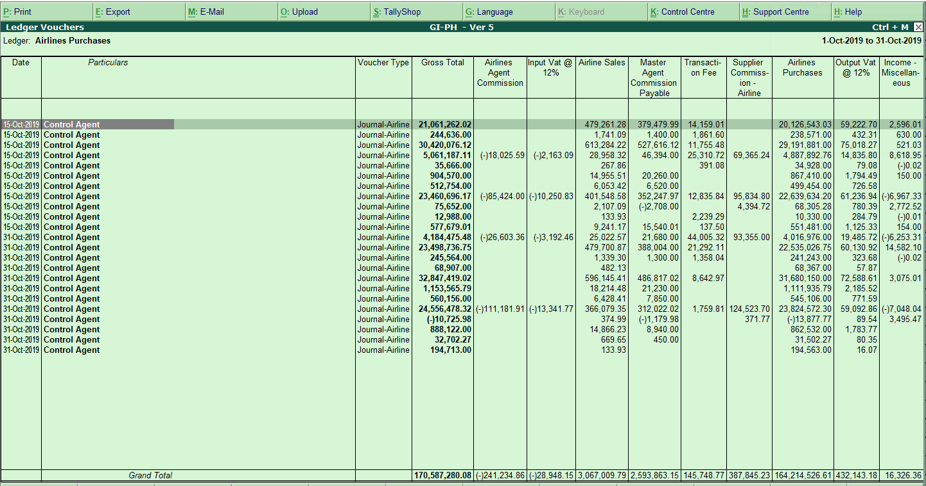
Auto posting of Product Transaction
Product Report from Tally

Slide 12
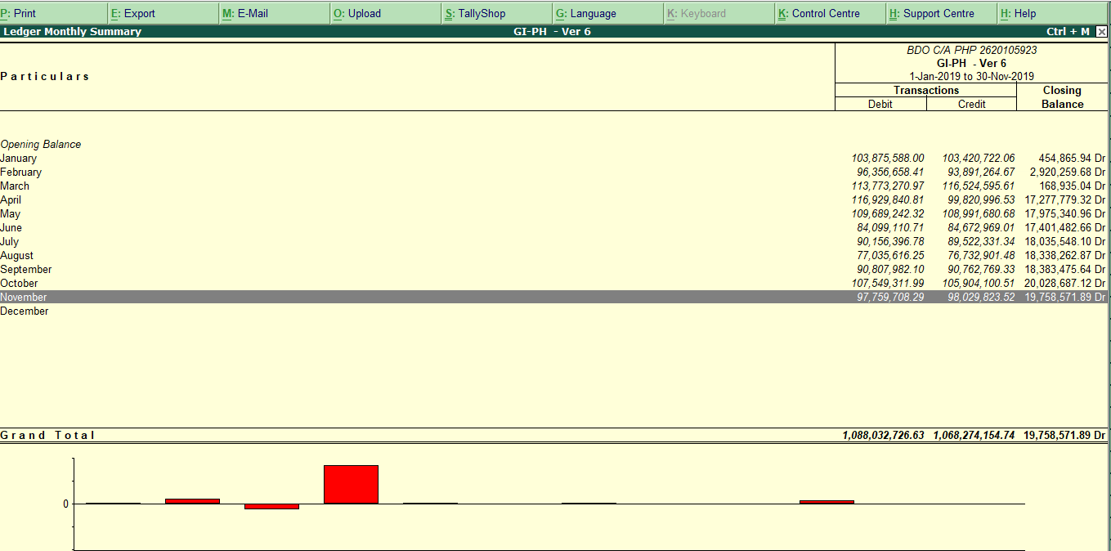
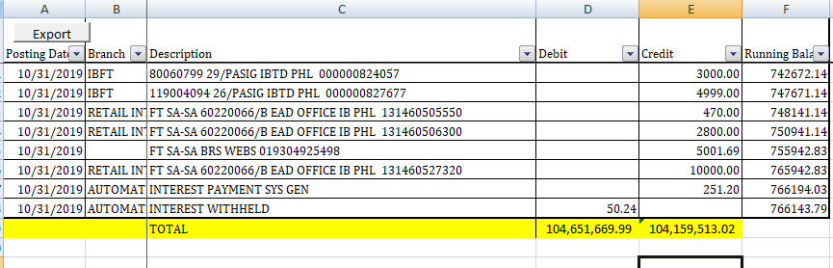
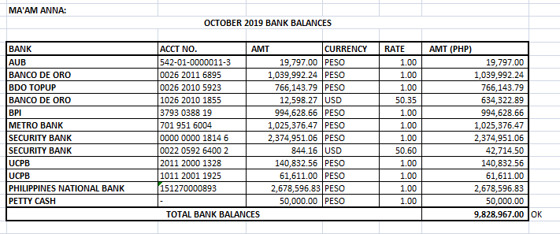
Pending – Reconciliation of Data
Bank data in Tally
Bank statement
Report October 2019
Bank balance

Slide 13
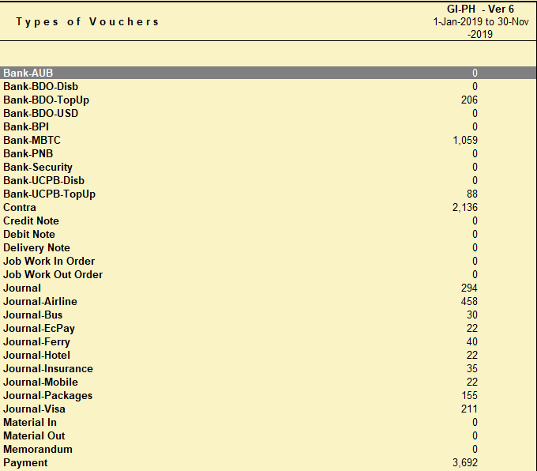
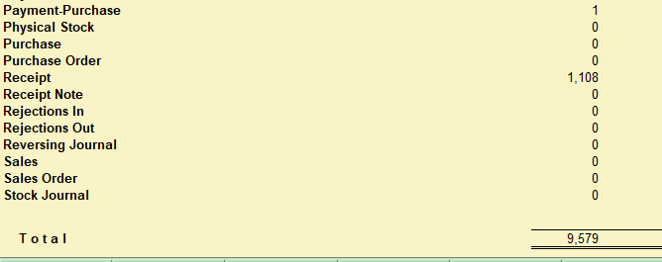
Automatic Posting of Transactions in Tally

Slide 14
Pending
Reconciliation/Verification of data in Tally
December Data - need the date?
Opening Balance - 2019 - once the ledger name is standardized
Define groups and GL codes as per group reporting - pending from Harish
Training on Tally to Philippines user

