Slide 1
GIPH Migration
Ver3

Slide 2
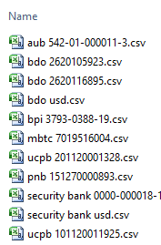
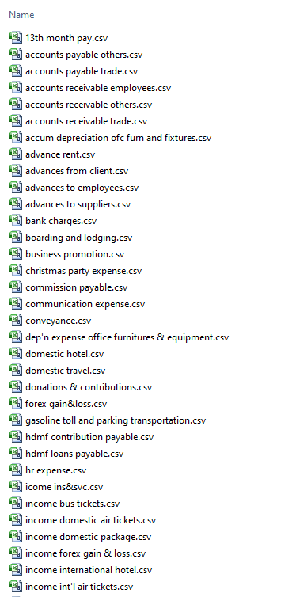
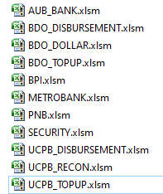
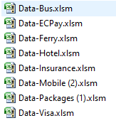
Source Data - 1
Bank Reconciliation
Product Information
Detailed transaction
Excel Files
Bank Statements
Product
AUB
BDO Disbursement
BDO Dollar
BDO Topup
BPI
Metrobank
PNB
Security
UCPB Disbursement
UCPB Recon
UCPB Topup
Excel Files
Monthly Reports
Product
Airline
Hotel
Mobile
Ferry
Insurance
Packages
EcPay
Visa
Bus
Other data (scattered)
BOS’s System
Receipts - Accounts Receivable
Payments - Accounts Payable
Journal – Adjustments
Contra – Interbank transfer
Purchase - Adv to Suppliers
Sales – Adv from Customers
Bank Transaction – Bank Book

Slide 3
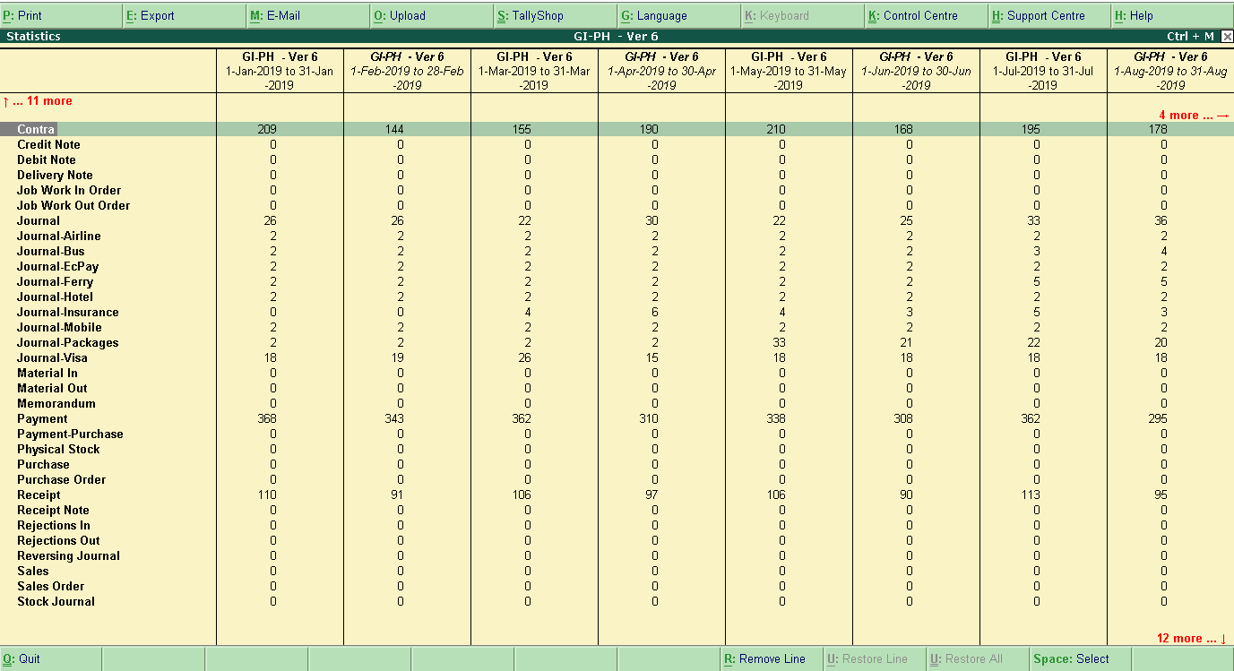
Voucher type - Monthly

Slide 4
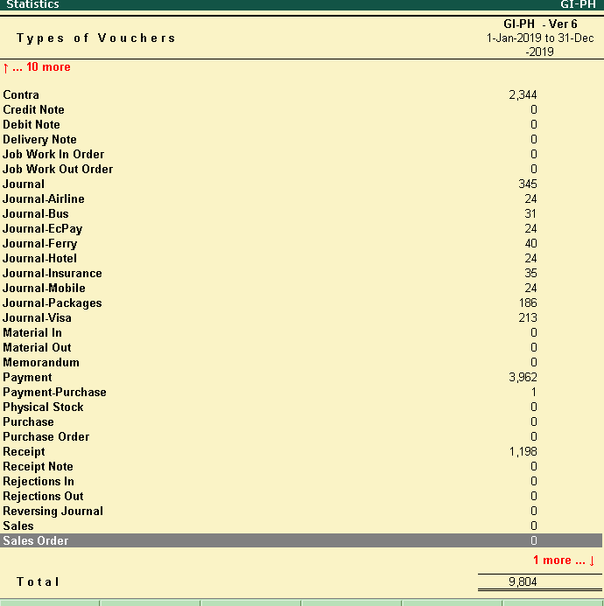
Voucher type - Total

Slide 5
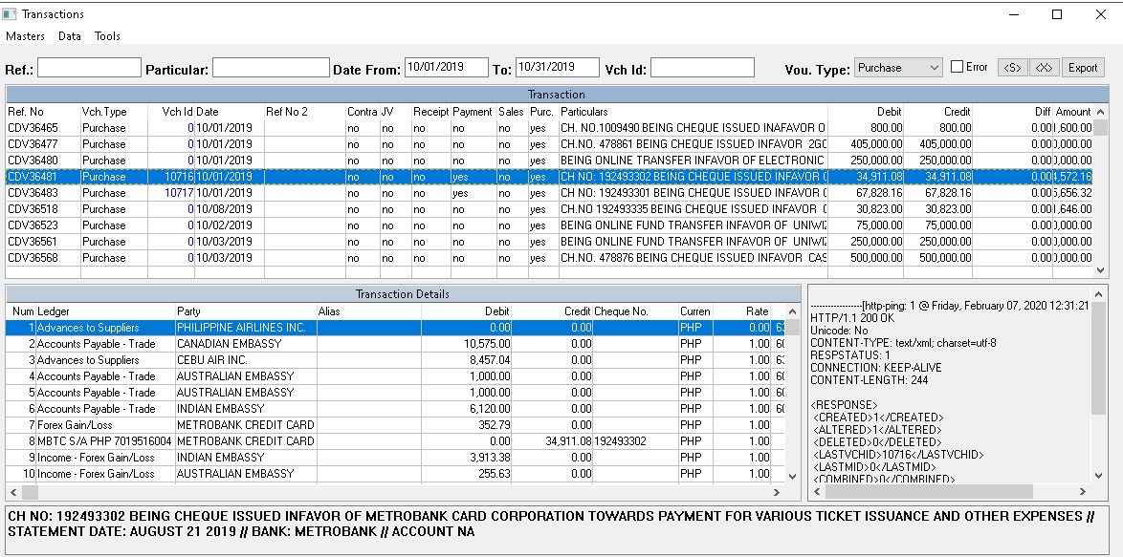
Purchase - Transaction

Slide 6
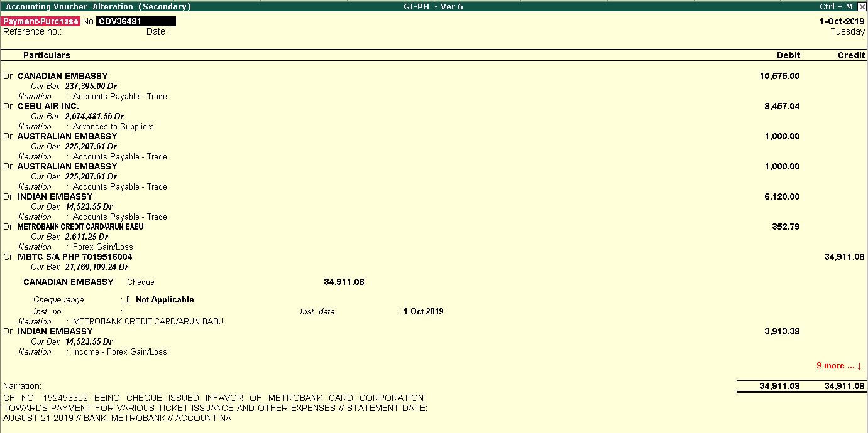
Purchase – Transaction - Tally

Slide 7
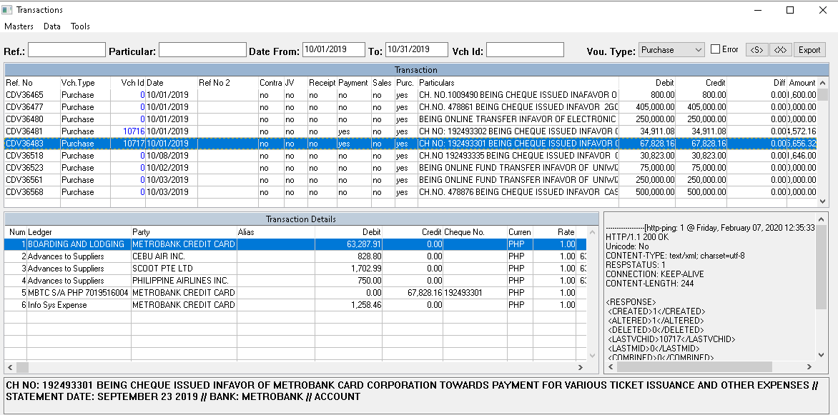
Purchase – Transaction

Slide 8
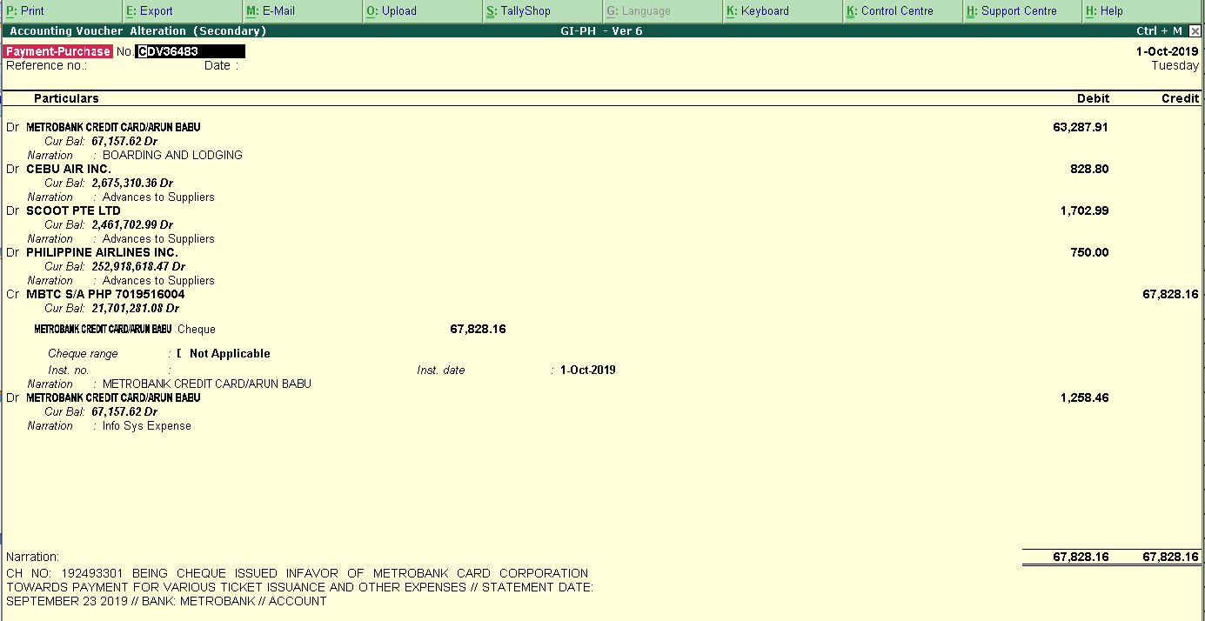
Purchase – Transaction - Tally

Slide 9
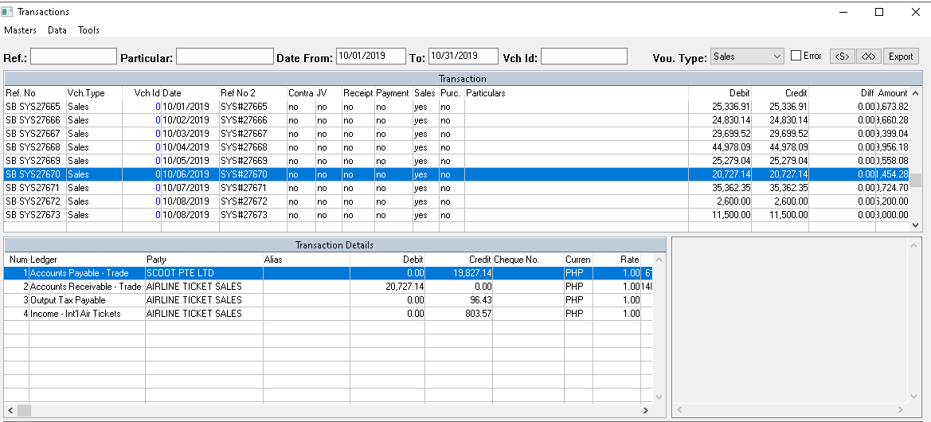
Sales – Transaction – Sample 1

Slide 10
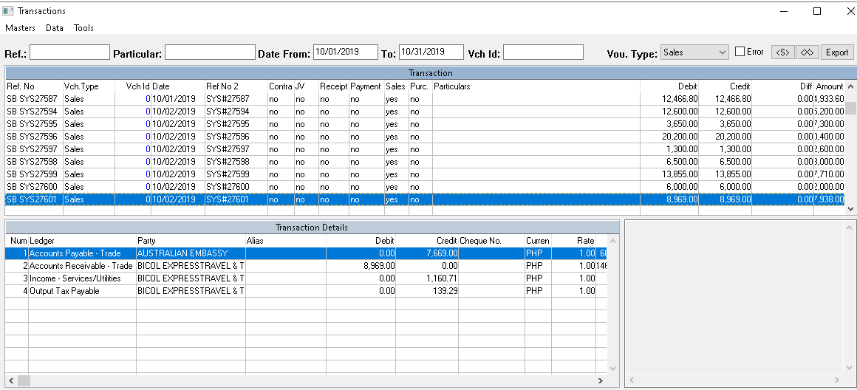
Sales – Transaction – Sample 2

Slide 12
Pending
Feb 03, 2020
Reconciliation/Verification of data in Tally
December Data - need the date?
Opening Balance - 2019 - once the ledger name is standardized
Define groups and GL codes as per group reporting - pending from Harish
Training on Tally to Philippines user
Feb 07, 2020
I need to check the data – which was sent yesterday
Reconciliation/Verification of data in Tally
December Data - need the date?
Product sheets – Dec 2019 (Party name and Alias)
Opening Balance - 2019 - once the ledger name is standardized
Define groups and GL codes as per group reporting - pending from Harish
Training on Tally to Philippines user

Slide 13
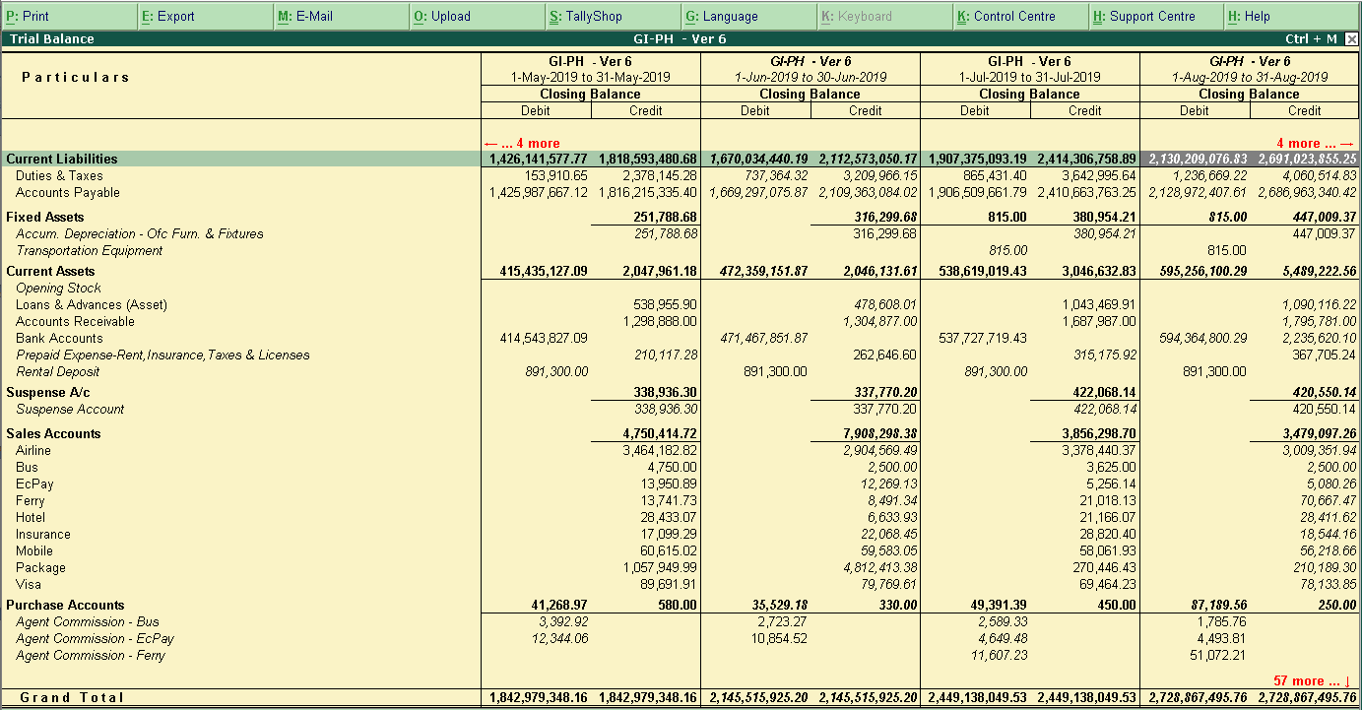
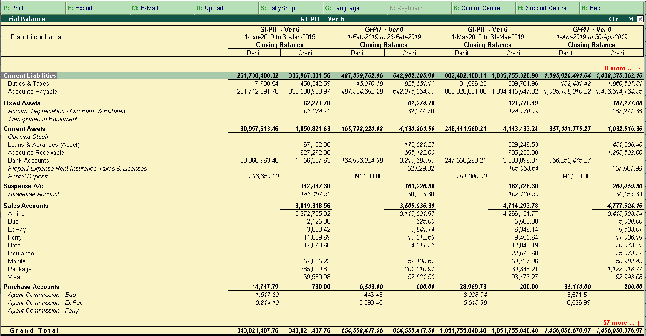
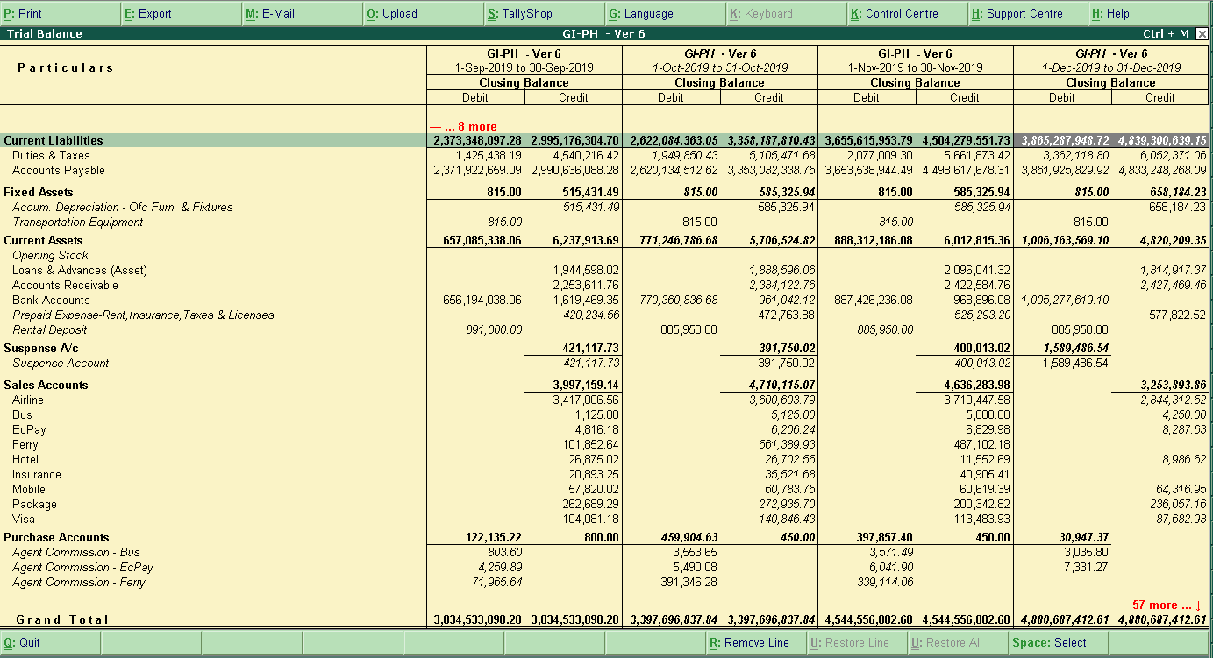
Total Data

Slide 14
Hi Serkan
Are you there?

