Slide 1
GIPH Migration
Ver3

Slide 2
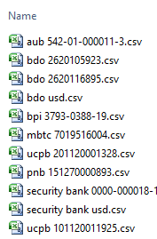
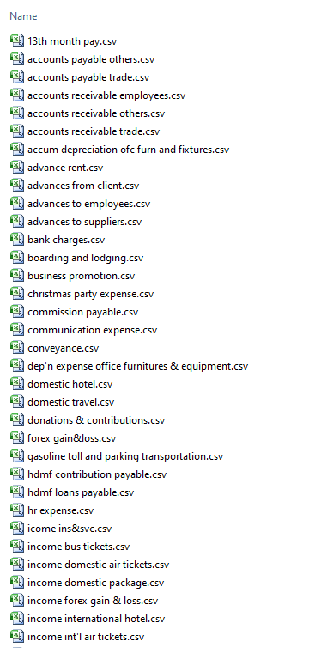
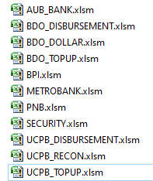
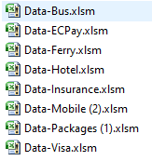
Source Data - 1
Bank Reconciliation
Product Information
Detailed transaction
Excel Files
Bank Statements
Product
AUB
BDO Disbursement
BDO Dollar
BDO Topup
BPI
Metrobank
PNB
Security
UCPB Disbursement
UCPB Recon
UCPB Topup
Excel Files
Monthly Reports
Product
Airline
Hotel
Mobile
Ferry
Insurance
Packages
EcPay
Visa
Bus
Other data (scattered)
BOS’s System
Receipts - Accounts Receivable
Payments - Accounts Payable
Journal – Adjustments
Contra – Interbank transfer
Purchase - Adv to Suppliers
Sales – Adv from Customers
Bank Transaction – Bank Book

Slide 3
Pending
Feb 03, 2020
Reconciliation/Verification of data in Tally
December Data - need the date?
Opening Balance - 2019 - once the ledger name is standardized
Define groups and GL codes as per group reporting - pending from Harish
Training on Tally to Philippines user
Feb 07, 2020
Reconciliation/Verification of data in Tally
December Data - need the date?
6 Banks statement from Jan to Dec 2019
Product sheets – Dec 2019 (Party name and Alias)
Opening Balance - 2019 - once the ledger name is standardized
Define groups and GL codes as per group reporting - pending from Harish
Training on Tally to Philippines user

Slide 4
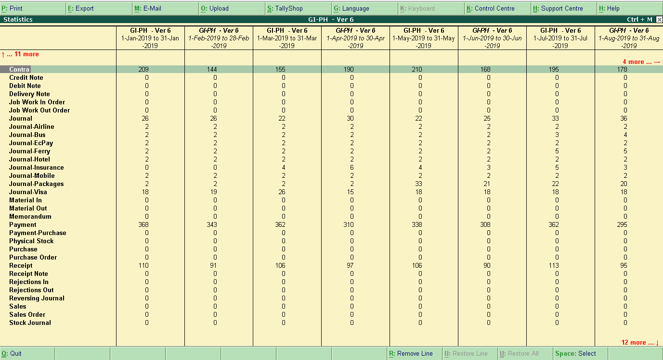
Voucher type - Monthly

Slide 5
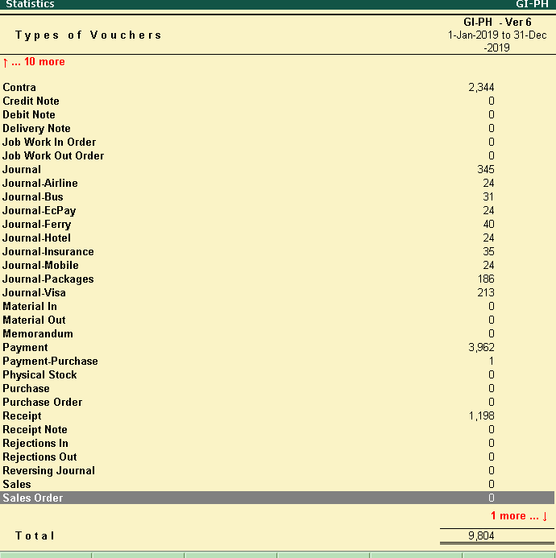
Voucher type - Total

Slide 6
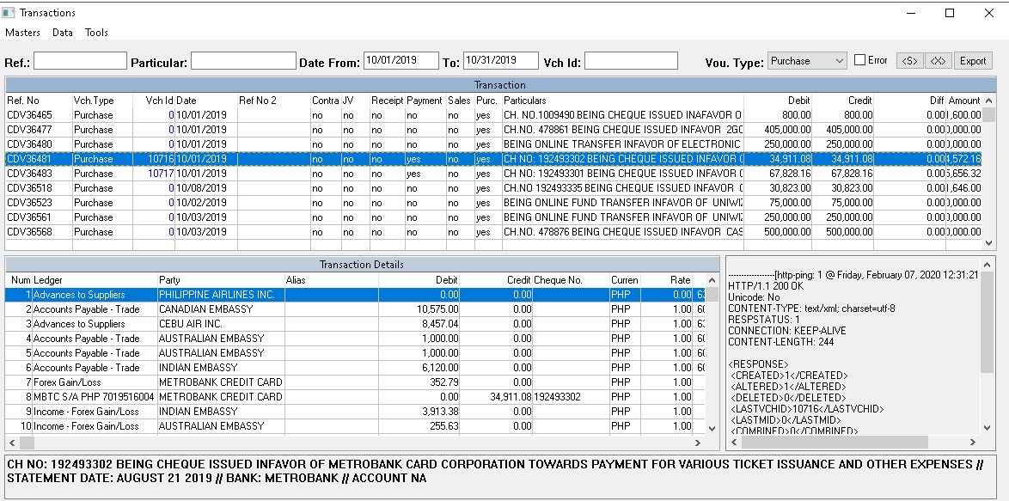
Purchase - Transaction

Slide 7
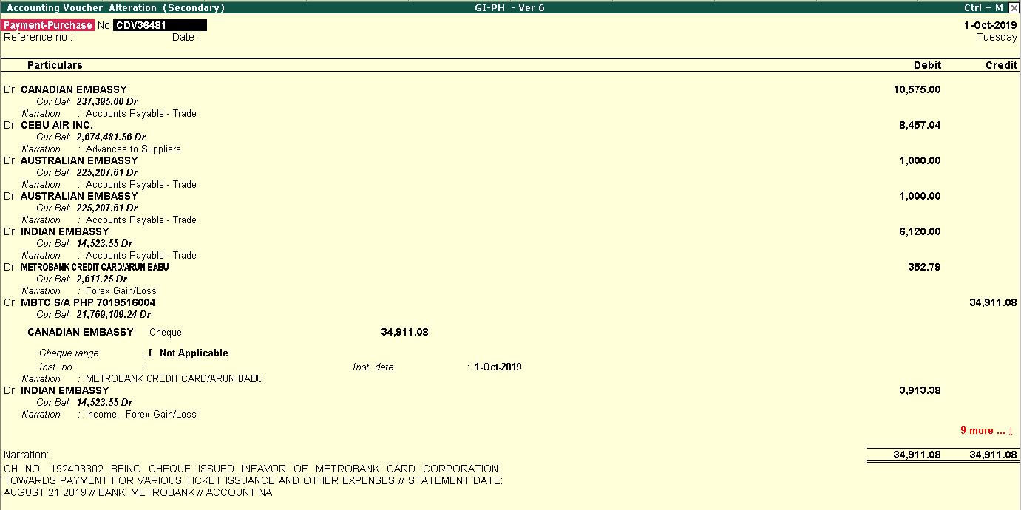
Purchase – Transaction - Tally

Slide 8
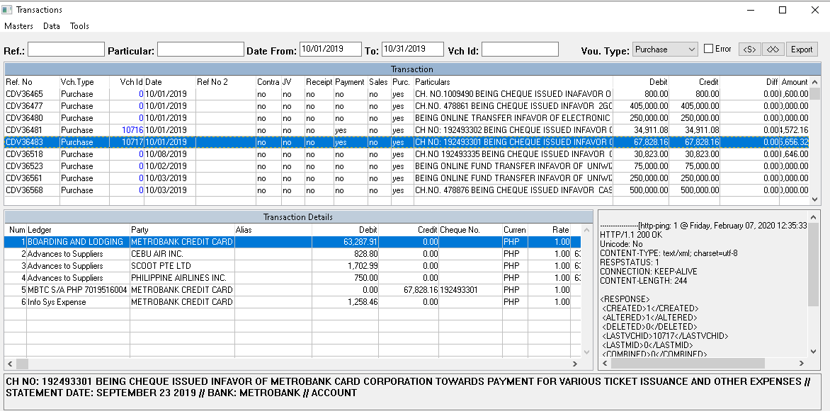
Purchase – Transaction

Slide 9
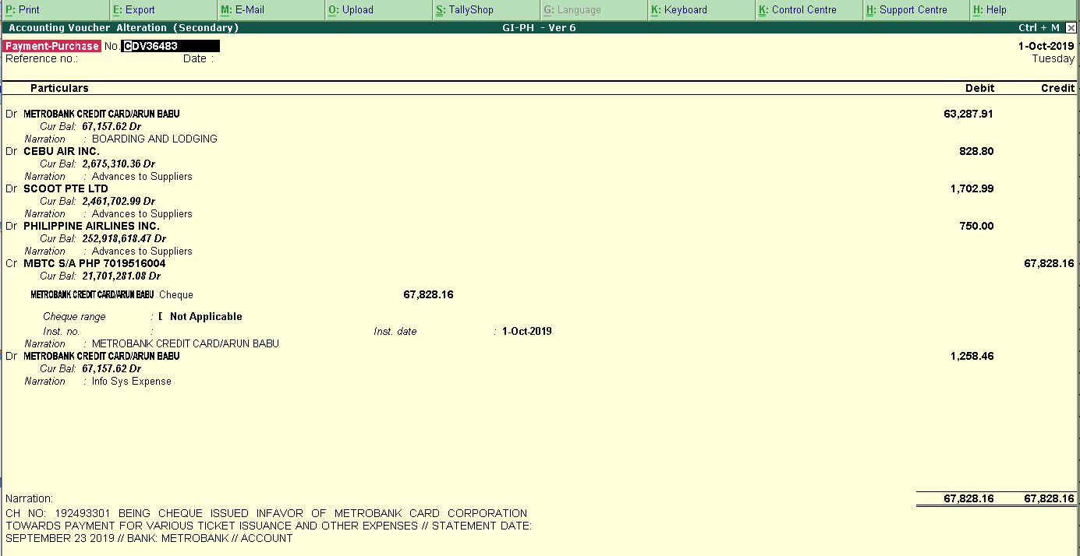
Purchase – Transaction - Tally

Slide 10
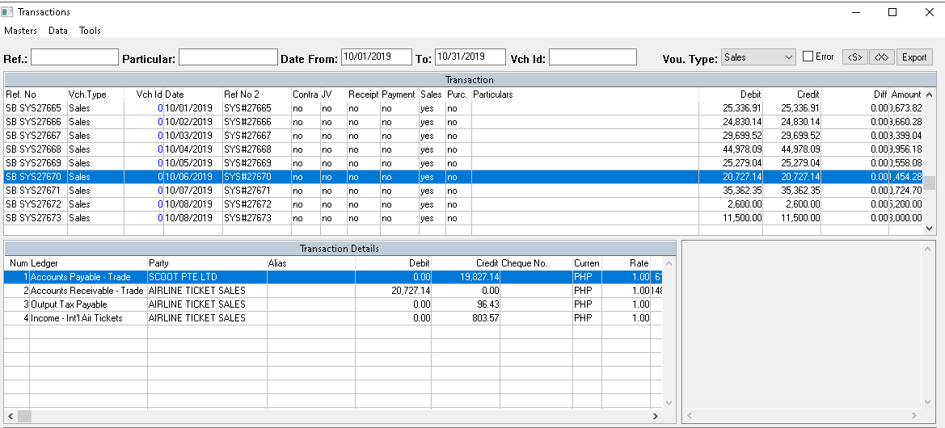
Sales – Transaction – Sample 1

Slide 11
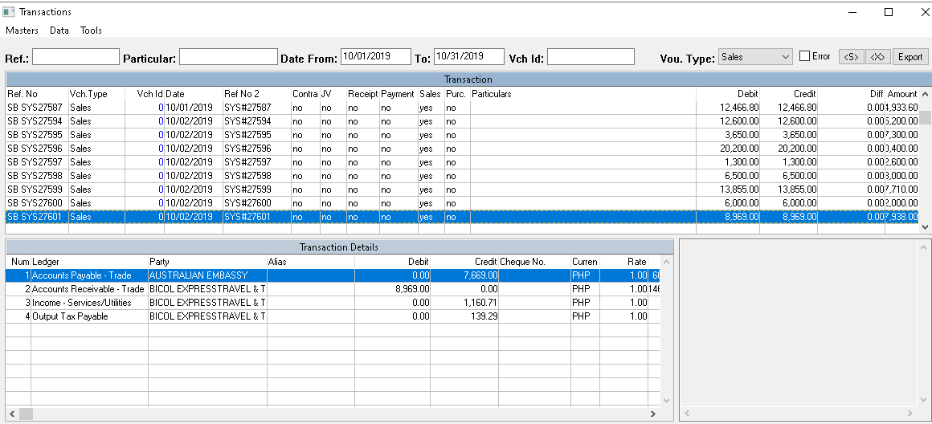
Sales – Transaction – Sample 2

Slide 12
Bank Statement
Bank list
AUB --- AUB 542-01-000011-3
BDO Disbursement ---BDO S/A PHP 260116895
BDO Dollar --- BDO S/A USD
BDO Topup --- BDO C/A PHP 2620105923 - YES
BPI --- BPI C/A 3793-0388-19 - YES
Metrobank --- MBTC S/A PHP 7019516004
PNB --- PNB S/A PHP - YES
Security --- Security Bank C/A Php
UCPB Disbursement --- UCPB C/A PHP 201120001328 - YES
UCPB Recon ---
UCPB Topup --- UCPB S/A PHP 101120011925 - YES

Slide 13
Bank Statement
Bank Statement - Pending
AUB --- AUB 542-01-000011-3
BDO Disbursement ---BDO S/A PHP 260116895
BDO Dollar --- BDO S/A USD
Metrobank --- MBTC S/A PHP 7019516004
Security --- Security Bank C/A Php
Bank Statement - Received
BDO Topup --- BDO C/A PHP 2620105923 - YES
BPI --- BPI C/A 3793-0388-19 – YES
PNB --- PNB S/A PHP – YES
UCPB Disbursement --- UCPB C/A PHP 201120001328 – YES
UCPB Topup --- UCPB S/A PHP 101120011925 - YES

Slide 15
Bank Statement
Bank Statement - Pending
BDO Disbursement ---BDO S/A PHP 260116895
Security --- Security Bank C/A Php
Bank Statement - Received
AUB --- AUB 542-01-000011-3
Metrobank --- MBTC S/A PHP 7019516004
BDO Dollar --- BDO S/A USD
BDO Topup --- BDO C/A PHP 2620105923 - YES
BPI --- BPI C/A 3793-0388-19 – YES
PNB --- PNB S/A PHP – YES
UCPB Disbursement --- UCPB C/A PHP 201120001328 – YES
UCPB Topup --- UCPB S/A PHP 101120011925 - YES

