Slide 1
GIPH Migration
Ver5

Slide 2
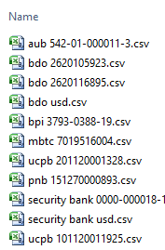
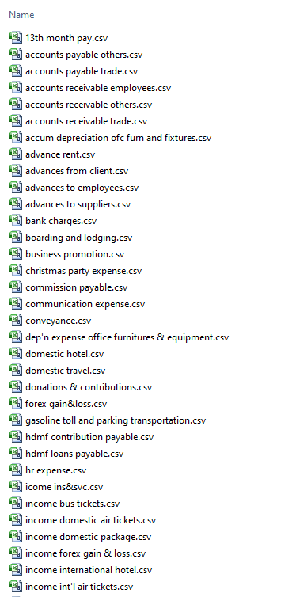
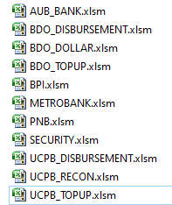
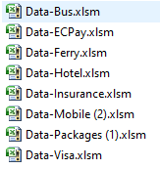
Data Source
Bank Reconciliation
Product Information
Detailed transaction
Excel Files
Bank Statements
Product
AUB
BDO Disbursement
BDO Dollar
BDO Topup
BPI
Metrobank
PNB
Security
UCPB Disbursement
UCPB Recon
UCPB Topup
Excel Files
Monthly Reports
Product
Airline
Hotel
Mobile
Ferry
Insurance
Packages
EcPay
Visa
Bus
Other data (scattered)
BOS’s System
Receipts - Accounts Receivable
Payments - Accounts Payable
Journal – Adjustments
Contra – Interbank transfer
Purchase - Adv to Suppliers
Sales – Adv from Customers
Bank Transaction – Bank Book

Slide 3
Pending
Feb 11, 2020 / Feb 14, 2020 / Feb 18, 2020
Reconciliation/Verification of data in Tally (waiting for answers)
Opening Balance - 2019 - once the ledger name is standardized (received)
Define groups and GL codes as per group reporting - pending from Harish
Training on Tally to Philippines user (16th to 31st March)
Feb 07, 2020
I need to check the data – which was sent yesterday
Reconciliation/Verification of data in Tally
December Data - need the date?
Product sheets – Dec 2019 (Party name and Alias)
Opening Balance - 2019 - once the ledger name is standardized
Define groups and GL codes as per group reporting - pending from Harish
Training on Tally to Philippines user
Feb 03, 2020
Reconciliation/Verification of data in Tally
December Data - need the date?
Opening Balance - 2019 - once the ledger name is standardized
Define groups and GL codes as per group reporting - pending from Harish
Training on Tally to Philippines user

Slide 4
Planned Schedule
Full 2019 migration including 2019 opening and 2019 closing balances and all transactions should be finalized by the end of Week 8 – by Feb 21st (15th to 21st Feb)
Week 9 will be the reconciliation work and Arun to finalize the Reconciliation together with Pankaj and send us the recon documents. (22nd to 28th Feb)
Week 11 & Week 12 Pankaj and Harish to visit Manila and key in all transactions with the team from January 1st onwards and Pankaj to run the End User Training. (16th to 31st March)

Slide 5
Project Log
Date | Details | Action
Nov 21, 2019 | First meeting with Mr Serkan | Decision to migrate information to Tally
Nov 21 to Dec 19, 2019 | Pre analysis of the project | Conceptual analysis on accounting, banking and product data
Dec 20, 2019 | Project Approval
Dec 21, 2019 | Gathering Data – Accounting Transaction | Development of interface
Dec 31, 2019 | Gathering Data – Product Reports | Development of interface and auto posting in Tally Discussion on formulas for accounting product sales, purchase
Jan 09 to Jan 19, 2020 | Gathering Data – Product Report | Development of interface and auto posting in Tally Waiting for purchase sales formulas
Jan 19, 2020 | Gathering Data – Product Report – Alias/Party name definition | Development of interface and auto posting in Tally Decision on formulas for accounting product sales, purchase. Adding party name
Jan 30 to Feb 11, 2020 | Gathering Data – Banking Data | Development of interface and auto posting in Tally Provided reports for discrepancy
Feb 14, 2020 |  | Waiting for verified banking data

Slide 6
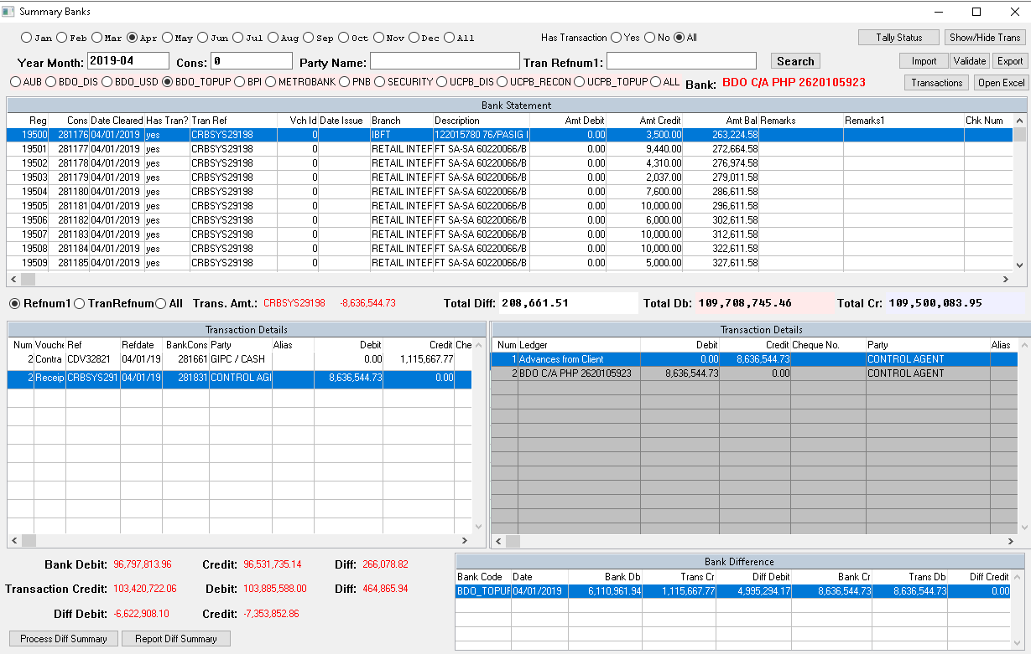
Control Agent Clarification
If we select Control Agent – What about the Party name?
And How it will affect the Opening balances?

Slide 7
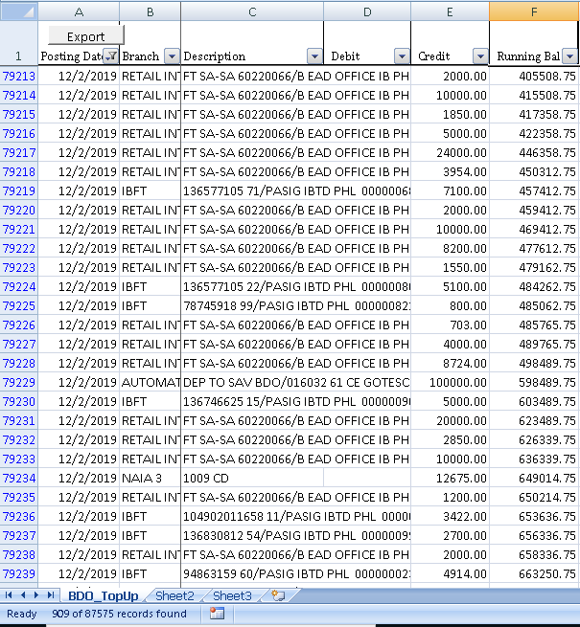
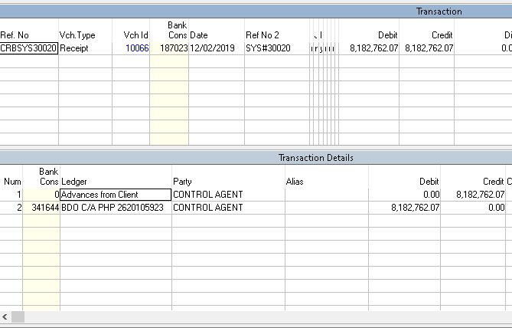
Bank deposit posting - Clarification
Total amount 8,182,262.07
Possibility of bank statement will not match with actual deposit and bank reconciliation will not be exact. Depending on this we plan for 2020
Dec 02, 2019 has 909 individual deposits

Slide 8
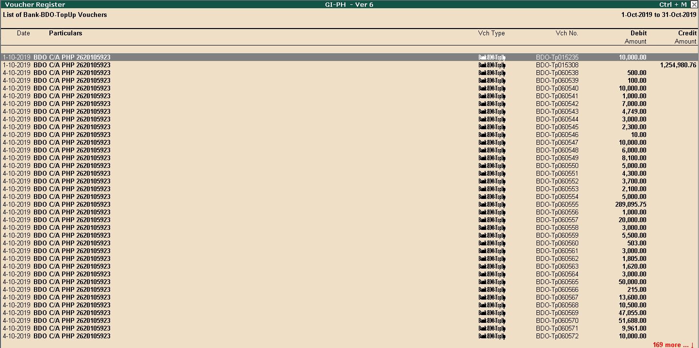
BDO – Topup

Slide 9
Bank Accounts – Posting of Transactions
Bank | Transactions
AUB --- AUB 542-01-000011-3 | 119
BDO Disbursement ---BDO S/A PHP 260116895 | 3,164
BDO Dollar --- BDO S/A USD | 339
BDO Topup --- BDO C/A PHP 2620105923 | 87,575
BPI --- BPI C/A 3793-0388-19 | 34,515
Metrobank --- MBTC S/A PHP 7019516004 | 13,511
PNB --- PNB S/A PHP | 824
Security --- Security Bank C/A | 5,949
UCPB Disbursement --- UCPB C/A PHP 201120001328 | 611
UCPB Topup --- UCPB S/A PHP 101120011925 | 970
TOTAL | 147,577

Slide 10
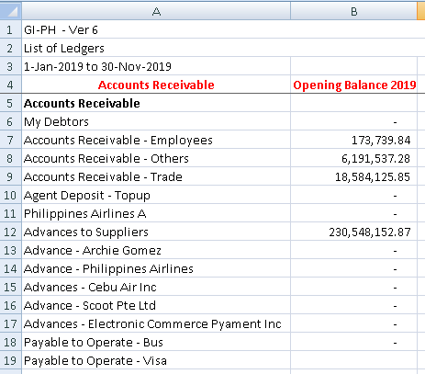
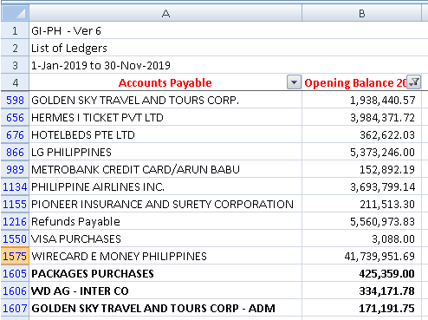
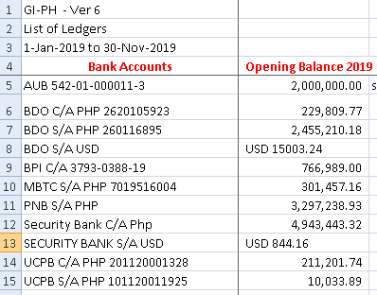
Opening Balances
Accounts Payable
Accounts Receivable
Bank Balance

Slide 11
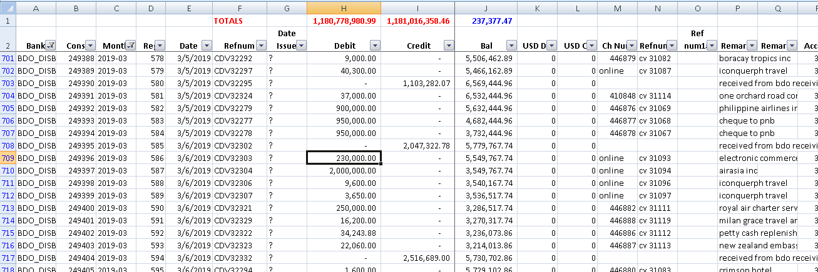
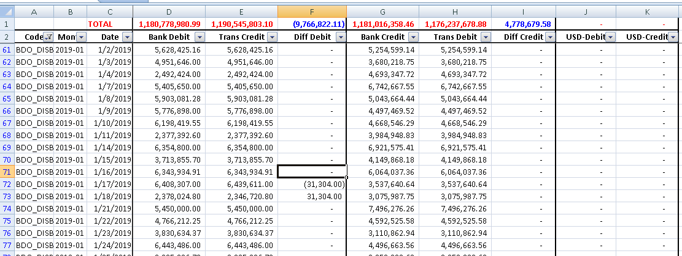
Bank Data
Daily Summary – Matching with Transactions

Slide 12
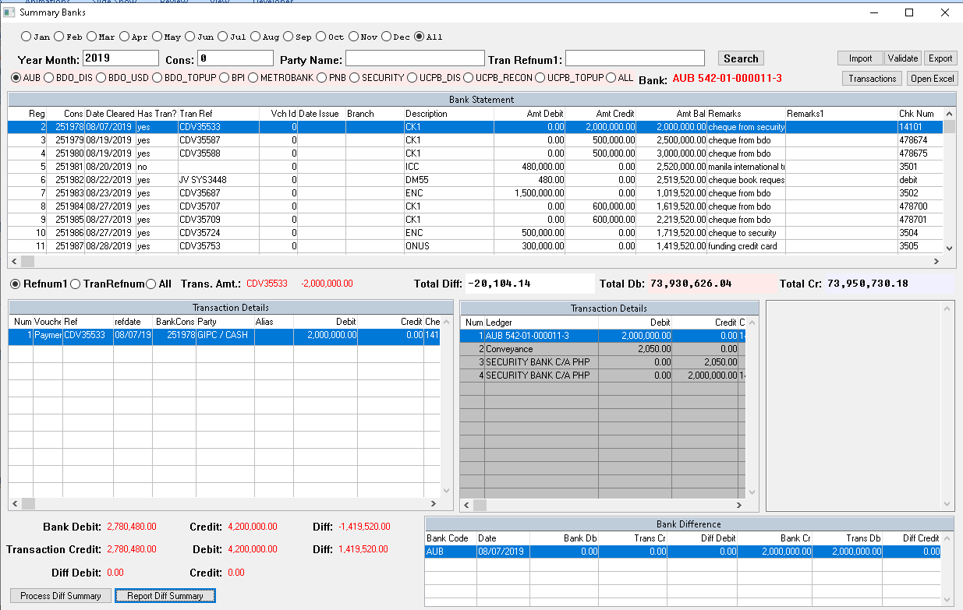
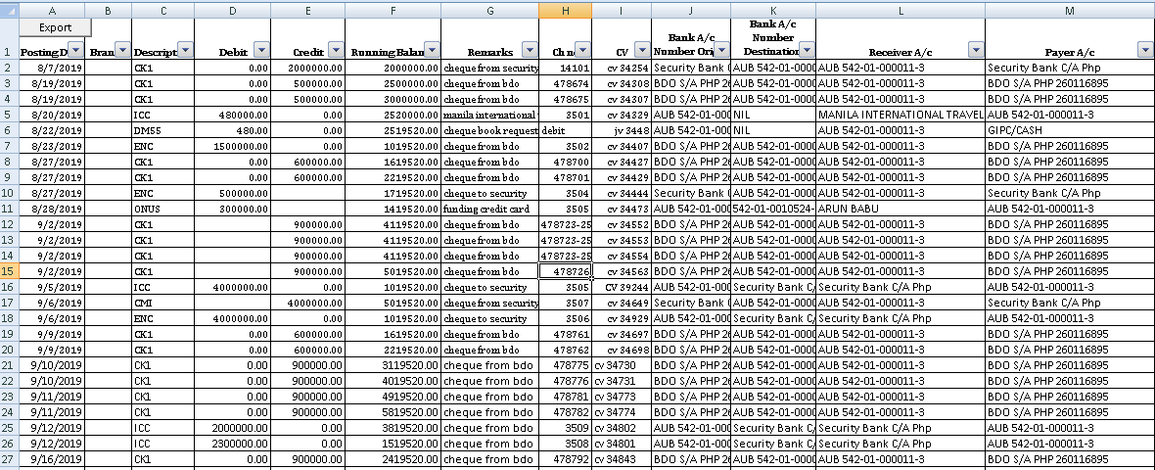
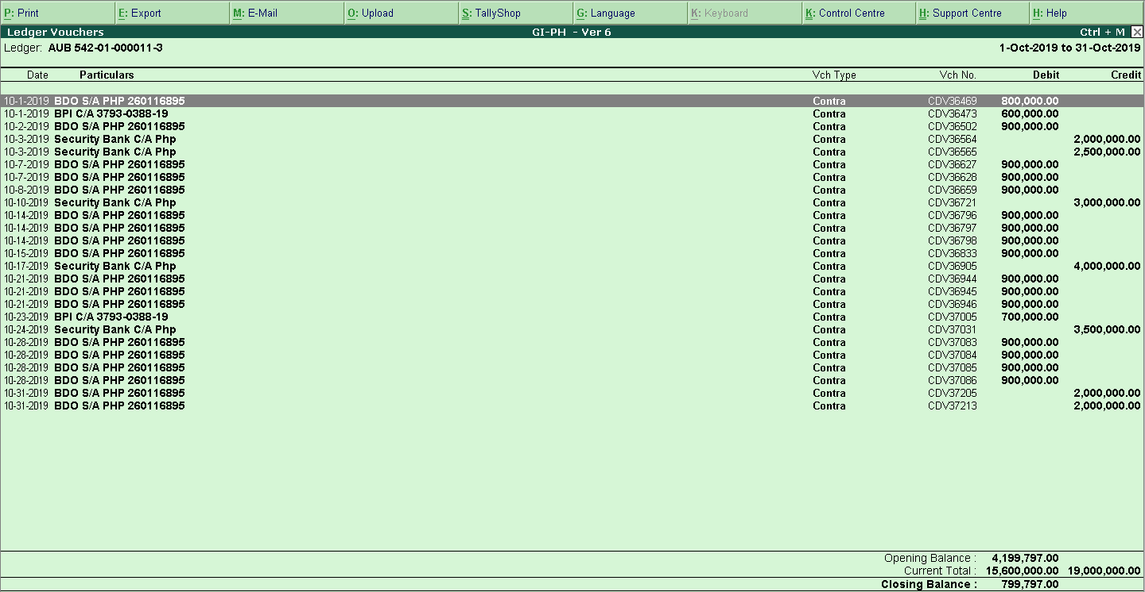
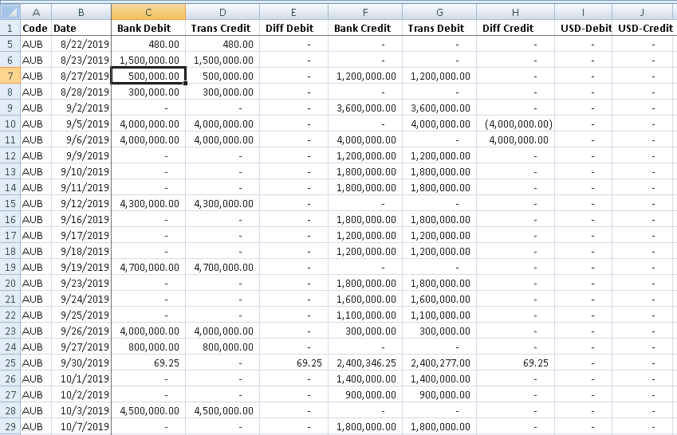
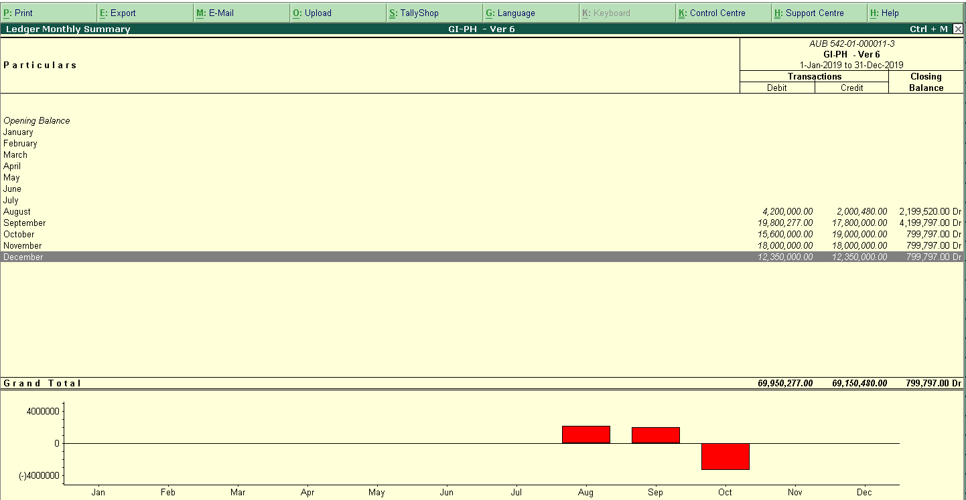
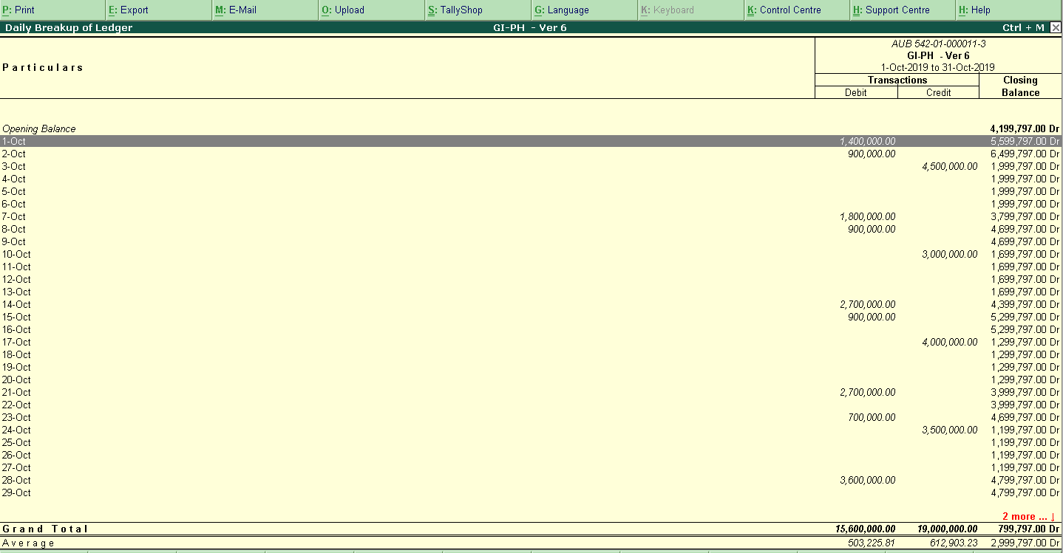
Bank Data – Verification Flow Chart

Slide 13
Bank Data – Verification
Bank Statement

Slide 14
Bank Data – Verification
Migration Interface
Bank Statement
Transaction BOS System

Slide 15
Bank Data – Verification
Daily Transaction Summary

Slide 16
Bank Data – Verification
Transaction in Tally

Slide 17
Bank Data – Verification
Monthly Summary in Tally

Slide 18
Bank Data – Verification
Daily Summary in Tally System

Slide 19
Bank Data – Verification
Daily Comparison

Slide 20
Milestones
Date | Details | Action
Nov 21, 2019 | Introduction with Serkan
Dec 04, 2019 | Pre analysis of the project | Received Oct 2019 monthly report and BDO disbursement
Dec 12, 2019 | Pre analysis of the project | Accounting Transactions – Jan to Nov
Dec 19, 2019 | Pre analysis of the project | Received Banks statement - Oct 2019
Dec 21, 2019 to Dec 20, 2019 | Pre analysis of the project | Data Gathering – Oct 2019 / Accounting Transactions
Dec 20, 2019 | Project Approval
Dec 25, 2019 | Data Analysis | Harish Report
Dec 27, 2019 |  | Decision to implement Tally in the same format like Hermes in India
Dec 31, 2019 |  | Data Gathering – Monthly Report – Jan to Sep 2019
Jan 09, 2020 |  | Data Gathering – Products details

Slide 21
AUB --- AUB 542-01-000011-3 (119)
BDO Disbursement ---BDO S/A PHP 260116895 (3164)
BDO Dollar --- BDO S/A USD (339)
BDO Topup --- BDO C/A PHP 2620105923 – (87575)
BPI --- BPI C/A 3793-0388-19 – YES (34515)
Metrobank --- MBTC S/A PHP 7019516004 (13511)
PNB --- PNB S/A PHP – YES (824)
Security --- Security Bank C/A Php
UCPB Disbursement --- UCPB C/A PHP 201120001328 – YES (611)
UCPB Topup --- UCPB S/A PHP 101120011925 – YES (970)

