Slide 1
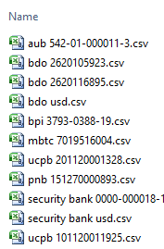
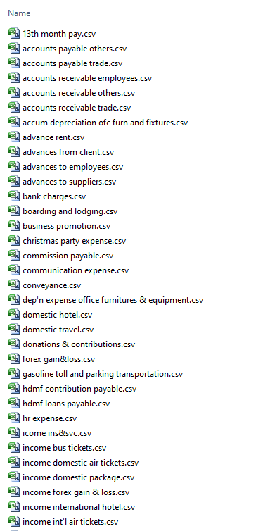
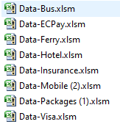
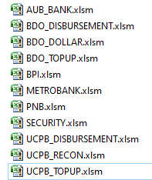
Data Analysis
Source Data
Excel Files
Monthly Reports
Product
Airline
Hotel
Mobile
Ferry
Insurance
Packages
EcPay
Visa
Bus
Other data (scattered)
Excel Files
Bank Statements
Product
AUB
BDO Disbursement
BDO Dollar
BDO Topup
BPI
Metrobank
PNB
Security
UCPB Disbursement
UCPB Recon
UCPB Topup
BOS’s System
Receipts - Accounts Receivable
Payments - Accounts Payable
Journal – Adjustments
Contra – Interbank transfer
Purchase - Adv to Suppliers
Sales – Adv from Customers
Bank Transaction – Bank Book

Slide 2
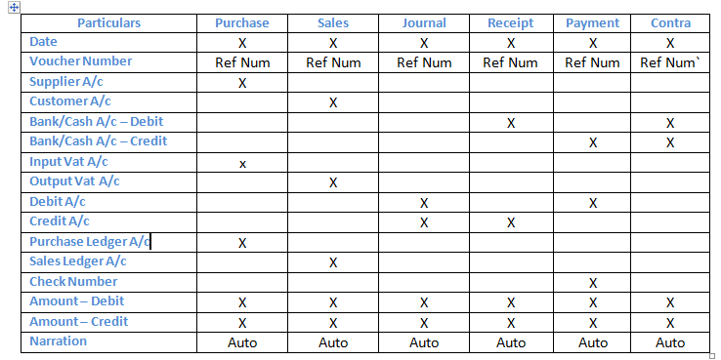
Understanding Transactions
BOS’s System
Receipts
Payments
Journal
Contra
Purchase
Sales
Bank Transaction

Slide 3
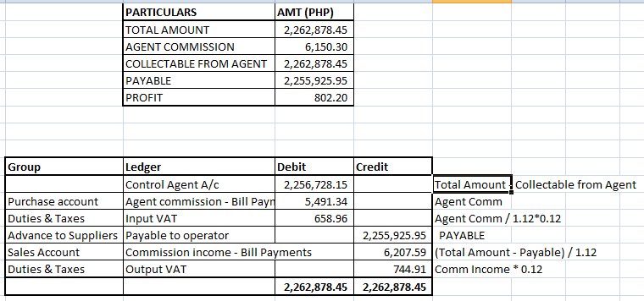
Understanding Products
Excel Files
Monthly Reports
Product
Airline
Hotel
Mobile
Ferry
Insurance
Packages
EcPay
Visa
Bus
Other data (scattered)
Party Name
Knock of Payables
Alias
Knock of Payables

Slide 4
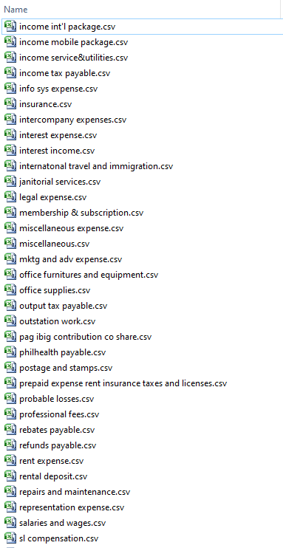
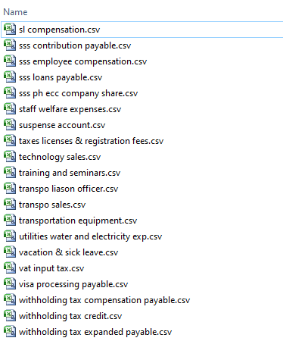
Transactions from BOS’s system

Slide 5
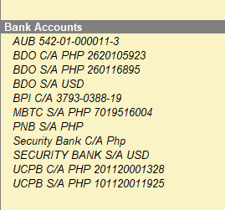
Understanding Banking Transactions
TRANSACTION REQUIREMENT
Date Cleared (Bank Statement)
Date Issued (Tally Date)
Debit Amount (Payment Ledger)
Credit Amount (Receipt Ledger)
Check Number
Running Balance (Auto from Tally)
Excel Files
Bank Statements
Product
AUB
BDO Disbursement
BDO Dollar
BDO Topup
BPI
Metrobank
PNB
Security
UCPB Disbursement
UCPB Recon
UCPB Topup

Slide 6
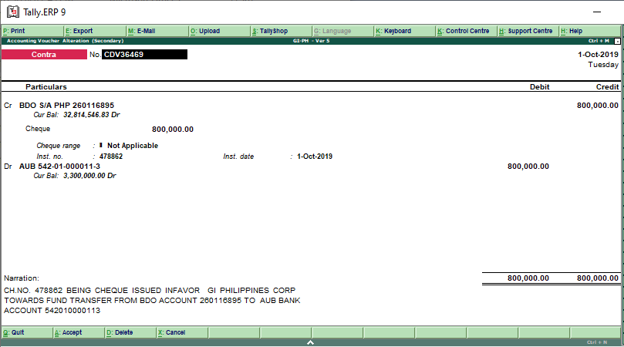
Understanding Contra Entries
AUB - Bank Statement
AUB – Receiver
BDO - Payer
BDO - Bank Statement
BDO– Receiver
AUB - Payer
Automatic transaction is not possible from the bank statement without the transaction ID

Slide 7
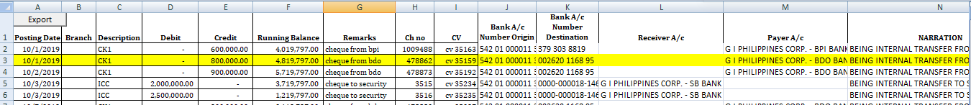
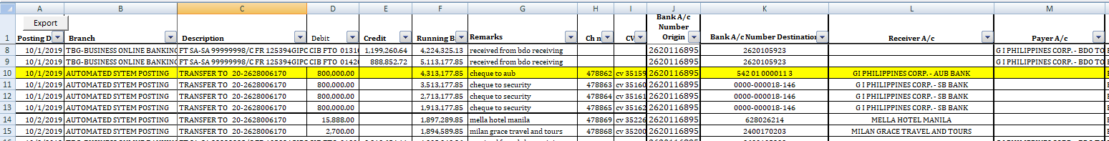
Understanding Contra Entries
Cash Voucher No:
CV35159

Slide 8
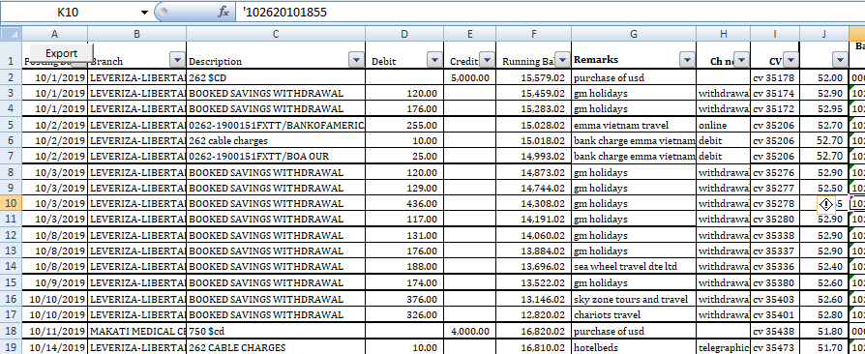
BDO – Dollar account
Amount in USD, whereas Tally is recording the transaction in Pesos. BOS’s transaction has Pesos details, which is more complete

Slide 9
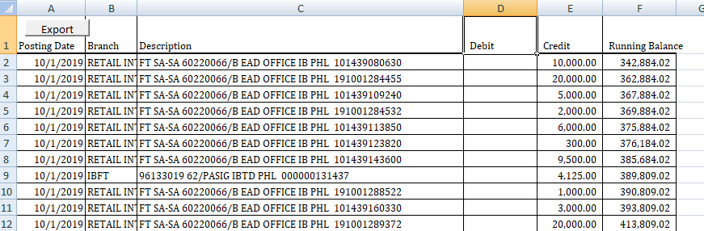
BDO Topup
Lacking receiver and payment account

Slide 10
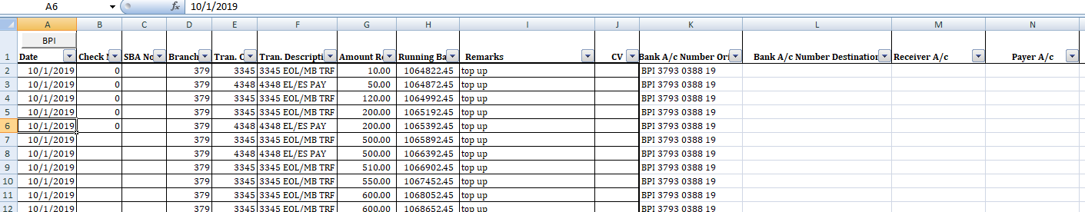
BPI
Lacking receiver and payment account

Slide 11
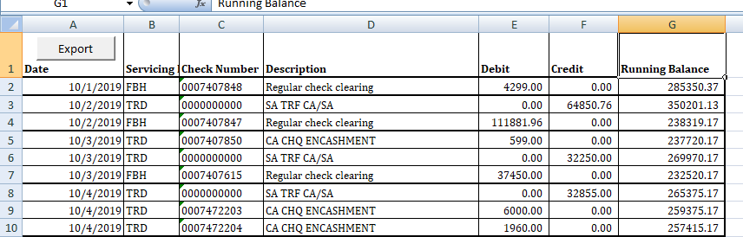
UCPB Disbursement
Lacking receiver and payment account

Slide 12
AUB --- AUB 542-01-000011-3
BDO Disbursement ---BDO S/A PHP 260116895
BDO Dollar --- BDO S/A USD
BDO Topup --- BDO C/A PHP 2620105923
BPI --- BPI C/A 3793-0388-19
Metrobank --- MBTC S/A PHP 7019516004
PNB --- PNB S/A PHP
Security --- Security Bank C/A Php
UCPB Disbursement --- UCPB C/A PHP 201120001328
UCPB Recon ---
UCPB Topup --- UCPB S/A PHP 101120011925
AUB 542-01-000011-3
BDO C/A PHP 2620105923
BDO S/A PHP 260116895
BDO S/A USD
BPI C/A 3793-0388-19
MBTC S/A PHP 7019516004
PNB S/A PHP
Security Bank C/A Php
SECURITY BANK S/A USD
UCPB C/A PHP 201120001328
UCPB S/A PHP 101120011925

Slide 13
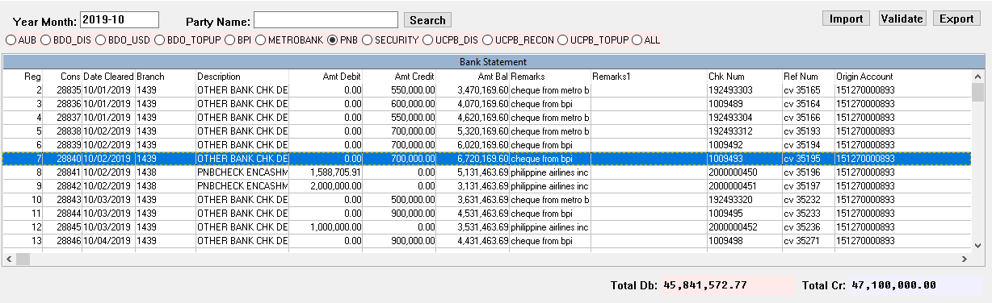
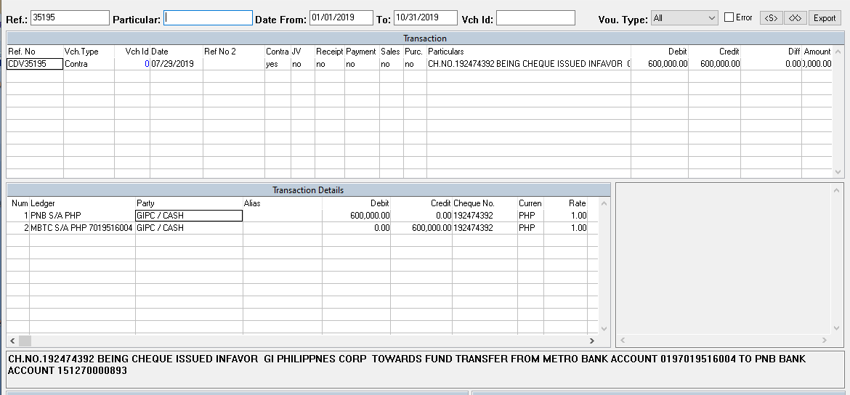
Mismatch Transactions
Transaction number doesn’t match with the date and amount with the information from Bank Statement and BOS’s system data.

Slide 14
AUB --- AUB 542-01-000011-3 (Most of the transactions are available)
BDO Disbursement ---BDO S/A PHP 260116895 (Most of the transactions are available)
BDO Dollar --- BDO S/A USD (Transactions not matching)
BDO Topup --- BDO C/A PHP 2620105923 (Transactions not matching)
BPI --- BPI C/A 3793-0388-19 (Transactions not matching)
Metrobank --- MBTC S/A PHP 7019516004 (Partial matching)
PNB --- PNB S/A PHP (Most of the transactions are available)
Security --- Security Bank C/A Php (Partial Matching)
UCPB Disbursement --- UCPB C/A PHP 201120001328 (Most of the transactions are available)
UCPB Recon --- (invalid)
UCPB Topup --- UCPB S/A PHP 101120011925 (Partial Matching)

Slide 15
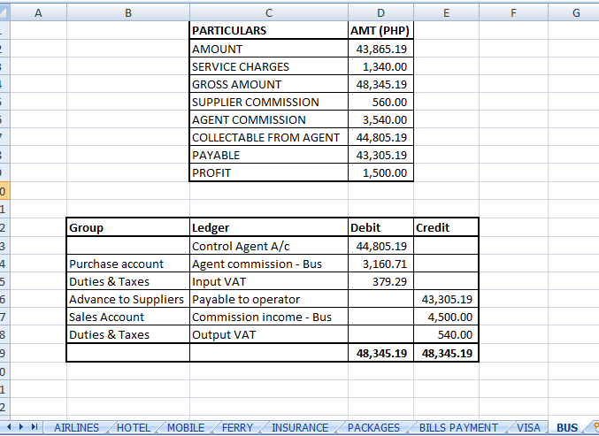
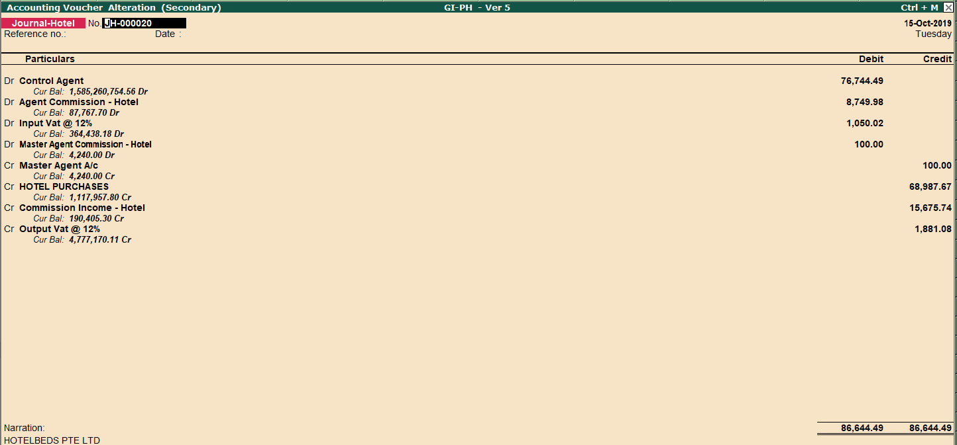
Pending
How to validate the transactions posted in Tally with Monthly Reports

Slide 16
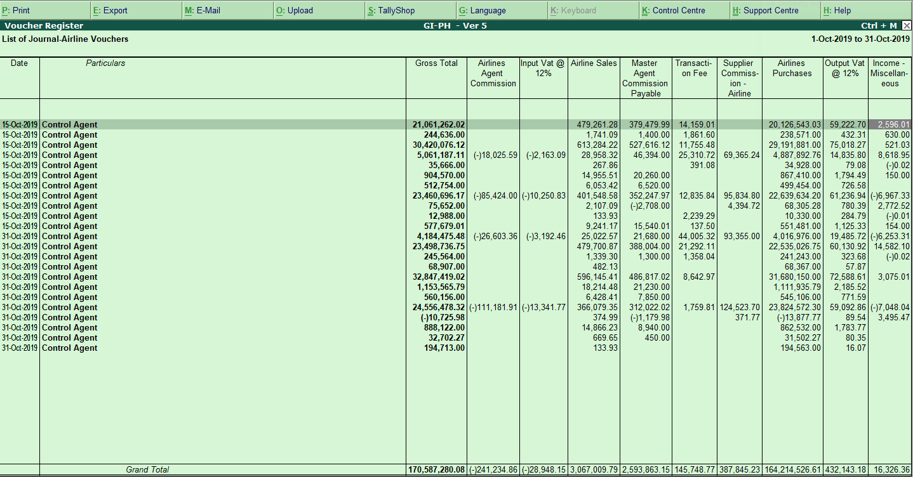
Airline Transaction

Slide 17
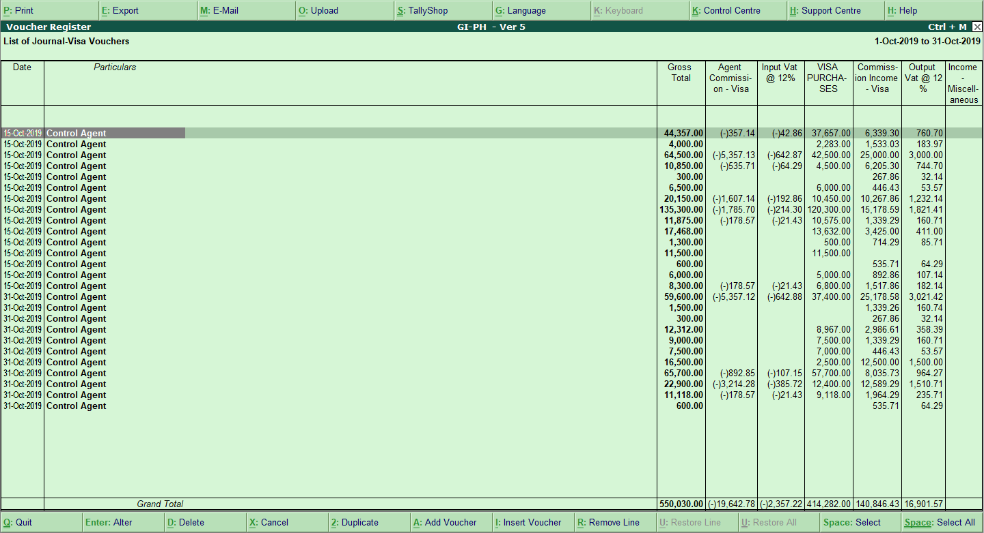
Visa Transaction

Slide 18
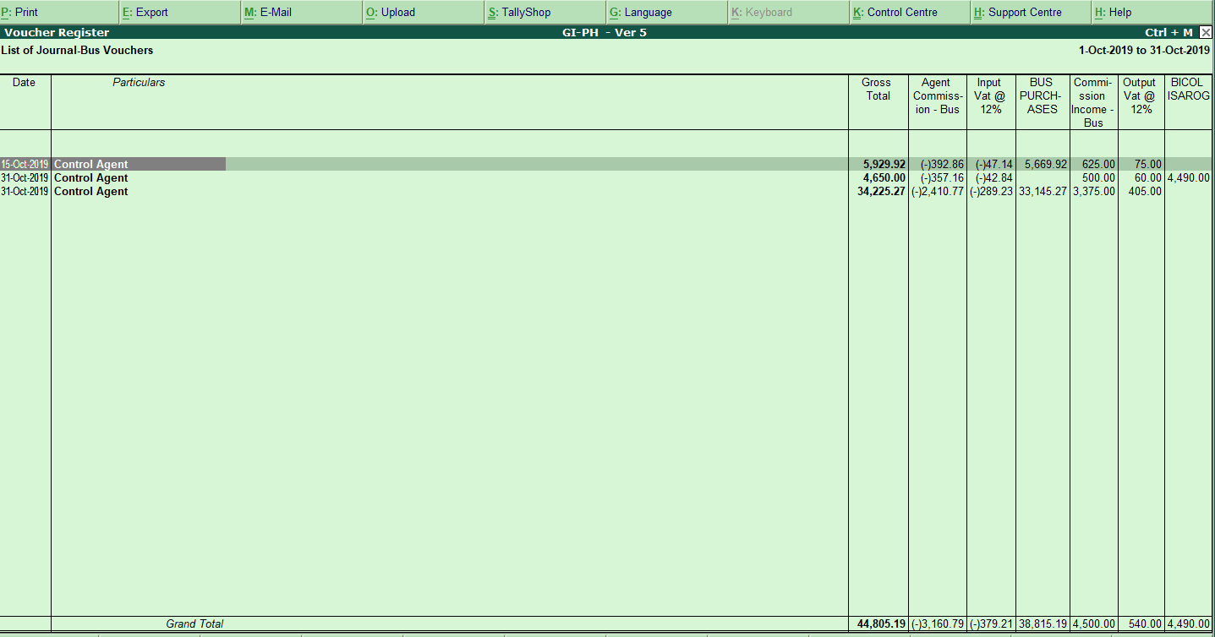
Bus Transaction

Slide 19
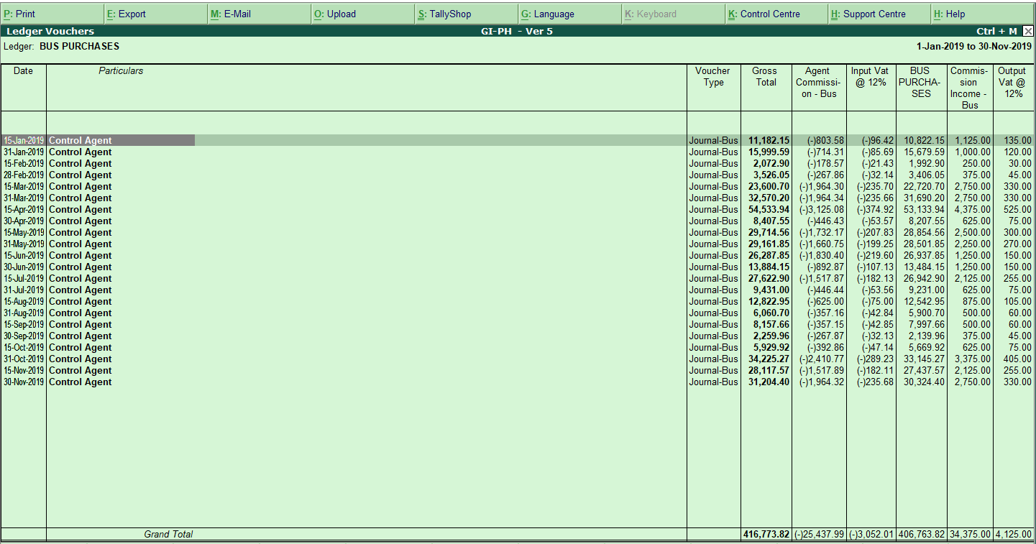
Bus Purchases

Slide 20
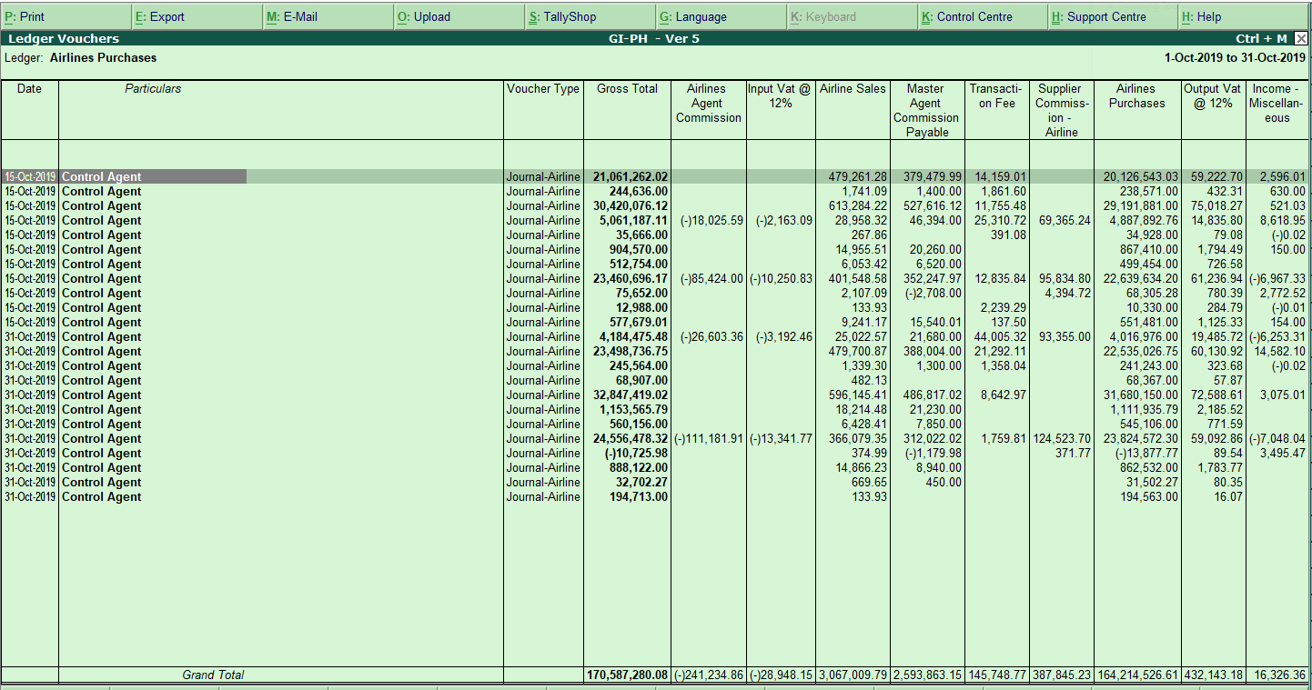
Airlines Purchases

Slide 21
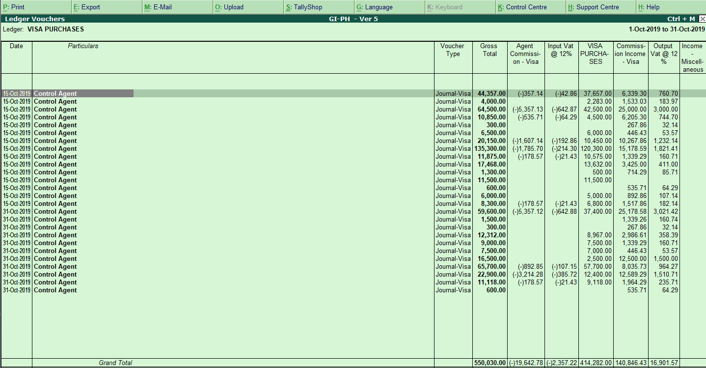
Visa Purchases

Slide 22
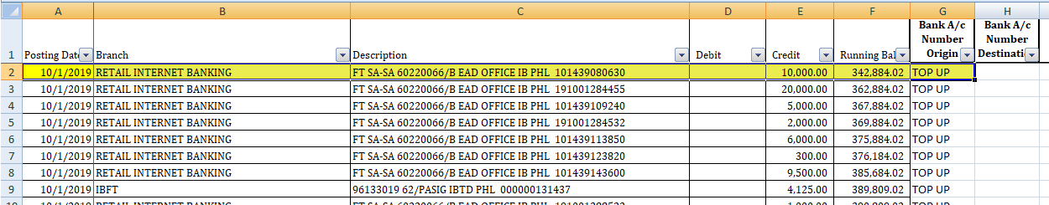
EXCEL FILENAME = BDO Topup
Bank Account: BDO C/A PHP 2620105923
Cr Amount = 10,000.00
The Transaction is as follows:
Db --- BDO S/A PHP 260116895
Cr --- BDO C/A PHP 2620105923
Is this entry correct?

Slide 23
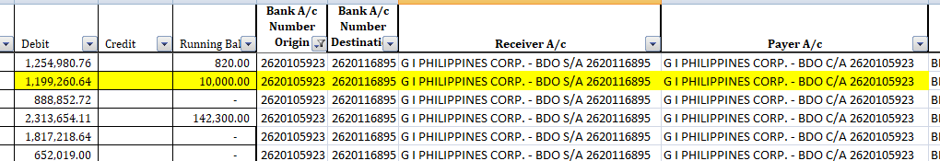
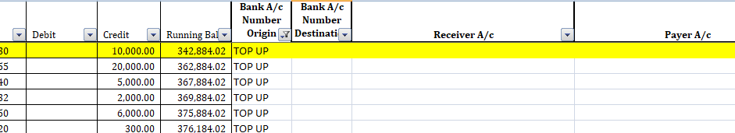
Invalid Name | Invalid Name | Valid Name as per BOS’s Master
AUB |  | AUB 542-01-000011-3
BDO Disbursement | G I PHILIPPINES CORP. - BDO S/A 2620116895 | BDO S/A PHP 260116895
BDO Dollar |  | BDO S/A USD
BDO Topup | G I PHILIPPINES CORP. - BDO C/A 2620105923 | BDO C/A PHP 2620105923
BPI |  | BPI C/A 3793-0388-19
Metrobank |  | MBTC S/A PHP 7019516004
PNB |  | PNB S/A PHP
Security |  | Security Bank C/A Php
UCPB Disbursement |  | UCPB C/A PHP 201120001328
UCPB Topup |  | UCPB S/A PHP 101120011925
Invalid Name
Input Receiver Ledger Name

