Slide 1

Yelp DataSet Analysis
A Case Study to find a Target City & Sector for a new Business
June 15, 2019
By Pankaj Rathore

Slide 2
Coverage of the Available Yelp Review Data - % of population covered & top states

Slide 3
Top 3 cities by the proportion of reviews within their state
So it seems that Las Vegas is the city that is more likely (almost 9 times out of 10) to attract reviews among the states with highest number of reviewed businesses

Slide 4
‘Restaurants’ were reviewed most & people are more likely to review them
Businesses with highest review counts
Highly reviewed businesses

Slide 5
A New Restaurant in Las Vegas that attracts good number of great reviews (3.5 to 4.5) is more likely to remain opened
The Restaurants that were found to be opened attracted more number of reviews
Mean-Median Review Count Vs Review Stars in first 30 days of business

Slide 6
‘Sentiment Analysis’ on Bad & Good Reviews for Restaurants
Lowly rated Reviews
Highly rated Reviews
Service below par, rude behavior, less friendly behavior could lead to a bad review
Quality & delicious food, good & quick service and friendly behavior attract good reviews

Slide 7
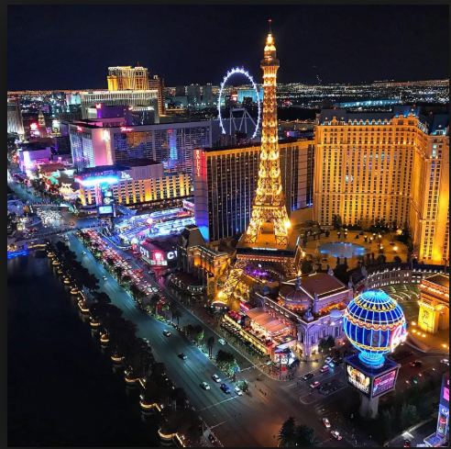
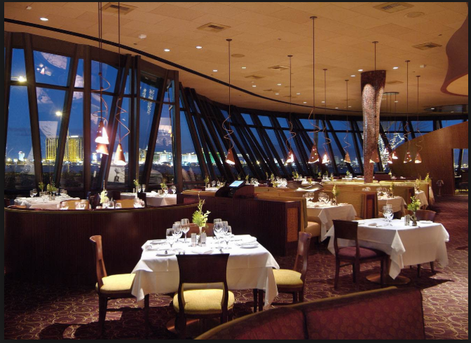
Final Recommendations & Next Steps
&
Restaurants businesses in Las Vegas seems to be a good choice
Restaurant owners to keep close eyes on reviews initially & do course correction
Firm to use advanced ML techniques to pin point the key improvement areas iteratively
Start considering other review platforms too

Slide 8
Appendix
The data for this exercise was downloaded from Yelp –
https://www.yelp.com/dataset/challenge

