Slide 1
Instant hire
DATE OF PRESENTATION : 12-11-2020
Post Graduate Diploma in Advanced Computing (PGDAC), February 2020 C-DAC Mumbai

Slide 2
PROJECT TEAM
Harshada Kerkar (PL), 200240320039
Shankar Lad, 200240320104
Prathamesh Patil, 200240320075
Meghana Mahajan, 200240320056
Shubham Naik, 200240320117

Slide 3
Content
Introduction
Problem definition and proposed solution
Scope of project
Benefits of project
Hardware and software requirements

Slide 4
Introduction
The main objective of our project is to provide job to unemployed ,talent ed, trustworthy people and also to provide instant services to customers.
In this project customer can hire employee according to their requirements and according to their time.

Slide 5
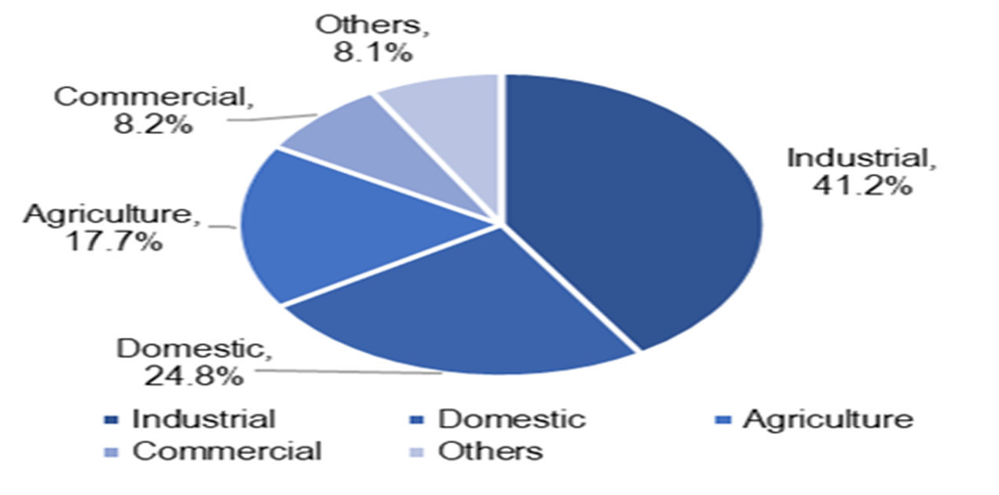
Problem definition and proposed solution
Project idea is based on current COVID scenario. Its very hectic job to search some workers like plumber, driver, chef etc.
Due to COVID unemployment rate is increased
Solution :
Our project will overcome above problems and provide much more facilities to the customer and employees.

Slide 6
Scope of project
Nowadays its very hard to search trustworthy employee and searching job our project can easily provide services to users and job to jobless people.
Our project consists of lots of category like divers, plumber, painter, event-planner, tutor, designer, web designer and many more.
So that user can access all the facilities using single application.

Slide 7
Benefits of project
Saves time & effort by connecting with all the workers on a single platform.
Connect people according to their location and specific time duration.
Easy to use.

Slide 8
Thank you !!!!!!! pkapgate@cdac.in or pkapgatelive@gmail.com Whats App: 09421735905

